Slide 1
Native Energies Fund

Slide 2
Executive Summary
Substantial income, energy access and infrastructure gaps exist between First Nations and the rest of Canada.
Native Energies Fund (NEF) is a renewable energy infrastructure fund investing in First Nations owned projects and developers across Canada.
NEF aims to close these gap by bringing together First Nation communities, renewable energy developers, and institutional investors to develop regenerative resources for First Nation communities.

Slide 3
First Nations: the Gap
Income:
Aboriginals earn 30% less than the Canadian average, 80% less for on-reserve natives
Unemployment on FN reserves is 23%, compared to 6.6% for the rest of Canada
Energy:
20% of aboriginal communities are energy impoverished according to UNDP
Infrastructure:
The value of infrastructure on reserve land is $20k per person as compared to $53k in the rest of Canada

Slide 4
Opportunities to close the gap
De-regulation
Legislation
Greater access to transmission lines
Granting of PPAs
GHG reduction targets; incentives for renewables
NEF
Political Pressure
Supply & Demand
Land claim settlements
Prosperity incentives
Rising fossil fuel prices
Technological advancements

Slide 5
Neo-colonialism or business as usual?
New “gold rush” to develop renewable energy;
FN own substantial renewable energy resources…
…but lack financial and technical capacity.
Groundswell of activity to develop FN capacity lags development pressures.
NEF

Slide 6
Market Opportunity: Driven by Legislation
Saskatch-ewan
NEF
Manitoba
Ontario
Quebec
Maritimes
Territories
British Columbia
Alberta
Example: Ontario
Aims to double RE sources to 15,700 MW by 2025
Currently 700MW of aboriginal projects across wind, solar and hydro awaiting Economic Connection Test (ECT)
FN representing 10% of all RE projects by capacity
Notes:
British Columbia - Aiming to maintain RE sources at 90% of portfolio
BC Hydro building transmission networks across FN land, bringing communities onto the grid
Nova Scotia - Aiming for 25% RE by 2015
Saskatchewan - Aiming for 50% RE by 2025
New Brunswick aiming for 10% renewable power generation by 2016 and 4,500 MW of wind energy produced by 2025;
Québec: 4,000 MW of installed wind generation capacity by 2015;
Nova Scotia aiming for 25% renewable power generation by 2015;
Prince Edward Island requiring 500 MW of wind energy produced by 2013 and 30% renewable power generation by 2016;
Saskatchewan 500 MW of wind power by 2015 and 50% sustainable and renewable power generation by 2025;
and Manitoba pursuing 1,000 MW of installed wind generation by 2015

Slide 7
Strategy: Filling Structural Holes
- Few funds with expertise in infrastructure risk, portfolio aggregation
- NEF brings world class experience and cultural sensitivity
Infrastructure buyers (trade or financial) with lower risk/yield preferences
Project IRR %
30
25
20
15
10
5
Cost / MW $mm
0.5
2
4+
yield compression as assets de-risk
NEF Investment Focus
Exit Partners
Development
Construction
Operation

Slide 8
Strategy: Optimizing Returns / Reducing Risks
Criteria | Strategy | Rationale
First Nation | >= 10% ownership | Underserved, proximity to demand, tax arbitrage, fiscal incentives, subsidized capital
Geography | Canada (possibly U.S.) | Resource, incentive/risk diversification
Size | 2MW - 100MW | Capital efficient scale, competitive openings
Technologies | Wind, solar, hydro, geothermal, biogas | Resource, incentive/risk diversification
Stage | Development, construction, distressed | Ideal risk-return profile, abundant deal flow
Revenues | Clean energy, carbon credits, by-products | Combine long-term contracts with merchant positions; maximize financial returns
Hold Period | 3-5 years | 1-2 years construction, 2-3 years operation; performance track record optimizes cap gains
Distributions | Cap gains (optional yield) | Divest to infrastructure buyers (trade and financial) with lower yield requirements

Slide 9
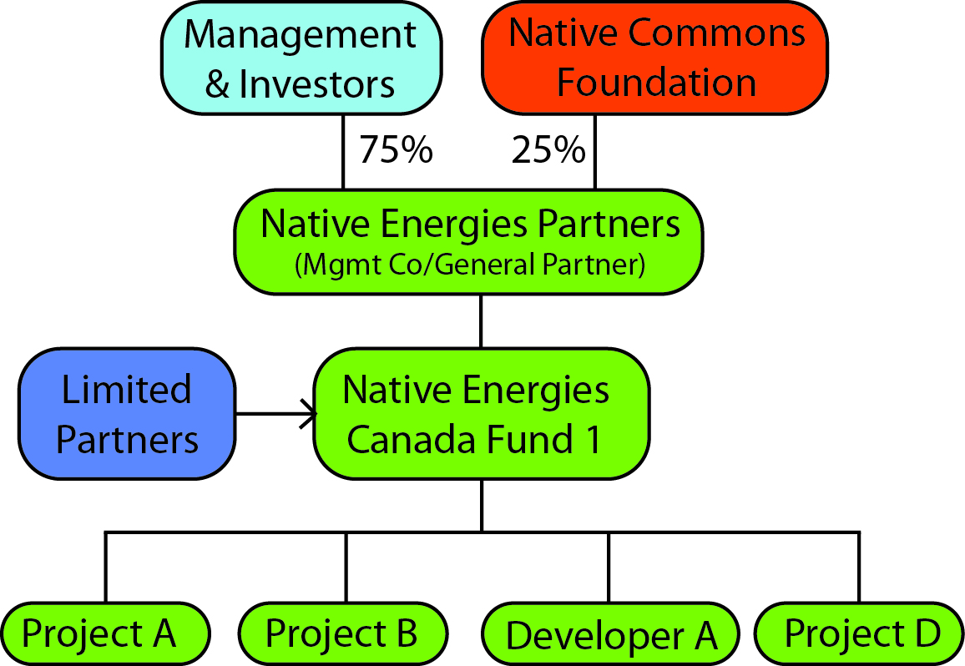
Organizational Structure
FN ownership = advantages in deal sourcing + competitive tenders

Slide 10
Pukwis Wind Park – “whirlwind” in Ojibwe
Chippewa of Georgina Island, 1,500 members
JV between Chippewa and institutional investors
20MW first phase of 64MW
$60 million; $44mm debt, $16mm equity (first phase)
FN: $2mm equity + 75% govt. loan guarantee
PEq: Native Energy Fund, Elemental Energy, CAPE Fund
Co-op structure provides structured exit via retail investors

Slide 11
Financial Benefits
Financial first – market rate returns, 20-30% IRRs
Familiarity – typical GP/LP structure, timeframe
Flexibility – capital gains with possibilities for yield
Scalability – accessible to institutional investors
Replicability – transferrable to similar aboriginal contexts in U.S., Mexico (Oaxaca), Australasia

Slide 12
Risks
Level | Risk | Management/ Mitigation
FUND | Financing Risk | Conservative forecasting and contingency financing plans, wherever possible Careful structuring & agreements to protect lenders security over assets on FN reserves
 | Political Risk | Fixed rate long term PPAs Geographic diversification of projects
 | Competition | NEF’s structure (direct FN ownership) provide sustainable competitive advantage
PROJECT | Resource Performance | Higher-quality, longer resource assessment data Co-investment/co-development partnerships with developers and engineering firms
 | Construction & Operational Risk | Expert management, reserve funds, careful siting and extensive resource data

Slide 13
Social & Environmental Benefits
We enable our FN partners to become independent players in the Canadian energy market through harnessing their own resources.
Our FN partners benefit from a sustainable:
steady stream of income;
energy independence; and
surrounding infrastructure development.
Access to Native Commons tactical philanthropy for long term community development projects.

Slide 14
Impact measurement
GIIRS Report: NEF will apply for GIIRS Fund Rating.
INVOLVEMENT OF PRIMARY CONSTITUENT VOICES (IPAL)
IMPACT OBJECTIVES (IRIS Framework)
* Income/productivity growth * Sustainable energy * Access to energy * Access to financial services * Generation of profits for charitable giving Native Commons Foundation * Community development * Equality and empowerment
Income
* Cash flows to FN
Energy Independence * % ownership of RE project * Grid connectivity
Surrounding Infrastructure
* Capital mobilized for infrastructure used by FN
NCF Impact
* Change in rates of access to drinking water, healthcare and education
NEF
METRICS
REPORTING & FEEDBACK

Slide 15
Summary
A compelling mix of environmental, social and financial returns
A structure based on proven investment models with inherent competitive advantage
A large market with a long pipeline of projects diversified by geography and jurisdiction
A balanced approach to risk and return

