Slide 1
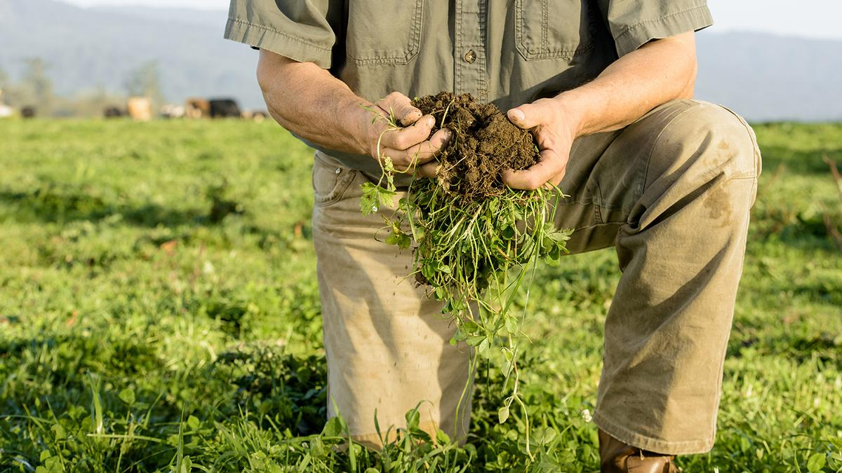
Soilsurance
Kellogg-Morgan Stanley
Sustainable Investing Challenge
Soilsurance
Crop insurance for farmers building soil
Ella McAlister
Gamze Evirgen
Hamish Kwon
Yash Todi

Slide 2




Soilsurance team
Ella McAlister
Ella McAlister
Gamze Evirgen
Hamish Kwon
Yash Todi
First year MBA student at Columbia Business School
Hometown: Sydney, Australia
Pre-MBA: Equity research
Interests: Bushwalking, contemporary art, philosophy
First year MBA student at Columbia Business School
Hometown: Istanbul, Turkey
Pre-MBA: Consulting
Interests: Water sports, gastronomy
First year MBA student at Columbia Business School
Hometown: Seoul, Korea
Pre-MBA: Commodities Trading
Interests: Wine & Whisky, Sports
First year MBA student at Columbia Business School
Hometown: Delhi, India
Pre-MBA: Consulting and Entrepreneurship
Interests: Food and sports.

Slide 3
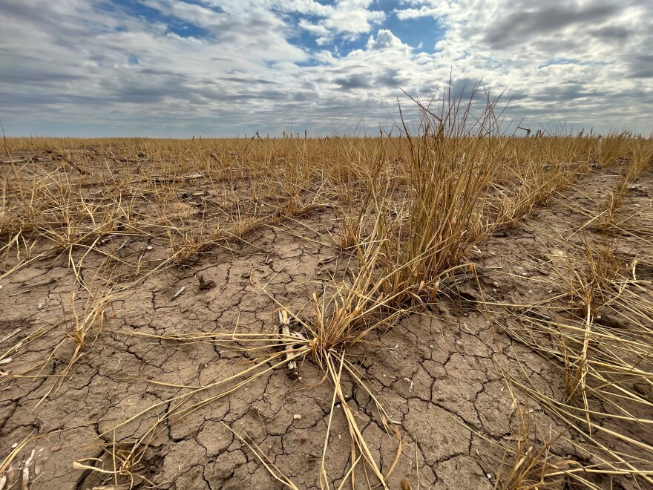
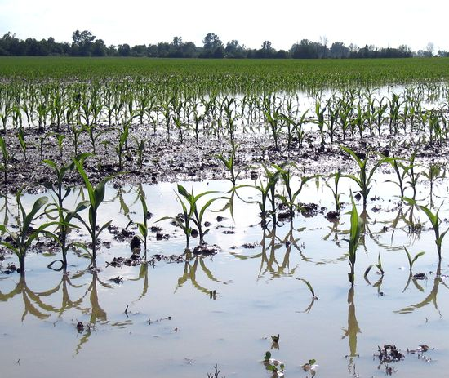
Crop losses cost US taxpayers $8 billion per year
2022 Kansas drought
2017 Michigan floods
Notes:
Payouts have tripled since 1970
Soil biology creates infrastructure that can provide:
Abundant clean water, for everyone.
Pleasant livable temperatures and weather, around the world
Protection from flooding, drought, wildfires
Nutrient dense food to grow healthy people, plants, and animals.
Strong local economies
Resilient communities inside and outside our bodies, above and below the ground.
Source: Didi Pershouse

Slide 4
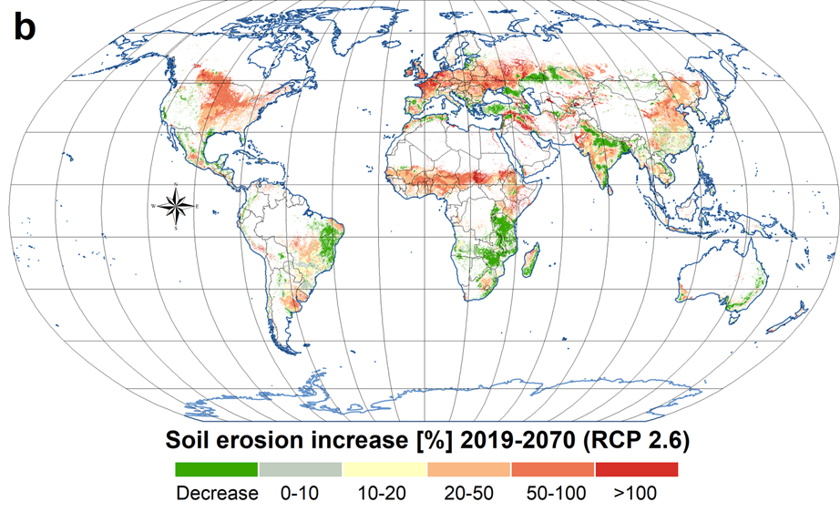
Soils are degrading at a rate 10 – 1,000x greater than before modern agriculture
As erosion degrades soil, productivity decreases and
farmers are required to increase tillage, use more fertilizers and
enter into a vicious cycle
United States faces significant soil degradation risk concentrated in Midwest driven by conventional farming
Notes:
Global Soil Erosion Modelling (GloSEM) predicted erosion estimates for global croplands
Soil Erosion naturally higher in coastal areas but big trends in mainly agricultural areas

Slide 5
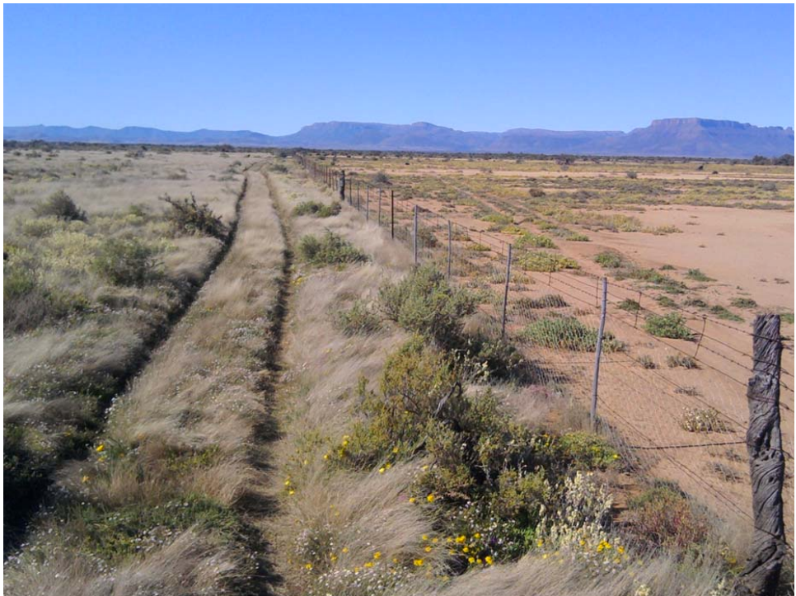
There is a solution: Regenerative agriculture
1
2
Landscape in the process of grassland regeneration
Landscape in the process of desertification
Regenerative agriculture is not a ‘one size fits all’ approach to farming or land management. It is principles and practices that enhance and restore strong, healthy ecosystems (like soils). Together, these have benefits for the farmer in terms of productivity and profitability but also have long-term ecological benefits and support a healthy agricultural landscape.
Notes:
This photograph of two neighboring but differently managed landscapes—one in the process of desertification, and the other in the process of grassland regeneration
Regenerative agriculture is not a ‘one size fits all’ approach to farming or land management. It is principles and practices that enhance and restore strong, healthy ecosystems (like soils). Together, these have benefits for the farmer in terms of productivity and profitability, but also have long-term ecological benefits and support a healthy agricultural landscape.
Source: Soils for Life Australia
Regenerative ag can look like:
Integrating livestock
Growing a cover crop in the winter (instead of leaving the fields bare)

Slide 6
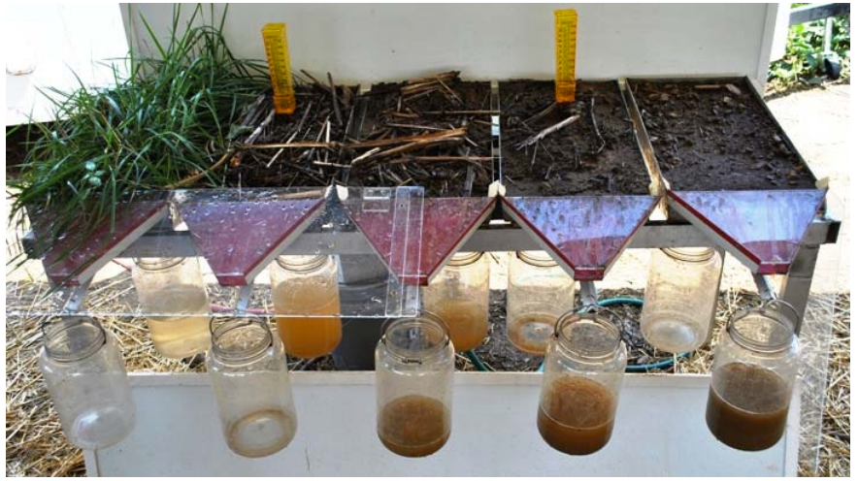
Soils are a living thing – there are principles to keep it healthy
1
Maximise photosynthesis
Provide shelter, moisture, and nutrition for soil life by keeping it covered year round
Minimise physical, chemical and biological stresses
Use plant diversity above ground to increase biological diversity
Integrate a diversity of animals
Choose interventions that work within the context of the land
2
3
4
5
6
Source: Didi Pershouse; Photo credit: Benton James Madison County Soil Conservation District, Tennessee
Notes:
photo credit: Benton James Madison County Soil Conservation District, Tennessee
Healthy topsoil is a living matrix, a carbon-rich sponge that soaks up water
Soils are a living thing, there are principles to keep it healthy:
Maximise photosynthesis
Provide shelter, moisture, and nutrition for soil life by keeping it covered year round with living plants and mulch
Minimise physical, chemical and biological stresses (e.g. unnecessary tillage, biocides, over/undergrazing)
Use plant diversity above ground to increase biological diversity above and below ground
Integrate a diversity of animals to move nutrients, microbes, seeds and pollen, and regulate water flows
Choose interventions that work within the context of the land
Source: Didi Pershouse

Slide 7

Current status | The current Federal crop insurance system prevents farmers from building soil health
1
2
3
4
To qualify for crop insurance, farmers must meet the USDA’s guidelines for ‘good farm management
The USDA’s good farming guidelines are outdated, and aren’t compatible with practices that improve soil health
To qualify for federal loans, farmers often need to have crop insurance to prove lower financial risk
Farmers renew their policies in order to keep their access to loans and lower their financial burden, so they are trapped using the same practices year after year, with no way out.
Notes:
Many farmers in the US want to implement or expand regenerative practices on their land
But they can’t, because:
They won’t qualify for federal crop insurance
Farmers need insurance to
Share risks
Qualify for loans

Slide 8
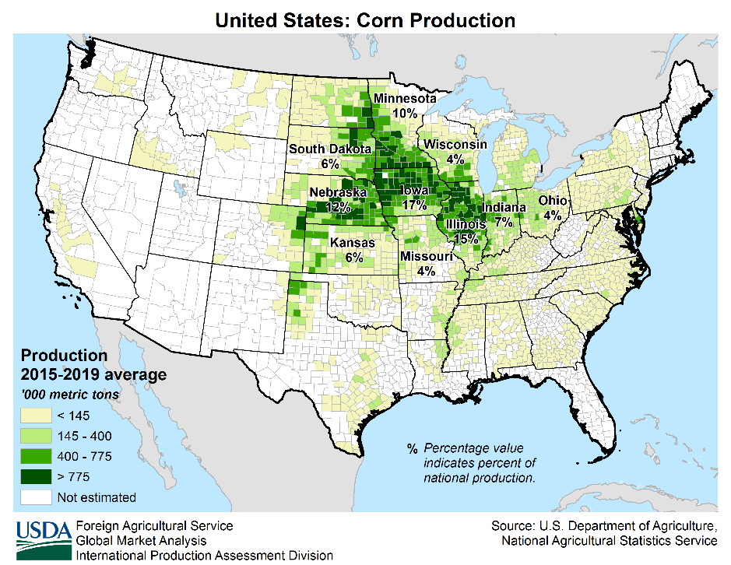




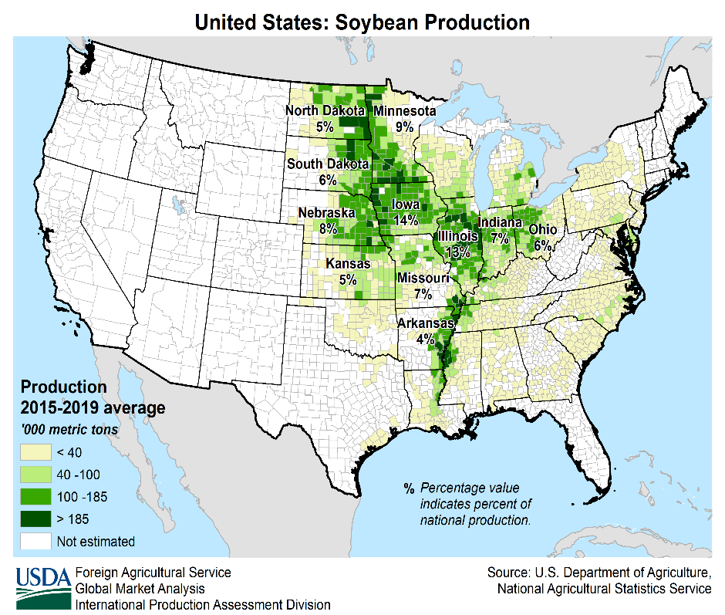




Opportunity | target farmers is concentrated in Mid West United States covering >50% of agriculture land
Target Addressable Market
Soybean & Corn
Access to Carbon Credit market
90mn acres each
$760 Bn
# of Farmers
Potential to reduce loss ratio from
~450k
0.83 to 0.65
Corn Production USA
Reduce taxpayer burden
on FCIC
Reduce drought and flood
claims of
$8 Bn
~$88 Bn²
Increase water storage¹
potential by
Global expansion targeting
~3000 Bn gallons
3 Bn acres
Soybean Production USA
Notes:
Theoretically COVER Act could make Pandemic Cover Crop Plan permanent
Cover crop pilot programs would be made permanent if this budget were to pass.
With $208 million more in conservation funds from the 2023 enacted funding level, the NRCS would work to “increase the voluntary adoption of conservation practices that sequester carbon and reduce greenhouse gas emissions associated with agricultural production.” BUT Unclear where/how it will be spent
Farmers already considering federal too restrictive for regen farming
Regulatory Approval
High rates of passing/we believe there is a strong market for it. ny individual or organization can submit a proposal following the guidelines in these regulations even if they do not plan to write or retain any of the risk for the proposed program. While the submitter must have a commitment in writing from at least one approved insurance provider (AIP) to sell and support the policy or plan of insurance, this is often very informal and the supporting AIP will generally have little or no involvement in the development process of such product.. FCIC agrees that the current regulations do not contain enough involvement of the AIP in the development process or consideration of the impact of the submission on other AIPs and the delivery system. As a result, FCIC is adding provisions that require a more formal involvement by an AIP in the development process, requiring that an AIP be included as a submitter, and having that AIP and one other independent AIP provide an assessment of marketability, risks, and anticipated impacts on the delivery system. With respect to the risks, AIPs can independently assess the potential risk of a privately developed policy, and based on their own assessment, may choose whether or not to sell the product. AIPs have the option to reduce their risk exposure by assigning higher risk policies to the Assigned Risk Fund under the Standard Reinsurance Agreement (SRA), a fund that significantly limits risk exposure to the AIP and transfers that risk to FCIC
Low loss ratios over time indicate that premiums are too high relative to payments. Farmers do not pay all the premiums associated with the total premiums as the Federal government provides premium support. Even given this premium support, farmers in some counties have paid more into crop insurance than have been received in indemnity payments over time.It seems extremely risky to eliminate crop insurance on soybeans. Costs have increased greatly, and there is the risk of downside price movements
Soil health-focused programs currently receive less than 1% of Farm Bill
Supplemental/Enhanced Coverage Option, Harvest Price Exclusion
https://farmdocdaily.illinois.edu/2023/01/crop-insurance-for-soybeans-the-low-loss-ratio-concern.html
https://conservationfinancenetwork.org/2020/04/08/the-case-for-crop-insurance-reform

Slide 9



Risk Mitigation | Effective underwriting and greater pool size is key to effective risk-sharing
Fund Risk Factors
Risk Mitigation
Federal Crop Insurance Expansion
  Changes in Federal Program
  hinder fund performance
1
2023 Farm Bill Changes Unlikely
  Farm Bill every 5 years and federal requirements considered restrictive
Regulatory Approval Required
  New policies must present evidence of marketability to FCIC and RMA
2
RMA 508(h)Process Available
  High approval rate and use of Approved Insurance Providers
Low Loss Ratio over Time
  Regenerative farming lowers loss ratio and premiums > payments
3
Tools/Options Widely Used
  Supplemental/Enhanced Coverage Option, Harvest Price Exclusion
Notes:
Theoretically COVER Act could make Pandemic Cover Crop Plan permanent
Cover crop pilot programs would be made permanent if this budget were to pass.
With $208 million more in conservation funds from the 2023 enacted funding level, the NRCS would work to “increase the voluntary adoption of conservation practices that sequester carbon and reduce greenhouse gas emissions associated with agricultural production.” BUT Unclear where/how it will be spent
Farmers already considering federal too restrictive for regen farming
Regulatory Approval
High rates of passing/we believe there is a strong market for it. ny individual or organization can submit a proposal following the guidelines in these regulations even if they do not plan to write or retain any of the risk for the proposed program. While the submitter must have a commitment in writing from at least one approved insurance provider (AIP) to sell and support the policy or plan of insurance, this is often very informal and the supporting AIP will generally have little or no involvement in the development process of such product.. FCIC agrees that the current regulations do not contain enough involvement of the AIP in the development process or consideration of the impact of the submission on other AIPs and the delivery system. As a result, FCIC is adding provisions that require a more formal involvement by an AIP in the development process, requiring that an AIP be included as a submitter, and having that AIP and one other independent AIP provide an assessment of marketability, risks, and anticipated impacts on the delivery system. With respect to the risks, AIPs can independently assess the potential risk of a privately developed policy, and based on their own assessment, may choose whether or not to sell the product. AIPs have the option to reduce their risk exposure by assigning higher risk policies to the Assigned Risk Fund under the Standard Reinsurance Agreement (SRA), a fund that significantly limits risk exposure to the AIP and transfers that risk to FCIC
Low loss ratios over time indicate that premiums are too high relative to payments. Farmers do not pay all the premiums associated with the total premiums as the Federal government provides premium support. Even given this premium support, farmers in some counties have paid more into crop insurance than have been received in indemnity payments over time.It seems extremely risky to eliminate crop insurance on soybeans. Costs have increased greatly, and there is the risk of downside price movements
Soil health-focused programs currently receive less than 1% of Farm Bill
Supplemental/Enhanced Coverage Option, Harvest Price Exclusion
https://farmdocdaily.illinois.edu/2023/01/crop-insurance-for-soybeans-the-low-loss-ratio-concern.html
https://conservationfinancenetwork.org/2020/04/08/the-case-for-crop-insurance-reform

Slide 10




Our solution | We propose an insurance vehicle that accounts for the risk-mitigation benefits of improved soil health
Key features of our system
Farmers pay only a modest premium (~30%) to federally-subsidized insurance based on yield protection
Farmers pay discounted premium
Lower insurance premiums
Farmers prioritise soil health
Resistant to fraud & easily measurable outcomes
Soilsurance process cycle
Lower indemnities
Improved soil health
Promotes environmental restoration
Lower risk
Lower cost & repayment via carbon credit
Notes:
On point 4: High-resolution soil data exist and can be used to monitor implementation of soil-health practices such as continuous ground cover.
Key features of our system:
Farmers pay only a modest premium (~30%) to federally-subsidized insurance based on yield-protection: Discounted premium based on the farmer’s use of soil-building practices such as cover cropping.
Resistant to fraud & easily measurable outcomes: Outcomes will be verified by measuring soil organic carbon levels – farmers who show increasing soil carbon stay enrolled
Promotes environmental restoration: To enroll, farmers must demonstrate history of prioritizing soil health or a commitment to improving soil health in the life of the insurance policy
Lower cost & repayment via carbon credit: Adherence is monitored using satellite rather than costly field insurance agents. Framers can use carbon-credit for repayments which will be promoting environmentally-friendly practices

Slide 11
Investment thesis| Better soil function supports lower loss ratios, allowing farmers to receive a 'good driver discount'
Fund size: | USD $150M
Geography: | United States of America
Target IRR: | Average 6% over the first 10 years, increasing to 7% by year 10
Investors: | Long-term patient capital providers - insurance companies, retirement funds & impact funds
Time horizon: | Minimum 10 years
Expense ratio: | 0.2%
Fund diagram
Farmer
“Good driver discount”
Improving soil health data
Premium
Indemnity
Soilsurance
Reinsurer
Part of liability & premium
Upfront capital
Investors
Investors benefit from triple-bottom line returns

Slide 12


Farmer Impact | Regenerative Cropping increases long term productivity and profitability
Reduced seed and
fertilizer contribution
Revenue and cost ($ per ha):
32% to 12%
+18%
% chg
Saving taxpayer in
surface water cleanup
$200mn
1346
-67%
1144
Reduced Soil Erosion by
-20%
90%
-33%
Carbon sequester saving²
40mn ton
98%
Improved Profitability
97%
Additional profit from
Carbon Credit³
$2bn
Conventional
Regenerative
Others
Machinery & Labour
Seed
Crop Insurance
Fertilizers
Profit
Unlock additional
profitability for farmers⁴
$62bn
Supply chain
Pesticides

Slide 13






Impact | Soilsurance removes barriers to healthy soil practices enabling large-scale landscape regeneration
Public impact
Farmer impact
Decreased cost of financial risk management & access to loans
Enhanced resilience of land & autonomy to farm the way they want to farm and is right for their biosystem
Ecosystem services such as increased biodiversity
Reduced cost to provide federally subsidized crop insurance
Improved water and air quality
Healthier, more nutritious food
Source: Team analysis, Rodale Institute, Union of Concerned Scientists, USDA
Notes:
Environmental costs of extractive agriculture no longer externalized to the taxpayer

Slide 14
Fund returns | Returns accelerate with increased penetration driven by better risk sharing
Projected Cash Flow
Projected Returns
in Millions
Acres Insured ('000s) vs ROE & Market Share:
ROE
31.9
Acres insured (’000s)
+10%
29.0
26.4
21.8
24.0
17.4
19.4
14.1
15.6
11.8
12.8
2023
2024
2025
2026
2027
2028
2029
2030
2031
2032
2033
2023
2024
2025
2026
2027
2028
2029
2030
2031
2032
2033
1%
Market share
6%
Cash flows increase as geography expands, risk is shared more efficiently, and soil health improves
Returns improve as more farmers join the program, enabling more efficient risk-sharing & soil health improvements to reduce the risk of indemnity

Slide 15
Soilsurance
Kellogg-Morgan Stanley
Sustainable Investing Challenge
Matthew Carney feedback:
Check additional revenue streams – How do you get farmers to participate in this program? What kind of incentives that you can give so that farmers can participate the program? The more diversified you can get the better you can sell the idea -> Yash’s idea could cover this point (carbon credits, ecosystem services, water quality)
More diversified revenue streams would make business case more resilient
What kind of players purchases these products? -> Pepsi is the biggest customer
About judge’s feedback:
  Validating the impact is important – we could build in a buffer to account for skepticism
  Expanding on the risks (Especially for Q&A)
Next steps:
Send the deck (can be draft) to Matthew to get his feedbacks offline
Schedule a call with him to practice our pitch
Thank you

Slide 16
Appendix

Slide 17




Thank you to our advisors
Matthew Carney, Quantified Ventures
Claire Pluard, Carbon Yield
Jennifer Poh, Orrick
Bruce Usher, Columbia Business School
William McAlister, The Mulloon Institute
Gabriel Cordeiro, Hang Tung
Pablo Ferreira, CJ International

Slide 18
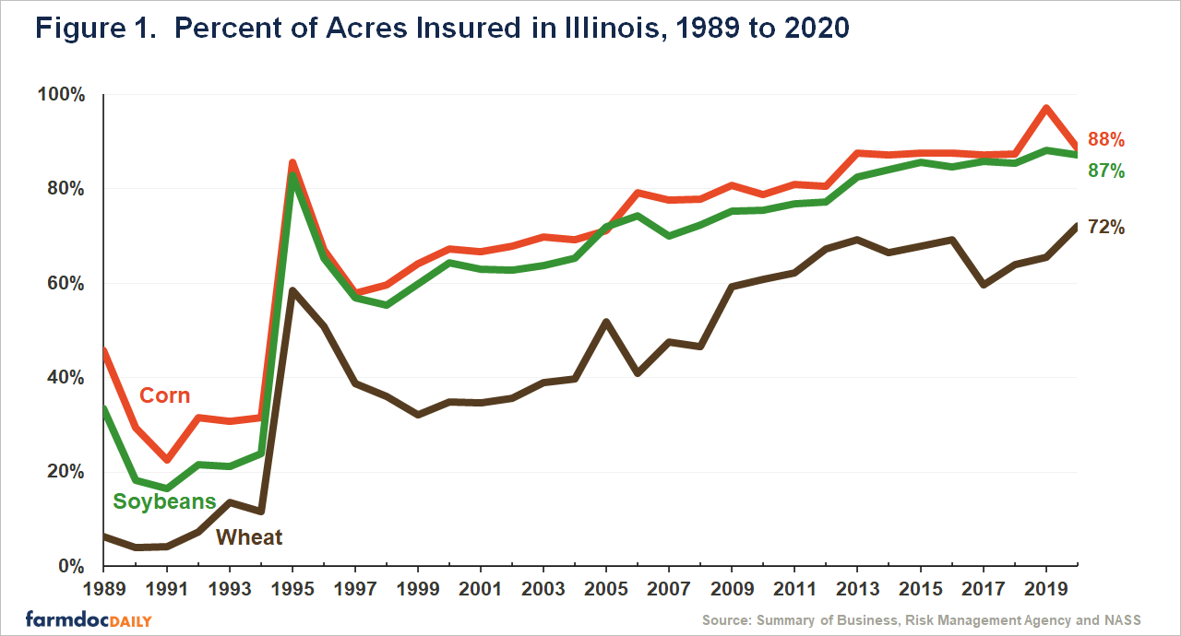
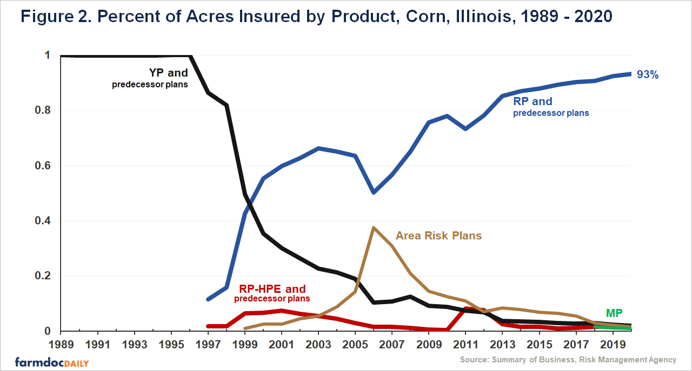
Crop Insurance Type in US
Source: Farm Doc Daily, Revenue Protection: The Most Used Crop Insurance Product

Slide 19
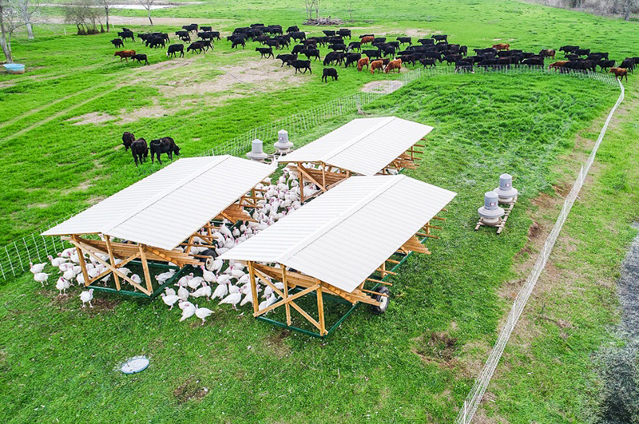
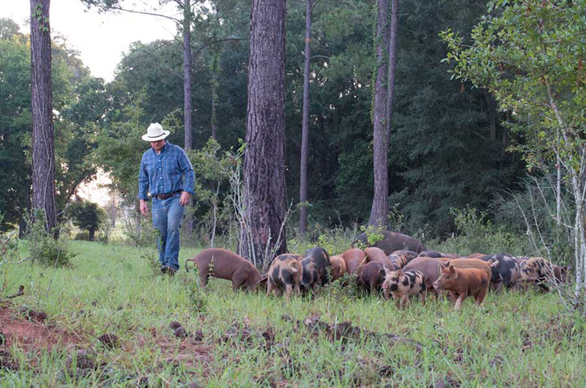
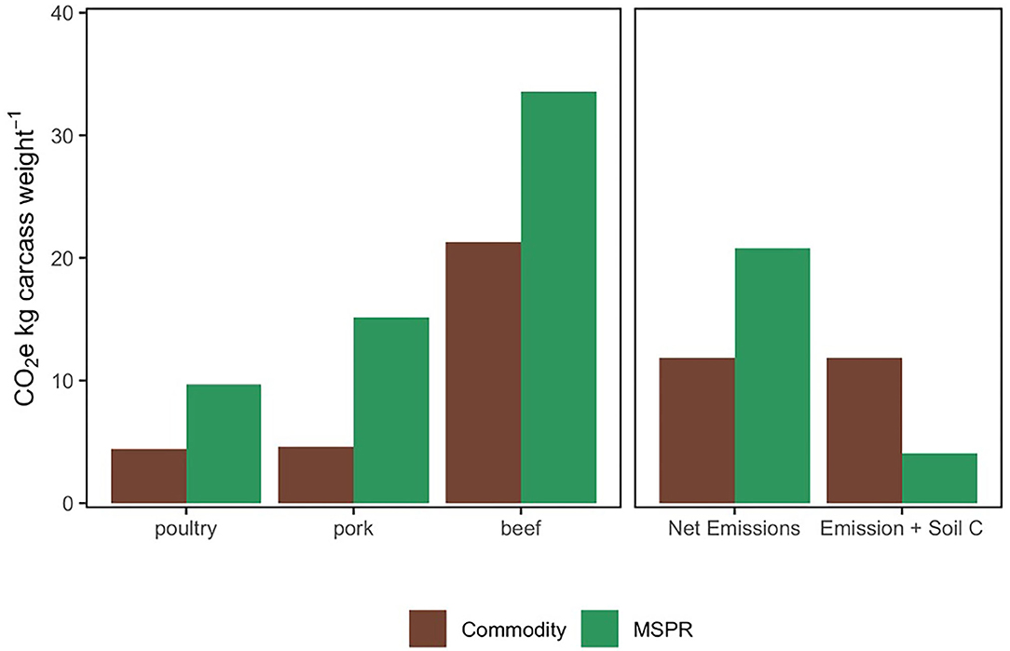
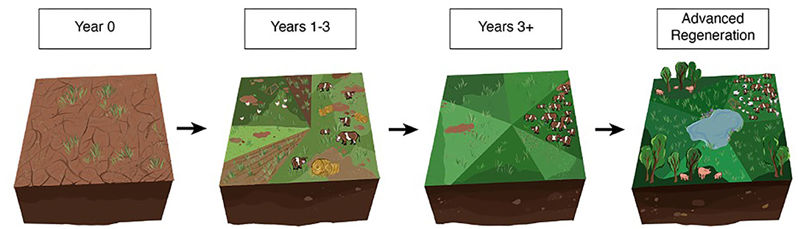
Example of landscape regeneration through farming
Carbon emissions in a multi-species pasture rotation vs Conventional system:
Regeneration process employed:
Source: White Oak Pastures, Chico State, Rowntree et al
Notes:
The regeneration process employed by White Oak Pastures. Year 0: Degraded cropland is acquired; Years 1–3: Hay is fed to cattle grouped in moderate densities, compost is applied, grass is seeded, and cattle and poultry are grazed at low stock densities; Years 3+: Animal stock densities are increased (25 to 50 Mg ha−1 daily), and holistic planned grazing (HPG) is implemented, where animals are rotated often and land is rested between grazing events; Advanced Regeneration: Represents a regenerative landscape (no seedings, added hay or compost since year 3) including rotations of diverse animal species with improved soil health and water cycling.
The accumulation of C through land management has the potential to offset up to one-third the annual increase in atmospheric CO2 (Lal, R. 2004)
Studies show up to 8 t C per ha per year can be sequestered in some soils in the US
But most studies show around ~2tCO2/ha/year (Source: Savory Institute)
Converting tilled cropland to grazed pasture can drive substantial SOC accumulation while providing food and economic return for a landowner.

Slide 20
Key driver of fund performance – loss ratio
Risk mitigation from soil health improvement
Source: Team analysis

Slide 21
Top 10 national causes of loss with the largest indemnity payments, 1995-2020
Cause of loss | Indemnities paid 1995-2021 | Percent of total indemnities
Drought | $48,633,395,480 | 33.9%
Excess Moisture/Precipitation/Rain | $38,984,412,139 | 27.2%
Hail | $9,704,733,932 | 6.8%
GRP/GRIP/ARPI/SCO/STAX/MP/HIP WI Crops Only | $8,156,944,228 | 5.7%
Decline in Price | $7,770,562,653 | 5.4%
Heat | $6,345,151,240 | 4.4%
Freeze | $4,137,767,940 | 2.9%
Wind/Excess Wind | $2,944,078,993 | 2.1%
Cold Wet Weather | $2,911,869,646 | 2.0%
Hurricane/Tropical Depression | $2,154,466,851 | 1.5%
Source: EWG, from USDA Risk Management Agency, Cause of Loss Historical Data Files. * Types of insurance policies; details on the RMA website. Indemnities for GRP/GRIP crops between 1995-2013; indemnities for ARPI, SCO, STAX, MP, HIP, WI crops 2014-2020..

Slide 22








Cash Flow Model
& key assumptions
1 | assume 2023 premiums in line with Federal Crop Insurance, then grows at 2% per year (inflation)
2 | good driver discount compensates farmers for government subsidy
3 | farmers pay a higher premium to have access to crop insurance
4 | assume 8% investment return
5 | loss ratio in line with FCIP
6 | healthy soil risk mitigation factor increases as farmers adopt more soil building practices
7 | industry feedback - last 50% of liability costs 20% of the premium to reinsure
8 | increase 5% per year for first 3 years, then 2% thereafter (inflation)
Year |  | 2023 | 2024 | 2025 | 2026 | 2027 | 2028 | 2029 | 2030 | 2031 | 2032 | 2033
Premium revenue | $ | 2,234,197 | 4,557,762 | 6,973,376 | 9,483,791 | 12,091,834 | 14,800,405 | 17,612,482 | 20,531,122 | 23,559,462 | 26,700,724 | 29,958,212
Premium per acre | $/acre | 13.42 | 13.69 | 13.96 | 14.24 | 14.52 | 14.81 | 15.11 | 15.41 | 15.72 | 16.04 | 16.36
Less: good driver discount | $/acre | -3.70 | -3.77 | -3.85 | -3.93 | -4.00 | -4.08 | -4.17 | -4.25 | -4.33 | -4.42 | -4.51
farmer cost vs FCIP | % | 50%
Farmer premium | $/acre | 9.72 | 9.91 | 10.11 | 10.31 | 10.52 | 10.73 | 10.94 | 11.16 | 11.39 | 11.61 | 11.85
Acres insured |  | 229,885 | 459,770 | 689,655 | 919,540 | 1,149,425 | 1,379,310 | 1,609,195 | 1,839,080 | 2,068,966 | 2,298,851 | 2,528,736
% of TAM | % | 0.5% | 1.0% | 1.5% | 2.0% | 2.5% | 3.0% | 3.5% | 4.0% | 4.5% | 5.0% | 5.5%
Investment income | $ | 12,000,000 | 12,942,592 | 13,968,394 | 15,094,639 | 16,341,089 | 17,729,247 | 19,283,011 | 21,028,896 | 22,950,915 | 25,064,535 | 27,386,503
Total revenue | $ | 14,234,197 | 17,500,354 | 20,941,770 | 24,578,430 | 28,432,923 | 32,529,652 | 36,895,493 | 41,560,018 | 46,510,377 | 51,765,259 | 57,344,715
Revenue growth | % |  | 23% | 20% | 17% | 16% | 14% | 13% | 13% | 12% | 11% | 11%
Revenue per acre | $/acre | 61.92 | 38.06 | 30.37 | 26.73 | 24.74 | 23.58 | 22.93 | 22.60 | 22.48 | 22.52 | 22.68
Indemnity | $ | 1,634,870 | 3,209,281 | 4,717,644 | 6,154,118 | 7,512,607 | 8,786,745 | 9,969,890 | 11,622,043 | 13,336,295 | 15,114,467 | 16,958,432
growth | % |  | 96% | 47% | 30% | 22% | 17% | 13% | 17% | 15% | 13% | 12%
Loss ratio |  | 0.83 | 0.83 | 0.83 | 0.83 | 0.83 | 0.83 | 0.83 | 0.83 | 0.83 | 0.83 | 0.83
Less: healthy soil risk mitigation factor |  | -0.30 | -0.32 | -0.34 | -0.36 | -0.38 | -0.40 | -0.42 | -0.42 | -0.42 | -0.42 | -0.42
Net loss ratio |  | 0.53 | 0.51 | 0.49 | 0.47 | 0.45 | 0.43 | 0.41 | 0.41 | 0.41 | 0.41 | 0.41
True loss ratio |  | 0.73 | 0.70 | 0.68 | 0.65 | 0.62 | 0.59 | 0.57 | 0.57 | 0.57 | 0.57 | 0.57
Reinsurance cost | $ | 616,932 | 1,258,542 | 1,925,569 | 2,618,774 | 3,338,936 | 4,086,858 | 4,863,361 | 5,669,289 | 6,505,510 | 7,372,911 | 8,272,406
% of undiscounted premium | % | 20% | 20% | 20% | 20% | 20% | 20% | 20% | 20% | 20% | 20% | 20%
Administration costs | $ | 200,000 | 210,000 | 220,500 | 224,910 | 229,408 | 233,996 | 238,676 | 243,450 | 248,319 | 253,285 | 258,351
Total expenses | $ | 2,451,803 | 4,677,823 | 6,863,712 | 8,997,801 | 11,080,951 | 13,107,599 | 15,071,927 | 17,534,783 | 20,090,123 | 22,740,664 | 25,489,189
Expense growth | % |  | 91% | 47% | 31% | 23% | 18% | 15% | 16% | 15% | 13% | 12%
Expense per acre | $/acre | 10.67 | 10.17 | 9.95 | 9.79 | 9.64 | 9.50 | 9.37 | 9.53 | 9.71 | 9.89 | 10.08
Net income | $ | 11,782,395 | 12,822,531 | 14,078,058 | 15,580,629 | 17,351,972 | 19,422,053 | 21,823,565 | 24,025,235 | 26,420,254 | 29,024,596 | 31,855,526
Net income growth | % |  | 9% | 10% | 11% | 11% | 12% | 12% | 10% | 10% | 10% | 10%
Net income per acre | $/acre | 51.25 | 27.89 | 20.41 | 16.94 | 15.10 | 14.08 | 13.56 | 13.06 | 12.77 | 12.63 | 12.60
Source: Team analysis

Slide 23
Balance sheet & return metrics
1 average of FCIP in 2023, increases at 2% per year (inflation)
Balance sheet |  | 2023 | 2024 | 2025 | 2026 | 2027 | 2028 | 2029 | 2030 | 2031 | 2032 | 2033
Long term investments | $ | 150,000,000 | 161,782,395 | 174,604,925 | 188,682,983 | 204,263,612 | 221,615,584 | 241,037,636 | 262,861,202 | 286,886,437 | 313,306,691 | 342,331,287
Total Assets | $ | 150,000,000 | 161,782,395 | 174,604,925 | 188,682,983 | 204,263,612 | 221,615,584 | 241,037,636 | 262,861,202 | 286,886,437 | 313,306,691 | 342,331,287
Insurance liability | $ | 12,353,851 | 25,201,856 | 38,558,839 | 52,440,021 | 66,861,027 | 81,837,897 | 97,387,097 | 113,525,530 | 130,270,546 | 147,639,952 | 165,652,027
Insured value | $ | 27,453,002 | 56,004,123 | 85,686,309 | 116,533,380 | 148,580,060 | 181,861,993 | 216,415,772 | 252,278,957 | 289,490,103 | 328,088,783 | 368,115,615
Liability per premium dollar | $ | 119.42 | 121.81 | 124.25 | 126.73 | 129.26 | 131.85 | 134.49 | 137.18 | 139.92 | 142.72 | 145.57
Less: Reinsured value | $ | 15,099,151 | 30,802,268 | 47,127,470 | 64,093,359 | 81,719,033 | 100,024,096 | 119,028,674 | 138,753,426 | 159,219,557 | 180,448,831 | 202,463,588
Reinsurance % | % | 55% | 55% | 55% | 55% | 55% | 55% | 55% | 55% | 55% | 55% | 55%
Total Liabilities | $ | 12,353,851 | 25,201,856 | 38,558,839 | 52,440,021 | 66,861,027 | 81,837,897 | 97,387,097 | 113,525,530 | 130,270,546 | 147,639,952 | 165,652,027
Liabilities/Assets | % | 8% | 16% | 22% | 28% | 33% | 37% | 40% | 43% | 45% | 47% | 48%
Equity | $ | 137,646,149 | 136,580,539 | 136,046,086 | 136,242,962 | 137,402,585 | 139,777,687 | 143,650,539 | 149,335,671 | 156,615,891 | 165,666,739 | 176,679,260
ROE | % | 9% | 9% | 10% | 11% | 13% | 14% | 15% | 16% | 17% | 18% | 18%
ROA | % | 7.9% | 7.9% | 8.1% | 8.3% | 8.5% | 8.8% | 9.1% | 9.1% | 9.2% | 9.3% | 9.3%
Cash flow |  | 11,782,395 | 12,822,531 | 14,078,058 | 15,580,629 | 17,351,972 | 19,422,053 | 21,823,565 | 24,025,235 | 26,420,254 | 29,024,596 | 31,855,526
Growth |  |  | 9% | 10% | 11% | 11% | 12% | 12% | 10% | 10% | 10% | 10%
IRR |  | 6.17%
Projected 10-year ROI |  | 1.65%
Source: Team analysis

Slide 24
Sources & photo credits
Fenceline photograph: Kroon Family, The Savory Institute
Soil erosion & rainfall demonstration photo credit: Benton James Madison County Soil Conservation District, Tennessee
Flooded corn field: https://www.canr.msu.edu/news/evaluating_flood_damaged_crops_part_2
2022 Kansas drought affected wheat field: https://www.kmuw.org/2023-01-23/how-bad-was-the-2022-drought-for-these-seven-kansas-communities-it-was-the-driest-on-record
Carbon sequestration in soils studies: https://savory.global/assets/docs/evidence-papers/2015-climate-a-restoration-story.pdf
Carbon sequestration potential: https://doi.org/10.1016%2Fj.geoderma.2004.01.032
Green Soybeans with storage: https://ag.purdue.edu/digitalag/spreadsheet-toolbox.html

