Slide 1


Saarthi
EMPOWERING HER

Slide 2






LET's MEET RAJJI !
Personal Profile
24yrs old married woman who lives with her husband and in-laws in Bengaluru, Karnataka
Education
Completed high school but dropped out of college due to an early marriage
Story
Married for 5yrs;
Faces domestic abuse from partner and in-laws;
Understands that financial independence can help her confront this injustice;
Looking for a start and guidance through this journey of empowerment.

Slide 3
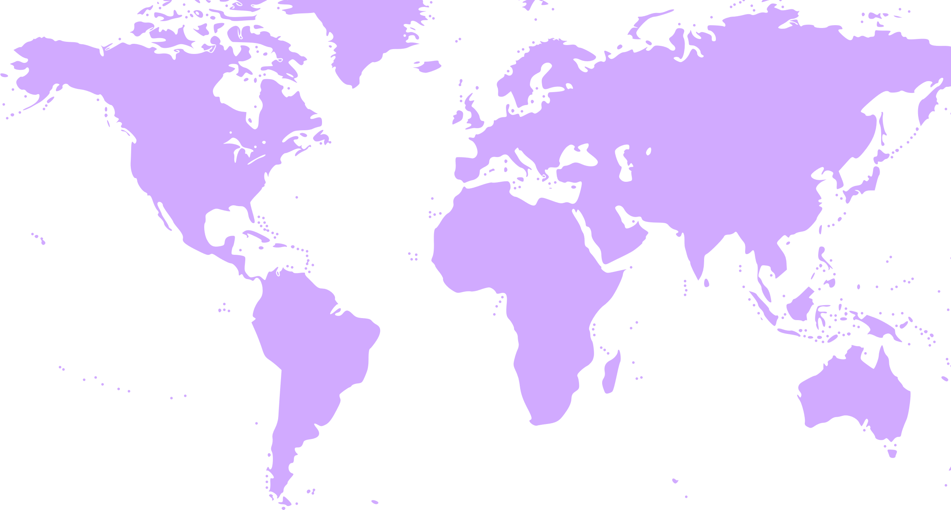








WHY THIS MATTERS
Our Introduction
Cost (as % of GDP) of violence against women
Number of women experiencing violence, globally
600M+
3.7%
3.7%
1 in 3
Increase in cases of Domestic Violence post-Covid
33%
~40%
Labor force participation rate for women is 40% lower compared to men
33%
50% vs 80%
Source: IMF and World Bank Group
WARDIERE.INC
About
Agenda
Resources
Elevator Pitch
2028

Slide 4

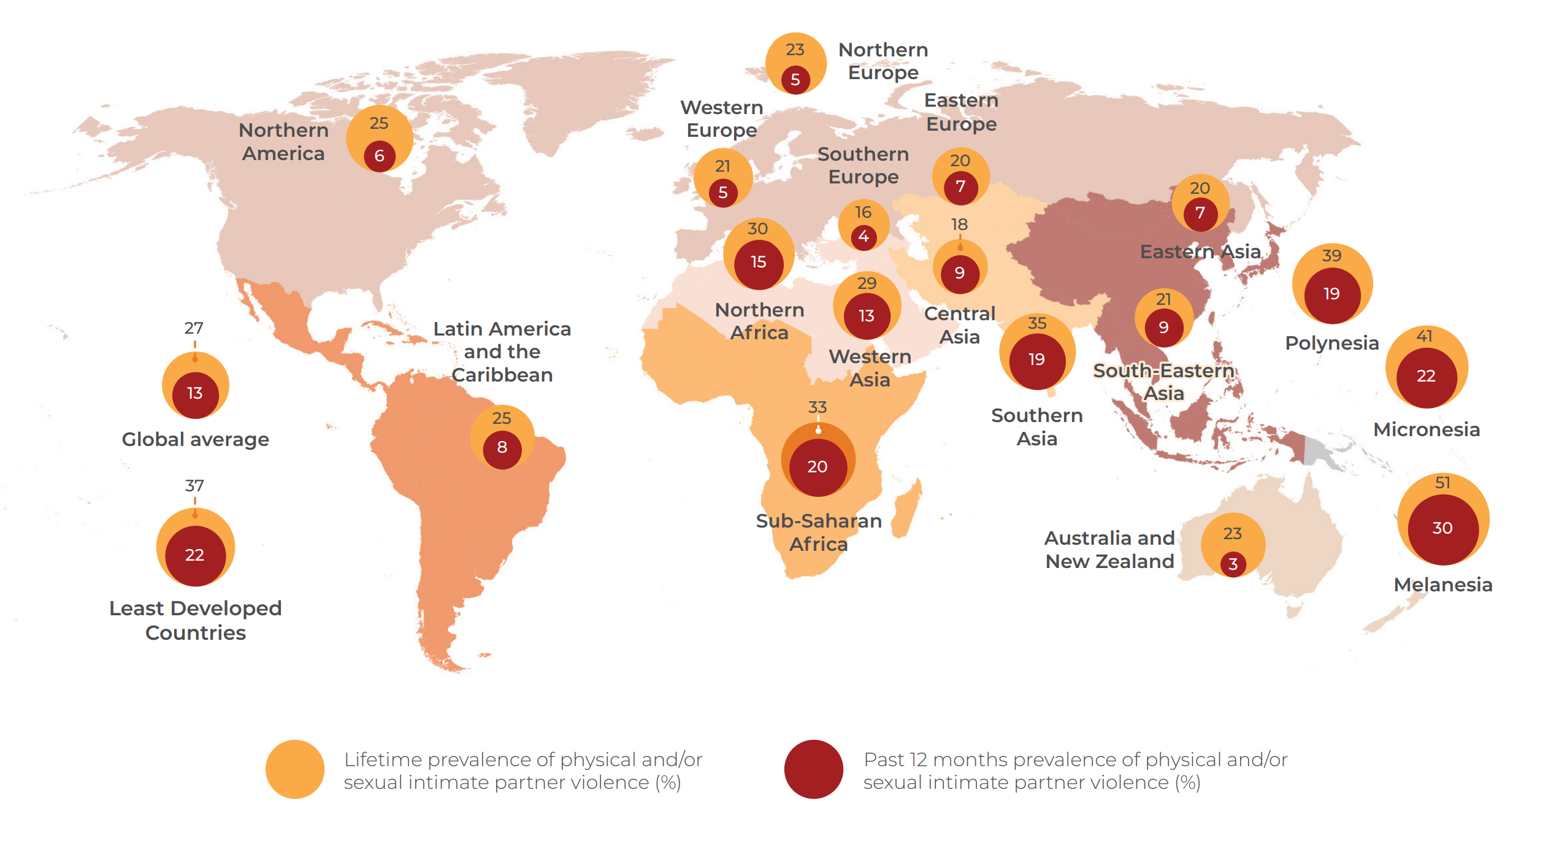
PARTNER VIOLENCE IS A GLOBAL PHENOMENON
Source: WHO, Violence Against Women Prevalence Estimates, 2018

Slide 5





1
2
3
4
5
No credit history
Social boycott
Debt trap
Expropriation of funds by family
Lack of comprehensive and single solution
MAJOR HURDLES TO WOMEN EMPOWERMENT

Slide 6









SAARTHI…
A one-stop solution that aspires to empower DV victims to confidently undertake the journey of financial security and independence.
  Credit
  Rehabilitation
Extend credit through an Income Sharing Agreement (ISA) based on the future income earning potential of the borrower.
Inputs of a partner employer help inform this credit assessment while also determining the skills training(s) that the borrower should undertake.
Saarthi facilitates connections with existing social programs aimed at women empowerment.
  Employment
  Job specific training
At the conclusion of the training(s), the borrower starts employment with a partner employer who deducts Saarthi’s share of income from borrower’s salary up front, in accordance with the terms of the ISA, until the loan is extinguished.
Vetted 3rd party training vendors provide training for skills (identified by partner employers) to Saarthi’s borrowers.

Slide 7









…TAKES A PLATFORM APPROACH
Rehabilitation services through partners
Mandatory skill training & other support services
Credit extended in cash to meet day-to-day expenses
Investor
Investment
Saarthi
DV Victim / Borrower
Returns
ISA
Salary after deducting Saarthi's share
Skills & services
Saarthi's share of
employee's income
Partner Employer
Cash outflow
Cash inflow

Slide 8

1
2
3
4
5
No credit history
Social boycott
Debt trap
Expropriation of funds by family
Lack of comprehensive and single solution
ISA
Community
Debt sizing
Direct payments to vendors
One stop shop
…TO ADDRESS CHALLENGES HOLISTICALLY

Slide 9













Connecting with prospects
Screening and Assessment
CUSTOMER
JOURNEY
Paired With Employer And Support
Housing Assistance
Loan Terms & ISA
Skill-based training
Legal & Health Support
Employment Begins
Loan Repayment
A New Begining

Slide 10














FOUR PILLARS OF SAARTHI
DV Victims
Investors
Social Organisation
Employer Partnerships
  Outreach and building pipeline through civil organizations
  Preventing dropouts through continuous engagement and monitoring
  Community model
  6yr closed-end investment vehicle
  Suitable for DFIs, Impact investors, and banks
  Risk-adjusted returns
  Annual Monitoring and Impact Report
  Partnering with existing social programs to ensure effective yet subsidized services
  Alignment with mission
  Partnership campaigns for awareness
  Partner employers make a public pledge to increase reputational costs of reneging
  Agreement on a garnishing clause
  Continuous engagement to cultivate relationship

Slide 11










STAKEHOLDER BENEFIT
  DV VICTIMS
  INVESTORS
Credit
Rehabilitation support
Employable skills
Employment
Risk-adjusted market returns
Desired impact
  ECONOMY
  EMPLOYERS
Improved labor workforce participation rates for women
Boost to GDP
Pipeline of trained and diverse workforce

Slide 12























POTENTIAL
SERVICE
PARTNERS

Slide 13





77%
¹
ROLES AND EMPLOYERS
Employers face difficulties in filling roles
POTENTIAL EMPLOYERS
TARGET ROLES
  Accountant
  BPO/Customer care
  Data entry/Back office
  Hospitality Executives
  Front office
¹ Manpower group, among world’s top 5 staffing agency

Slide 14


TERMS OF THE LOAN
4% + 7%
25%
100K
5yr + 1yr
$200M
  Fees/expenses
  Borrower and loan size
  Total Commitment
  Tenor
  Income sharing
25% of annual income shared for the first 5 years; loan repayment capped at 2.5x of the loan
4% origination fee (paid by investor); Operating expenses 7% of outstanding loan book
100K borrowers with an average loan of $2,000 per victim
Target raise $200M + loan origination fee
Loan term will be up-to 5 year + 1 year grace period

Slide 15

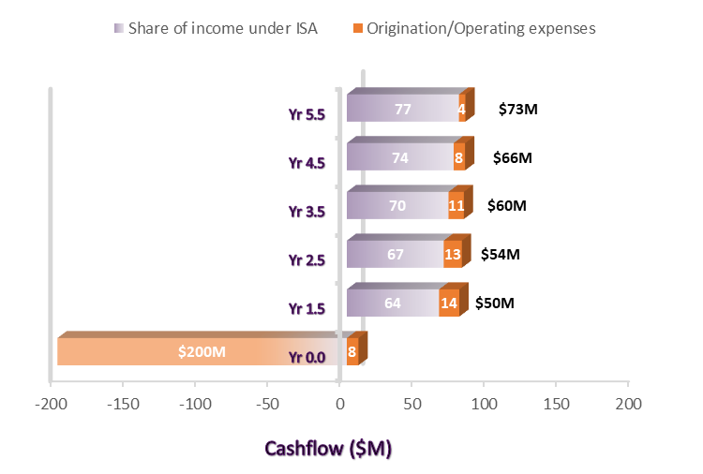
INVESTOR CASHFLOW
Assumptions
  No. of DV victims: 100k
  Delinquency rate: 15%
  Loan origination fee: 4%
  Operating expenses: 7% of the outstanding loan book
  Growth in wages: 5%
  Loan multiple: 8x of expected monthly income
  Cash flows assumed in middle of the year
11%
1.5x
24%
Investor IRR
Investor MOIC
Borrower APR

Slide 16



ILLUSTRATIVE LOAN
In USD
(=250*8)
(=250*12)
24%
  Initial loan includes the cost of rehabilitation services that will be paid directly by Saarthi.
  Loan amount can only be used for approved expenses which will be required in first year.
  Loan repayment capped at 2.5x of original loan.
  Average monthly salary for women in urban India is ~$200¹
Borrower APR
¹ The State of Inequality in India, by Institute for Competitiveness; See Appendix for competitiveness of Saarthi’s loan against other unsecured loans available in market

Slide 17

Delinquency (%)
Delinquency vs Operating Expenses
Operating expenses
IRR SENSITIVITY
Income Share (% of salary)
Income Share vs Loan Multiple
Loan Multiple

Slide 18





RISK ASSESSMENT AND MITIGATION
Counterparty Risk
Financial Risk
Credit Risk
Demand Risk
Enforceability Risk
Mitigated by assessment of DV victim's earning
potential with partner
employers & up-skilling them for employment
Mitigated by segregation & monitoring of fund usage by DV victims; clubbing in social groups to ensure employement continuity & repayment
Mitigated by adding performance covenant to loan disbursement; Employer transferring Saarthi's share directly from salary
Mitigated by tying up with existing social program, conducting workshops & leveraging high digital penetration for outreach
Mitigated by raising reputational costs for employers and borrowers

Slide 19











LEARNINGS
This pilot will help closely observe:
  Challenges in signing up new clients
  Delinquency and dropout rates
  Employment partnerships
  Third party and employer collaborations
  Improvement in lives of clients
P
I
L
O
T
Place:
Karnataka, India
Selection crtirea:
High number of DV victims & presence of partner organisation
Target group:
1,000 DV victims
Loan amount:
~$2M for loan disbursals

Slide 20



IMPACT ASSESSMENT
  Impact
  KPI
Empower women to escape domestic abuse and rehabilitate
No. of participants who get rehabilitated and rescued from domestic violence
Focus on skill development and job training to help women enter workforce
No. of participants entering workforce
Work with partner employers to ensure women have fair opportunities for economic growth
No. of opportunities created for upward mobility of women

Slide 21


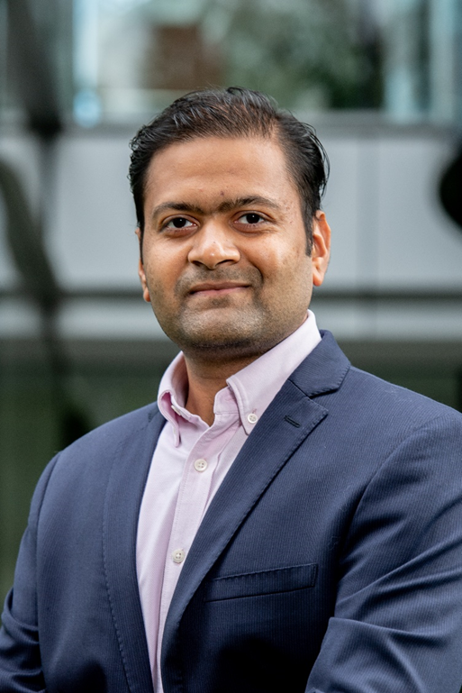
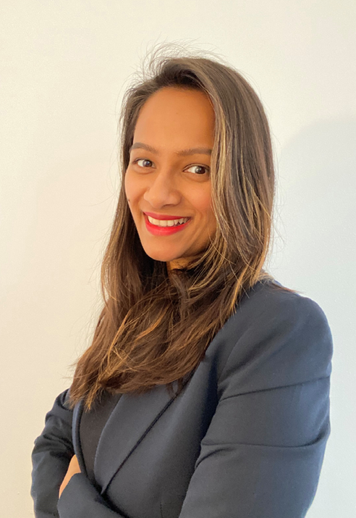
OUR TEAM
Nikhil Goel
Kritika Goel
Yale School of Management, MBA
University of Connecticut, MSFRM
Nikhil is a 2nd year MBA candidate at the Yale School of Management. He is passionate about using finance to improve people’s quality of life.
Before Yale SOM, he worked with Flourish Ventures, International Finance Corporation and J.P. Morgan.
Kritika is a qualified Chartered Accountant and is currently pursuing her Masters in Financial Risk Management at the University of Connecticut. She loves cooking and advocating for women rights and equality. Before UConn, she worked with American Express and Goldman Sachs.

Slide 22



KEY ADVISORS
Song Ma
Professor, Yale SOM
Associate, Orrick
Simone Gross
Maycomb Capital
Ramiro Jaramillo
Eric Newman
Principal, RRG Group
Associate, Orrick
Dipankar Khasnabish
Hong Tran
Associate, Orrick
Mentor

Slide 23

THANK YOU

Slide 24
BENCHMARKING

Slide 25
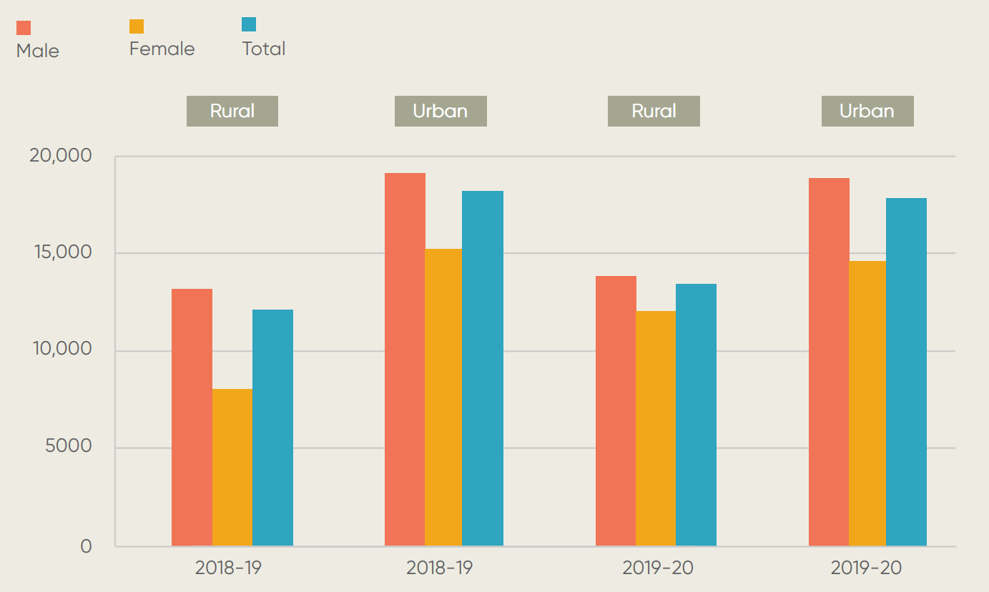
Gross earnings of salaried labor in India (INR)
MONTHLY EARNINGS
($250)
($190)
($125)
($60)
Source: The State of Inequality in India, by Institute for Competitiveness

Slide 26
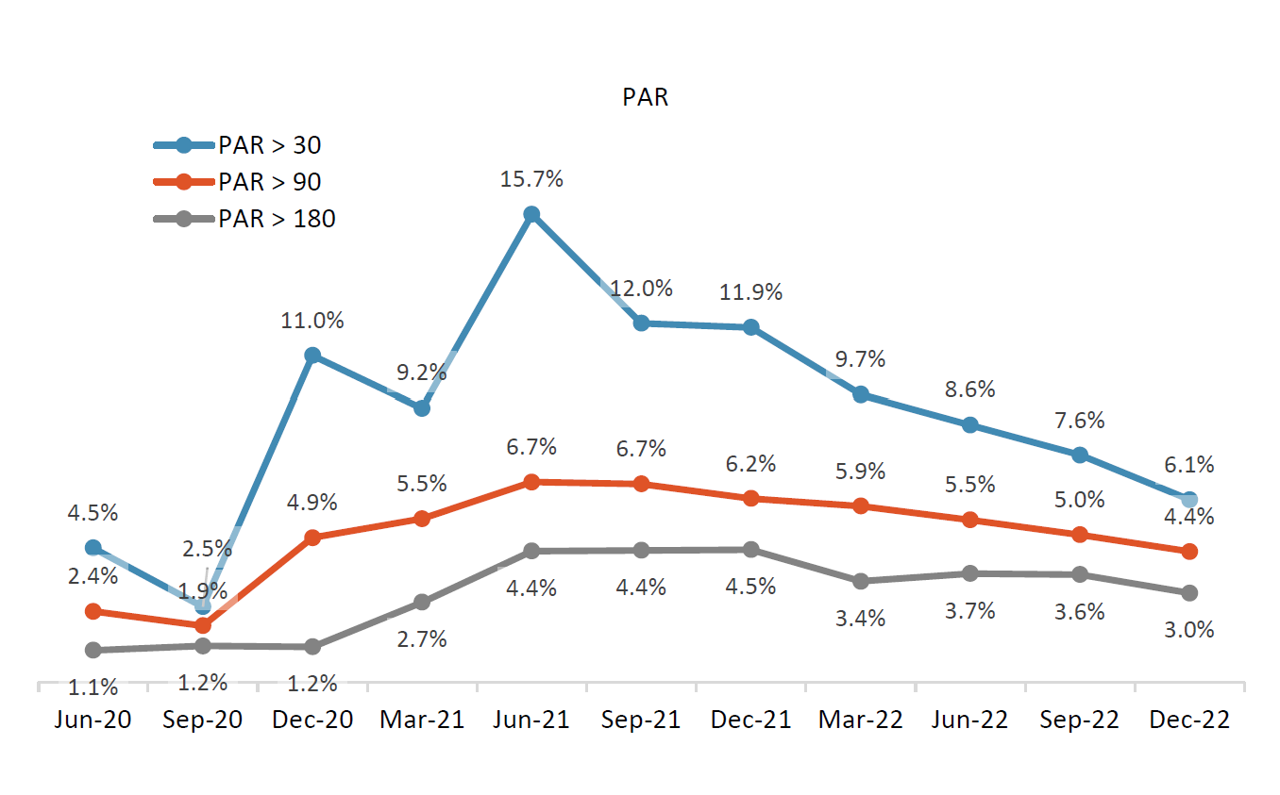
PAR TRENDS FOR NBFC-MFI IN INDIA
Note: Portfolio at Risk (PAR) means the outstanding principal amount of all client Loans that have one or more instalments of principal, interest, penalty interest, fees or any other expected payments past due more than a specified number of days.
Source: Micrometer, Microfinance Institutions Network, as of Dec 2022

Slide 27
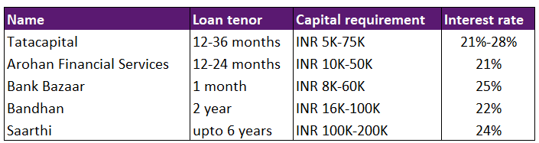
UNSECURED LOAN APRs IN INDIA
Source: Individual company websites

Slide 28
APPENDIX

Slide 29


Education
JOB
MATCHING PROCESS
Skills
Prior experience
Geographical feasibility
Alignment on time commitment

Slide 30
CASH FLOW SUMMARY

Slide 31






SETUP PLAN
Set up initial contracts
Agreement with government and social agencies for rehabilitation services
Building a pipeline
Leveraging existing social programs to build a pipeline of women who can benefit from Saarthi’s offering.
Fund Raising
Reaching out to potential investors such as DFI’s, Impact Investors for the 1st investment vehicle.
Employer Partnerships
Reaching out to potential employers and creating a job database for current vacancies and skills required
Loan repayment
Post-employment,, Saarthi receives loan repayment directly from employers and transfers the same to investors

Slide 32

SAARTHI'S GROWTH
Use learnings from the pilot to inform set-up of the first investment vehicle
Scale up geographically outside India
1
3
5
2
4
Start pilot in Karnataka, India
Raise follow-up funds based on the performance of the first vehicle
Empower women globally

