Slide 1
Sustainable Runway Fund
Accelerating the adoption of green standards across the apparel industry supply chain.

Slide 2
Situation Overview: Fast Fashion
This rise in production has negatively impacted the environment.
The fast fashion industry is the second largest consumer of water in the world.
Since 2000, clothing production has doubled from 100 to 200 billion units a year, while clothing utilization has decreased by 36%.
The value of the fast fashion market in 2022 was estimated to be $99 billion with a CAGR of 8.8%
Notes:
Carmen

Slide 3
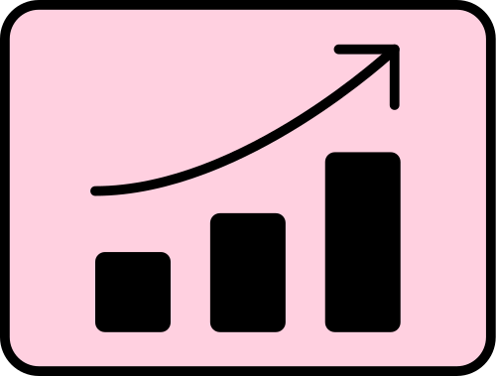
Problem
Opportunity
Apparel production is responsible for 10% of global carbon emissions and 92 million tons of global waste
As consumers become more aware of these issues, they are increasingly seeking out clothing that is made in a more responsible and sustainable manner.
As companies strive to reduce their environmental impact, many are investing in more sustainable and environmentally-friendly supply chains.
85% of textiles go to waste annually
When washed, 60% of materials contribute to microplastics in the ocean
Notes:
Carmen

Slide 4
Solution: Investment Thesis & Diagram
SPV
Loan + Equity Warrant
Green
Loan
Contracts
Accelerating the adoption of green standards across the apparel industry supply chain by financing innovation and implementation of sustainable practices in textile and clothing manufacturing businesses, ultimately leading to higher accessibility to sustainable clothing for the average consumer.
MSA
MSA
Textile Production
Apparel Manufacturers
Brand Partnerships
Notes:
Carmen

Slide 5
Solution: Special Purpose Vehicle
The Sustainable Runaway Fund is a Special Purpose Vehicle that aims to address the multiple environmental issues stemming from textile producers, apparel manufacturers, and fashion brands. The goal is to support technological growth at sustainable textile producers and reduce environmental harm during the apparel manufacturing process.
Textile Production
Loans and Equity Warrant for Ioncell to expedite technological growth.
Apparel Manufacturers
Offer green loans to apparel manufacturers in Vietnam to hit sustainability KPIs.
USA Brands
Gather investors from USA apparel brands with sustainability goals that the Sustainable Runway Fund can help achieve.
Notes:
Carmen
-Dependent on raw materials
-4th largest manufacturer
-2nd largest garment exporter -Supplies 6.4% of apparel exports

Slide 6
Solution: Process for Pilot
Textile Production
Apparel Manufacturers
Brands
Solution
Loans & Equity Warrant for Ioncell
Details
Loans provided will need to be used for technological growth
Incentives
Ioncell is raising capital for technological growth, brands that partner with Sustainable Runway Fund during this stage will have early access to this innovative textile.
Solution
Green Loans to foster innovation in the production of apparel
Details + KPIs
Manufacturers will have KPIs to choose from and they must meet them annually
Incentives
Makes them more attractive to brands that have sustainability goals
Solution
Brands can hit annual sustainability goals by purchasing from sustainable manufacturers
Details + KPIs
Zara, Uniqlo, Muji, Patagonia, H&M, Reformation, J.Crew, Calvin Klein
Incentives
Working with sustainable textile producers and/or apparel manufacturers will count towards their sustainability goals
Notes:
Jorge

Slide 7
Why Ioncell?
Ioncell is a “Recycled” manmade cellulosic fiber that offers an environmentally friendly alternative to water-intensive production. It is the strongest cellulosic fiber in the world and is an alternative to cotton, viscose and polyester.
100% from textile waste, 2X stronger than original virgin fibers
100% recyclable and biodegradable
No land use, minimal water use, no harmful chemicals
50% less CO₂ emissions vs. conventional fibers like cotton
Notes:
Jorge

Slide 8
Green Loans for Apparel Manufacturing
SRF Green Projects include:
Renewable energy - including production, transmission.
Energy efficiency – refurbished buildings, energy storage, heating, smart grids
Pollution prevention and control – including waste-water treatment, reduction of air emissions, greenhouse gas control, waste prevention and recycling
Green loans must align with the four core components of the
Green Loan Principles (GLP):
Use of proceeds
Process for project evaluation and selection
Management of proceeds
Reporting
SRF Green Loans are subject to the incorporation of Ioncell to 10% of apparel manufacturing
Notes:
Paulina
Green loan: any type of loan instrument made available exclusively to finance or re-finance, in whole or in part, new and/or existing eligible Green Projects.

Slide 9
Green Loans: KPIs
Core KPIs
Secondary KPIs
Scope 1 and 2 GHG emissions (intensity and absolute) (tCO₂, kgCO₂e/t or # of products)
Proportion of renewable energy consumption vs. total energy consumption
Volume of fresh water withdrawn/consumed
Proportion of reused/recovered water
Weight of waste to landfill
Proportion of raw materials third-party certified to an environmental and/or social sustainability standard
% of reduction on weight of packaging
% PCR plastic used in all plastic packaging of consumer goods
Purification and treatment of contaminated water
Quantity of pollutants (and/or annual average concentrations) in water discharged to water
Notes:
Paulina

Slide 10
Due Diligence
External review is recommended …
Certification – The green loan or associated green loan framework certified against an external green assessment standard. An assessment standard defines criteria, and alignment with such criteria is tested by qualified third parties/certifiers.
Verification – The green loan, associated green loan framework, or underlying assets independently verified by qualified parties, such as auditors or independent ESG rating providers.
Consultant review – seek advice from consultants and/or institutions with recognized expertise in environmental sustainability or other aspects of the administration of a green loan.
Rating – a borrower can have its green loan or associated green loan framework rated by qualified third parties, such as specialized research providers or rating agencies.
Borrowers provides information on the use of proceeds, renewed annually until fully drawn.
Include Green Projects to which the green loan proceeds have been allocated, a brief description of the projects, the amounts allocated, and their expected impact.
The credibility of green loans rests on the correct selection, compliance and reporting of its KPIs.
If borrowers fail to comply with agreements during annual checks, they are subject to a 50-bps premium until the next assessment.
Notes:
Paulina

Slide 11
Potential Manufacturers in Vietnam
Capacity: 50 tons of fabric, 250,000 garments/month
Currently use recycled polyester & cotton, and botanic dye.
Aware of brands’ commitment to sustainability
Capacity: 800,000 garments/month
Currently work with organic cotton, recycled nylon/ polyester, bamboo.
Sustainability goals
R&D for textiles
Capacity: 1,500,000 garments/month
Public company since 2019 listed on Hanoi Stock Exchange
Various certificates including Certificate of Top 50 electricity- saving Enterprises
Notes:
Paulina

Slide 12
Impact for USA Brands
Metric | Patagonia | Reformation
Total tons of CO₂e (2021) | 224,565 | 32,027
% from material manufacturing | 84% | 65%
Tons of material originating from SFR linked manufacturers | 50% | 50%
% of Ioncell in total manufacturing production | 10% | 10%
% of emissions avoided by Ioncell | 50% | 50%
Estimated CO₂ reduction- Ioncell | 4,716 tons | 577 tons
% from trim & garment manufacturing | 9.5% | 25%
% CO₂ reductions from green loan companies | 10% | 10%
Estimated CO₂ reduction-green loans | 2,133 tons | 887 tons
Total % reduction of CO₂ emissions | 3.05% | 4.13%
Both companies aim to become climate neutral across the entire business- including supply chain- by 2025
They also aim for 100% of fabrics to be from recycled, regenerative, or renewable materials in the next 10 years
Notes:
Carmen

Slide 13
Fund Terms & Cash Flow
Private Equity & Special Purpose Vehicle
Instrument | Loan + Warrant | Grean Loans
Capital | 30M USD | 70M USD
Geographic Focus | Finland | Vietnam
Expected Return Rate | 29% | 4%
Potential Time Horizon | 10 years | 15 years
Amounts in M USD
Revenue
Origination Fees 0.1% on loan size
Ioncell loans interest rate 8% & 47% equity ownership after year 4 with mandatory buyback on year 10.
Apparel manufacturers green loans interest rate 9%
MSAs brokerage fees of 50k USD every 5 years
Notes:
Jorge

Slide 14
Risks & Mitigation
Risk |  | Mitigation Strategy
 | Changes in regulations and geopolitics in Vietnam. | Close monitoring of regulations to allow for proactive responses Develop relationships with local officials
 | Resistance from manufacturers about using new materials. | Work with manufacturers who are actively pursuing sustainability goals Provide educational materials that highlight benefits for both the environment and the manufacturers
 | Implementing a uniform reporting process. | Clearly define measurable KPIs Provide financial incentives for meeting KPIs Implement financial penalties for repeated noncompliance
 | Delays in production or the lack of access to new material for manufacturers. | Provide acceptable alternatives (e.g. organic cotton) so that manufacturers can reach targets while maintaining low impact Structure agreements aligned with Ioncell’s timeline
Notes:
Sydney

Slide 15
Risks & Mitigation
Risk |  | Mitigation Strategy
 | Lack of legal enforceability of green loans. | Build KPIs into loan agreements, with financial incentives for success and financial penalties for noncompliance Provide loans to manufacturers with existing sustainability goals
 | The feasibility of Ioncell’s technology has not been proven on a large scale. | Ioncell’s technology has been proven on a smaller scale during their pilot project in 2021. They have ambitions to scale up and are actively looking to increase capacity.
 | Not being paid back as a loan provider. | Specifically target established factories in Vietnam that have existing relationships with well-known brands. Perform financial due diligence on manufacturers
Notes:
Sydney

Slide 16
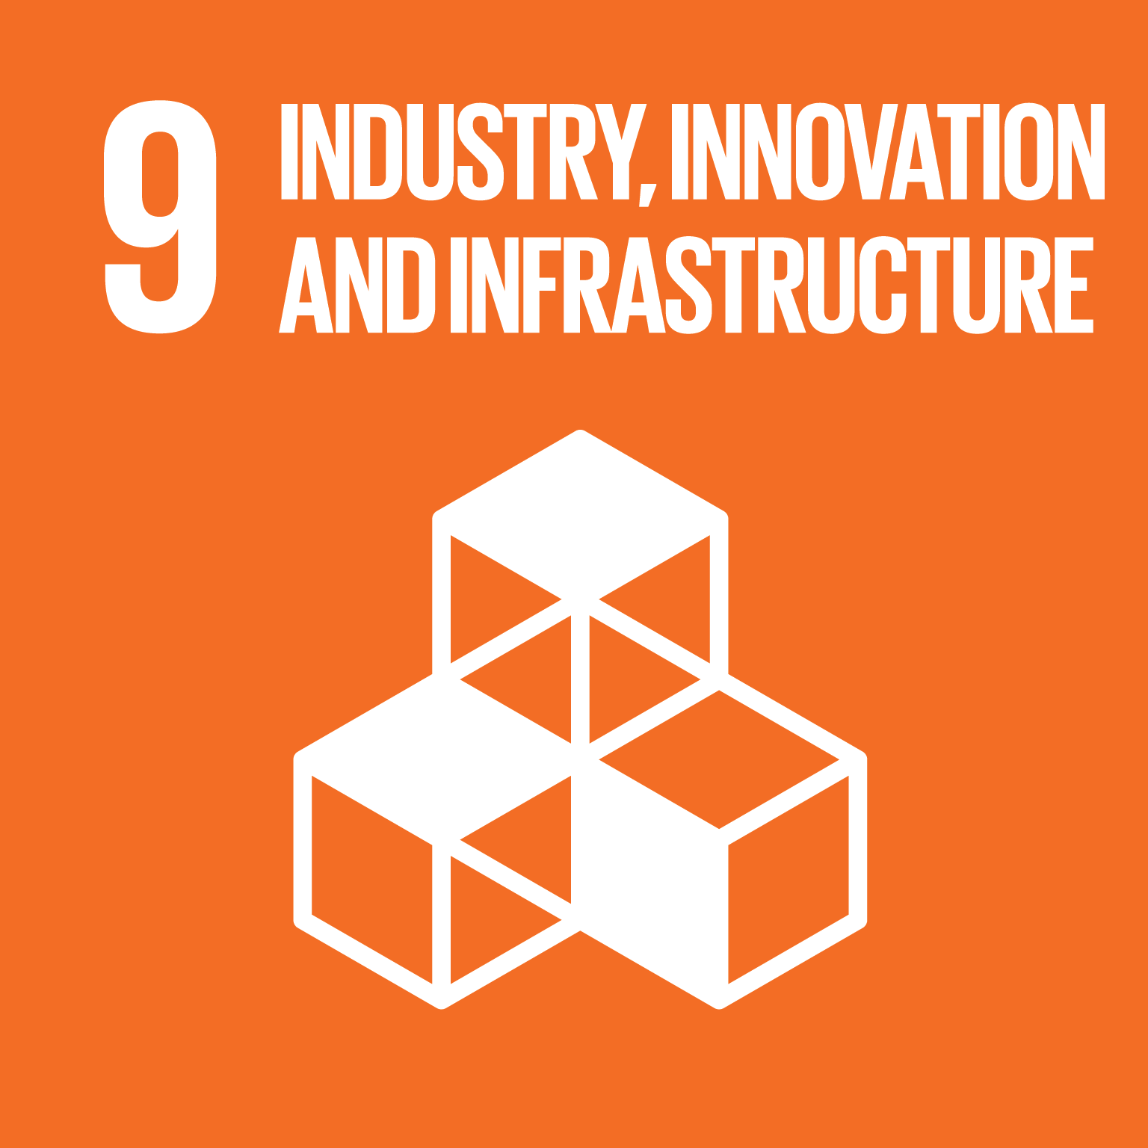
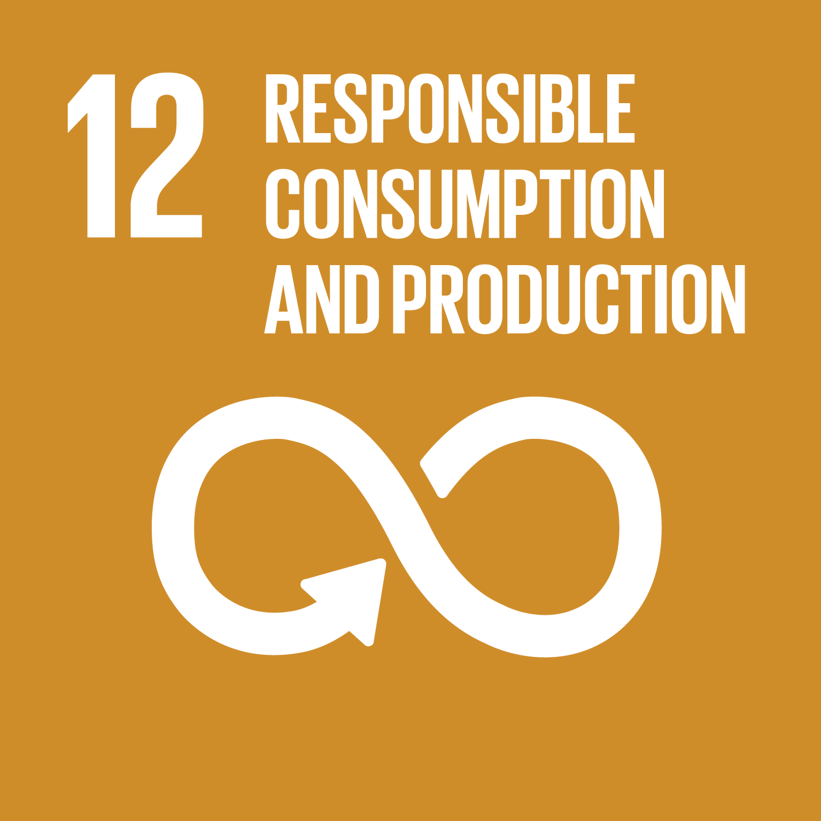
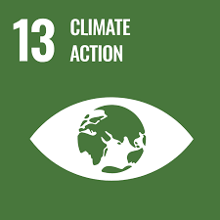
Portfolio Impact
Incentivize sustainable and efficient supply chain management throughout the entire process, reducing water and energy use
Metric: Cubic feet of water used; kWh of electricity consumed
Investment in sustainable materials and practices will reduce CO₂ emissions, mitigate landfill waste.
Metric: Tons of CO₂ emissions avoided, tons of waste
Phase 1: 9,000 kg CO₂
Phase 2: 1,000 tons CO₂
Investment in the development of innovative materials, such as Ioncell.
Metric: tons of material created
Phase 1: 2 tons
Phase 2: 200 tons
Notes:
Paulina
10 kg of co2 per garment- ioncell reduces to 5 kg
1800 kg of garment
1 kg per garment- 1800 garments- 18,000 kg of co2 - 9000 kg of co2 avoided
181,500 kg of garment- 181,500 garments- 1,815,000 kg of co2 - 907500 kg of co2 avoided

Slide 17
Moving Forward
“Ioncell is aiming for 10% market share of the textile industry in 15 years.” Antti Rönkkö, CEO of Ioncell
Manmade cellulosics fibers (MMCFs):
Annual production volume- 7.2M tonnes,
market share- 6% of total fiber production
“recycled” Manmade Cellulosic Fibers (rMMCFs) market share: 0.5% of all MMCFs.
Research and development is ongoing, expected to increase significantly in the next years.
After its first round, the fund could expand to other innovative manufacturing technologies or techniques, supply chain efficiency mechanisms, or additional sustainable fabrics.
The fund could expand its green loans to other clothing manufacturing countries in Southeast Asia like Bangladesh, Cambodia, and Thailand.
Notes:
Jorge

Slide 18
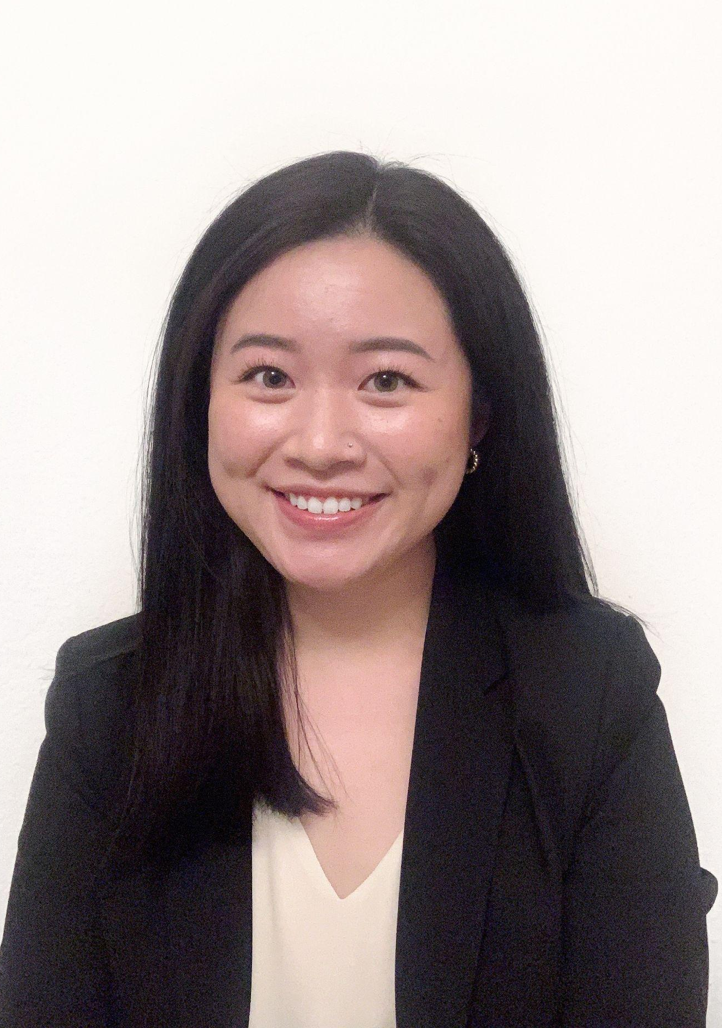
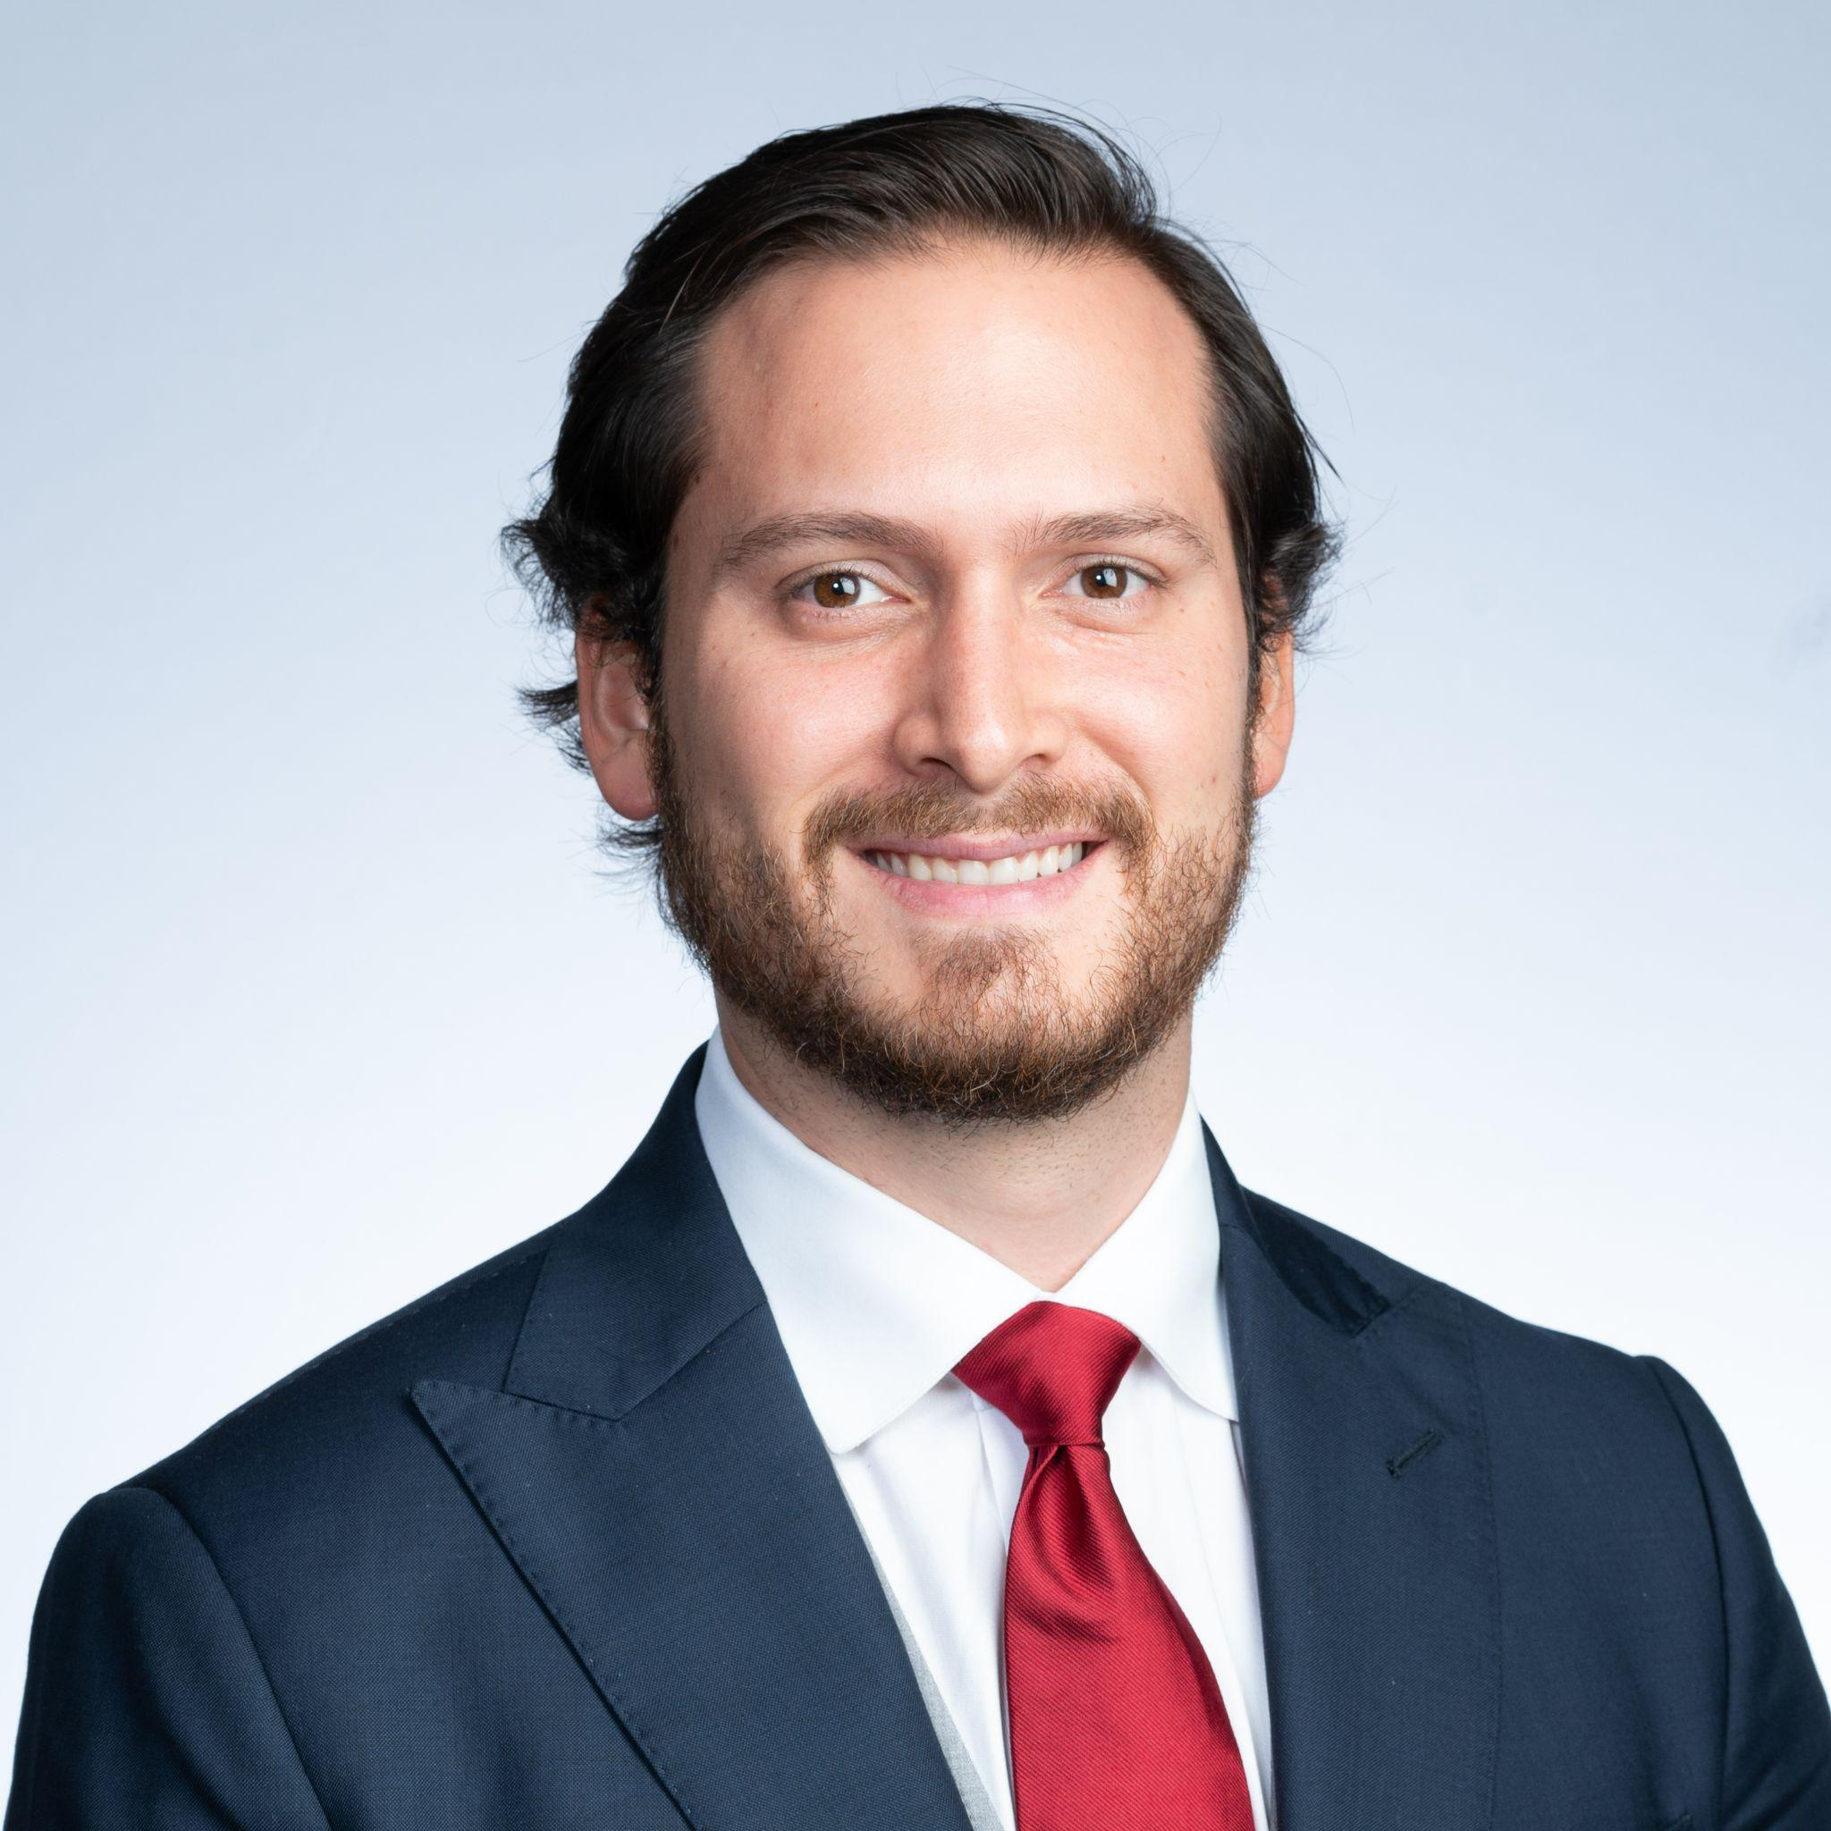
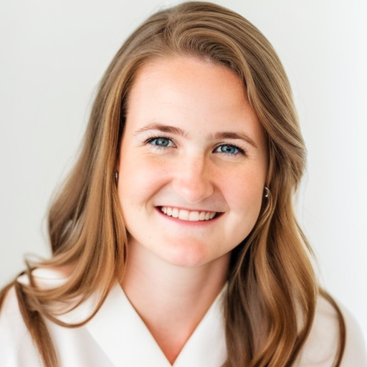
The Sustainable Runway Fund Team
Paulina Carregha
Carmen Pham
Sydney Altmeyer
Jorge Garcia
Social Impact MBA + MS Energy & Environment
Management Science MBA
Social Impact MBA
Social Impact MBA

Slide 19
Special Thanks
Maxime Sauzet, Questrom School of Business, Boston University
Antti Rönkkö, Ioncell
Daniel Brennan, Blackstone
Taylor Short, Blackstone
Lynette Lim, Orrick
Jess Erdenekhuu, O’llen Akademia

Slide 20
References
Hachiba. (2021). About Us. Công Ty cổ phần DỆT may 29/3. Retrieved April 3, 2023, from https://hachiba.com.vn/?view=en
ICMA. (2022, June 28). The principles announce key publications and resources in support of Market Transparency and Development. ICMA- International Capital Market Association. Retrieved April 3, 2023, from https://www.icmagroup.org/News/news-in-brief/the-principles-announce-key-publications-and-resources-in-support-of-market-transparency-and-development/
Kinetik Holdings Inc. (2022, May 16). Sustainability-Linked Financing Framework. Kinetik. Retrieved April 3, 2023, from https://www.kinetik.com/wp-content/uploads/2022/06/Kinetik-Sustainability-Linked-Financing-Framework-FINAL.pdf
Loan Market Association. (2018, March 21). Green loan principles (GLP). Green Loan Principles " ICMA. Retrieved April 3, 2023, from www.icmagroup.org/assets/documents/Regulatory/Green-Bonds/LMA_Green_Loan_Principles_Booklet-220318.pdf
Loan Market Association. (2023, March 27). Guidance on green loan principles (GLP). LSTA. Retrieved April 3, 2023, from https://www.lsta.org/content/guidance-on-green-loan-principles-glp/
Thai Son S.P Co., Ltd. (2020, February 19). Sustainability. Thai Son S.P Sewing Factory in Vietnam. Retrieved April 3, 2023, from https://www.thaisonspgarment.com/sustainable-garments-factory-in-vietnam.html
Thygesen Textile Vietnam. (2022, October 3). Sustainability. Thygesen Textile Vietnam. Retrieved April 3, 2023, from https://thygesen.com.vn/sustainability
Research. Ioncell. (2021, November 11). Retrieved April 3, 2023, from http://ioncell.fi/research/

Slide 21
Appendix

Slide 22
Manmade Cellulosics - Lyocell
Lyocell is a rayon fabric. It's made of cellulose fiber, which is formed by dissolving pulp and then spinning it dry jet-wet. This process was first developed in 1972 by American Enka, a rayon fiber manufacturer. However, the fabric was created for the first time in 1980s by Courtaulds Fibers, a fabric manufacturer. Unlike viscose rayon, lyocell rayon does not include hazardous carbon disulfide, which is damaging to both employees and the environment. The fabric is used in a wide range of industries, including the fashion, the fabric industry, the medical industry, the pulp industry and the paper industry. Lyocell fiber is so versatile, that it can act as a substitute for cotton, silk, cotton blends, and even nylon in the production of sportswear, shirts, bed linens, denim, t-shirts, pants, and towels. It is airy, absorbent, long-lasting, soft breathable fabric.1
1..https://www.globenewswire.com/en/news-release/2021/07/12/2260931/28124/en/Outlook-on-the-Lyocell-Fiber-Global-Market-to-2029-Featuring-Lenzing-Aditya-Birla-and-Smartfiber-Among-Others.html#:~:text=In%20terms%20of%20growth%2C%20North,volume%20for%20Lyocell%20fiber%20products.

Slide 23
Outlook on Lyocell
Production of manmade cellulosic fibers (MMCFs) including lyocell (Ioncell), modal, acetate, and cupo increased from 6.5 million tonnes in 2020 to 7.2 million tonnes in 2021, representing a 6% of the global textile production.1
In 2019, the Lyocell Fiber Market was estimated to be worth over USD 970 million, and it is expected to rise at a compound annual growth rate over 7% for the forecasted period. The rise is mostly attributable to the increasing demand for sustainable fabrics.2
1.https://textileexchange.org/app/uploads/2022/10/Textile-Exchange_PFMR_2022.pdf
2.https://www.globenewswire.com/en/news-release/2021/07/12/2260931/28124/en/Outlook-on-the-Lyocell-Fiber-Global-Market-to-2029-Featuring-Lenzing-Aditya-Birla-and-Smartfiber-Among-Others.html#:~:text=In%20terms%20of%20growth%2C%20North,volume%20for%20Lyocell%20fiber%20products.

Slide 24
Other rMMCF
Asia Pacific Rayon (APR) is pilot testing the production of viscose made from recycled pre-and post-consumer textiles.
Renewcell’s Circulose®, launched in 2019, is a branded dissolving pulp made from 100% cellulosic textile waste such as cotton and viscose, reusing the process chemicals
Birla’s Liva Reviva is a new viscose fiber made with up to 20% pre-consumer cottonplus a small amount of postconsumer waste (up to 5%), certified under the Recycled Claim Standard (RCS).
Evrnu is a US-based startup working on the commercialization of nuCycl™, an MMCF made from discarded clothing and textile waste.
SaxCell has developed a pulp made from post-consumer cotton textiles. SaxCell aims to create the first industrial scale production unit in 2022.
Södra’s OneMore® is RCS-certified dissolving pulp, currently produced with 20% post-consumer cotton
textileexchange.org/app/uploads/2022/10/Textile-Exchange_PFMR_2022.pdf

Slide 25
Why Vietnam?
Exported $39 billion in clothing, 3 million people employed, supply 6.4% of the world’s apparel exports. Clothing Manufacturing is a core pillar of their modern economy.
The country is the 4th largest clothing manufacturer in the world. Vietnam is the second largest garment exporter in the world. Their main export market is the USA, amounting to $16 billion U.S. dollars. The industry employs around 12% of the industrial workforce and nearly 5% of the country’s total labor force, contributing 16% of the total GDP.
Vietnam has numerous multilateral free trade agreements, such as the Comprehensive and Progressive Agreement for Trans-Pacific Partnership (CPTPP), Vietnam-EU FTA (EVFTA), and Regional Comprehensive Economic Partnership (RCEP) (latter two signed in 2020).
Vietnam is highly dependent on imports of raw materials such as cotton, fiber, yarn, textiles, and garments for clothing production as domestic supply has not been sufficient recently.

Slide 26
Investment Details
We will deploy 30M USD in equity with a warrant with an interest rate of 8%. On year 4 the warrant will convert to 47% of ownership with a mandatory buyback on year 10. For the terminal value we are estimating a 70M EBITDA with a 10x market multiple with our 47% ownership. Expected return of 29%
We will deploy 70M USD in Green Loans with an interest of 9% to clothing manufacturers to invest in green projects that will let them hit the KPIs and avoid paying the extra premium of 50 bps. Expected return of 4%
Blended expected return of 14% after costs.
We will secure master service agreements between Ioncell and the clothing manufacturers to incentivize the adoption of the environmental friendly fibers with a brokerage fixed fee of 50k USD each 5 years, and master service agreements between clothing brands and clothing manufacturers to purchase garments made with Ioncell with a brokerage fixed fee of 50k USD each 5 years.

Slide 27
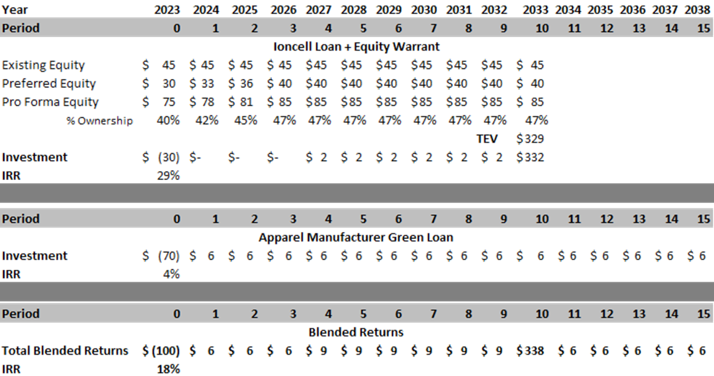
Revenue Detail
Amounts in M USD

Slide 28
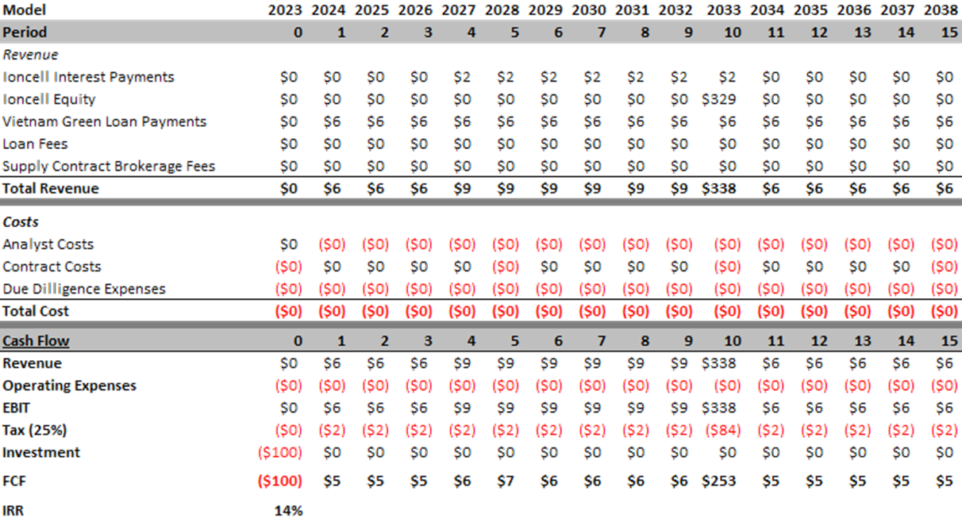
Financial Model
Amounts in M USD

Slide 29
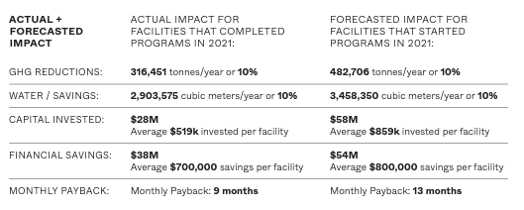
Apparel Impact Institute
AII works to identify, fund, scale, and measure the apparel and footwear industry’s proven environmental impact solutions. Their focus areas are energy, water, and chemistry.
https://apparelimpact.org/

Slide 30
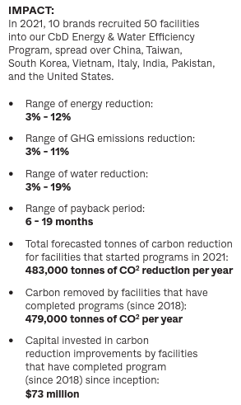
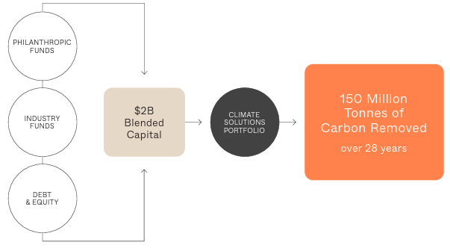
Apparel Impact Institute
https://apparelimpact.org/

Slide 31
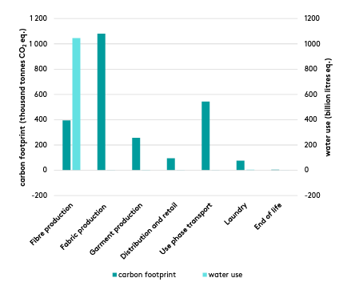
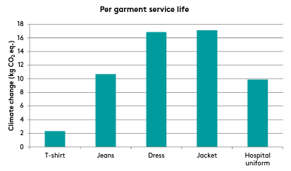
Environmental Impact of Clothing
mistrafuturefashion.com/wp-content/uploads/2015/06/Environmental-assessment-of-Swedish-fashion-consumption-LCA.pdf

Slide 32
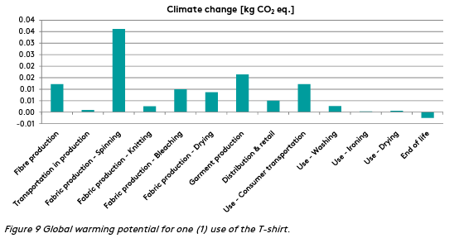
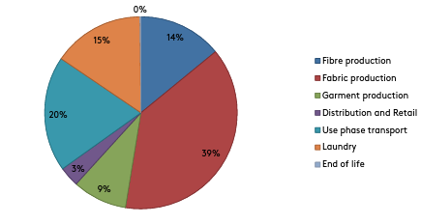
Environmental Impact of Clothing
mistrafuturefashion.com/wp-content/uploads/2015/06/Environmental-assessment-of-Swedish-fashion-consumption-LCA.pdf

Slide 33
Green clauses included in loan documents
• Purpose/use of proceeds provisions – Eligible green project categories
• Information undertakings/covenants
• Representations – The borrower should be under an obligation to represent the accuracy of any reporting.
• Disclosure – Include an express consent from the borrower for lenders to disclose the existence and the details of any green/ESG transaction for both internal reporting and external disclosure purposes.
• Conditions precedent
• No communication
• Green Loan Coordinator
• Declassification
GLP_Guidance_23_February_2023-v.2.pdf

Slide 34
Calculations for SDG Impact
10 kg of CO₂ emissions per garment- Ioncell would reduce it to 5 kg of CO₂
2 tons of garment= approximately 1800 kg of garment
Weight of 1 piece of garment= 1 kg on average
1,800 garments- 18,000 kg of CO₂ → *50%= 9,000 kg of CO₂ avoided
200 tons of garment= 181,500 kg of garment= 181,500 garments= 1,815,000 kg of co2 = 907,500 kg of CO₂ avoided

Slide 35
Calculations for US Brand Impact
Total tons of CO₂e (2021) | 224,565 | 32,027
% of CO2e from material manufacturing | 84% | 65%
Tons from material manufacturing | 188634.6 | 20817.55
Tons of material from SRF green loan companies | 94317.3 | 10408.775
% of Ioncell in total manufacturing production | 10% | 10%
% of emissions avioded by Ioncell vs. Conventional fabric | 50% | 50%
Estimated CO2 reduction from incorporating Ioncell | 4715.865 | 520.43875
% from trim & garment manufacturing | 9.50% | 25%
Tons from trim & garment manufacturing | 21333.675 | 8006.75
% CO2 reductions from green loan companies | 10% | 10%
Estimated CO2 reduction from green loans | 2133.3675 | 800.675
Total % reduction | 3.05% | 4.13%

