Slide 1
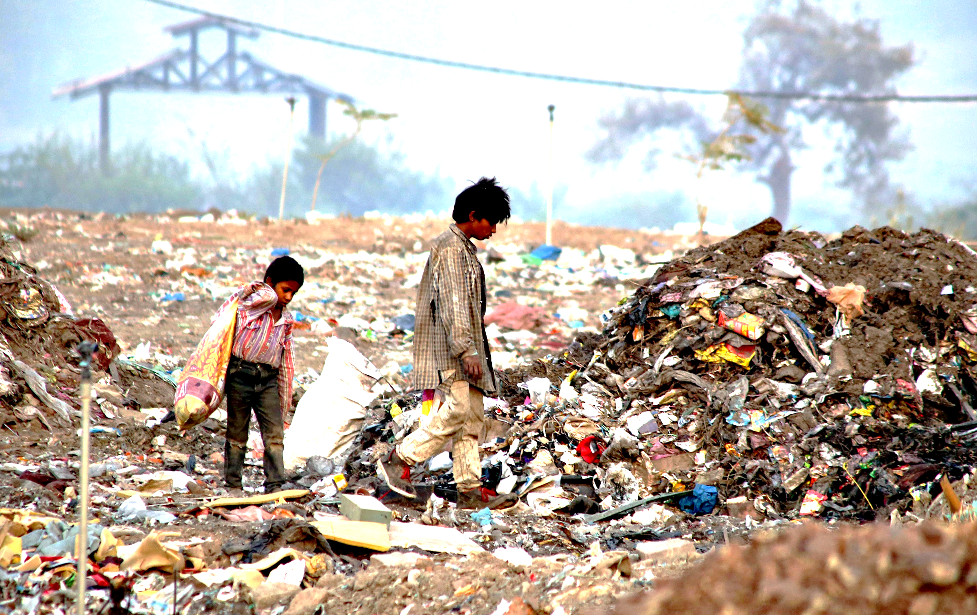
CLEAN INDIA STRUCTURED NOTES

Slide 2
AGENDA
ISSUES AND SOLUTIONS
INVESTMENT OPPORTUNITY
CLEAN INDIA FUND

Slide 3
AGENDA
ISSUES AND SOLUTIONS
INVESTMENT OPPORTUNITY
CLEAN INDIA FUND

Slide 4
WHY WASTE MANAGEMENT IN INDIA
6.09%
USA, UK, FRANCE, GERMANY
0.86%
9.93%*
INDIA, BANGLADESH, VIETNAM, SUDAN
SOUTH AFRICA, CHINA, BRAZIL
ZIMBABWE, NEPAL, ETHIOPIA
1.3 billion tonnes of annual waste
Lower middle income regions (Indian Subcontinent) to contribute most
Extremely little waste recycled or processed
* CAGR
Data Source : World Bank Report 2012

Slide 5
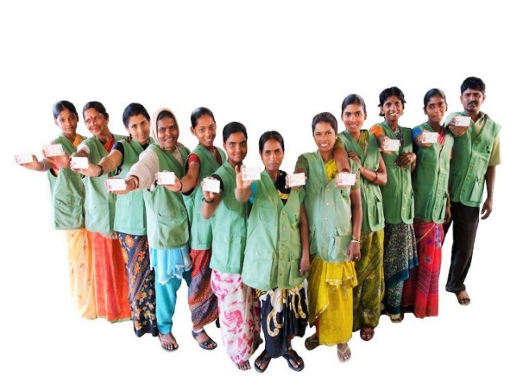
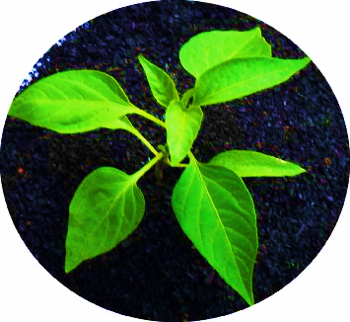
IMPACTS GENERATED- DAILY BASIS
1650 tonnes of waste averted from dumpsites
Electricity to 0.17 mn households
1280 tonnes of CO2 averted
USD 8960 earned – Wages to 1500 rag pickers
2 tonnes of organic compost produced
50% reduction in pesticides + less irrigation + better soil
5000
Rag pickers reached
10 tonnes of Bio-LNG produced
25-50% less CO2 than diesel and petroleum

Slide 6
PROBLEMS ADDRESSED
Waste Processing
Funding/Infrastructure
Rag Pickers

Slide 7
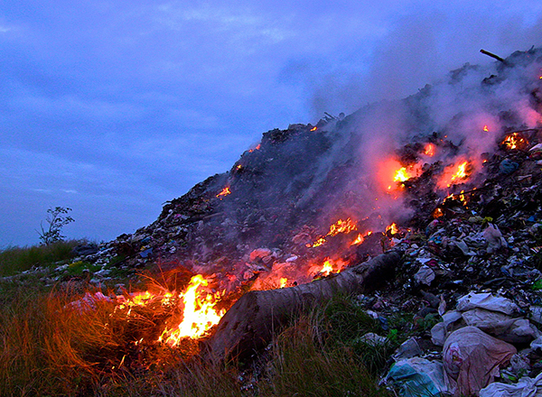
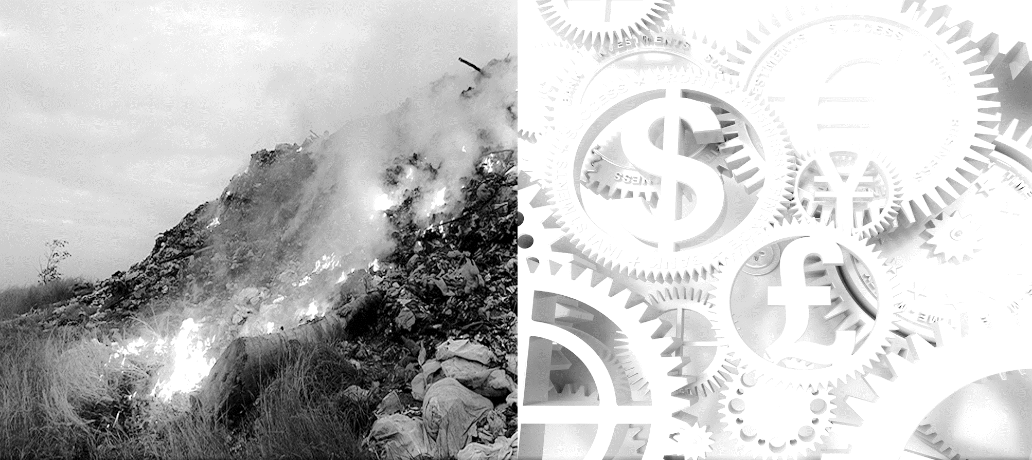
PROBLEMS ADDRESSED
Waste Processing
Funding/Infrastructure
Production - 68.8 million tonnes/year
Disposal - 80% via unsanitary means
GHG - 6% contribution (Global avg. 3%)
Infrastructure – 40% waste uncollected
Budget - 70% shortage of funds
Landfills – Inefficient operation of sites

Slide 8
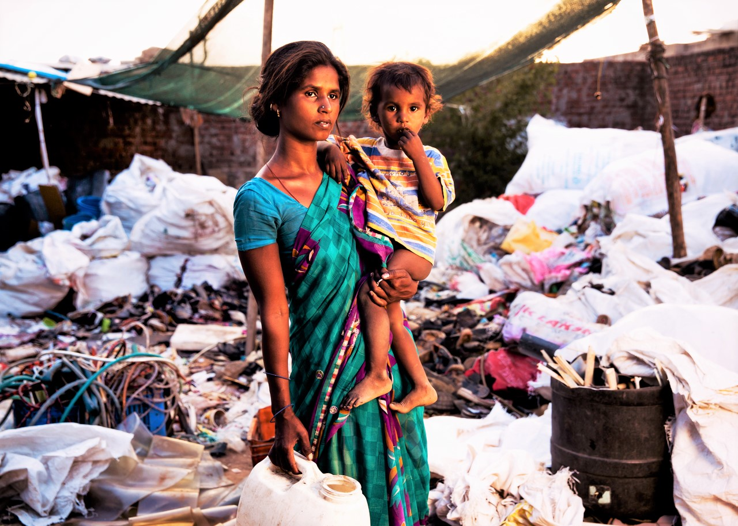
PROBLEMS ADDRESSED
Rag Pickers
Highest in world (2.86 million)
Occupational Hazards - 68% rag pickers
Meagre payments - Handle 20-30% of waste
Unorganized sector - Generates 20% savings
Health risks for rag pickers extremely high
82% women rag pickers severely anaemic
Data Source : World Bank Report 2012

Slide 9
AGENDA
ISSUES AND SOLUTIONS
INVESTMENT OPPORTUNITY
CLEAN INDIA FUND

Slide 10
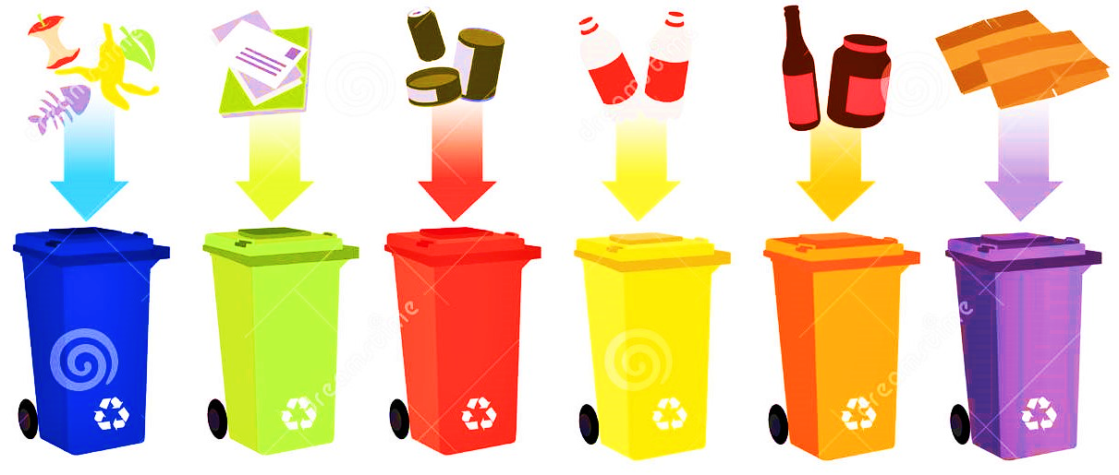
WASTE MANAGEMENT SYSTEM - SEGREGATION
Two Fold Approach
Only 20-30% waste segregated at source
Steps to improve segregation at source
Proposal to charge fee for non segregated waste
Difficult to achieve 100% segregation at source
Proposal to set up Mechanical Segregation Unit at each site

Slide 11
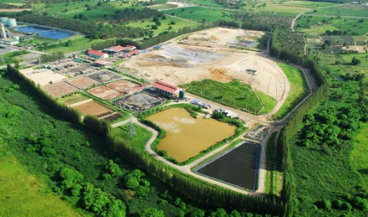
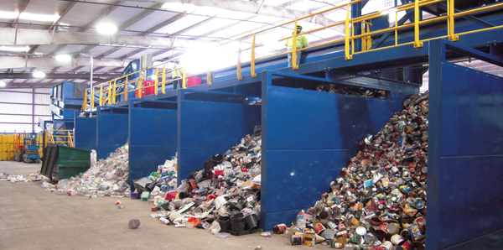
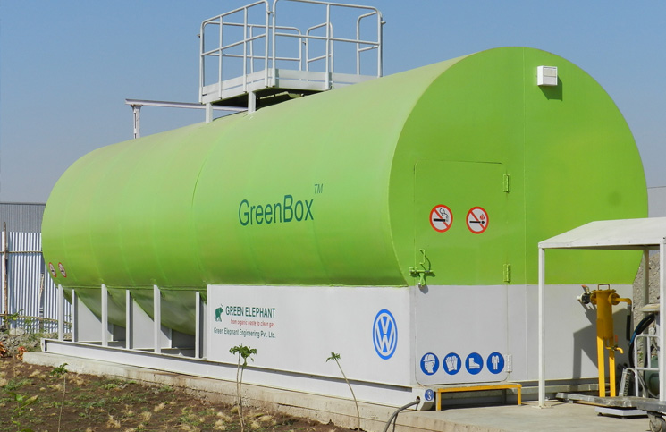
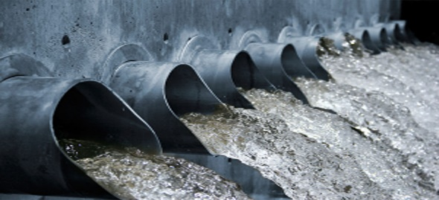
WASTE MANAGEMENT SYSTEM - TREATMENT
Segregation
Inert (15%)
Recyclables (25%)
Organic (60%)
Safe Disposal in Sanitary Landfill
Sold to Recycling Industries
Generator
Electricity
Sewage Waste
Biogas Generation in Anaerobic Digester with integrated solar panels
Residue
Compost

Slide 12
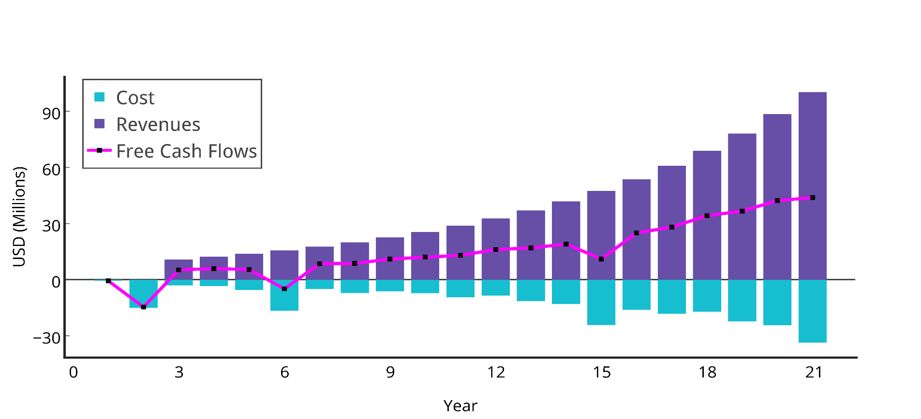
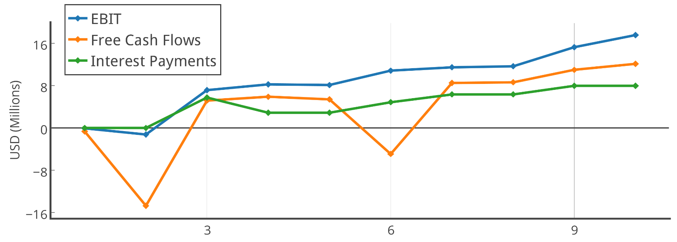
CASH FLOW ANALYSIS
Projected IRR ~ 30%
(for 10 years)
Major Cost Drivers
Wages to Rag Pickers, Anaerobic Digester, Landfill Development,
Sources of Revenue
Electricity, Recyclables, Compost, Tipping Fees, Carbon Credits

Slide 13
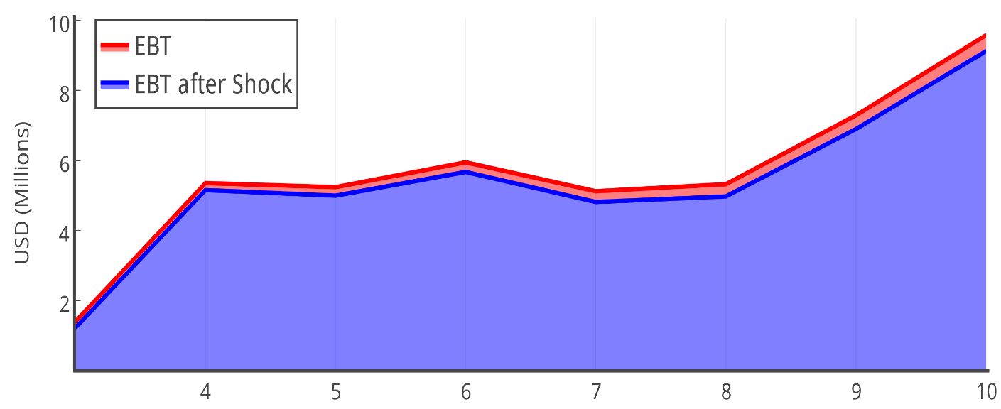
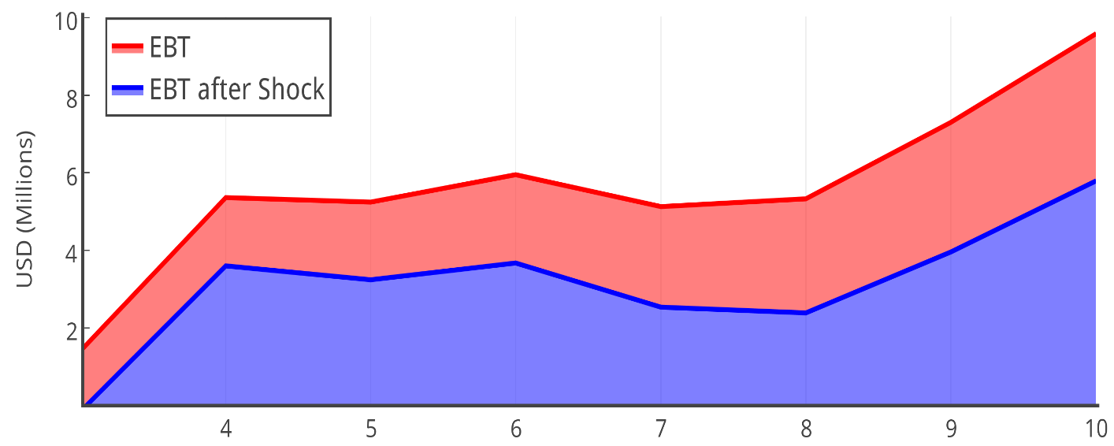
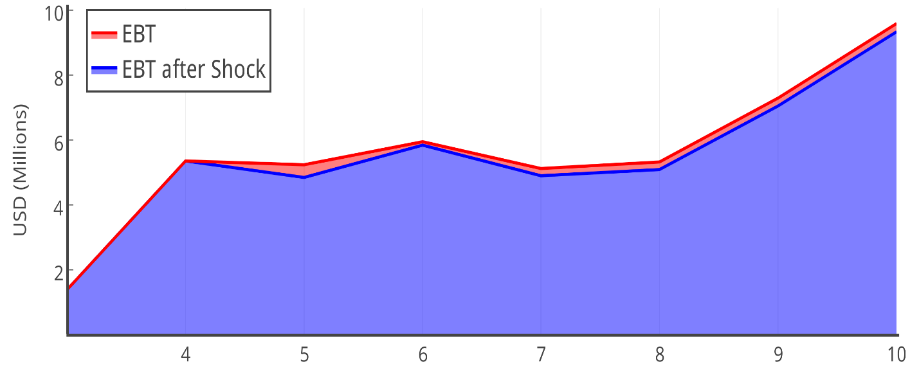
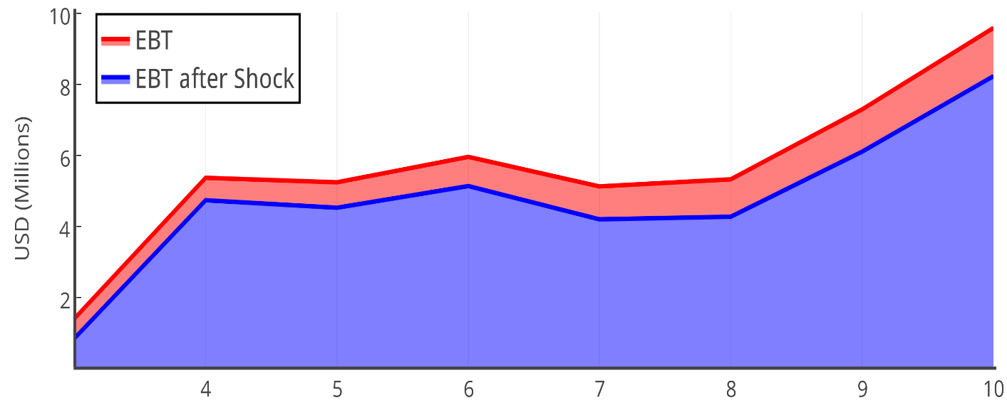
EBT SENSITIVITY
EBT
5.5%
EBT
46%
Tipping Fees
25%
Revenues from Electricity
25%
EBT
3.3%
EBT
16.5%
Biogas Plant breaks down in Y5; O.C. increases
25%
25%
Biogas O.C.
Price of Recyclables
25%

Slide 14
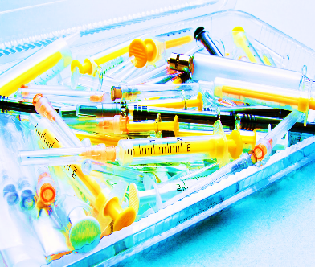
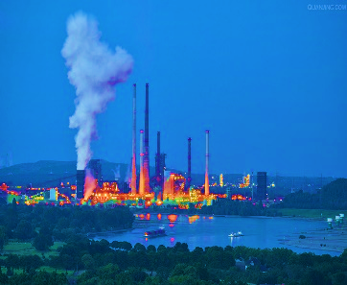
SCALABILITY
Waste Diversification
Geographical Expansion
E – WASTE
BIOMEDICAL WASTE
INDUSTRIAL WASTE

Slide 15
AGENDA
ISSUES AND SOLUTIONS
INVESTMENT OPPORTUNITY
CLEAN INDIA FUND

Slide 16
WHY CLEAN INDIA FUND?
Investors avoid directly funding waste ventures
Issues
Limited Credit Information Access
Absence of Impact Quantification
Foreign Exchange Risk
Inadequate Risk Adjusted Returns
SERVICE PROVIDER
Contractual terms between Clean India Fund & Service Providers
Proposed Solution
REVENUE GENERATING ASSETS
Operating Contract
Minimum impact ratio target
Periodic reviews
Future funding dependent on past performance
Recourse to collateral (assets)
COST SAVINGS FOR MUNICIPALITY

Slide 17
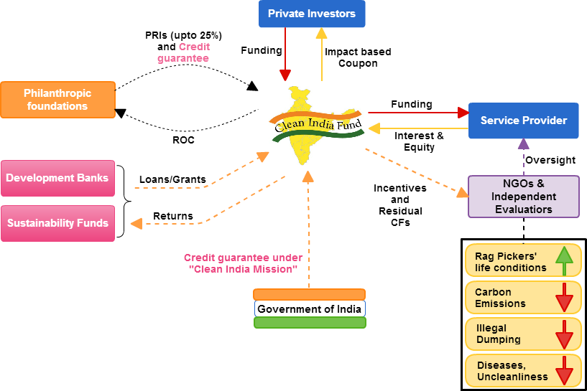
CLEAN INDIA FUND
Partner with Foundations for up to 25% of initial funding
Credit guarantee by Government of India under Clean India Mission
Setting up ties with NGOs and Independent evaluators for impact measurement and oversight
Incentives/fees for NGOs to align interest

Slide 18
CLEAN INDIA STRUCTURED NOTES (CISN)
Coupon*$=Max(7\%, 7\% x\sum_{1}^{4}{wi∗Impact Ratios})$
Traditional Venture Capital
Maximizing financial returns
Floor payment of 7% p.a. to the investor
Clean India Fund
Blending social and financial returns
Premium (~120 bps) over other EM hard currency bonds
Financial Focus
0% IRR
Performance and Impact based payments
Traditional Philanthropy
Maximizing social returns
Convertible to equity for a greater upside
Social Impact Focus
*Subject to cap of 12%

Slide 19
CISN- ISSUANCE AND SECURITIZATION
Initial Phase
Expansion Phase
Impact Investors/Private Investors
Foreign Institutional Investors
High Yield Investors/ Hedge Funds
HNI Investors, Family Offices
Funds/Risk Capital
Interest & Preferred Equity
Senior Issues
Mezzanine Issues
Residual CFs
CISN
CISN
PRI
SPV
Clean India Fund
Interest & Income share
Interest & Income share
Funds
Funds
Credit Guarantee by GoI/Initial Partners
Loan Portfolio/Service Providers
Loan Portfolio/Service Providers

Slide 20
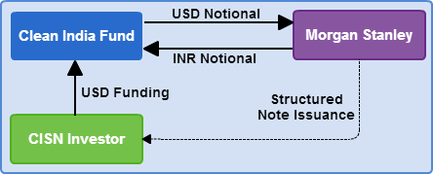
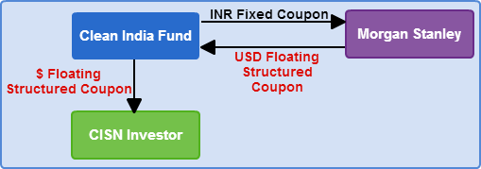
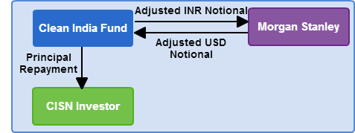
CISN – FX HEDGING
INITIAL EXCHANGE
INTERIM CASHFLOWS
FINAL PAYMENTS AT MATURITY
FX RESET ADJUSTMENTS

Slide 21
FUND SUMMARY
Clean India Fund- Summary Terms
Portfolio size | USD 80-100mm
Floating coupon | Min(12%, Max (7%, 7% x ∑w_{i}*Impact Ratios))
Issuer | Clean India Fund
Maturity | 10 Years, convertible to equity from 4th year
Target IRR to impact investors | Capped at 12-14%, residual cash-flows to NGOs, Service Providers
Credit Enhancement 1 | 20-25%, PRI grant from a foundation
Credit Enhancement 2 | Government of India
Foundation fees (after 4 years) | 30-40 bps, running
Fund Management Fees | 50bps, running
NGO Fees | 100-120bps, running+ residual CF incentive
Underwriting Fee | 3%, paid on closing

Slide 22
SENSITIVITY ANALYSIS
IR 1 | IR 2 | IR 3 | IR 4 | Coupon Payoff*
1 | 1 | 1 | 1 | 7.00%
1.1 | 1.3 | 1.2 | 1.1 | 8.23%
1.6 | 1.7 | 1.9 | 1 | 10.85%
1.7 | 1.8 | 2.1 | 2.2 | 12.00%
2 | 2.1 | 2.5 | 2.8 | 12.00%
2.5 | 3.1 | 3.4 | 3.5 | 12.00%
Conversion to Equity
Unlimited participation
*Net of fund management fees

Slide 23
IMPACT MEASUREMENT CRITERIA
Impact Ratio Index
Quantifiers
Independent Evaluator (Annual Evaluation)
Earning Level
Proportion formalised
Quantity of Unauthorized Waste (in Tonnes) dumped
District Collector
GHG Emissions from Municipal Solid Waste
Government Cleanliness Rating
Local Municipal Environment Division
NGOs/Educational Institutions/Municipal Corporation
Ministry of Tourism
Rag Pickers’ Conditions
Illegal Dumping
Carbon Footprint
Societal Health and Cleanliness
Notes:
http://time.com/4059051/india-indc-climate-change-carbon-emissions/
http://www.newindianexpress.com/cities/chennai/Act-Against-Lorries-Dumping-Waste-illegally-NGT/2016/03/17/article3331210.ece
http://indianexpress.com/article/cities/mumbai/city-of-garbage-hits-a-dead-end/
(Illegal dumping is 10% of total waste) - http://timesofindia.indiatimes.com/city/bengaluru/Illegal-dumping-throws-up-300-mini-Mandurs/articleshow/36984991.cms
India’s average is 0.699
Indian government target is to reduce by 33035% by 2030.
Illegal dumping is 10% of total dumping.
Odn’t know how to come up with an impact

Slide 24
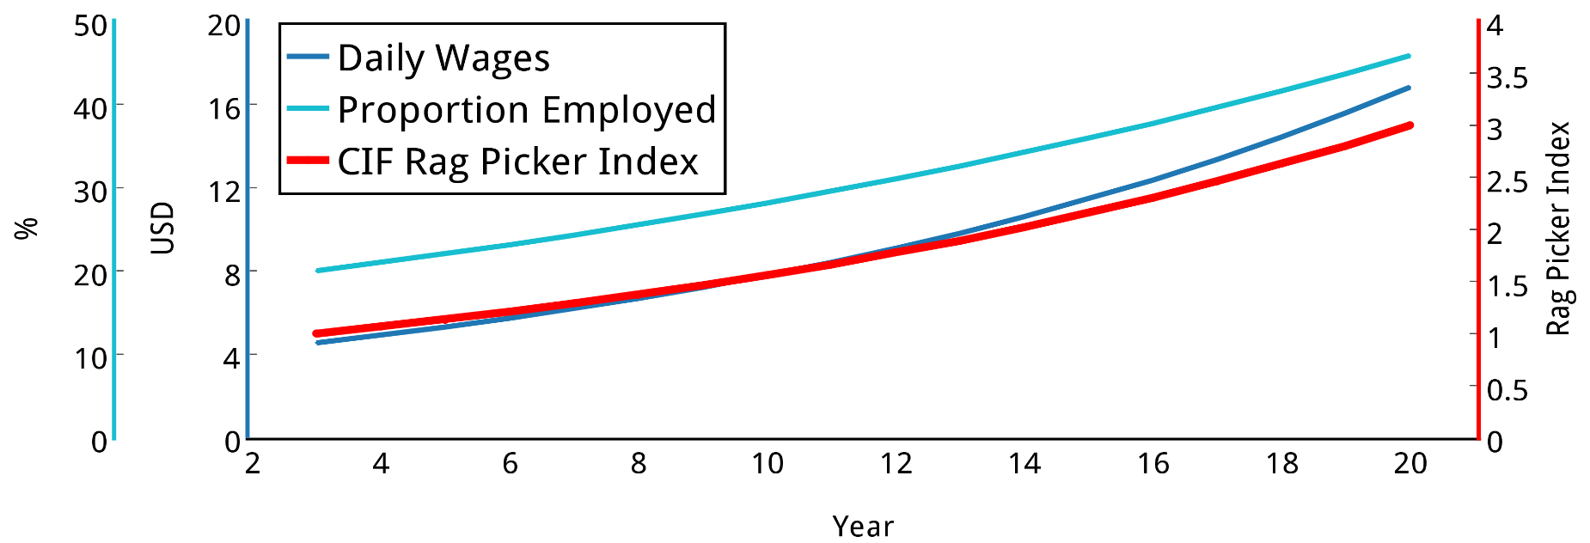
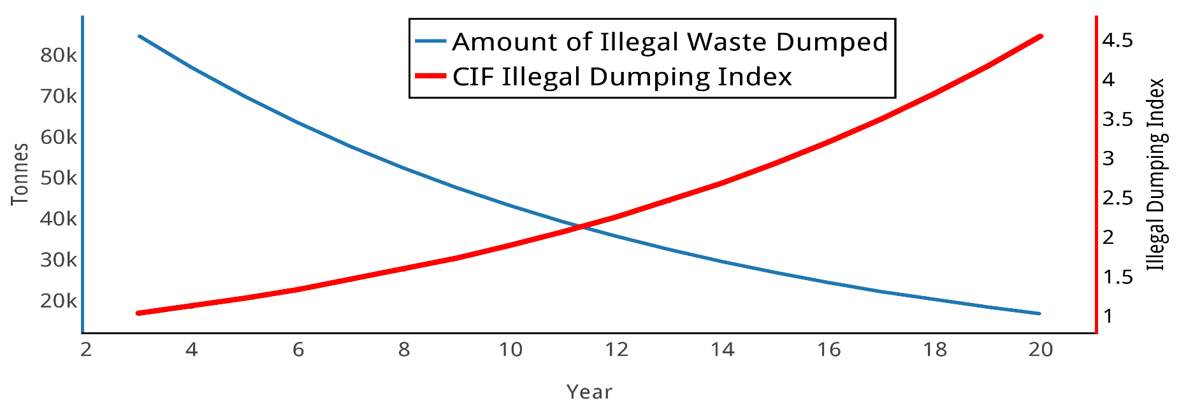
IMPACT RATIOS TREND
Daily Wages | $ 4.5 → $ 17
Percentage Formalized | 20% → 45%
CIF Rag Picker Index | 1 → 3
$ 4.5
$ 17
20%
45%
1
3.5
Illegal Dumping | 84k T → 16k T
CIF Illegal Duping Index | 1 → 4.5

Slide 25
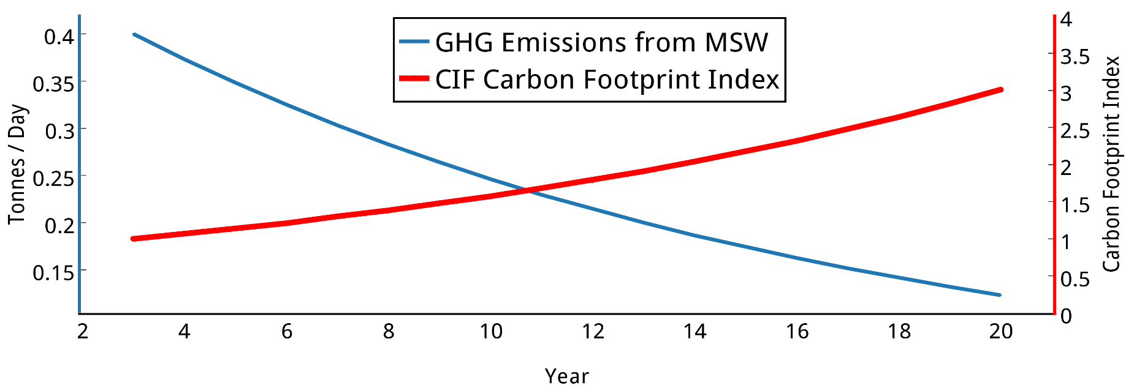
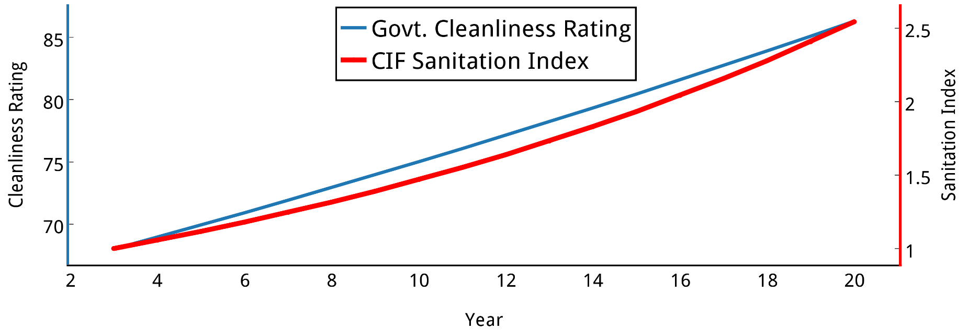
IMPACT RATIOS TREND
GHG Emissions from MSW | 0.4 tpd → 0.1 tpd
CIF Carbon Footprint Index | 1 → 3
Cleanliness Rating | 68 → 90
CIF City Sanitation Index | 1 → 2.5

Slide 26
TOTAL RETURNS TREND
Year | Annual Return (%)
3 | 7.0
4 | 7.5
5 | 8.0
6 | 8.6
8 | 9.9
10 | 11.3
12 | 13.0
14 | 14.9
16 | 17.2
18 | 19.8
20 | 22.9
Time Period (Years) | Compounded Annual Return (%)
5 | 7.3
10 | 8.6
15 | 10.4
20 | 12.7

Slide 27
PROSPECTIVE PARTNERS
Service Providers
Foundations
NGOs
Development Banks & Sustainable Funds

Slide 28
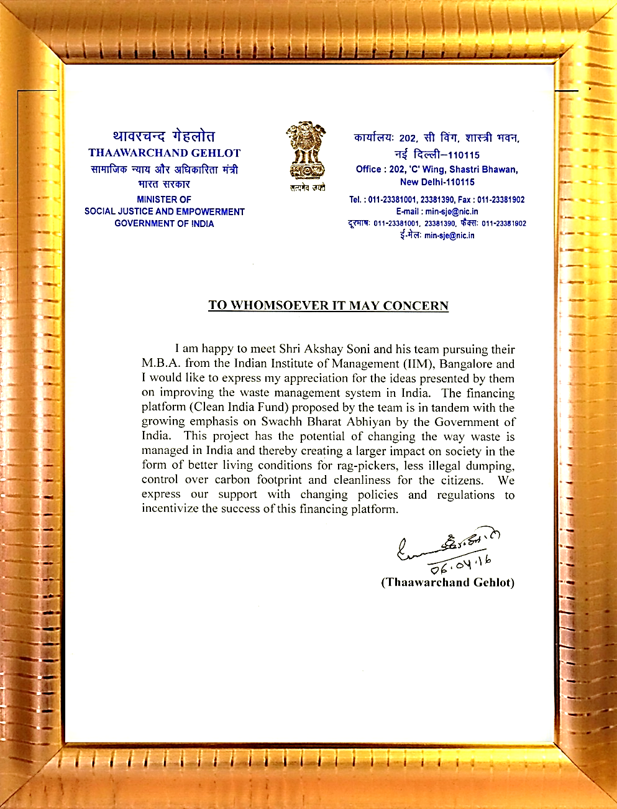
SUPPORT FROM THE GOVERNMENT

Slide 29
OUR ADVISORS
We would like to sincerely thank our mentor for his support and guidance:
Mr. Peter Lobin, Managing Director, ZeroWaste Global, LLC
Government
Academic Advisor
Corporates
Hon. Federal Minister Shri Thaawarchand Gehlot
Hon. Satyanarayan Jatiya (Former Federal Minister)
Mr. Srinivas (Hyderabad Municipality)
Mr. Sidhanku (Bangalore Municipality)
Mr. HAC Prasad (I.A.S.)
Mr. Dharmendra Gehlot (Mayor, Ajmer)
Prof. Charan Singh, RBI Chair, IIM Bangalore
Prof. Saurav Mukherjee, Dean, IIM Bangalore
Prof. P D Jose, Sustainability Expert, IIM Bangalore
Azim Premji Foundation
Reliance Foundation
Infosys Foundation
Goldman Sachs
JP Morgan
j

Slide 30
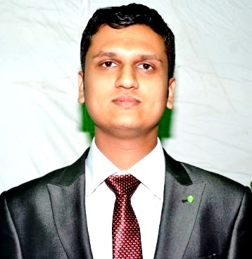
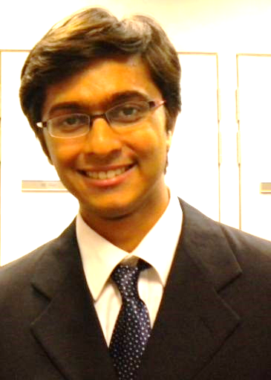
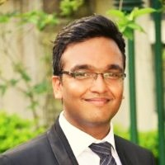
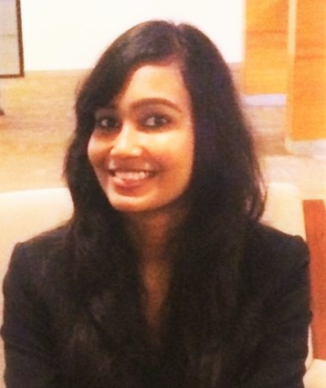
THE TEAM
Fixed Income Trading – Deutsche Bank, London/Mumbai
Sales and Trading – J.P. Morgan, Hong Kong/Mumbai
Investment and Risk Management – Oppenheimer Funds (USA)
Business Development – Hike Consultancy (Real Estate Start-Up)
FRM from GARP, USA
Sales and Trading – J.P. Morgan, Mumbai
Credit Risk – Goldman Sachs, Singapore
Supply Chain – Procter and Gamble, Singapore
Credit Risk Modelling – American Express, Gurgaon
Optimization Lab – Simon Fraser University, Canada
KVPY Fellow – Scholarship by Govt. of India
Supply Chain – AB InBev
Design and Production – Hindustan Aeronautics Ltd.
Production Engineer – NTPC Ltd.
5 yrs in social sector – Upliftment of destitute women and children

