Slide 1
LOCUS AGRICULTURE
Real assets fund to invest in arable land to help improve rural farmers’ quality of life by employing landless farmers and cultivating high margin cash crops through modern agricultural techniques
Indian Institute of Management, Ahmedabad
Bani Singh Eshwar Agarwal Khushbu Gupta
Sabyasachi Mishra

Slide 2
8_84
Agenda
PROBLEM STATEMENT Current problem plaguing the sector and scope of opportunities
SOLUTION AND INVESTMENT THESIS How we plan to solve the problem and create financial value at the same time
IMPLEMENTATION ASPECTS Finer executional details contributing to the success of the project
IMPACT Benefits accrued to the society, farmers and the investors
APPENDIX Deep dive into specific aspects for further discussions

Slide 3
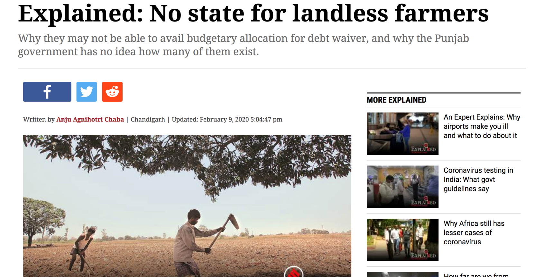
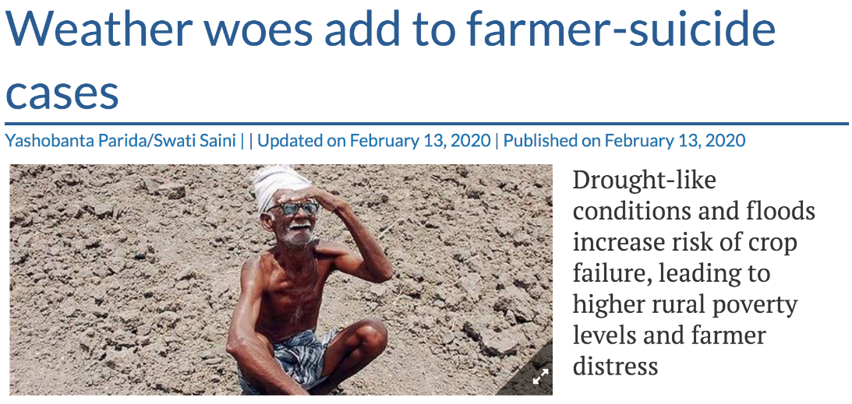
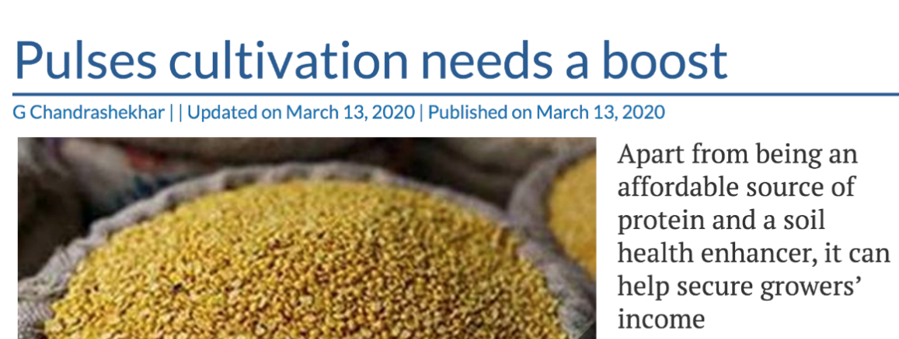
58% of Indians employed in agriculture
47% of farmers are landless in India
50% of farmer households under debt
65% deficit in rice yield compared to America

Slide 4
Our FUND aims to address six major problems in the Agricultural sector
19_84 20_84 21_84 22_84 23_84 24_84
LANDLESS Farmers / small land size
47% of farmers plough the land not owned by them and survive on meager existence
POOR QUALITY OF INPUTS and low yields
Usage of low yield seed variety, poor irrigation methods, unsuitable fertilizers still common
Archaic agricultural techniques
Farmers yet to adopt modern agricultural practices like soil testing, green house farming en masse
LOW margin crops Choice of crops remains traditional with low margins often dictated by local community trends
Indirect access to Consumer market
Multiple middlemen involved in supply chain leading to farmers getting a fraction of what consumers pay
Poor risk management
Risk management remains poor with farmers dependent on natural forces for the success of their crops

Slide 5
8_84
Agenda
PROBLEM STATEMENT Current problem plaguing the sector and scope of opportunities
SOLUTION AND INVESTMENT THESIS How we plan to solve the problem and create financial value at the same time
IMPLEMENTATION ASPECTS Finer executional details contributing to the success of the project
IMPACT Benefits accrued to the society, farmers and the investors
APPENDIX Deep dive into specific aspects for further discussions

Slide 6
Our Solution
Locus Agriculture creates a Special Purpose Vehicle
SPV funded by investors
Pilot phase of $1.5mn
Land procured from landlords
Soil & climate quality testing
Equipment & technology purchase
Landless farmers employed & trained
Higher than market salaries
Creation of separate fund to purchase land for farmers at exit
High yield crops – cash crops and organic farming
Market access & collaborations for direct distribution
Risk management and expenditure on farmer community development
Investors receive a periodic return
Equity gains in accordance with land appreciation
Multiple exit opportunities

Slide 7
REVENUES from the business are used for Six primary purposes
Private investors
Total Fund Raised: Pilot: $1.6 Million 5 Follow-on Tranches: $10 million each
Equity Return at exit
(~6% for 10y, ~10% for 20y)
Special Purpose Vehicle (SPV)
Land Purchased from Landlords
Equipment and Capacity Building
Reinvestment back into the Land Pool
Higher Revenues using Advanced Agricultural Techniques
Business Surplus
Farm Expenses
Farmer income
Management Fees
Community Development Fund
Investor Returns
Farmer income
Farmer income
Farmer income
Invested in development of amenities in the area
COGS, distribution expenses etc.
Retained by the SPV for providing management
Invested in development of amenities in the area
Periodic return to the investors on the funded amount
Salary
Salary
Salary
Salary
Land Purchase Fund²
Land Purchase Fund²
Land Purchase Fund²
Land Purchase Fund²
10% of revenue
3.5% of LVUM⁴
0.4% of LVUM
Capped at 9% pa of IA⁵
¹Increased annually as per inflation
²Assumption: Land prices will change as per inflation
^{3A}nnual investment as per the land price
⁴Land Value Under Management
⁵Invested Amount
$9000 annual¹
0.04 acre³

Slide 8
with a market of $22bn in India, the fund aims for a 0.25% share across five tranches
Fund details
Target geography | India & other developing countries
Asset class | Preferred equity (periodic return + equity)
Share class | 50% Class A and 50% Class B
Addressable market size | 21.65 bn
Pilot fund size | $1.55 mn (100 acres land)
Fund size in each round | $10 mn (600 acres land)
# of funding rounds | 5 rounds across 10 years
Total fund size | $50 mn
Average land acquisition price² | $14,000 per acre in Year 0³
Investment time horizon | Minimum 10 years
Land to each farmer at year end | 0.04 acres
Assumed inflation | 5% (5y average of India’s CPI)
215mn acres
$22
billion
Gross irrigated land in India
Addressable market size¹
$50
million
Proposed investment in five tranches
¹Assuming 65% land with landlords and 1% of that as addressable market
²Based on primary interactions with experts in the field and secondary research
³Increased along with inflation in subsequent years

Slide 9
innovativeness lies in INVESTOR security, long-term FARMER benefits & SCALABILITY
Creates investor confidence and ensures returns even in unforeseen circumstances
LAND BACKED SECURITY
ECONOMIES OF SCALE
The aggregator nature of platform enables economies of scale through better agricultural techniques
SUSTAINABLE IMPACT FOR FARMERS
Providing land and training ensures that the Farmers can continue production of high-income crops
SCALABILITY ACROSS GEOGRAPHY
Can be successfully replicated in countries with high dependence on agricultural activities

Slide 10
8_84
Agenda
PROBLEM STATEMENT Current problem plaguing the sector and scope of opportunities
SOLUTION AND INVESTMENT THESIS How we plan to solve the problem and create financial value at the same time
IMPLEMENTATION ASPECTS Finer executional details contributing to the success of the project
IMPACT Benefits accrued to the society, farmers and the investors
APPENDIX Deep dive into specific aspects for further discussions

Slide 11
Implementation Details of pilot in Bihar, India
Details of the chosen market
Planned interventions
Fact Table
Market Chosen | Bihar, India
Area Cultivated | 7.946 million hectare
Landless Labor | 71%
Current Crops Mix | Rice, Wheat, Maize, Vegetables Bihar is 4th largest producer of vegetables
Problems in the Agricultural sector | Low mechanization: 92.6% of land holdings small and fragmented; prevent economically viable mechanization Low Yield: 28/37 districts in Bihar yield <1500 kg/ha (Chinese average 7000 kg/ha) Information Asymmetry about High Return Crops: Basic crops like rice/ wheat contribute 70% cropped area; Farmers unaware about high margin crops Poor Market Access: Small farmers have limited scope of tying up with supply chain partners to command a premium
Improvement of Yield
Yield improvement through targeted interventions such as drip irrigation, rain water harvesting, better seeds
Mechanization and New Agricultural Practices
Agricultural machinery, Green House farming can replace human labor and introduce economies of scale
Diversified Crop Mix
Diversification to cash crops and organic produce will help farmers move towards higher return activities
Partnering across Supply Chain
Partnering with 3rd Parties across the supply-chain will induce efficiency and help command better price

Slide 12
We have identified several potential partners to help optimize operations
WHY PARTNER WITH US?
POTENTIAL PARTNERS
Large scale of operations with diversified risk
Technology Partner
Knowledge Partner
Stable, long- term customer base
Single vendor for high quality produce
Supply Partner
Market Partner
Variety of high quality crops, fruits and vegetables
Easier fleet management with a single pickup point

Slide 13
WE have also developed strategies to mitigate major risks
RISK SCENARIO
MITIGATION STRATEGY
Equipment or Technology failure
Equipment will be purchased only from suppliers with track record of similar scale operations. Warranties and insurance costs have been included in the operating expenses.
Farming
Crop Failure due to Natural Calamity
Government crop insurance allows us to maintain the farmer salaries in the event of a crop failure.
Farmer union protests
The community development contribution and better incentives are intended to keep such unrests at bay.
Early exit by investors
The management will be responsible for finding another suitable investor as replacement. inability would result in selling a part of the land to allow exit.
Market
Variability in price of produce
Delivery contracts(futures) with big retailers like Reliance Fresh or BigBasket can fix a future selling price.
Tie-ups with cold storage units like Ecozen would allow us to store the produce in case the market partner is unable to provide immediate logistical support.
Low market demand of the produce

Slide 14
Timeline and execution roadmap
Pilot Project (100 acres)
Round I Funding
Round II Funding
Round III Funding
Round IV Funding
Round V Funding
Y1
Y2
Y3
Y4
Y5
Y6
Y7
Y8
Y9
Y10
Y20
Fund Formation & Farming Operations
Team & SPV creation
Identification & funding of land
Farmer recruitment and training; transition to advanced agricultural techniques for production of commercial crops
Generation of Returns and Exit Opportunities
Investment in index-linked bonds to purchase land for farmers and purchase of additional land with surplus
Upto 9% dividend received by pilot round investors over the investment period
Option for farmers to exit with the respective land accrued
Investor exit option every 5 years
Parties Engaged
Partners:
Suppliers
Distributors
Agri-tech companies
Institutional buyers
Investors:
Family Offices
Institutional investors
University endowments
VCs, HNIs

Slide 15
8_84
Agenda
PROBLEM STATEMENT Current problem plaguing the sector and scope of opportunities
SOLUTION AND INVESTMENT THESIS How we plan to solve the problem and create financial value at the same time
IMPLEMENTATION ASPECTS Finer executional details contributing to the success of the project
IMPACT Benefits accrued to the society, farmers and the investors
APPENDIX Deep dive into specific aspects for further discussions

Slide 16
27_84 28_84 31_84
Locus offers competitive returns as well as tangible impact to investors
Investor Value Proposition
~18%
Stable returns (capped at 9%) starting from Year 2
Annualized investor return at a 20-year exit (base case)
Real asset backed investment leading to reduced risk
Higher returns due to combination of continuous revenues and land price appreciation
30%
Promotion of positive public image by addressing several UN Sustainable Development Goals (SDGs)
Tangible and quantifiable social/financial impact metrics (e.g. # of farmers impacted, increase in farmer income)
Increase in land area under management in 10 years
Self feeding business model that uses surplus to buy land and expand, generating higher subsequent returns
Notes:
Highlight impact metrics

Slide 17
Farmers will receive high income and land ownership along with other benefits
Income stability
Assured employment throughout the year and the steady flow of monthly income for the household
Training and Sustainability
Partners will be trained to produce high yield crops, which will help derive benefits from land ownership
100%
Increase in effective farmer income through combination of higher monthly salary and land ownership
>3000
Land Ownership
Partners turn from being landless to owning sufficient amount of land, to ensure self sustainability
Community Development
Initiatives like housing, sanitation, education and clean water availability for the partners and their families
Farmers impacted over 5 rounds of funding

Slide 18
27_84 28_84 31_84
several of the sustainable development goals Set by the un have also been addressed
Goal #17: Partnerships
Goal #1: No Poverty
Goal #2: Zero hunger
Goal #15: Life on Land
Goal #5: Gender Equality
Goal #12: Responsible Consumption & Production
Goal #10: Reduced Inequalities
Goal #8: Decent Work and Economic Growth
Notes:
Specify L1, L2 etc.

Slide 19
Appendix
Our Mentors
Business Model Explanation
Scope of Opportunity for Agriculture in India
Selection of Farm Land and Farmer
Target investors Proposition
Share Classes in the Fund
Priority of Cashflows in the Fund
Investor Return Benchmarking with the Market
Legal / Political Framework Supporting Our Fund
Government Policies in Alignment with the Fund
Dig Deep on Achievement of Sustainable Development Goals
Scalability of the Fund
Potential Market Partners: Ninjacart
Potential Methods for Improving Farm Yields
Excel Model Assumptions
Excel Model for the Pilot
Revenue Breakup for the Pilot
Sensitivity of investor Return with Land Purchase Price
Success Case Study of an Indian Farmer

Slide 20
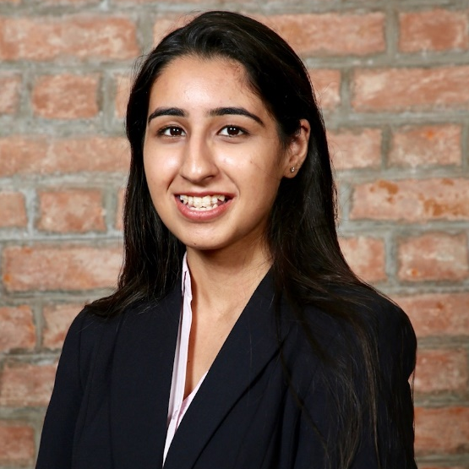
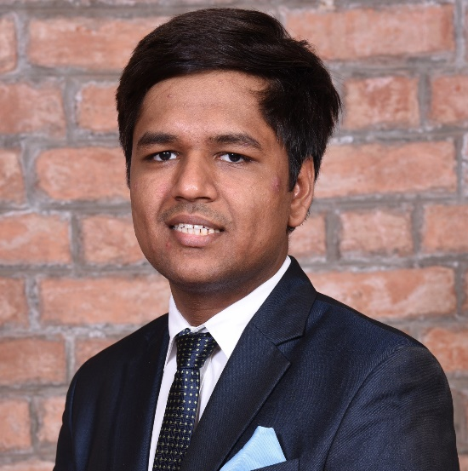
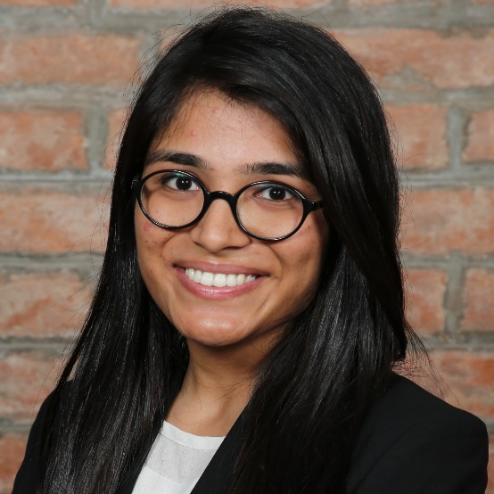
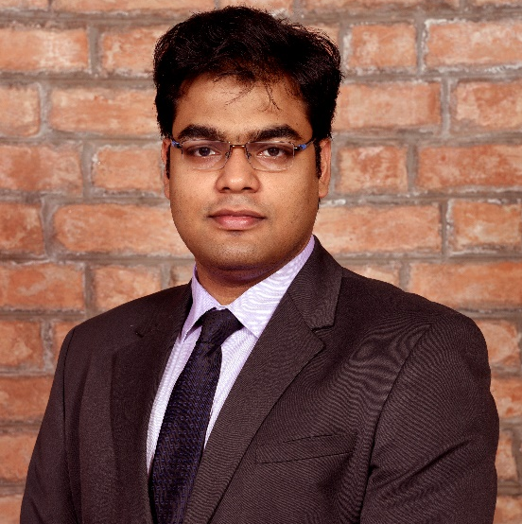
THE LOCUS agriculture team
Bani Singh
Eshwar Agarwal
Khushbu Gupta
Sabyasachi Mishra
MBA, IIM Ahmedabad
BBA, Delhi University
MBA, IIM Ahmedabad
B.Tech., Delhi Technological Uni.
MBA, IIM Ahmedabad
B.Tech., IIT Delhi
CFA Level 2 Qualified
MBA, IIM Ahmedabad
B.Tech., IIT Kharagpur
CFA Level 1 Qualified
Experience in finance along with market research
Experience in consumer banking along with SDGs
Experience in structuring financial instruments & valuation
Experience in data analytics and visualization
Additional expertise required: The Team will also seek external agronomy expertise, and legal advice specifically in reference to laws regarding tax treatment, agricultural law, and community reinvestment act investments.

Slide 21
Sustainable solutions for a sustainable existence
Thank you!

Slide 22
QUESTIONS

Slide 23
8_84
Agenda
PROBLEM STATEMENT Current problem plaguing the sector and scope of opportunities
SOLUTION AND INVESTMENT THESIS How we plan to solve the problem and create financial value at the same time
IMPLEMENTATION ASPECTS Finer executional details contributing to the success of the project
IMPACT Benefits accrued to the society, farmers and the investors
APPENDIX Deep dive into specific aspects for further discussions

Slide 24
Appendix
Our Mentors
Business Model Explanation
Scope of Opportunity for Agriculture in India
Selection of Farm Land and Farmer
Target investors Proposition
Share Classes in the Fund
Priority of Cashflows in the Fund
Investor Return Benchmarking with the Market
Legal / Political Framework Supporting Our Fund
Government Policies in Alignment with the Fund
Dig Deep on Achievement of Sustainable Development Goals
Scalability of the Fund
Potential Market Partners: Ninjacart
Potential Methods for Improving Farm Yields
Excel Model Assumptions
Excel Model for the Pilot
Revenue Breakup for the Pilot
Sensitivity of investor Return with Land Purchase Price
Success Case Study of an Indian Farmer

Slide 25
Advisors and mentors
General Advisors and Mentors
Agricultural Advisors and Mentors
Ana Raviña - Manager, ISF Advisors
Raghav Chandra – Former Chief Secretary, Tribal Affairs Ministry, Government of India
Aatish Pandit - Associate, McKinsey & Company
Ravi Saund – Founding Director, Emperium Realty Pvt. Ltd.
Amit Jain – Group CEO, EMAAR
Anurag Kashyap – Landlord and MBA in Agriculture & Food Management
Amlan Patnaik - Founder, Nudgetech
Aastha Gulati- Author (Extreme Rainfall Events); Ph.D water resource management, TERI University
Kirti Naithani – Director, ICL Fertilizers Limited
Allhadini Patnaik – Landlady, Bihar
Financial Advisors and Mentors
Legal Advisors and Mentors
Shantanu Gupta - CFO/Director, Global Business Services, IBM
Harshendu Bindal – Managing Director, Head of Digital Strategy and Wealth Management at Franklin Templeton
Sachit Sehgal - Senior Associate, PAG Asia
Akash Patel - Associate, AnaCap Financial Partners
Jainik Shah - Associate, IARC Pvt Ltd.
Gaurav Kejriwal – Advocate, Supreme Court of India
Navodit Mehra – Senior Vice President Legal, Sterlite Power
Arushi Bindal – Lawyer, High Court Ahmedabad and Legal Associate, Vector Legal

Slide 26
Locus Agriculture is the solution to provide land to farmers & develop skills
Setting up the Fund
Locus Agriculture creates a Special Purpose Vehicle (SPV) which is funded by the investors
The funds are used by the SPV to acquire land, equipment and expertise required for production
Farmers are hired and trained by the fund to use techniques for growing high yield crops (cash crops or organic farming)
Ongoing Activities
Production of high yield crops on the acquired land along with on-the-job training for the farmers
Distribution through direct channels to ensure max margins (e.g. collaboration with e-commerce players)
Farmers incentivized by a fixed salary and investment in inflation linked bonds which is used to buy land for farmer at tenure end; Community development fund
SPV receives a management fee;
Investors get a fixed dividend;
Surplus (if any) invested back in the business by acquiring more land and farmers
Exit for Partners and Investors
Farmers need to mandatorily stay for the pre-defined tenure and post that can exit at any time by taking the land allocated to them
Investors can exit at pre-defined tenures with equity gains or can choose to continue the investment
SPV gets a part of the equity gains at investor exit; Need to find in new investors when existing ones exit

Slide 27
However, the scope of opportunity is large
research indicates multiple avenues of growth
However, multiple factors inhibit their implementation
S. No. | Source | Scope | 10 Year Contribution
1 | Crop Productivity | 3.1 | 25.0
2 | Life Stock Value Added | 4.5 | 16.6
3 | Improvement in Resource Use Efficiency | 2.26 | 25.0
4 | Crop Intensity | 1pp | 4.9
5 | Crop Diversification | Area Increase by 3.13% | 7.3
6 | Better Price Realization | 13% | 9.1
7 | Shift to non-farm-occupation | 1.81% | 19.6
 | Total |  | 107.5
POOR ECONOMIES OF SCALE
Small land size (<2 ha avg in 24/29 states) limits scope/ resources for diversification & capacity building
INFORMATION ASYMETERY
Dissemination of information like new agri techniques, govt. schemes, weather & market demands remain poor
INCAPABILITY OF LARGE LAND OWNERS
Zamindars (large land owners) don’t have entrepreneurial capabilities, knowledge, will or resources often sustaining on rental
RISK CONCENTERATION
Currently risk (production, market, personal, financial and intuitional) are borne by farmers, limiting experimentation
Research by Niti Ayog (Government of India) outlining the avenues for doubling farmers’ income

Slide 28
Currently, multiple factors inhibit their implementation
Small land size (<2 ha avg in 24/29 states) limits scope/ resources for diversification & capacity building
Income growth for small farmers (<.4 ha) has been 10-13% over 10 years (against 102% for large farmers)
POOR ECONOMIES OF SCALE
Dissemination of information such as new agricultural techniques, govt. schemes, weather trends & market demands remain poor.
Farmers are not able to command the premium prices paid by end consumers
INFORMATION ASYMETERY
INCAPABILITY OF LARGE LAND OWNERS
Zamindars (large land owners) don’t have entrepreneurial capabilities, knowledge, will or resources
They sustain on rental incomes extracted from landless farmers ploughing their fields
Currently all risk (production, market, personal, financial and intuitional) are borne by farmers, limiting experimentation.
Risk reducing insurance cover ~26% cultivated land with 66% farm households unaware & 21% unsatisfied with terms
RISK CONCENTERATION

Slide 29
Selection of farm lands and farmer
FARM LANDS
Large Land Owners
Productivity Analysis
Acquisition Costs
Legal/Operational Barriers
Identification of farmers cluster groups that control land > 10 acres and willing to negotiate/sell the same
Analysis of soil, weather, connectivity, existing crops etc. to identify financially lucrative land for investment
Cost Benefit analysis to narrow down on farmland that can be acquired within the limitation of the fund returns
Ensuring the land to be acquired has no legal concerns or operational challenges such as third party occupation
FARMER
Landless Labour
Experience in Farming
Willingness to Start & Learn
Ensuring Diversity
Identification of landless labors near the area of land acquisition to minimize switching costs, if any.
Selection of labor who have worked on third party farms for at least 5 years to well know the traditional techniques at least
One on one selection of farmer to ensure their willingness to learn and start immediately given the level of benefits (monetary or otherwise) to be accrued
Ensuring adequate diversity in farmer selection with women forming at least 25% of the total and 50% coming from historically disadvantaged groups

Slide 30
Target Investors
Family Offices and HNIs
>24% family offices in US allocate 17% on average to impact investment with greater flexibility for innovative financial instruments
Impact investing helps families across generations bond on values increasing chances of inter-generational wealth transfer
University Endowment Fund
>25% colleges engage in some form of Socially Responsible Investing with 60% passing some form of ESG criterion
University Social Venture Funds have also been formed on campuses with the aim to invest in impact funds
VCs, PEs & other Fin Institutions
FIs such as Bain Capital, UBS, TPG Growth and multiple VCs are investing in impact funds.
Millennials, more socially responsible that the previous generations, increasingly want the start/work for socially responsible firms
Pension Funds
Increasingly people want their pensions invested in socially conscious investment options, a challenge for traditionally cautious pension funds
They particularly look for scalable funds with good returns

Slide 31
the Fund has two share classes A & B differing in periodic return and risks
The fund will have equal number of Class A and Class B shares
Parameter | Class A | Class B
Annual Periodic Return | Capped at 7% | Capped at 9%
Equity Gains | 40% share in equity gains | 60% share in equity gains
Preference during Shortfall in a Period | Paid after farm expenses, farmer salaries, debt obligations and management fee | Paid after farm expenses, farmer salaries, debt obligations and management fee and Class A returns
Preference during Bankruptcy | Preferred after debt obligations (if any) | Preferred after debt obligations (if any) and Class A obligations

Slide 32
INVESTORS ARE Prioritized IN THE EVENT of A BANKRUPTCY
As the investment is asset backed through land holdings, a bankruptcy would not result in significant loss of capital.
SALARIES, DEBT OBLIGATIONS AND EXPENSES
Annual management fee
investors – Share Class A
investors – Share Class B
FARMER’S Land Development FUND
COMMUNITY DEVELOPMENT FUND

Slide 33
122_84 123_84 126_84 125_84 58_84
TEXT
investors will receive higher than average market returns
10 year Indian govt. bond yield
6.4%
Average FD rate of Indian banks
7%
Locus investor’s annual average return
8%
Average Indian annual Returns on Equity (long-term)
15%
Average (expected) annual return on Indian REITs
14%
Expected annualized ROE for Locus investors (over 20 years)
16%
Numbers are based on average investor return for share Class A and B

Slide 34
REGULATORY SUPPORT IN INDIA FOR AGRICULTURE
GOVERNMENT MEASURES TO IMPROVE SALABILITY
Agricultural income is tax free for any individual or firm.
Government offers crop insurance for any individual or firm engaged in farming activities.
Government has set up procurement centers offering fixed purchase prices for various crops.
INCENTIVES PROMOTING AGRICULTURAL & RELATED ACTIVITIES
Government offers a INR 2 M grant for setting up horticulture plants.
Prime Minister Employment Scheme offers a INR 1 M grant to start beekeeping.
National Bee Board offers 35% subsidy for apiary set-up and development activities.

Slide 35
Policies of Government of India and its alignment with the fund’s objectives
Doubling Farmer’s Income
The government of India has targeted to double the farmer’s income by 2022 through initiatives such as improvement of crop productivity, improvement of livestock productivity etc.
The fund also aims to double farmer’s income over 10 years.
The scheme aims to reduce risks in farming by providing financial support in case of crop damage and encourage adoption of modern agricultural practices
Our fund aims to directly achieve above objectives by spreading risk over different entities apart from insuring crops
PMFBY (Crop Insurance Scheme)
eNAM (National Agricultural Market)
Online market place for agricultural commodities to ensure better price discovery and quick payment for the goods
The fund also aims to arrange for the best price for the farm produce by directly selling it to retailers

Slide 36
27_84 28_84 31_84
We also address several of the sustainable development goals Set by the un
Decent work and economic growth: Farmers earn a better livelihood with higher wages, and are further empowered through land ownership
No poverty: Provide higher incomes to farmer as well as provide training and a network that would allow them to earn more than they would on their own
Level 1 Impact
Gender equality: Maintain 25% quota for female farmers to provide them a source of livelihood and promote their financial independence
Zero hunger: Procure inputs and provide training that help improve farmer productivity and yields, thereby contributing to global food supplies
Reduced inequalities: Transfer land ownership from large landlord to small farmers to help them reap the benefits of future profits from the land
Level 2 Impact
Life on land: We train farmers to preserve the soil and promote agricultural practices that do not damage soil quality
Partnerships: Develop and maintain partnerships with players across the supply chain, in addition to institutional collaborations for promotion of best practises
Good health and well-being: Investing in a community fund to build infrastructure for health, as well promoting overall well-being through increased prosperity in the community
Level 3 Impact

Slide 37
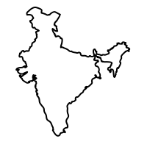
The model can be scaled in both domestic and international markets across products
India has 215mn acres of gross irrigated land, out of which ~65% is with landlords
Locus Agriculture is currently planning to expand only to 2500 acres, leaving a vast untapped market
DOMESTIC EXPANSION
Other countries like Liberia and Somalia are highly dependent on agriculture
The model can be replicated across geographies with changes as per the country
INTERNATIONAL SCALABILITY
A large variety of cash crops like broccoli and organic farming across products
Once successful, other avenues like fisheries can also be explored on the land not suitable for farming
VARIETY EXPANSION

Slide 38
Aggregation of FARMLAND and mechanization can improve the yield TWICE
HOW CAN YIELD BE IMPROVED?
Bihar enjoys around 1,205 mm of rainfall spread across 53 rainy days a year. Rainwater harvesting and drip irrigation together can improve water utilization and ensure availability throughout the year.
Introduction of precision agriculture can allow 3 crop seasons annually through rotation.
Agricultural machinery can replace human labor and introduce economies of scale.
HOW CAN WE ACCESS BETTER MARKETS?
Ninjacart has established supply chains facilitating transfer of fresh produce. A partnership with them can allow us to sell directly in the organized markets.
The partnership will enable profitability analysis of various crops by understanding the demand patterns.

Slide 39
EXCEL MODEL for pilot - ASSUMPTIONS
Investment Assumptions
 | Land cost per acre (in $) | 14,085 | Based on primary & secondary research
 | Land bought (in acre) | 100 | Pilot fund size
 | initial investment required - technology, equipment etc. (in $) | 140,845 | 10% of the land cost assumption
 | Total investment required (in $) | 1,549,296
Return Assumptions
 | Class A investor return | Capped at 7% | Refer to previous slides for benchmark
 | Class B investor return | Capped at 9% | Refer to previous slides for benchmark
Forecast Assumptions
 | Daily Salary for farmer (in $) | 4.58 | Indian farmer’s average salary $4.2/day
 | Selling and Distribution (as a % of revenue) | 2.50%
 | Management Fee (as a value of land under management) | 3.50% | Higher as hands-on management
 | Community Development cost (as a value of land under management) | 0.40%
 | Working Capital Funding Cost | 8.00%
Inflation Assumptions
 | Land rate | 5.00% | Based on India’s 5y average CPI
 | Revenue | 5.00% | Based on India’s 5y average CPI
 | Cost | 5.00% | Based on India’s 5y average CPI
 | Farmer Salary | 5.00% | Based on India’s 5y average CPI

Slide 40
EXCEL MODEL for pilot - Working
Period | 1 | 2 | 3 | 4 | 5 | 6 | 7 | 8 | 9 | 10
Land rate (per acre) | 14,085 | 14,789 | 15,528 | 16,305 | 17,120 | 17,976 | 18,875 | 19,818 | 20,809 | 21,850
Land Available (in acre) | 100.00 | 100.00 | 100.00 | 102.35 | 105.30 | 108.89 | 113.16 | 118.17 | 123.97 | 130.64
Revenue¹ | 0 | 402,349 | 443,590 | 476,724 | 514,978 | 559,143 | 610,131 | 668,999 | 736,961 | 815,426
Cost¹ | 0 | 31,613 | 34,854 | 37,457 | 40,463 | 43,933 | 47,939 | 52,564 | 57,904 | 64,069
Farmer Salary | 0 | 96,127 | 100,933 | 108,472 | 117,177 | 127,226 | 138,827 | 152,222 | 167,686 | 185,539
Farmer investment Fund | 0 | 18,181 | 62,113 | 66,752 | 72,109 | 78,293 | 85,432 | 93,675 | 103,191 | 114,178
Investment Return | 0 | 123,944 | 123,944 | 123,944 | 123,944 | 123,944 | 123,944 | 123,944 | 123,944 | 123,944
Selling and Distribution | 9,580 | 10,059 | 11,090 | 11,918 | 12,874 | 13,979 | 15,253 | 16,725 | 18,424 | 20,386
Management Fee | 49,296 | 51,761 | 54,349 | 58,408 | 63,095 | 68,506 | 74,753 | 81,966 | 90,292 | 99,906
Community Development Cost | 0 | 0 | 6,211 | 6,675 | 7,211 | 7,829 | 8,543 | 9,367 | 10,319 | 11,418
Working Capital Loan interest | 766 | 11,024 | 11,750 | 12,628 | 13,641 | 14,811 | 16,162 | 17,721 | 19,521 | 21,600
Surplus | -59,642 | 0 | 38,347 | 50,470 | 64,465 | 80,623 | 99,278 | 120,815 | 145,680 | 174,387
Total investor Return | - | 3% | 7% | 9% | 11% | 12% | 12% | 13% | 14% | 14%
All numbers are in USD
Numbers are based on average investor return for share Class A and B

Slide 41
Yearly Break-up of Revenue received by the FUND for pilot phase

Slide 42
10 year Investor return increases by 3PP if land acquisition price reduces by ~15%
A decrease in Land Acquisition Price positively affects the investor returns. However, an increase in the Land Acquisition Price impacts the investor returns by a lesser magnitude.

Slide 43
Ramesh Verma: Success story of an Indian farmer
Initial Situation
Search for better returns
Transition to exotic crops
Current
Returns
Small farmer in Lucknow, with marginal landholding (0.5 ha)
Earlier cultivated only crops like rice and wheat with his father
Returns barely enough to meet family expenses
Visited the Indian Council of Agricultural Research in Lucknow
Received broccoli seeds from the KVK (a farm science centre)
Attended their training programme about commercial crops
Instead of low margin crops, shifted cultivation to exotic vegetables
Currently grows multiple vegetables such as parsley, red cabbage, broccoli, cherry tomato etc.
Enjoys a net margin ~$4,500 per annum over an area of 0.5 ha (typical farmer household income is approx. $1000)
Commendable cost to benefit ratio (1:11.75) for small land holding farmer

Slide 44
REFERENCES
(2020). Retrieved 5 April 2020, from https://niti.gov.in/writereaddata/files/document_publication/DOUBLING%20FARMERS%20INCOME.pdf
Despite Droughts, This Maharashtra Farmer Is Earning Lakhs From 1 Acre!. (2020). Retrieved 5 April 2020, from https://www.thebetterindia.com/120207/bhairwadi-vishwanath-bobade-1-acre-farming-beed-maharashtra/
(2020). Here's a happy farm story from a small Jammu village - Lavender farmers of Jammu. Retrieved 5 April 2020, from https://economictimes.indiatimes.com/news/economy/agriculture/heres-a-happy-farm-story-from-a-small-jammu-village/high-demand/slideshow/65805772.cms
India, T. (2020). Harish Dhandev quit his govt job and cultivated aloe vera to become a crorepati. Retrieved 5 April 2020, from https://yourstory.com/2016/07/harish-dhandev
Free ricefield Stock Photo - FreeImages.com. (2020). Retrieved 5 April 2020, from https://www.freeimages.com/photo/ricefield-1375627
Half of rural India still doesn't own agricultural land: SECC 2011. (2020). Retrieved 5 April 2020, from https://economictimes.indiatimes.com/news/economy/agriculture/half-of-rural-india-still-doesnt-own-agricultural-land-secc-2011/articleshow/48062767.cms?from=mdr
India - leading vegetable producing state 2018 | Statista. (2020). Retrieved 5 April 2020, from https://www.statista.com/statistics/1036898/india-leading-vegetable-producing-state/
PA-Table-04-Bihar. (2020). Retrieved 5 April 2020, from http://drdpat.bih.nic.in/PA-Table-04-Bihar.htm
Padmanabhan, V. (2020). The land challenge underlying India’s farm crisis. Retrieved 5 April 2020, from https://www.livemint.com/Politics/SOG43o5ypqO13j0QflaawM/The-land-challenge-underlying-Indias-farm-crisis.html
Alexander, S. (2020). Crop insurance schemes need better planning. Retrieved 5 April 2020, from https://www.livemint.com/industry/agriculture/why-crop-insurance-needs-to-be-better-designed-1562741755465.html
YOUR MONEY: Family offices lead the way on impact investing. (2020). Retrieved 5 April 2020, from https://in.reuters.com/article/us-money-investing-esg/your-money-family-offices-lead-the-way-on-impact-investing-idINKBN20417Q
(2020). Retrieved 5 April 2020, from http://www3.weforum.org/docs/WEFUSA_FamilyOfficePrimer_Report.pdf
Christopher K. Merker, C. (2020). Six Trends in College and University Endowments. Retrieved 5 April 2020, from https://blogs.cfainstitute.org/investor/2019/04/03/six-trends-in-college-and-university-endowments/
Rist, K. (2020). Why Venture Capital Is The Original Impact Investing. Retrieved 5 April 2020, from https://www.forbes.com/sites/kjartanrist/2018/11/30/why-venture-capital-is-the-original-impact-investing/#1c6ae11353f3
REITs may help generate 14% return annually to investors : Anarock. (2020). Retrieved 5 April 2020, from https://economictimes.Indiatimes.com/industry/services/property-/-cstruction/reits-may-help-generate-14-return-annually-to-investors-anarock/articleshow/67526986.cms?from=mdr
Investment tip: Realistic expectations help in setting financial goals. (2020). Retrieved 5 April 2020, from https://www.businesstoday.in/moneytoday/investment/investment-tip-on-setting-financial-goals/story/190972.html
Fixed Deposit Interest Rates: Best FD Rates of Top Banks in India 2020. (2020). Retrieved 5 April 2020, from https://www.bankbazaar.com/fixed-deposit-rate.html
Sonavane, R. (2020). India bond yields fall 10 bps as government sticks to borrowing numbers. Retrieved 5 April 2020, from https://www.livemint.com/market/stock-market-news/India-bond-yields-fall-10-bps-as-government-sticks-to-borrowing-numbers-11580701444121.html
Bihar. (2020). Retrieved 5 April 2020, from http://farmech.dac.gov.in/FarmerGuide/BI/index1.html

