Slide 1
M2M Partners
Team A5

Slide 2
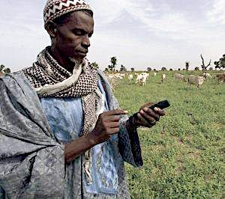
Our mission
Provide financial and social returns to our investors by supporting businesses that leverage mobile technology to extend basic services to Bottom of the Pyramid customers in emerging markets.

Slide 3
The market
Mobile platform-based applications present a compelling investment opportunity
Unique Mobile Owners by Segment
Consumer Spending as a % of Total
Sources: CGAP, Wireless Intelligence
Source: JP Morgan Chase

Slide 4
Unique business opportunities
Low cost handsets
Business
Case
Social
Impact
Ubiquitous access
Improved health conditions
More affordable education services
Increased agricultural yields
Increased access to financial services
High client volume
Scalability
Small but growing disposable income

Slide 5
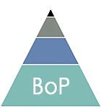
Our fund addresses this untapped market
Industry focus
Geographic Focus
Firm Focus
Early stage mobile-based technology companies in 4 key areas: Education, Health, Agriculture, and Finance
Serves BoP customers via a clear business model with proof of concept and scalable model.
Plans to reach financial sustainability within 4 years.
BRIC and “Next 11”
Initial focus on 2-3 countries

Slide 6
Ability to transform markets
Healthcare
Agriculture
Education
Financial Services

Slide 7
Investment process
Sourcing
Work with field-based partners (e.g., TechnoServe)
Leverage regional angel investor networks
Conduct desk analysis based on initial discussions with entrepreneur and thorough analysis following in-country visit
Elements of diligence checklist include financial projections, social impact, management experience, and competitive & regulatory environment
Provide capacity building support to investees
Track financial and social metrics
Use traditional exit strategies (IPOs, acquisitions) if possible
Consider other innovative exit strategies such as royalty-based returns if liquidation is not an option
Due diligence
Value-add support
Exit

Slide 8
Criteria for evaluation
Factors used to distinguish among potential investments
Management Team
Product and Business
Market Size
Exit Potential
Is the management team personally dedicated to this venture?
Can they execute? Is the team complete with the relevant tech and business skills?
Does the product serve a clear need?
Is there a viable business model (do revenues exceed costs)?
How large and growing is the potential market?
What proportion of this market can the company capture?
How many years until we can reasonably make an exit?
Does a reasonable exit meet our target IRR in multiple scenarios?
All investments must also meet minimum threshold for achieving social impact

Slide 9
Their challenges
Our solutions
Convertible debt
International contacts and shared experience .
Growth equity
Industry expertise
Fund size: $50 M
Local partnerships with mobile operators .
Capital
Advisory services
Capacity building
Business / Government relations
Experienced M2M team
Network of mobile . entrepreneurs
Host country partners
Guidance on corporate . structure

Slide 10
Investment terms
Instruments | Convertible debt, equity, warrants
Size of investment | Seed capital: $50,000 - $100,000 Growth capital: $300,000-$2,500,000
Financial Returns | Minimum 2x invested capital
Social Returns | Agreed upon social metrics
Liquidation preference | 1x liquidation preference
Investor Rights | Participating preferred or simple preferred, broad-based anti-dilution provision, right of first offer and refusal
Exit timeframe | 5-7 years

Slide 11
Social returns
Measured during due diligence and throughout lifetime of investment
Country-level social indicators
Company’s stated focus on wealth creation and increase in access to basic services
Penetration and retention rates
Key measurement tools (applied in conjunction with in-country partners)
Social Return on Investment (SROI)
Customer- targeting tools such as Progress out of Poverty Index (PPI)
Health improvement & educational attainment indicators
Corporate Social Responsibility adherence

Slide 12
Risk mitigation strategy
Risks | Mitigating Factors
Political Risks | Geographic Diversification, deep in-country knowledge, local partners
Financial & Currency Risks | Syndicated investments, currency swaps
Execution Risks | Tranched investments based on financial & social milestones, board seat
Product Risks | Minimal viable product requirement
Market Risks | On-site due diligence and local partnerships
Exit Risks | Investor rights , scenario planning, established multiples

Slide 13
Illustrative investment example
Company Overview
Kopo Kopo allows SMEs in emerging markets to leverage mobile money as a payment channel by providing a low-cost software-as-a-service solution
Investment highlights
> Simple value proposition
> Clear social impact (also opportunities in health, education, agriculture)
> Scalable revenue model (software licensing and ongoing fees)
Investment Terms
Lead investor in $1.1M Series A Round
35.4% ownership on a fully diluted basis based on pre-money valuation of $2 million
Downside protection terms such as broad-based anti-dilution clause, 1x liquidation preferences, right of first offer, right of first refusal, etc.
Tranched investments based on milestones such as sales targets and key management hires
Expected Returns
Financial: $4.5M in sales in 5 years, exit (private placement) at 2X earnings for a 30% IRR
Social: Increased access for 500,000+ microfinance clients; saving ~2 million client hours per year, reducing transaction time and allowing entrepreneurs to keep their business open longer

Slide 14
Why invest with us?
M2M is appropriate for investors seeking financial and social returns.
Other advantages include:
Emphasis on equity ownership
Faster potential exit timeframe vs. other social investments
Exploitation of significant market inefficiencies
Counter-cyclicality
Diversification of your portfolio

Slide 15
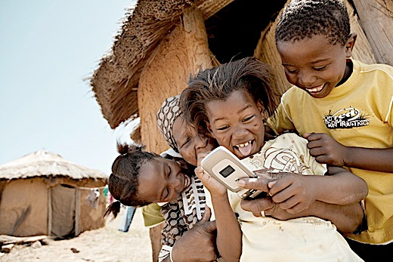
Thank you!
Q&A

Slide 16
Appendix A
M2M Partners – Our Team
We look for growth stage companies that deliver a double bottom line
Active fund working closely with entrepreneurs to add direct value to the business model. To that end we offer extensive support: financial, legal, policy, and technical; and the benefit of a vast network of partners within our domain
Deep knowledge of emerging markets, social investment, mobile technology, and financial services
Stacey Tsai
Investment banking (Bear Sterns)
Former diplomat, U.S. State Dept.
Experience in venture investments and clean tech (Better Place)
Deep knowledge of East and Southeast Asia business landscape
Lauren Miller
Microfinance rating analyst
International banking (JPMorgan)
Social impact methodology expertise
Experience in LAC, Africa, N. America
Daniel Kahn
Focus on innovative financial services: Kiva, World Bank, Innovations for Poverty Action
Mobile advertising (Google)
Latin America and Africa experience
Amee Patel
Principal Manager Strategy & New Initiatives, SKS Microfinance India
Multi-sector consulting experience (McKinsey & Company)
International food and agriculture policy experience

Slide 17
Appendix B
Potential targets (pipeline)
Mobile healthcare company based in Bangladesh
Partnership with GrameenPhone
Over 7 million consults served via “Healthline” call-a-doctor service, lowering the cost for effective treatment and monitoring
Mobile health company with modules in screening, primary care, tele-medicine, patient management, billing, etc.
Seeking funding to expand on active projects in Philippines, India, Bangladesh, Egypt, etc.
Independent mobile money service solution, focused on payroll administration for agricultural firms and multi-laterals
Processed $15.5 million in transaction volume in 2010
Leading online learning platform available over all mobile phones
Proven impact: cell phone games improved literacy of students in rural India
Flexible business model (free, freemium, ad-supported)
Provides payment, shared phone, and virtual phone services
Targets bottom billion for health and agriculture solutions
Protected IP and multiple existing revenue streams (pay for service, consulting, etc.)
Frogtek is a leader in mobile small business solutions targeting independent shop owners
Currently piloting in Mexico and Colombia, with products for both shop owners and large CPGs
Point-of-sale applications allows micro-retailers to better manage inventory and increase profits

