Slide 1
The Skills Ladder Empowering the worker and uplifting society
INTERNATIONAL IMPACT TEAM B5
INVESTING CHALLENGE 8th April 2011

Slide 2
CONTENTS
Emerging World’s Demographic Dividend - The Problem
The Opportunity
Test Case
Investment Strategy
Fund Structure
Approach and Sources of Returns
Training and Development Company
Large potential Investor Base
Societal Impact- Two fold
The Investment Value Proposition

Slide 3
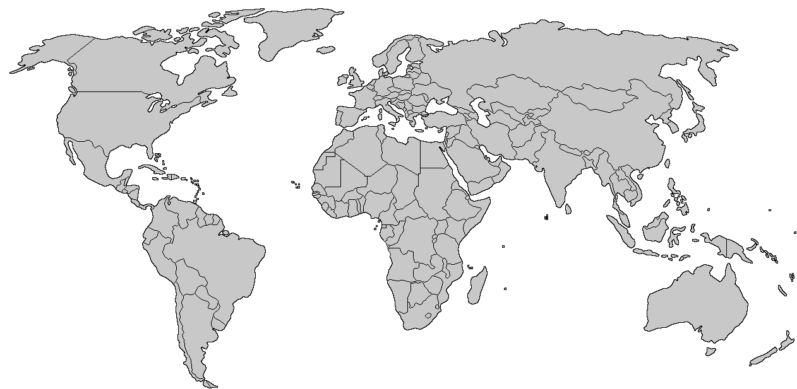
Young Population: Demographic Dividend or Societal Nightmare
Turkey: 41%
Bangladesh: 50%
Egypt: 58%
Iran: 46%
Morocco: 49%
China: 31%
Pakistan: 58%
Thailand: 35%
Mexico: 45%
Brazil: 39%
India: 50%
Chile: 40%
Indonesia: 47%
Peru: 49%
Argentina: 42%
South Africa: 51%
Population under the age of 25
Source: Human Development, Equity and Environment Report, Govt. of India

Slide 4
Anatomy of the Problem
Key Issues :
Demographic Dividend hard to manage
Lack of access to training keeps large population unemployable
Underemployment and unemployment hampers economic and social development
Why Does the problem persist?
Socio-Political environment keeps SME’s from moving up the value chain
Businesses not willing to risk capital
Limited upfront funding and know-how on improving labor productivity
Lack of innovative financing
structures

Slide 5
The
Strategy for Immediate Maximum Impact
Low Hanging Fruit
Improving labor productivity
Slow
Difficult
Socio- Political change
Capital building
Possible Solutions
Improvement human capital will seed a step change in the level of societal development

Slide 6
Test Case – “The Indian Plumber who could(n’t) Click”
Who?
Current job description:
Manages installation of plumbing systems
Shortfall in skills:
Unable to make on spot design alterations
Consequences for employer:
Needs to hire a contract software operator for the site - expensive
Leads to over-staffing and slower pace of work
Benefits of training the supervisor?
Reduction in costs due to streamlined workflow and lesser delays
Increased opportunities for growth within the organization
Manages 2-3 handymen
Unable to use CRM software leading to re-work costs and delays
Plumbing supervisor at a construction firm who lacks basic computer literacy
How does our organization add value to his life?

Slide 7
Financial Innovation: Hybrid Capital Structured to Mitigate Risk

Slide 8
Investment Strategy: Empowering High Impact SMEs
Step 1
Step 2
Step 3
Step 4
Identify Target Companies
Fund incubates TDC
Special Purpose Vehicles (SPVs) are created
SPV engages TDC to create training programs
Fund owns a majority stake
Company issues warrants/ structured instruments to the SPV
SPV incurs cost of training the employees
Employees sign a 3 year retention contract
Capital returned after 5 years with 10% accrued interest
Share in increased productivity and enhanced workmen compensation
Construction services
Manufacturing firms and
Small scale production houses.
Training needs across company are matched to achieve scale
A larger workforce created with diversified skill set
TDC monitors
training programs

Slide 9
Training and Developmental Agency
TDC will be the main agency for researching and matching needs, developing programs and monitoring training across all investee companies
Benefits of Central Agency
Returns
Lower Costs: Achieve scale in managing programs
Develop broad expertise: Across department and company expertise in skill enhancement
Accessibility: Focus on making modules more accessible – e.g. web based training
Create wider talent pool: Can be tapped across organizations.
Attrition management: Smoother attrition management & better skill to job match
Current yield: Steady source of advisory income for the fund
Continual Business: with investee companies will continue even post exit by the fund since training is an on-going activity
Gains on Sell-off or IPO: at the end of fund life would generate tremendous upside for the investors

Slide 10
Sources of Financial
Return
Higher Valuation for
Company
Increased productivity leads to higher value creation in the company, a part of which is captured by the SPV using the previously issued warrants / structured instruments
Training the employees
Increase in producivity
The SPV is entitled to 15% of the incremental salary of the trainee. This contract is valid for a period of 10 years and applies even after the employee leaves the company and joins some other organization
Higher Salary for Employee
The company and employee pay back the SPV for the incurred training costs over a deferred period of time in 85:15 ratio (company: employee) at 10% cost of capital
Capital
Preservation
Return from TDC
Acquires external clients in addition to portfolio co’s
TDC will be exited at the time of the fund closing through sale or IPO
Grow TDC-Spin off/IPO/Sale

Slide 11
The Test Case – Actual Value-add to the plumber, the company and the SPV
Low Hanging Fruit
Construction firm is able to scale
Increased Productivity optimizes capital allocation fueling growth
Construction firm is able to scale and create more jobs
Trained worker can move up to be a mangerand possiblly lead to enterprenurship
Trained plumber can create his own firm and more jobs for the region

Slide 12
Multi-tiered Social Impact
COMMUNITY LEVEL IMPACT
DIRECT IMPACT
Increased spending on education,
healthcare
Increased spending on community
development by companies
Better environmental
protection measures
Jobs growth in newly seeded
companies
Decline in emigration
to overpopulated urban
areas
Increase in salary of employee
Increase in level of employment
Increase in number of
industrial units
Decrease in labor cost
Setting Quantifiable Measures at Company level and Community level

Slide 13
Investment Value Proposition
Feasibility
Less Upfront Capital
Bottom Up Approach
Asset is the worker
Innovative
Structure
Attractive for
LP’s
Multiple Sources of financial return
Worker moves up value chain , impact is trickled down to all levels on society
Unique financing structure
Upside for all stakeholders
Scalability
Calculated risk reward
Potential to attract large investor base

Slide 14
Large Potential Investor Base
Social/Development Goals
Country/Sector Agnostic
Healthy IRR
Country Specific Interest
Dependant on labor efficiency
Healthy IRR
TYPICAL IMPACT INVESORS
MNC’s SEEKING LABOR POOL
PE /BANKS WITH EM
PORTFOLIO
SOVEREIGN FUNDS
GOVT. OF THE EM

