Slide 1
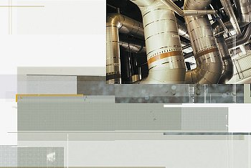
Team A6 Presents _
i3 Fund Family_
i3 Water Fund_
Notes:
Good afternoon everyone. We are very excited to be present to you an exciting investment vehicle—i3 Fund Family that aims to generate alpha over DJ World Index, and make meaningful impact on some of our biggest shared challenges.
Today, we not only want to share our current investment ideas, but also two other things that we believe are even more important – one, structure of this investment vehicle, and two, our investment process.
So, here’s how we will proceed – first, we will quickly discuss the structure and define our focus for today; second, we will discuss our investment process for one of our funds—the water fund; and finally, we will look at some of the current investment recommendations under this fund and details on portfolio construction.

Slide 2
What is Impact Investing?
i3 Water Fund
Fixed Income Securities
Public Equities
Other “Early-Stage” Investments
Private Equity
Venture Capital
Positive financial returns
and __ _
Measurable social impact
Limited impact of public securities
Lowers cost of capital
Early-stage investments offer
turbocharged impact
i3 Funds maximize total impact
Intro » Why Water? » Public Securities » Venture Capital » Q&A
Notes:
I don’t think the statement “Making a direct positive marginal impact with every dollar that is invested” is fully accurate, as often we will be investing in public equities before investing in private investments.
I am rephrasing it to say something like “To maximize impact and return through the life of the fund”.

Slide 3
Unique Fund and Research Structure
i3 Water Fund
i3 Fund Family
i3 Water Fund
Public Equities
Venture Capital
i3 Energy Fund
White Label Vehicle
i3 Healthcare Fund
Impact-area research is shared across asset classes to find investments
Positive returns over
S&P Global Indices
Intro » Why Water? » Public Securities » Venture Capital » Q&A

Slide 4
Waterfall Deployment of Capital
i3 Water Fund
Assets will be transferred to VC fund as capital calls are made
Portfolio Management team works with investors to allocate between public and VC funds according to risk profile
Water
Two year capital raising window for each VC fund
100 bps. + 20% performance fee structure
Public
Equity
Water VC Fund I
Key Benefits:
Shared intellectual capital
Highly scalable business model
Immediate investment into impact areas
Venture
Capital
Water VC Fund II
Water VC Fund III
White label vehicle
Intro » Why Water? » Public Securities » Venture Capital » Q&A
Notes:
Shared intellectual capital resources across asset classes – reduce cost, wider knowledge base
Highly scalable business model (both vertically (asset classes) and horizontally (impact areas)
Immediate investment into impact areas (don’t have to wait for deal flow)

Slide 5
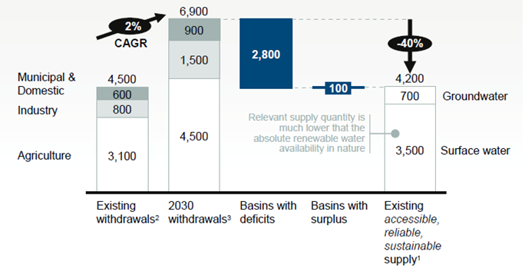
Startling Gap Emerging in 20 Years
i3 Water Fund
Significant spending commitments by governments:
China: $200 bn
India : $85 bn
Even these are expected to be inadequate
According to WHO and UN, $1 investment in water translates into an economic benefit of $8 on average
The gap is even larger (50%) for developing countries
Intro » Why Water? » Public Securities » Venture Capital » Q&A

Slide 6
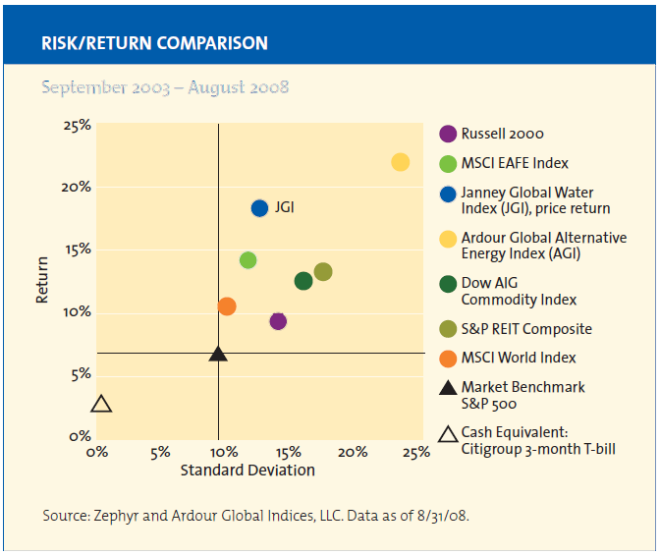
Desirable Investment Profile
i3 Water Fund
The water sector has outperformed the broader markets over the past 5 years on a risk-adjusted basis
Intro » Why Water? » Public Securities » Venture Capital » Q&A

Slide 7
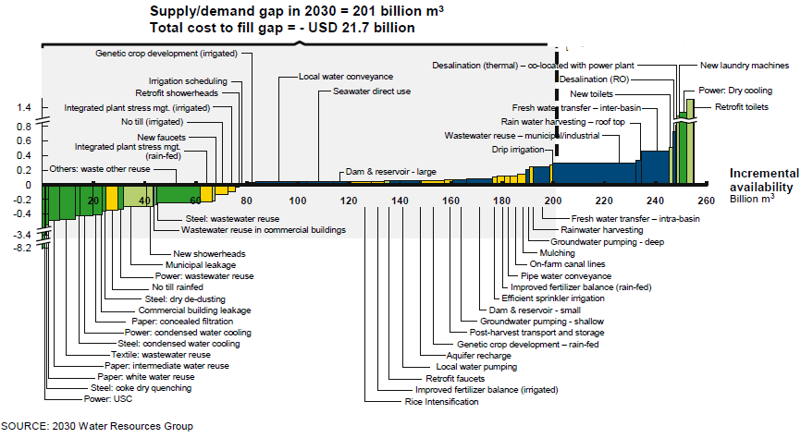
Groundbreaking Firm Selection Process
i3 Water Fund
Local solutions for a global problem
A large diversity of solutions:
Wastewater re-use
Commercial building leakage
Municipal leakage
Desalination
Intro » Why Water? » Public Securities » Venture Capital » Q&A
Notes:
We don’t arbitrarily divide the universe into sanitation, storage, transportation and so forth to decide our allocation.
We also don’t assume that the same solution will work across the globe. Water is a global problem, but has local solutions. We study the cost curves for each geography to understand which technologies will be adopted first, based on how much it costs the consumer / government to implement the solution. We invest beginning with the low-cost areas.

Slide 8
Portfolio Construction
i3 Water Fund
Considerations
Return Generation
Outsize returns directly from the growth in the water industry
Focus on emerging markets
Investability
Ability to diversify into all areas of water
Ability to build sizable positions commensurate with fund size
Impact Measurement
Maximize ability to measure social impact
Risk Management
Advising clients on how to minimize exposure to unwanted areas
Resulting Construction
Build a focused equity portfolio with 10-20 names that will capture returns from the water industry
Direct measurement of returns and focus on desired industries
High liquidity and large investable universe
Direct alignment with company performance and social impact
Diversify across geography, market caps, and maturity
Intro » Why Water? » Public Securities » Venture Capital » Q&A
Notes:
We would advise our clients on how to minimize their exposure to unwanted areas such as currency, interest rates, unwanted industries, etc. through shorting and derivative instruments.
However, we would not implement the risk management ourselves since each institution will have different overall risks within their larger portfolio and it will be less expensive for them to execute the transactions on their own.

Slide 9
Public Equities
i3 Water Fund
Tri-Tech Holding (TRIT)
Combines software and hardware solutions to help government entities manage and monitor China’s natural and municipal water resources
Two primary segments:
Wastewater & Tail Gas Treatment
Water Resource Management
Key Driver: Increased spending by the Chinese
Government on water and pollution abatement
Completed 500 water resource management and
100 wastewater treatment projects since 2003
Three Year CAGR of 111%
BV/Share = $7.14 P/Tangible BV = 1.63x
Strong balance sheet ($23m in cash, no LT debt)
Market Cap. (m) | $100
Current Stock Price | $11.00
52-Week Range | $7.62 - $15.96
EPS (ttm) | $0.98
Adjusted Beta | 2.23
Intro » Why Water? » Public Securities » Venture Capital » Q&A
Notes:
Although our portfolio contains approximately 20 names, we wanted to highlight the most attractive opportunities in this space.
TRIT: Provides integrated water solutions for China. This company has two segments- Wastewater & Tail Gas Treatment and Water Resource Management.
Through its Process Tail Gas Purification segment, the Company designs sewage treatment and odor control systems for municipal supplies. Through its Water Resource Management segment, the Company assists the government in monitoring natural waterways. It provides systems that combine technological solutions with hardware (sensors, supervisory control and data acquisition systems and mechatronics) to track water levels for drought and flood control, monitor groundwater quality and assist the government in planning its water resource use and management.
Market Cap= $100m, Float= 80%
Beta unadjusted = 2.84 (from Thomson One)
Target Stock Price = $17 (46% upside potential)
The Chinese government outlined in their 12th Five Year Plan to increase spending on water and pollution abatement.
Risks: Dependence on government spending, delayed projects, and competition.
Annual revenues of $44m. Pipeline of new projects ~$90m.
The company recently acquired a $40m joint contract (TRIT’s portion is $32m) which is their largest contract to date. This project is in the city of Ordos and positions TRIT well to compete for contracts of this size in the future.
EBIT Margins = 20%, Competitor Median = 15%
Forward P/E = 7.8x
Impact Return: They operate in 22 of 23 provinces in China for water resource management and 11 provinces for wastewater treatment

Slide 10
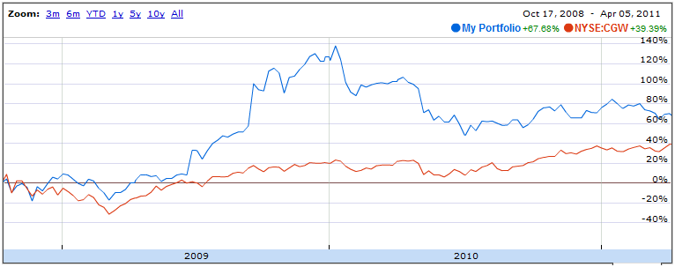
Public Equities Portfolio
i3 Water Fund
Df
Currently comprised of eleven companies
Minimized the overall portfolio volatility based on the covariance of each equity
Two-and-a-half year return of 67.7%, compared to the global water index return of 39.4%
Intro » Why Water? » Public Securities » Venture Capital » Q&A
Notes:
The global water index used was S&P Global Water Index.
I didn’t use JGI simply because Google Finance couldn’t find it.

Slide 11
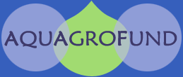
Venture Capital
i3 Water Fund
Significant and Measurable Impact
Early-stage investment in relatively illiquid market
Diversification
Outsized returns through deep due diligence
Early-stage entry in an exploding industry
Co-investment strategy spreads risk
Focus on disruptive technologies/services
Provide capital for the most impactful products
Ability to directly measure impact of investment
Potential Returns
Intro » Why Water? » Public Securities » Venture Capital » Q&A
Notes:
As part of offering a complete impact portfolio, i3 will also offer a Venture Capital fund to its investors. As mentioned earlier, this fund will operate independently from the equity portfolio, but will leverage intellectual capital and resources from the public equities side to take advantage of synergies between the two funds.
The VC/PE fund will focus on investing in emerging opportunities in areas of water that will have a significant positive impact while also providing shareholder returns. We believe there are distinct advantages of this type of strategy:
- The water VC space is still fairly small and has not seen large investments. We feel that by performing deep due diligence and being on an early entrant that has the growth prospects like water can have large potential returns for shareholders
- The fund also provides diversification for investors looking for longer-term, early-stage investments in a relatively illiquid market. Furthermore, it’s unique risk/reward profile allows investors to tailor their investments based on their risk/reward profile
- Finally, there are also significant impact opportunities in the private investment space. Having this type of fund allows us to focus on disruptive technologies/services that will have a significant impact in the water space. With the direct investment, we are also able to directly measure impact – something I will discuss in more detail.
According to the Cleantech Venture Network, venture-capital investments in water technologies plummeted to $77 million in 2006 from $128 million in 2005, in spite of a U.S. Environmental Protection Agency prediction that the United States will need to invest $267.8 billion for 74,400 water systems within the next two decades.

Slide 12
Investment Approach
i3 Water Fund
A highly structured approach in evaluating VC opportunities
Large & Measurable Impact
Desalination
Alignment With Water Cost Curve
Filtration
Expertise Across Asset Classes
Distribution
Disruptive Technologies
Intro » Why Water? » Public Securities » Venture Capital » Q&A

Slide 13
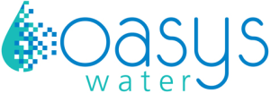
Sample Investment
i3 Water Fund
D
Redefining Desalination
Alignment with i3 Fund’s Objectives
Opportunity
Impact
Reduces energy cost--increases access
Cost Curve
Makes desalination competitive
Expertise
Leverage existing company knowledge
Disruptive
Game-changing
Uses significantly less energy
Investment
Raised $10M from three VC funds
Going to market in early 2012
Impact
Opens new emerging markets for lower cost desalinization
Intro » Why Water? » Public Securities » Venture Capital » Q&A
Notes:
Expected market size of $30B by 2015 – 59% of capex expected to be in more advanced reverse osmosis plants
The competition has intensified during recent years, with billion $ level acquisitions (for example, in
2004: Ionics by General Electric, U.S. Filter by Siemens) and the entrance of new competitors, in
particular from Asian countries.

Slide 14
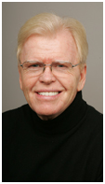
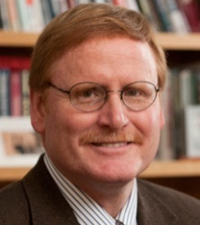
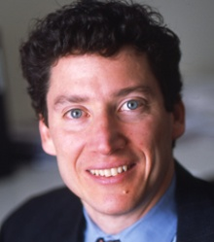
Advisory Board
i3 Water Fund
Kevin McGovern- Chairman of The Water Initiative®LLC, Chairman and CEO of McGovern Capital LLC. Founder/Key Shareholder in over 20 companies
Marc Manara- Water Portfolio Manager, The Acumen Fund. Been at the Acumen fund for over five years
Stu Hart- University Chair in Sustainable Global Enterprise. A top authority on the implication of environment and poverty for business strategy
Zach Shulman- Managing Partner, top-tier university Venture Fund. Prior experience at Spike Broadband Systems—negotiated and closed more than $80 million in venture capital financing
Intro » Why Water? » Public Securities » Venture Capital » Q&A
Notes:
Pro-bono advisors.

Slide 15
Q&A

Slide 16
Public Equities In Our Portfolio
i3 Water Fund
Duoyuan Global Water (DGW)
China-based water treatment equipment supplier
One of the largest distribution networks in China
Currently trading at cash
P/E = 2.1x P/BV = .36x
Suez Environment Company (SEV-FR)
Operates in water purification and distribution as well as waste management
Strong focus on international expansion
Dividend Yield = 4.2% P/BV = 1.6x
Calgon Carbon Corporation (CCC)
84% of revenues come from the Activated Carbon and Service segment which uses carbon to purify air and water by removing organic compounds
Improved gross margins by 73% over the past five years
Intro » Why Water? » Public Securities » Venture Capital » Q&A
Notes:
DGW: This company manufactures and distributes water environment protection equipment and water treatment products in China.
Addresses the key steps including circulating water treatment, water purification, and wastewater treatment.
They are trading at cash due to some internal control issues that the market is speculating are fraudulent.
Market Cap= $218m, Float= 42%
SEV-FR: The Company has formed two divisions: Water division, which is involved in the catchment, treatment and distribution of drinking water, the collection and purification of domestic and industrial water, as well as the biological waste treatment; Waste division, which is involved in the provision waste collection, the selection and preliminary treatment of waste, recycling, as well as material, biological and energy recovery, among others.
SUEZ Environment has operations in Europe, Asia, Oceania, North America, Africa, the Middle-East, and South America. The company is headquartered in Paris, France.
Market Cap= $7.5b, Float= 55%
CCC: Three segments- Activated Carbon and Service, Equipment and Consumer.
Approximately 50% of revenues are from abroad. Based in the U.S. (Pennsylvania)
Market Cap= $760m, Float= 98%

Slide 17
Public Equities In Our Portfolio
i3 Water Fund
Nalco Holding Company (NLC)- U.S., Treatment of boiler water, cooling water, influent, and wastewater.
Veolia Environment (VIE.PA)- France, Management and operation of drinking water plants, wastewater decontamination, and recycling.
Stantec Inc. (STN.TO)- Canada, Consulting services for infrastructure and facilities.
Valmont Industries (VMI)- U.S., Produces mechanized irrigation systems.
Tetra Tech (TTEK)- U.S., Consulting and infrastructure systems for water resources, groundwater systems, and watershed management.
Hyflux, Ltd. (600.SI)- Singapore, Seawater desalination, raw water purification, wastewater cleaning, and water reclamation.
Insituform Technologies (INSU)- U.S., Rehabilitates sewer, water, energy and mining piping systems.
Intro » Why Water? » Public Securities » Venture Capital » Q&A

