Slide 1
1.2 MILLION people living with HIV in the US
50 THOUSAND new infections in the US per year
WASHINGTON D.C. has the highest prevalence of HIV in the US
Notes:
What do we know?
There are 1.2 Million people living with HIV in the united states
There are 50,000 new incidences of hiv every year in the US
Washington D.C. has the highest prevalence of HIV, 6 times the national average

Slide 2
A pay for performance instrument to support improved treatment adherence by HIV/AIDS affected people in the U.S
Notes:
What else do we know?
Hiv is no longer a death sentence
Hiv is a chronically manageable disease
HIV treatment has advanced and it takes only one pill per day to suppress the virus the point where people no longer transmit and can lead relatively regular lives.
We have the opportunity to end the hiv epidemic in our life time, so let’s do it.
RRF intro slide
Sam Diego and I are here to introduce the Red Ribbon Fund, an investment vehicle that aims to reduce the incidence of HIV and improve patient outcomes in the United States through the private funding of a pay for patient performance program.

Slide 3
HIV in the United States
New HIV Transmissions
- 51%
A patient lost in care is a $350K burden on the system
Opportunistic Infections
Increased Hospitalizations
Why the drop off?
Feeling healthy
Misconceptions about treatment
Psychosocial issues
Societal factors
SOURCE: NATIONAL HIV/AIDS STRATEGY: UPDATED TO 2020
Notes:
Explain national hiv strategy
What happens when people aren’t in treatment
Why people don’t do treatment
DC has a behavioral NOT structural problem.

Slide 4
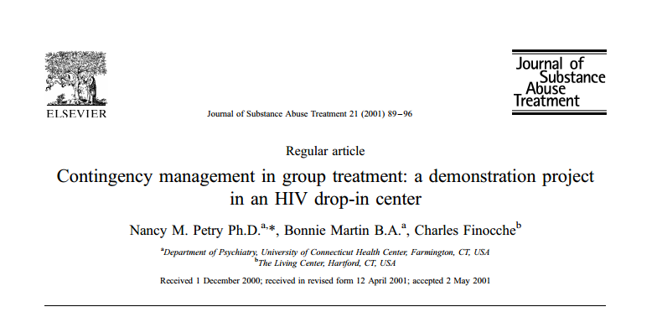
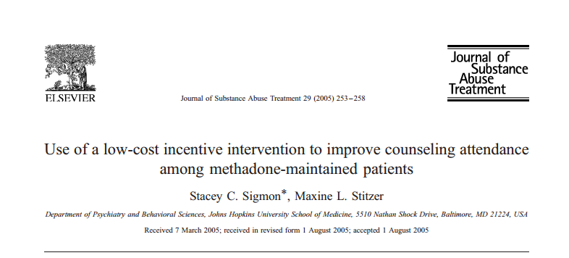
Influencing Patient Behavior
Contingency Management in Narcotics
Increased attendance of 20-30%
Improved baselines & positive outcomes
ATTENDANCE TO GROUP COUNSELING SESSIONS
No Incentives
Incentives
Financial incentives work
And many other scientific studies
Notes:
INFLUENCING BEHAVIOR
How do we target behavior? We looked at contingency management, which is a well known tool that is used in narcotics management. We researched several studies and found that with a lottery system of financial incentives, patient behavior changed and new baselines were developed after programs ended.

Slide 5
Washington D.C. is Ideal Pilot City
Highly developed HIV testing and treatment infrastructure
Marginalized patient population
Medicaid spent $142mm on enrollees with HIV/AIDS in D.C. in 2015
US Average
0.38%
Appetite for
Public-Private PFS Projects
Sources: CDC Surveillance Report, World Bank Data, Kaiser Family Foundation
Notes:
http://kff.org/hivaids/state-indicator/enrollment-spending-on-hiv/

Slide 6
The Red Ribbon Fund Intervention
GOAL
Sustained viral suppression
PATIENT INCENTIVES
Values significant relative to $10.50 / hr D.C. minimum wage
Incentives improve retention in care
Sustained Outcome Incentive
$12K Lottery Entry
RRF INTERVENTION: FINANCIAL INCENTIVES FOR TREATMENT MILESTONES
ELIGIBILE WITH SUSTAINED VIRAL SUPPRESSION
Notes:
Based on the contingency management literature and us national hiv strategy we developed the RRF intervention model.
Let me walk you through a patient experience.
The RRF model will incentivize Sam to follow the treatment process and realize the resources available to him to support him. The first year is critical and once Sam is virally suppressed he is eligible for an entry into a housing lottery of 12K.
Our goal is to improve viral suppression and our outcome payment will occur once we reach our benchmark, which we will go into detail shortly.

Slide 7
Red Ribbon 4-Pillars Intervention Model
BEHAVIOR AND TARGET POPULATION
OPERATIONS
INVESTORS
OUTCOME
FUNDERS
Patient incentives influence retention in care and achieve viral suppression
Decrease secondary diseases and new HIV transmissions
Utilize existing infrastructure
Experienced service providers
Share in outcome payments
20 integrated HIV clinics in D.C.
Investor capital directly targets patients and providers
Clear and established metrics
Scalable model
10 dollars of incremental cost savings for every dollar
Independent evaluator to monitor and report program indicators

Slide 8
Investors Share Cost Savings With Public Payers
INVESTOR CAPITAL
INTERVENTION OPERATIONS
OUTCOME FUNDERS
DEBT
SPV
Sub-contracted service providers
Health clinics
$ $
Patient Financial Incentives
Principal & Interest
$ $
Service Provider
FHI360
Increased Viral Suppression Rates
EQUITY
$ $
Residual Cash Flow
SUCCESS PAYMENTS

Slide 9
Outcomes Achieved Rapidly
Outcomes Achieved in Year Two
Rapid Validation of Outcomes
Quantifiable Cost Savings to Medicaid/Ryan White
Total D.C. medical cost savings: $500 million

Slide 10
Attractive Returns from Cost Savings
D.C. Fund Size: $15mm
Total Success Payments: $48mm
Debt IRR: 6-8%
Equity IRR: 13-16%
Cumulative Operating Cash Flows
Benefit Cost Ratio of RRF Intervention: 10:1

Slide 11
Risks and Mitigation Strategies
BEHAVIOR AND TARGET POPULATION
OPERATIONS
INVESTORS
OUTCOME
FUNDERS
Patient selection and drop-out risk
Effectiveness of delivery
Performance assessment
“Low hanging fruit” and savings realization
Selection criteria based on geography
Incentives escalate across the HIV care continuum
Leverage FHI 360 local expertise in site management
Funding for one position and clinic success fee based on performance
Clear, established and independent metric in assessing viral suppression
Proven effectiveness of P4PP programs in scientific studies
Viral suppression baseline increases on a step-function
Private capital de-risks funding of outcomes

Slide 12
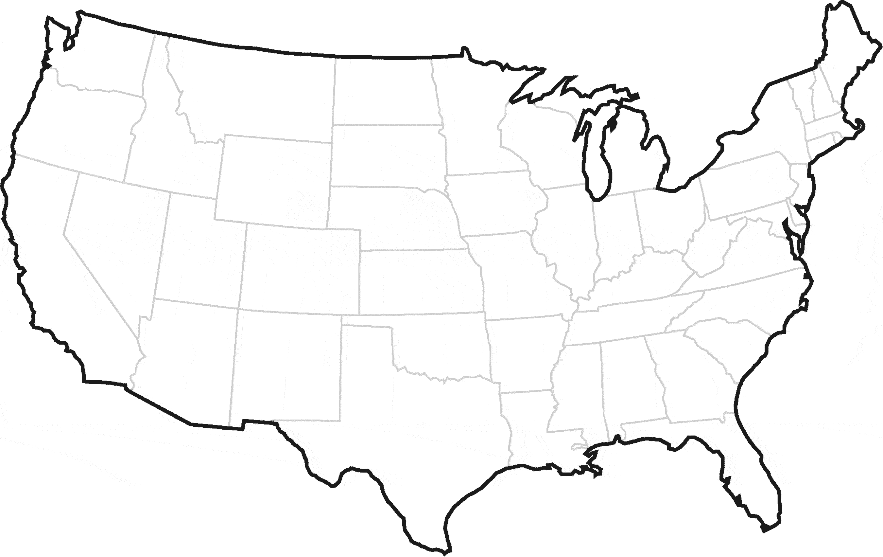
Scalable and Repeatable Intervention Model
NEAR ADDRESSABLE MARKETS
(potential savings – $ million)
Achieving a 75% rate of viral suppression in these cities
could result in healthcare savings of $5.8 billion

Slide 13
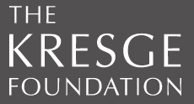
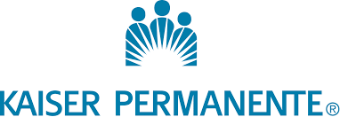
Further De-Risking Levers
FOUNDATIONS
Concessionary Capital
SUPPORTIVE HOUSING
Overlapping populations
PRIVATE INSURERS
Outcome payer expansion

Slide 14
In Depth Due Diligence in Progress
DUE DILIGENCE SESSIONS COMPLETED WITH
1
Specialists and
Researchers
Engaged key experts
Refined program design
COMPLETE
BEHAVIORAL INTERVENTION
NGOs and
Care Providers
Site visit complete
Evaluated service providers
COMPLETE
OPERATIONAL MODEL
2
Financial Services
Conducted initial due diligence
Identified key contract designs
COMPLETE
FINANCIAL STRUCTURE
3
Government
Engaged key departments
Medicaid in progress
IN PROGRESS
SAVINGS AND GOVERNMENT DEMAND
Private Investors and Foundations
IN PROGRESS
In progress
GAUGE INVESTOR DEMAND

Slide 15
What Do We Know Now?
Economic incentives can CHANGE BEHAVIOR
Private capital can jumpstart an innovative intervention and SAVE BILLIONS in medical costs
By aligning stakeholders we can IMPROVE LIVES AND SURVIVAL RATES of thousands of patients

Slide 16
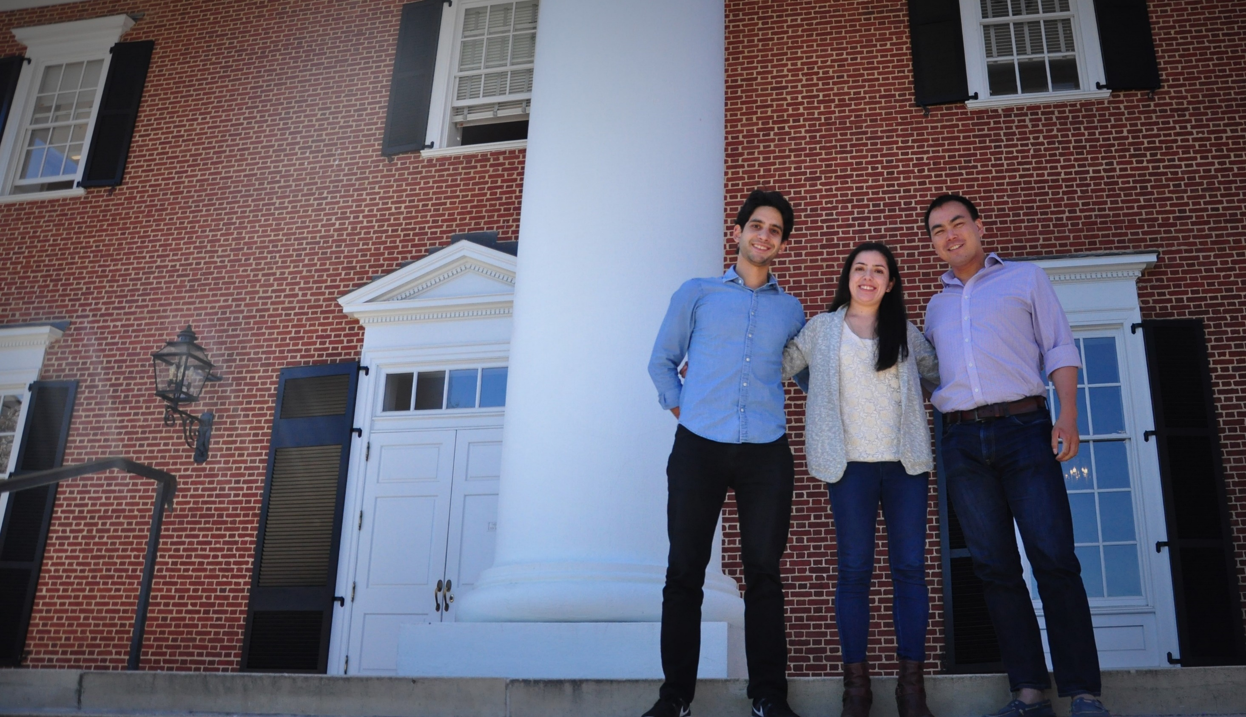
FINANCE EXPERTISE
PUBLIC HEALTH AND NGO EXPERIENCE

Slide 17
Appendix

Slide 18
Summary Terms
Red Ribbon Fund I
Total Investment Size | $15.0 million
Debt Tranche | $9.0 million, issued at par
Debt Coupon and Success Fee | 6.0% p.a. and 2.0% of success fees
Amortization | Upon receipt of first success fee
Equity Tranche | $6.0 million, target IRR of 13.0% - 16.0%
Management Fees | 2.5% p.a.
Transaction Fees | 3.0%

Slide 19
Sensitivity Tables
Sensitivity Table: Equity IRR
 |  | Ultimate Increase in Viral Suppression
 |  | 22.5% | 25.0% | 27.5% | 30.0% | 32.5% | 35.0%
Outcome Payment | $7,500 | -23.1% | -3.3% | 4.4% | 7.4% | 23.3% | 34.5%
 | $8,000 | -8.6% | 2.2% | 8.4% | 11.3% | 26.7% | 37.5%
 | $8,500 | -1.9% | 6.4% | 12.0% | 15.5% | 29.8% | 40.3%
 | $9,000 | 2.8% | 9.8% | 15.0% | 18.4% | 32.5% | 43.0%
 | $9,500 | 6.6% | 12.7% | 17.6% | 21.2% | 35.1% | 45.5%
 | $10,000 | 9.6% | 16.4% | 20.0% | 23.8% | 37.5% | 47.8%
Sensitivity Table: Debt IRR
 |  | Ultimate Increase in Viral Suppression
 |  | 22.5% | 25.0% | 27.5% | 30.0% | 32.5% | 35.0%
Outcome Payment | $7,500 | 7.1% | 7.2% | 7.4% | 7.5% | 7.6% | 7.9%
 | $8,000 | 7.1% | 7.3% | 7.5% | 7.6% | 7.7% | 8.0%
 | $8,500 | 7.2% | 7.4% | 7.6% | 7.4% | 7.8% | 8.2%
 | $9,000 | 7.3% | 7.5% | 7.7% | 7.5% | 7.9% | 8.3%
 | $9,500 | 7.4% | 7.7% | 7.8% | 7.6% | 8.0% | 8.4%
 | $10,000 | 7.6% | 7.5% | 7.9% | 7.7% | 8.1% | 8.5%

Slide 20
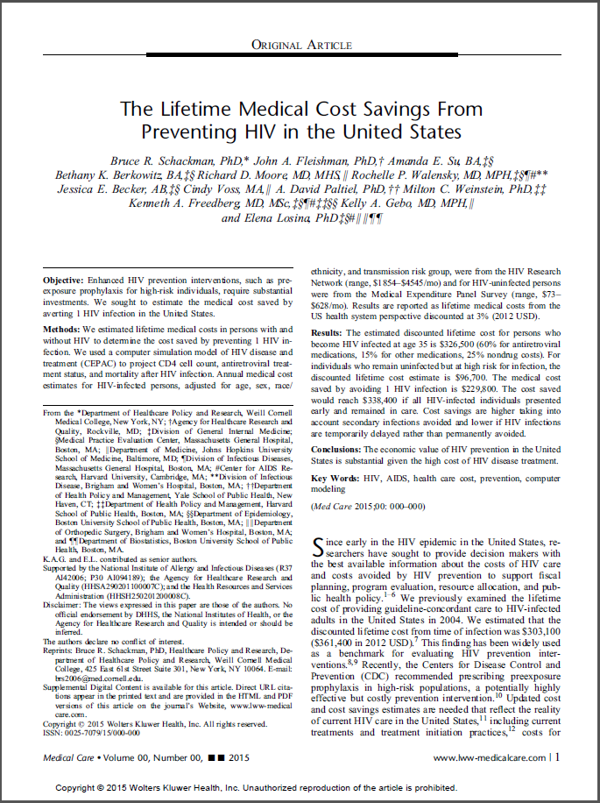
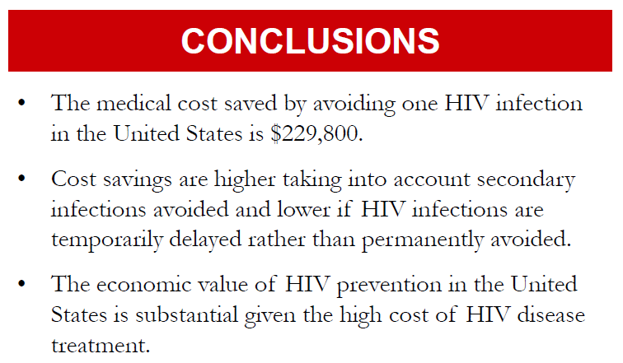
Viral Suppression Leads to Cost Savings
RETRANSMISSION COSTS
AVOIDED COSTS
The medical cost saved by avoiding one HIV infection in the United States is $229,800
Cost savings are higher taking into account secondary infections avoided
MEDICAL COSTS
Weakened immune system leads to opportunistic infections, which leads to increase in hospitalizations and medical costs. The estimate of the lifetime cost of keeping a patient in care amounts to a NPV of $160,000

Slide 21
Changing Behavior Through Incentive Programs
Contingency Management: Incentives as an Intervention
Contingency management is widely used to alter behavior in narcotic abuse treatment. Several studies have proved that it works in opioid, marijuana, alcohol and cocaine dependent patients.
Context: Group counselling is an important part of treating addiction and patients were not taking advantage of the services available.
Goal: Increase counselling session attendance
Incentive: Prizes of various sizes (Mcdonald’s coupons, gift cards, DVD players). Chips drawn from a fish bowl, consistent attendance increased number of draws (up to a maximum of five)
Result: Attendance increased from 52% to 76% and promoted continuous attendance.
Context: HIV Drop-in Center where 90% of members have a drug addiction.
Goal: Increase completion of activities based on case management coals and increase attendance of group therapy sessions
Incentive: Prizes drawn from fish bowl with decreasing probability of winning overtime and eventual end of incentives after 35 weeks
Result: Percent of activity completion went from 25% to 65% and settled on a new baseline, with over 50% activity completion even after reinforcements were removed. Patients also saw improved outcomes.

Slide 22
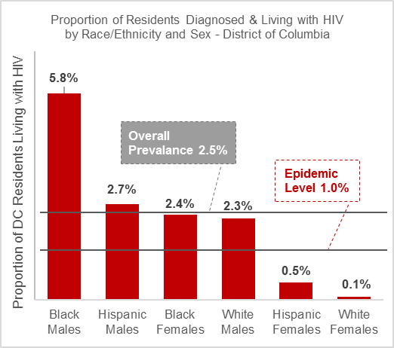
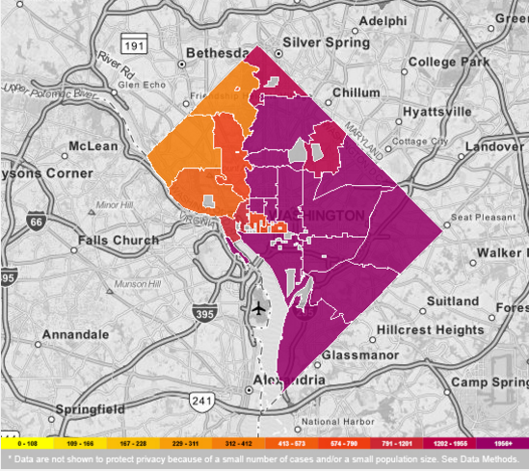
HIV in the United States
Rates of Persons Living with an HIV or AIDS Diagnosis
Overall Prevalence 2.5%
Source: AIDSVU, Washington D.C. 2012

Slide 23
US Domestic HIV Budget
Federal Spending for HIV/AIDS, FY 2015 (Billions)
Medicaid is estimated to cover half of people with HIV in regular care and about a quarter of those who have been diagnosed
Medicaid and Medicare make up the majority of HIV/AIDS expenditures
Growth fueled primarily by increased spending on mandatory domestic care
Source: Kaiser Family Foundation
Notes:
http://kff.org/global-health-policy/fact-sheet/u-s-federal-funding-for-hivaids-the-presidents-fy-2016-budget-request/

Slide 24
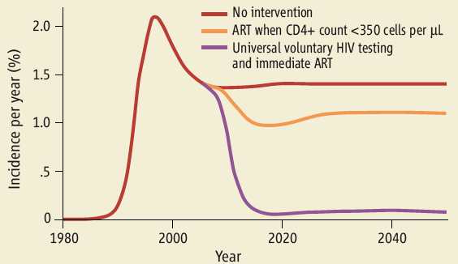
Effectiveness of Treatment as Prevention
Universal voluntary HIV testing with immediate antiretroviral therapy as a strategy for elimination of HIV transmission: a mathematical model
Rueben M Granich, Charles F Gilks, Christopher Dye, Kevin M De Cock, Brian G Williams
Courtesy of Dr. Julio Montaner

Slide 25
References / Bibliography
“DC HAHSTA Annual Report 2014”. DC Department of Health.
“Financing HIV/AIDS Care: A Quilt With Many Holes”. Henry J Kaiser Foundation.
“Viral suppression after 12 months of antiretroviral therapy in low- and middle-income countries: a systematic review”. World Health Organization.
“HIV/AIDS Care Continuum”. AIDS.gov.
“Africa – West and Central”. UN AIDS Country Data.
“HIV/AIDS in the Greater Washington Region”. Washington AIDS Partnership.
“90-90-90 An ambitious treatment target to help end the AIDS epidemic”. UN AIDS.
“National HIV/AIDS Strategy for the United States– Updated to 2020.” The White House.
“The Lifetime Medical Cost Savings From Preventing HIV in the United States”. Schackman, Bruce et. al. Medical Care.

