Slide 1
Refugee Integration Fund (RIF)
Empowering refugees to shape their future
Chirag Modi, Ann Jeon and Shawn He
15.04.2016

Slide 2
Refugee Situation in Europe…
Historical inflow of refugees in the EU, especially in Germany, Sweden and France
Refugee Crisis
Number of Asylum Applicants (2008-2015)
2012
2013
2014
2015
Turkey
Syria
Iran
Iraq

Slide 3
… is the world's largest humanitarian crisis since World War II
Source UNICEF

Slide 4
Refugees‘ Journey
After receiving status, social and financial integration is achieved via entrepreneurial and/or labour market activity.
Refugee crisis in Europe
Path of Asylum Applicants in a host country
Social and Financial Integration
Entrepreneurship
Learn language
& culture
Labour Market (low skilled labour)
accepted
Asylum
Application
Learn language
& culture
Application
Decision
rejected
Unemployment
Deportation
Year 0
Year 1
Year 3 – 5

Slide 5
Barriers towards Entrepreneurship & Proposed Solution
Proposed solution bridges the biggest barrier (lack of access to financing) for refugee entrepreneurs pursuing entrepreneurial activities in host countries
Refugee crisis in Europe
Challenge — Financial Exclusion
Entrepreneurship — Opportunity
Solution
Financial Inclusion
Social Integration
Economic Independence
Skill Development
Reduces reliance on welfare
Positive impact on hosts’ economy
Cut off from traditional funding sources
Microfinance
Product
Microcredit for business purposes
Target
Refugees in Europe
Mission
Stimulate business and employment generation
Enhance financial and social integration

Slide 6
Market Size
Nr. of refugee entrepreneurs to reach a peak in 2020; Market entry in 2020 attractive due to market size and potential social impact
Projected Refugee Entrepreneurs in the EU
Refugee loan market in 2020
Aggregate loans outstanding - EU-wide
€472m
€254m
€110m
€30m
Aggregate loans outstanding - Germany, France & Sweden (Core 3)
New Loan issuance 2020 (Core 3)
Fund Size is reasonable with 27% market share
2.2% of entrepreneurs within refugee population¹
Accounts for refugees‘ learning curve
Average loan size of €10,000 & loan length of 3 years
Accounts for repeated borrowers
Notes
1 Based on estimates obtained from Institute of Social Research

Slide 7
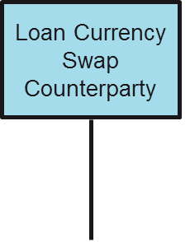
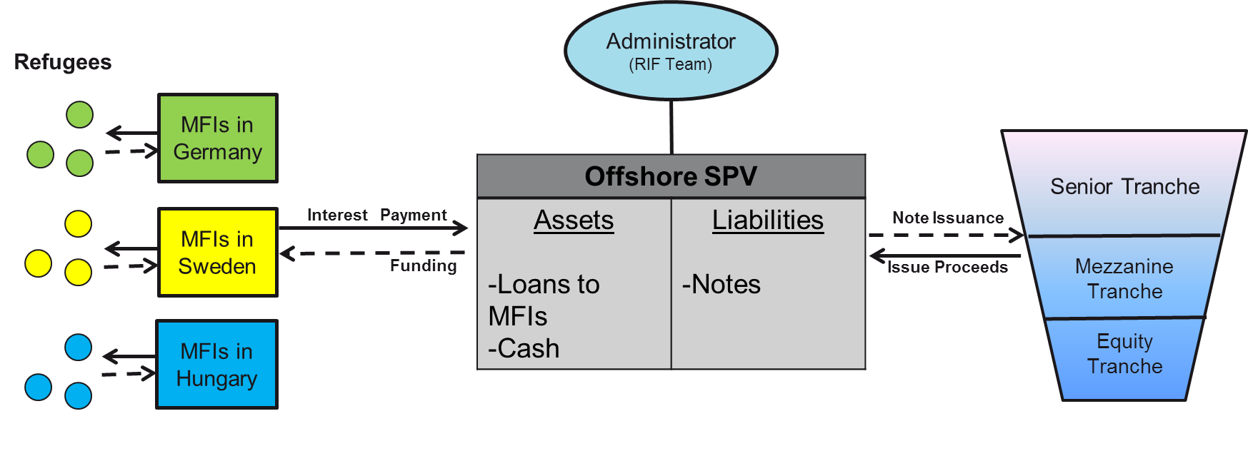
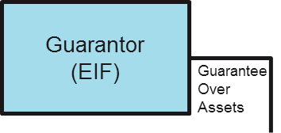
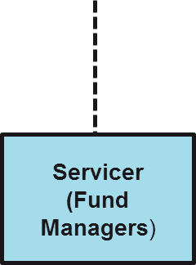
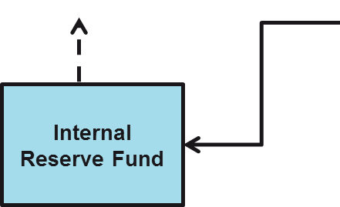
Refugee Integration Fund — Structure
Solution to a coordination problem and information problem
A MFLO is an optimal structure to target several countries and attract a diverse range of investors
Refugee crisis in Europe
Microfinance Loan Obligation (MFLO) Structure
Reduces currency risk and mismatches
EaSI Gurantee Instrument provides credit enhancement
Guarantee Over Senior tranche
France
Two-tier System to reduce counterparty risk

Slide 8
RIF — Expansion Strategy
Roll-out strategy to be implemented in 3 phases to minimise execution risk
Refugee crisis in Europe
3 Phase Strategy
Phase 1 (2016-2020)
Phase 2 (2020-2024)
Phase 3 (2024-2028)
Description | Pilot Phase Grant funding | Securitization CLO Model | Geographic expansion with Phase 2 specifications
Fund Size | €10m | €30m | €35m
Target Geography | Germany | Germany, Sweden and France | Rest of Europe
Target Investor | Philanthropic Investors | Senior Notes: Impact, DFIs and Institutional investors Mezzanine Finance: Hedge funds and impact investors Equity tranche: Servicer¹, hedge funds, MFIs and other parties
Notes
1 EU risk retention rules - originator/sponsor/original lender to retain minimum 5% material economic interest of securitized exposure (Capital Requirements Regulation (CRR) Article 405 CRR)

Slide 9
RIF —Cash Flow Analysis of Phase 2
Cash Flow Analysis (Semi-annual; Variable funding Note, MFI and SPV in €‘000)
Return Characteristics
Tranches | Coupon | WAL | Credit Enhancement
Senior | 4% | 1.93 | 81.2%
Mezzanine | 8% | 2.5 | 28.2%
Equity | Residual Cash Flow |  | 4.70%
Cash reserve ratio |  |  | 20% of equity tranche
End of Period Cash Balance (Semi-annual; Variable Funding Note in €‘000)
Fees
Tranche Distribution
Fees
Service cost | 2%
Guarantee cost | 2%
Management fee | 1%
Mitigating negative carry by providing funding to MFIs in staged approach
SPV raised funding by variable fund notes which allow noteholders to increase their funding to the SPV over limited period of time

Slide 10
Risk Factors
Key risk factors can be mitigated through operational processes, structural design and development of best practices
Refugee crisis in Europe
Key risk factors and mitigation tools
RISKS | MITIGATIONS
Refugee default risks | Stringent refugee payment obligations to be implemented by MFIs (MFIs’ loan agreements) – e.g. Collective Community Joint Liability Programme (geography, industry & ethnicity)
MFIs’ default risks | Two-tier system, Term loans’ requirements, e.g. debt-to-equity ratio, restrictions on subordinated debt
Loans’ quality (no collateral) | EIF guarantee for senior tranche; cash reserve from equity tranche
Lack of available information on refugee integration | Migration data; on-EU asylum seekers data; cooperation with language & vocational training agencies’ and other support organisations
Securitization regulation | Legal due diligence, hire local legal experts

Slide 11
Social Impact
Entrepreneurial Empowerment
Easily Accessible loans
Entrusting a future
Reflect solutions to local problems
Social inclusion
Brings employment
Creates bonds in community
Improves psychological well-being
Economic Benefit
Helps refuges engage with market
New blood to an ageing labour force
Increase fiscal capacity
Refugee crisis in Europe
Channels of social impact
Measuring social impact
Entrepreneurial Activity
Rate of Integration
Economic Measurement
Number of new businesses created
Proportion of refugee entrepreneurs
Increase of willingness and incentive to open new businesses
Density and radius of effect of businesses in communities
Number of refugee employees hired
Psychological wellbeing of refugee communities
Repayment rates
Survival analysis
Other related measures

Slide 12
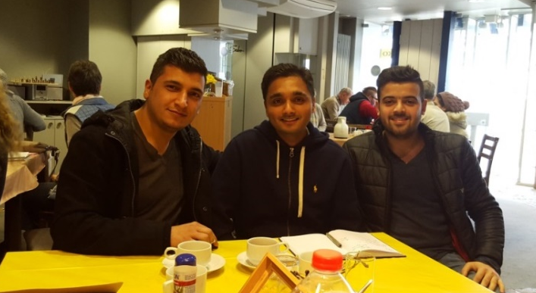
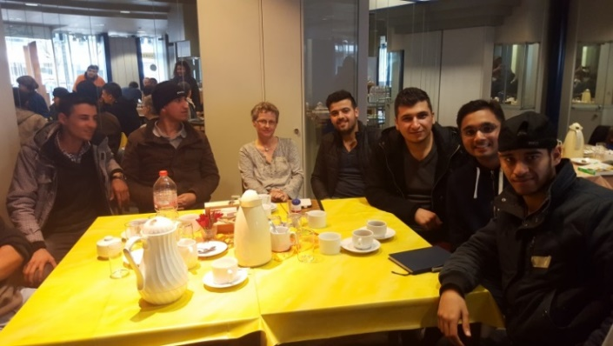
Stakeholder Analysis
Positive feedback from key stakeholders including refugees, MFIs and Investors; proof of concept phase
Refugees
MFIs/NGOs
Investors
Private Investors
Social Investment banks
First Microfinance
Insititution Syria
“
This project is absolutely relevant and urgently needed.
”
Notes:
Closing: There is no better timing for this project. Water, Poverty are perennial. The refugees are suffering and need a solution now.

Slide 13
Conclusion
Refugee Crisis in Europe is the largest humanitarian crisis since World War II
Entrepreneurship is the most attractive solution towards long term social integration of refugees in host countries
Due to financial exclusion, it is difficult to obtain funding for refugees to finance entrepreneurial activities
Our solution combines microfinance with securitisation (MFLO) in order to create a product that allows us to share risk with different types of investors
The concept is implemented in three phases: Pilot Phase (Germany) , Phase 2 (Germany, France and Sweden) and Phase 3 (expansion in rest of EU)
Our solution has an extraordinary social impact as it not only increases the wellbeing of refugees but also empowers them to make a positive impact in the host community
The concept has received positive feedback from key stakeholders including refugees, MFIs and investors

Slide 14
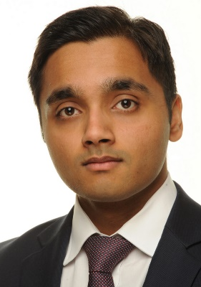
Thank you for your attention!
Q&A
RIF Management
Ann Jeon
Chirag Modi
Shawn He
Legal Experience
Banking Experience
Start-up Experience

Slide 15
Appendix

Slide 16
Refugee Innovation in Developed Economies
Diversity in refugees’ background leads to a wide range of refugee enterprises; Self-employment inherent in refugee culture
Refugee Economics
Select Cases
Economic Inclusion | Limited socio-economic segregation Directly connected to the wider host economy
Economic Heterogenity | Diversity of refugee livelihoods
Technological Literacy | Majority of refugees are Technology users
Entpreneurial spirit | Culture of self-employment popular
Migrants responsible for 1 in 5 new businesses set up in recent years in Germany¹
Source Refugee Economies (2014), Flickr, KfW estimates, Reuters, Federal Reserve Bank of St. Louis, Huffington Post, The Chickpea Sisters

Slide 17
Asset Quality
Asset Quality can be ensured through a tier system at MFI level and establishment of support network at Refugee level, reducing counterparty risk
MFI Level
Refugee Level
Knowledge exchange among MFIs
Target MFIs certified by EIF (JASMINE¹ programme)
European level development of governance and guidelines
2 Tier System
Group Lending
Guarantor/Co-signer
Efficient coordination of existing network enables identification and support of high quality borrowers/refugee entrepreneurs
Peer Groups | Tier I MFIs | Tier II MFIs
Years of operating | >5 yrs | >3 yrs
Credit Rating | International Agencies (Planet Rating SAS, Microfinanza etc.) | Local Agencies
Estimated Peer Group Size | 100-150 | 300
Base interest rate | 18% | 20%
Payments per year | 2 | 2
Loan term (Yrs) | 3 | 3
Grace period (Yrs) | 1 | 1
Loan size ('000 Euros) | 20,000 | 10,000
Loan loss rate (Estimate) | 0.5% | 1%
NGOs
Mentorship Programmes
Incubators
Refugees
Government Initiatives
Notes
1 JASMINE (Joint Action to Support Microfinance Institutions) provides selection of MFIs with due diligence carried out by EIF

Slide 18
Loan Architecture (for individual refugees)
Individual Candidate Screening
Joint Liability Collective Benefits Programme (JLCBP)
New candidates
With legal immigration status within the host country;
With solid language/education/work experience background and clean track record; and
Who have demonstrated their own initiative in starting a business
Joint Liability
All members with the same group of the programme are responsible for the repayment of group members:
Members of a refugee group nominate new candidate
Default by one group member leads to loss of future access for all members; and
Cumulative compulsory deposits as a buffer for possible defaults.
Returning Candidates
Who need additional capital to fund their business; and
With good repayment records
Collective Benefits
A larger group gives better rate allowances
Group financial services, transfer & savings

Slide 19
Select MFIs in developed economies
Microfinance in developed economies is sustainable; Recent initiative by IRC focuses on refugee entrepreneurs, validating our concept
Select List of MFIs focused on providing microcredits to entrepreneurs
Name | Geographic Focus | Target Group | Loan Amount | Loan term | Client Profile
Accion USA | USA | Low and moderate-income entrepreneurs | $500-50000 | Up to 60 months | 44% women, 55% low income and 86% minorities
ADIE | France | Entrepreneurs with focus on unemployed and welfare recipient | Up to 5,000 | 24 months | 85% of loans to new business and 15% to existing businesses
FINNVERA | Finland | Existing businesses and start-ups | 3,000-35,000 | Up to 36 to 48 months | Finances 3,000 microloans per year; 50% to women; Clientele of 28,000
Mountain Bizworks | USA | Entrepreneurs | Up to $50,000 | NA | 61% of clients are women, 65% of clients are low-to-moderate income and 22% are racial or ethnic minorities
International Rescue Committee | USA | Refugee Entrepreneurs | $6,500 | NA | NA
Source The future of Micro Credit in Australia report; Data as of 2009, WSJ

Slide 20
Comparable Securitisation of Microloans — Case study
Microfinance in developed economies is sustainable; Recent initiative by IRC focuses on refugee entrepreneurs, validating our concept
Case study — Symbiotics SA & EIF
Symbiotics SA & EIF
Sponsor | Opportunity International Network
Co-Arrangers | Symbiotics SA, Information, Consulting & Services/ EIF
Loan Servicer | Symbiotics
Transaction Size | €30 million
Number of Closings | 3
Volume of first closing | ~€8.4 million
Pool of term loans | 4 MFIs (first closing), up to 7 expected for future closings
Asset location | Albania, Montenegro, Romania & Russia
WAL of term loans | ~3.5/4/4.5 years
Participating investors | Senior Notes (with EIF guarantee): Institutional Investors Junior Notes & First-loss Notes: Specialised Microfinance investors
Source Jung & Erikson, ‘Microfinance Loan Obligations – Structured Finance for Microfinance Investments’

Slide 21
Alternative Financial Structure
Financial Structure with Warehouse Facility
Variable Funding Notes
Cash
Senior
80%
MFIs
SPV 1
Warehouse
Refugee Loans
Issuance Proceeds
Cash
Equity: MFIs
Refugees
Asset transfer
Asset transfer
Cash
Term Notes
Senior
SPV 2
Term Financing
Mezzanine
Issuance Proceeds
Equity: MFIs

