Slide 1
Exponential Equity Partners: Investing in Africa’s Growth
Fund I Overview
Team A2
April 8, 2011

Slide 2
Our vision
Exponential Equity Partners (e²) seeks to deliver outstanding financial and social returns by investing in companies and linking their distribution networks across Africa
$40 million fund
Equity investments in 8 – 12 companies, beginning with East Africa
Two focuses:
Environmental Sustainability (energy, water, agricultural products)
Health, Food, and Nutrition (medicine, nutritional foods, vitamins)
2

Slide 3
Our team brings significant Africa & investing experience
Professional impact investing experience at leading firms:
On the ground networks throughout the continent including: Ghana, Kenya, Liberia, Mali, Rwanda, Senegal, South Africa, Swaziland, Tanzania, and Uganda
Industry expertise in: agriculture, health care, microfinance, nutrition and renewable energy
Proven operating and entrepreneurial experiences
Investment banking, private equity, and top-tier management consulting experience in developed markets
3

Slide 4
Our strategy for achieving outstanding financial returns
e² will connect and integrate the distribution networks of its individual portfolio companies within and across different regions
Attractive Financial Opportunity
Additional Value Created by e² Strategy
Undervaluation of distribution assets
Rapid growth and greater demand from 220M new middle class consumers by 2015
Increased access to 60% of the population living in rural markets, where distribution is currently lacking
Scale: Economies of scale by connecting portfolio companies
Scope: New products and wider reach
Capability: Improved supply chain practices
Source: United Nations; McKinsey Global Institute Analysis
4

Slide 5
Our strategy for effecting lasting social change
Problem: Lack of adequate distribution channels limits access to critical goods and services
Failure of existing solutions
Need for market-based solution
Public sector supply chains have not achieved adequate scale and efficiency
Private sector supply chains lack access to necessary capital investment
e2 can connect and improve existing mini-distribution channels to deliver critical goods to all communities
5

Slide 6
Our investment strategy
Investment Approach
Fund Terms
Target 8-12 investments, with flexibility for follow-on investments
Target ~$5-10M enterprise value each
Early revenue, growth equity transactions
Proceeds to fund improved reach and capacity of distribution network
Seek to own a significant stake, including active Board seats
Commitment from each venture to support e²’s broader network strategy
Fund size: $40M
Target financial return: 12% - 15%
Significant social impact
Fund term: 10 years (extendable for up to two additional 1-year periods)
Investment period: 5 years
Management carry: 20% (5% hurdle)
Management fee: 2.25% (on committed capital)
6

Slide 7
Potential investments: A look to the past…
Health, Food and Nutrition Portfolio
Environmental Sustainability Portfolio
More products added to network between 2006 and 2010: yogurt and frozen dairy pushed through existing milk distribution network
Tripled sales from 32M GH to 104M GH
Which quintupled profits, from 5M to 25M GH, as new sales spread over a fixed cost (distribution network)
Toyola begins shipping solar lanterns with efficient cook stoves in 2008
Lanterns fit on trucks in between cookstoves, taking advantage of previously wasted space
Same customers desire both products; salesforce is cross-trained and now sells both products together
7

Slide 8
Potential investments: A look to the future…
Potential Environmental Sustainability network in East Africa
Uganda
Kenya
UltraTec
Botto Solar
Proven track records ($2-5M revenue, 25-100%+ CAGR)
Coordination occurring informally today
Minimal trade barriers (East African Community)
Potential for significant economies of scale
Need for investment
Stated interest from suppliers
Great
Lakes Energy
Power Advantage
Solar Tek
Zara Solar
ENSOL
Rex Investments
Tanzania
Source: team member conversations with companies
8

Slide 9
e² has developed a diligent pipeline review process
Financial Analysis
Social Analysis
Environmental Analysis
Intake & Desk Review
Each deal will be analyzed across all three verticals
Initial Diligence (including field visit)
Investment Approval
Closing
Portfolio Management
Key metrics:
Growth
Margins
Returns
IRIS and GIIRS metrics
IRIS and GIIRS metrics
Note: see appendix for additional details on pipeline review process and social metrics
9

Slide 10
e² will add value by connecting portfolio companies
Provide directly
Facilitate
Independent
Operational support and on-the-ground experts
Enhanced supply chain capabilities
IT (software)
Processes
Training
Centralized back-office
Coordinated procurement
Global sourcing
Consolidated ordering
Monthly calls between regional portfolio companies
Annual CEO retreat & LP meeting
Product manufacturing
Local sourcing
Transportation
HR/Staffing
10

Slide 11
Portfolio companies will have multiple exit possibilities
Strategic Buyers
Financial Buyers
Recapitalization
Looking to acquire broader distribution and access to new consumers
Seeking high-growth businesses and/or networks to grow other portfolio companies
Helping portfolio companies access commercial capital in order to buy out equity investors
“Our beverages are distributed through local distributors. [They] currently find it difficult to obtain capital to either start or further invest…”
– Coca-Cola
“Regional trade agreements are increasing opportunities for African businesses to expand across borders. This area of focus is a central theme for Africa.”
– Aureos
“Improving access to financial services is a vital part of promoting economic growth... A continuing priority for us is to stimulate grassroots enterprise…”
– Standard Chartered
11

Slide 12
e² has carefully considered risks and mitigation strategies
Macro Risks
Investment Risks
Country-specific risk
Political
Economic
Legal
Corruption and crime
Restrictions on trade
Inability to source suitable investments with established distribution networks
Limited capacity of individual portfolio company networks
Unreliable due diligence (financial, accounting, environmental, legal)
Long-term & illiquid investments
e² plans to mitigate these risks by:
Diversifying investments across geographies and product types
Focusing on one region at a time to fully develop deep networks and local expertise to support our portfolio companies before expanding
Putting in place investment and risk committees and processes to understand, evaluate and respond to concerns pre and post investment
12

Slide 13
e² will create meaningful value to all stakeholders
Investors
Portfolio Companies
Society at Large
Attractive risk-return profile
Significant social impact
Access to deals in high social impact sectors
Exposure to deals in sub-Saharan Africa
Revenue growth via wider distribution and cross-selling
Diversification of risk across more products and geographies
Access to e² support and network of entrepreneurs
Increased ability to access commercial capital markets
Improved supply chains in Africa, especially in remote areas
Increased access to critical products
Decreased cost of and time by consumers who struggle to access these critical products
13

Slide 14
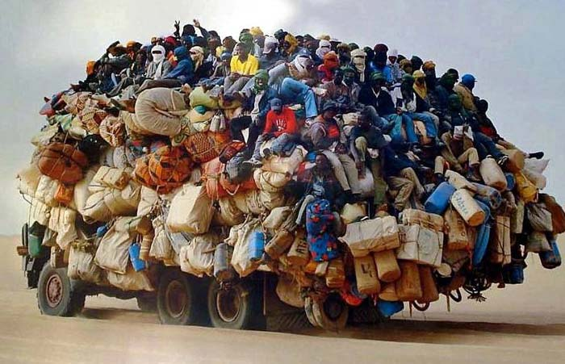
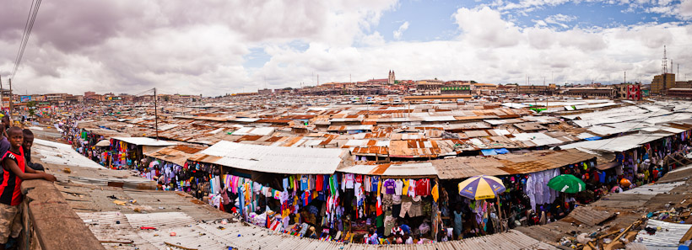
Questions
14

Slide 15
Appendix

Slide 16
Africa’s growth & need for improved distribution
Income Demographics of African Population
With a collective GDP of $1.6 trillion, it is roughly equal to the size of Brazil’s or Russia’s GDP
Growing middle class will create 220 million new consumers by 2015 with need for critical goods
60% of the population lives in rural areas, where distribution is especially needed
Source: United Nations; McKinsey Global Institute Analysis
16

Slide 17
e² has developed a diligent pipeline review process
Financial Analysis
Social Analysis
Environmental Analysis
Market size
Business model
Profitability
Scalability
Identify target income segments
Estimate # of people who will benefit
Check against any exclusion lists
Intake & Desk Review
Field visit to understand operations
Single unit financials
Field visit to understand operations and labor practices
Review labor policies with management
Field visit to understand operations
Review environmental policies with management
Initial Diligence (including field visit)
Investment Approval
External research to confirm assumptions
Complete social and environmental compliance checklist
Negotiate terms
Set operational and financial milestones
Include social and environmental covenants with term sheet
Closing
On-going management support
Integration of operations
On-going management support
Integration of operations
On-going management support
Integration of operations
Portfolio Management
17

Slide 18
Social impact metrics
e² will evaluate its companies based on a series of social metrics, which companies will report quarterly. These metrics will be defied based on existing third party social metrics (e.g. IRIS, GIIRS rating)
Inputs
Output Metrics
Outcomes
Impact
Capital
e² staff and advice
Cross-portfolio collaboration
IRIS operational impact metrics (e.g. number of employees, employee benefits, wages, training)
IRIS product impact metrics (e.g. quantity and reach of products sold through distribution channel, clients with new access)
Increased access to essential products
Increased time and capital to spend on things other than accessing essential products
Economic development for society
Creation of new, attractive market
*e² is a social enterprise based on the GIIRS definition. Specifically it plans to have more than 25% of end beneficiaries from an underserved population and to alleviate poverty through our supply chain.
18

