Slide 1


INVESTOR DRIVEN PACKAGE PRIVATE EQUITY
Impact Investment for Innovative Upstream-Downstream Waste Management Solution Trough Waste Value Creation
Double Green Cores Fund

Slide 2

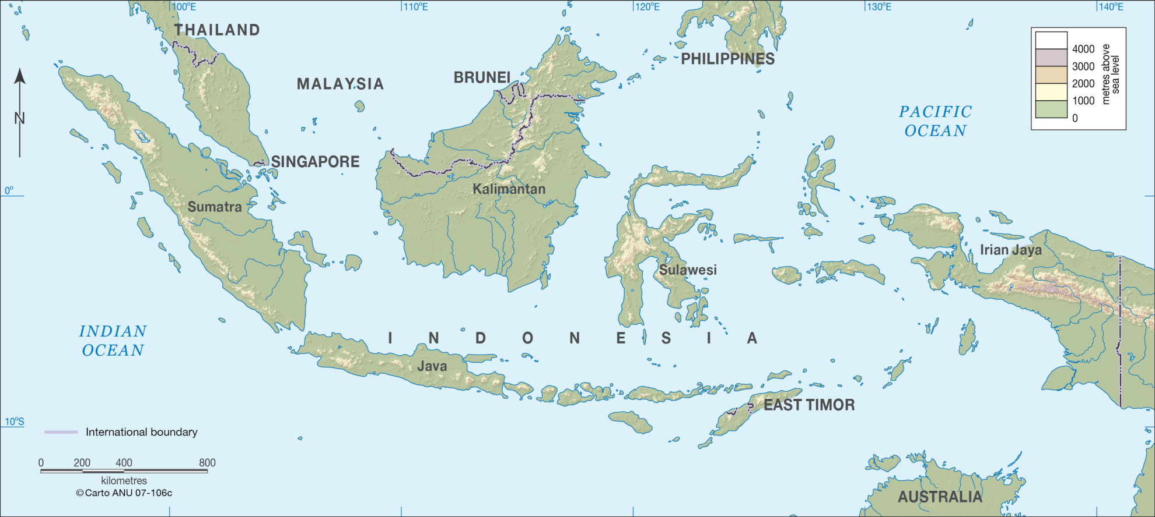
Indonesia: Profound Challenges

Slide 3

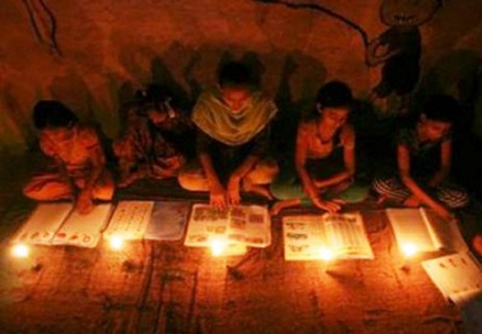

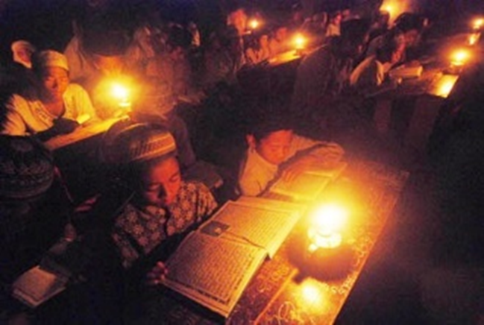
Shortage of Sustainable Power Production
National Electrification Ratio: 75%
Renewable Energy is only accounted for 13%

Slide 4

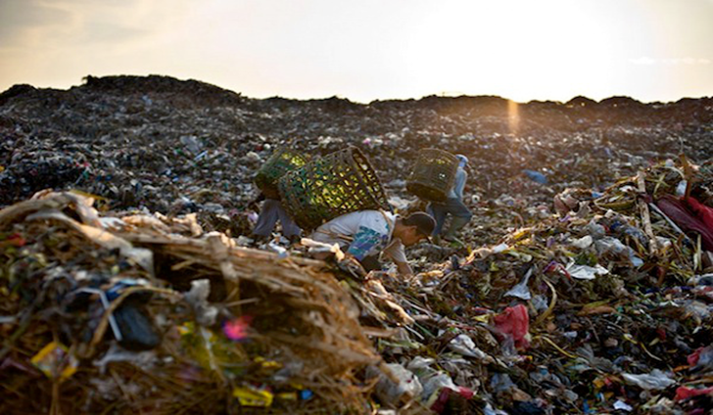
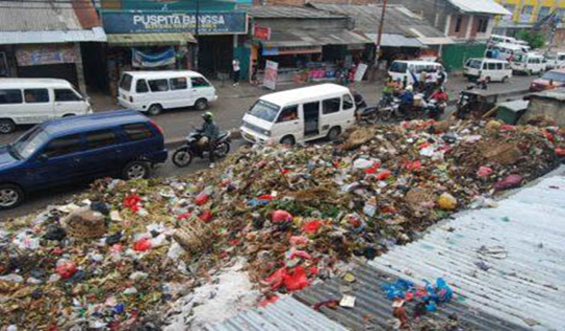
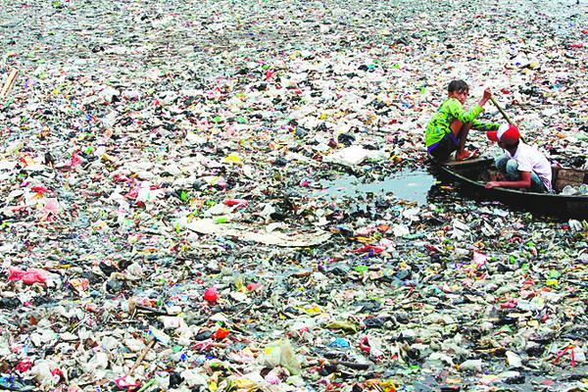
Shortage of Sustainable Waste Management
Managed conservatively
Limited capability of Sanitary Department
Low awareness about sustainable waste management

Slide 5
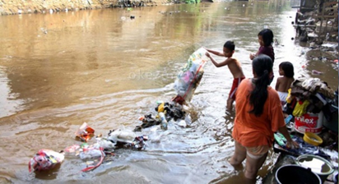
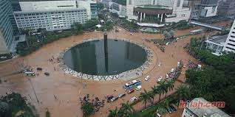
Main Issue: Littering Habit
Bogor: 163,200 middle-low-income habitants , low awareness & littering habit.
Limited capability of Sanitary Department (60%-65%)
Waste is severely unmanaged in densely populated settlements in urban area.
NO ECONOMIC INCENTIVE
IMPACT
Waste retribution fees IDR 750k-900k/house annualy
Flood; economic loss IDR 1.5 trillion (2015)
Notes:
..

Slide 6
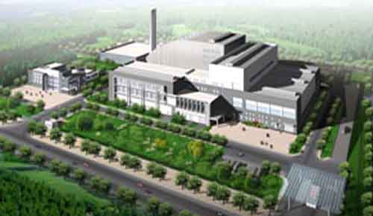
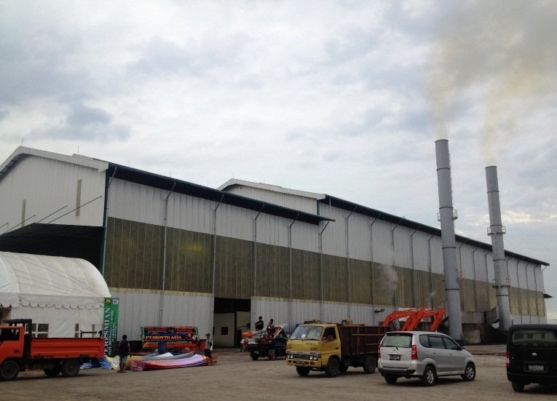
Main Issue: Low Calories Waste
Waste Power Plant (WPP) : 1.6 Mw with maximum capacity 250 m³ tonnes of waste /day
Requires high calories waste
Waste in landfill is unsegregated
It contains 80% of water (wet waste)
IMPACT
Calories: 800 Kcal/kg. Only support 0.234 Mw or 13.86%
WPP loss IDR 6 billion since 2009, need to be subsidized

Slide 7
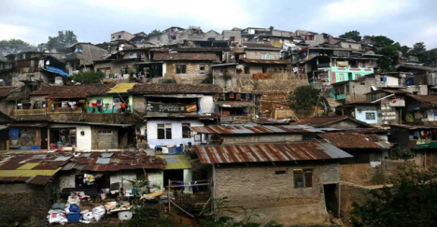

End-to-End Current Waste Management Process
Residential
Unsegregation
Littering
Highly dense population
Upstream
Limited capability
Landfill
Process Channel
High cost
Inefficiency
Waste Powerplant
80% water
Downstream

Slide 8

Current Solution:
High Cost and Not Effective
Residential
Unprofessional Waste Caretakers/ Scavengers
WPP
Waste Dripping Method
Waste Bank
Using Additional Substance

Slide 9

Current Solution: Not Effective & Efficient
Residential
Scavengers are irresponsible and unprofessional
Not creating value and no awarness
Unofficial Waste Caretakers/ Scavengers
Operating in Scattered Management
Buying waste from residents
Lack of Profit Orientation
Suffering from Weak Financial Resource

Slide 10
Current Solution: Neither Effective Nor Efficient
Waste Power Plant
Dripping Process and Used Additional Substances
Very dependent to weather condition
Lack of Standard
High Cost

Slide 11




INVESTMENT THESIS:
INTEGRATED AND HOLISTIC SOLUTION
Double Green Cores Fund
BUSINESS-SOCIETY COOPERATION
WASTE TREATMENT
BIODRYING & RECYCLING FACILITY
PROACTIVE WASTE RECYCLE

Slide 12
Biodrying & Recycling Facility:
Most Affordable and Highest Quality

Slide 13
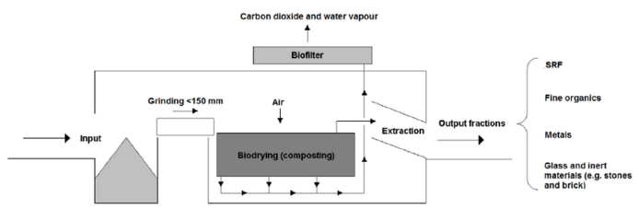
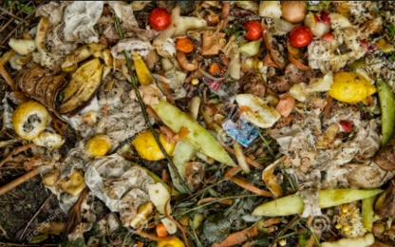
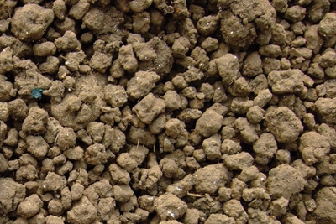
The Downstream Solution:
Biodrying & Recycling Facility
Energy value; 3800-4000 Kcal/kg, INCREASE 422%
WPP can SAVE UP 75% its raw material cost.
Mixed waste; 70% organic and 30% anorganic
Waste Granules; high calories waste

Slide 14
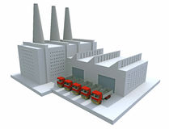

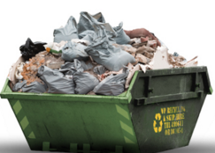
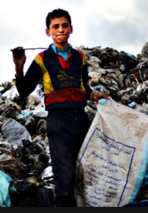
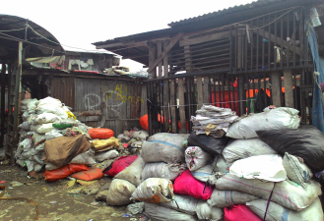
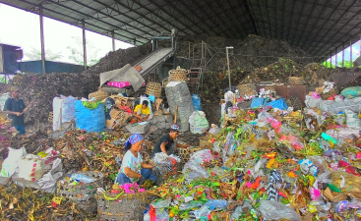
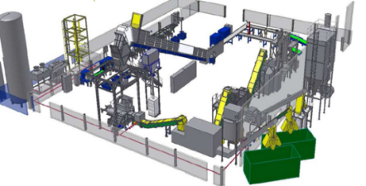
Current Waste Recycle Value Chain
Residents
Final Manufacturer
Retribution Fee
Unsegregated waste
Unofficial Scavengers
Intermediaries
Collector
Plastic Recycles Manufacturer
Value Creation
No Value Creation

Slide 15


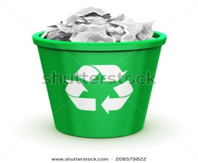
Proactive Waste Recycling (PWR) Shared Value Chain
Residents
Shared Value
Purchasing
Collecting
Selling
Final Manufacturer
Recycling
Segregated waste
Sorting
The residents are very sensitive with economic incentive

Slide 16
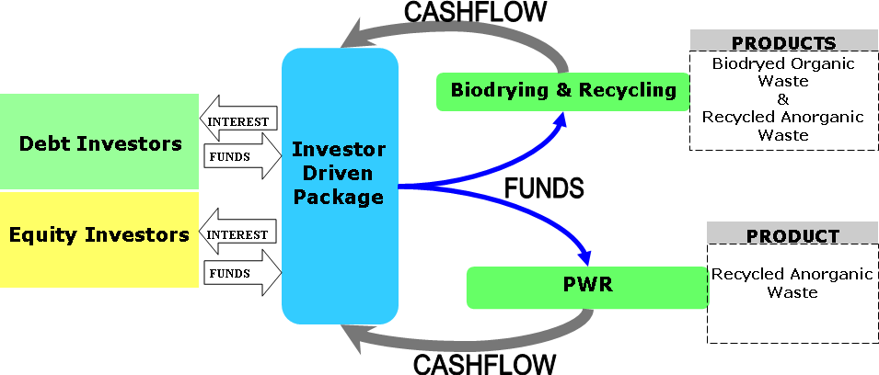
DGCF’s INVESTMENT VEHICLE: INVESTOR DRIVEN PACKAGE
Double Green Cores Fund
SPV:
Targeted Debt : 0.71 Million USD
Targeted Equity :
1.65 Million USD

Slide 17



Who Are Our Targeted Investors : Impact Investors
PRIVATE PLACEMENT AGENT (PPA)
Fund Managers
PUBLIC PARTIES
IDP
S
D
INDONESIA GREEN FUND HUB
Government Owned Company
PPA’s Investor Network
Non PPA’s Investor Network
Endowment Funds
Endowment Funds
Venture Capitalist
Venture Capitalist

Slide 18


HOW DO WE GENERATE CASHFLOW FROM BIODRYING FACILITY & PWR ?
Business
Stakeholder
Monetizing
Success Factor
WASTE POWER PLANT
ECONOMIC VALUE PRICING
CONTRACT
RESIDENTS
MARKET PRICE
CAMPAIGN
CONTINUITY & QUALITY

Slide 19
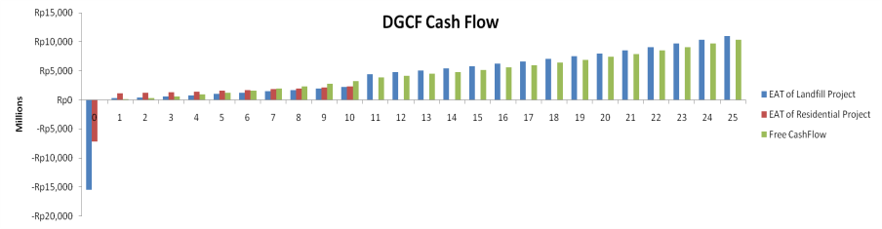
Cash Flow of DGCF: Benefit for Investors
EAT of Biodrying
EAT of PWR
Total PV of Free Cash Flow 4.89 Million USD
Free Cash Flow
IRR:12% ,Coupon: 11%
Cash flow assumptions: Based on government regulation, the electricity rate will be increased 30% regularly for every 5 years. The biodrying waste will be priced at IDR 12,782/tonnes. Recycled plastic will be sold for IDR 6,000/kg. These prices will be gradually increased 5-6% each year.

Slide 20
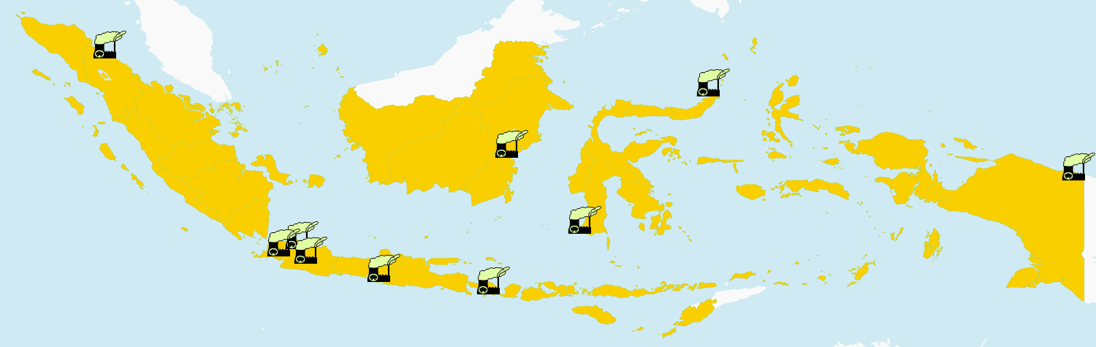
Future Market Value: Biodrying Facility
Year | WPP Electricity Production | Future Market Value
2016 | 57.5 Mw | IDR 167,670,000,000
2017 | 59.5 Mw | IDR 173,502,000,000
2018 | 69.4 Mw | IDR 263,081,520,000
2019 | 79.5 Mw | IDR 391,779,180,000
Government committed to increase waste to power program
The trend of converting waste to power is increasing
Potential Market: US$ 5.1 million anually in 2019
Market growth 2016-2019: 16.63%

Slide 21
Future Market Value: Plastic recycle market
Average growth of supply is 3% annually on average.
China accounted for 56% of recycle plastic recycle consumption.
Export of plastic recycle grows 20% anually.
Potential Market: US$ 29.2 billion.

Slide 22
Risk Identification & Mitigation
Requires Govt’ support
Allow government-owned company to invest in equity. Presenting most affordable and effective solution to cut subsidy
Rejection from society
Create a cooperation. Buying their collected and sorted unorganic waste with competitive variable price
WPP has long payable policy
Maintain sufficient liquidity, sell recycled plastic pellets to diverse companies with shorter payable
Biodrying relies on single buyer
DGCF creates common standard procedures as foundation for long-term partnership
EF requires principal augmentation
DGCF includes the retained earning policy for equity growth to compensate inflation rate
Govt’ is risk averse & it has budget constraint
No further investment for long-term maintanance. Transfer risk from public agents to private party
Conflict between public and private parties
Establish formalized discussion forum which communication, decision, and activities are coordinated and consolidated

Slide 23
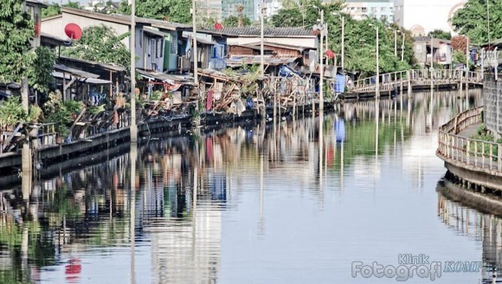

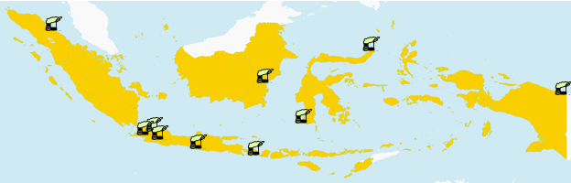
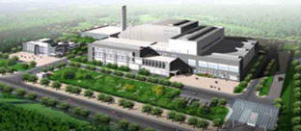



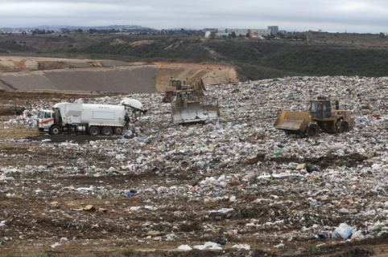
Social, Environment, and Economic Impact to External Stakeholders
Benefits
Measurement
Increase awarness of waste segregation
Historical vs expected unorganic waste sold to PWR
Decrease unorganic municipal waste
Historical vs expected waste received at landfill
Residents
Increase efficiency and lower cost
Electricity production rate based on waste/tonne
WPP
Lower subsidies
Historical vs expected subsidy on power plant
Improve waste solution in unmanaged area
Historical vs expected level of unmanaged waste
Local Government
Increase waste sustainability in landfill
Waste turnover

Slide 24










Implementation & Achievement Strategies
Target Stakeholders
Identify potential target market and stakeholder
Identify high potential residents to participate under PWR program.
Undertake market research and preliminary social campaign.
Pre-feasibility study of biodrying operational aspect and Identify long-term cost-efficient location.
Project Promotion and Approach Stakeholders
Present the deal structure and approach stakeholders.
Further PWR cooperation campaign and quantify early-stage potential stakeholders.
Finalize the business structure and pro-forma financial statement.
Affiliate with Association of Indonesia Plastic Recycle Entrepreneurs (ADUPI) to open markets for +60 buyers.
Approach fund managers and establish investment scheme scenario for each targeted investor.
Approach specific pool of investors focusing on impact investment.
Establish notary collective investment contract with investors and register it to Financial Service Authority
Establish PPP cooperation platform and facilitatedunder PT.SMI
Offer 20% privilage equity position for GoC to partcipate.
Approach Potential Investors & Implementation

Slide 25
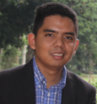

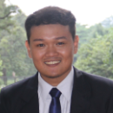


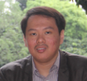
Meet the Team Members
SUPPORTING PARTNERS
Bangkit
Oetomo
Bogor Administration
Research based institution
Dadang W.
Juniarwoko
Bayu A.
Kresna
Association of Waste Recycle Entrepreneur
Leading recycle company

