Slide 1
Village Savings and agricultural Insurance (VSAI)
Investment opportunity overview
14 April 2023

Slide 2
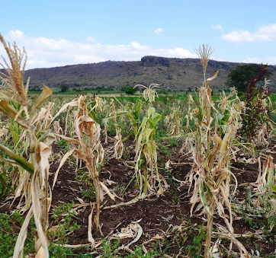
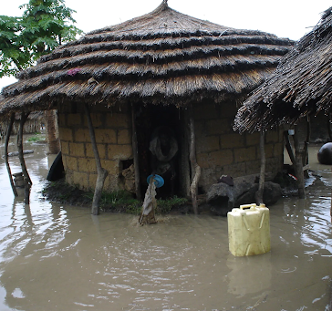
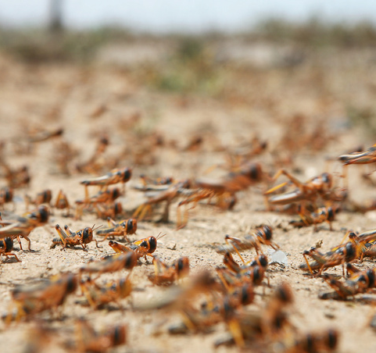
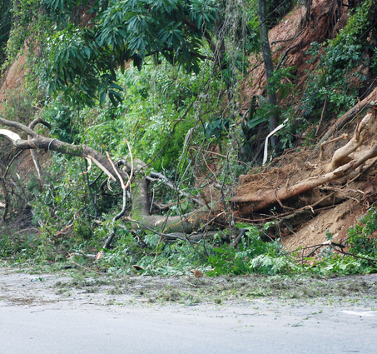
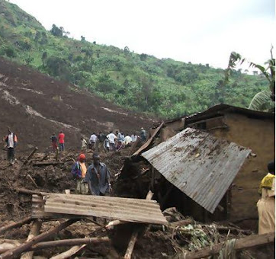
Problem & Opportunity
70%
Economic losses related to natural hazards, floods and droughts, in SSA ( Arogan et al.,2021)
<2%
2011-2012- Drought in the horn of Africa.
13 million people impacted. Food prices rise 230%. Malnutrition rates increase 30%
2020- Floods in East Africa.
1.3 million people impacted. Localized losses and crop damage
of the 8m people in agriculture sector in Uganda accessing Uganda Agricultural Insurance Scheme (Finance sector deepening Uganda 2018)
Insurance companies face difficulties in reaching smallholder farmers located in remote and dispersed areas with limited infrastructure and access to financial services.
2020- Locust Swarm in East Africa.
Over 500,000 acres of farmland affected
2010-Bududa land slides
Over 10,000 people displace and destruction of homes and agricultural land

Slide 3
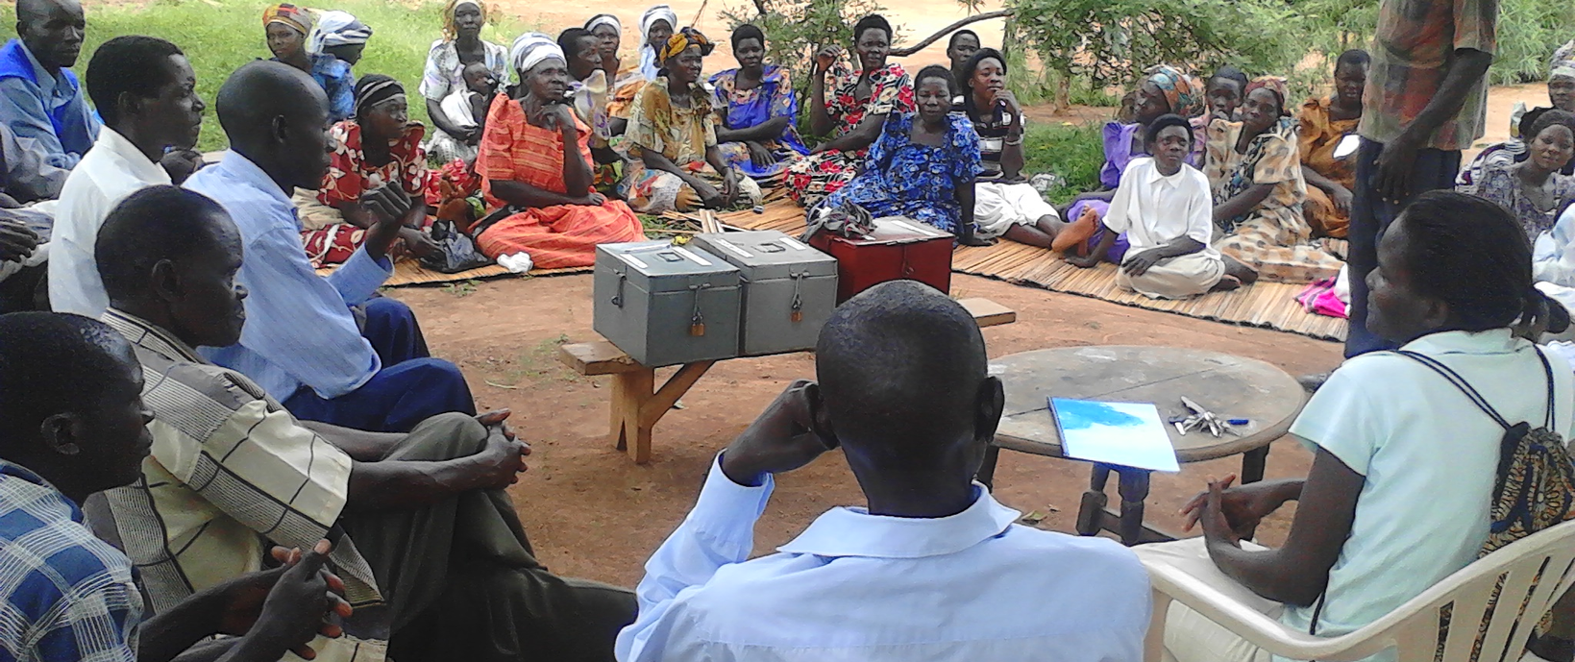
Solution: Village Savings and Insurance (VSAI)
VSAI leverages village savings and loan schemes to gather farmer information and aggregate premiums, creating an innovative and efficient solution to provide index insurance to smallholder farmers.

Slide 4
Solution: Village Savings and Loans Associations (VSLA)
VSLAs are community-based saving groups that are independent, self managed, transparent, self financing, accessible and profitable and are better fit for the poorest communities.
Access to customer base
Aggregated premiums
Trust and social capital
VSLAs are built in the community enabling a more effective outreach and sensitization of new insurance products.
Established customer base that are often difficult to reach through traditional distribution channels
Lower monitoring costs reducing premiums from $26-16 per acre

Slide 5
VSAI flow diagram
VSAI's value chain includes partnerships with local village savings and loan schemes, insurance companies, and agricultural extension agents.
Meteorological Experts
VSAI will utilize existing weather-collecting phone applications, as well as deploying field agents, to gather information from farmers. This information will be passed on to meteorological experts, who will use it to develop risk models that assess the probability of crop loss resulting from weather conditions.
Smallhold farmers who require affordable insurance products
VSAI serve as intermediaries to provide farmers with information on the policies and help them understand the benefits of purchasing insurance.
Insurance companies create policies based on the risk models and offer them to VSAI.
(VSAI)
Insurance Companies
Villiage Savings and Loans Associations
VSLAs provide VSAI with information on farmers, which includes relevant details such as the types of crops grown and the areas they cultivate.
VSAI provides the farmer information and risk models to insurance companies, which use the information to design policies for crop index insurance. VSAI collects premiums on behalf of farmers.
ROI
Capital for start-up costs
Investors

Slide 6
Stakeholders
Farmers
Yield protection
Weather risk mitigation
Livelihood preservation
Insurers
NGOs/
Public Sector
Customer retention
Maximize profits
Increase financial inclusion
VSAI stakeholders include farmers, insurers, investors, and government agencies.

Slide 7
Target market
Market Size
Insurance Companies in Uganda/East Africa offering Index Insurance:
TAM
$1.3 billion
Number of hectares in Uganda x Premium per hectare
SAM
$130 million
10% of the Total Addressable Market
UAP Insurance
Market Cap: $30 million USD
APA Insurance
Market Cap:
$20 million USD
ICEA Lion Insurance
Market Cap:
$65 million USD
SOM
$6.6 million
5% of the Serviceable Obtainable Market

Slide 8
Financial Projections
Competive Analysis
Target Customers | Large-scale farmers and agribusinesses | Large-scale farmers and agribusinesses | Large-scale farmers and agribusinesses | Large-scale farmers and agribusinesses | Smallholder Farmers
Services | Agricultural insurance, including crop, livestock, and health | Agricultural insurance, including crop, livestock, and health | Agricultural insurance, including crop, livestock, and health | Agricultural insurance, including crop, livestock, and health | Brokerage of Index Insurance for crops
Crop Index Insurance

Slide 9
VSAI: Revenue Model
VSAI operates as an insurance brokerage and earns revenues from commissions and service fees.
10%
$100
Commission on premiums (charged to insurers)
Service fee
(charged to VSLAs)
$3,372,414
Projected over 10 years
$2,320,984
Projected over 10 years

Slide 10
Financial Projections
Financial Projections Graph
Brokering fee revenue
Service fee revenue
Operating expenses
Total Revenue
Net profit
Assumptions
1.Insurance brokerage fee of 10%
2.Financing brokerage fee of $100/VSLA
3. VSAI brokers insurance for 350 VSLAs in their first year
4. By their 2nd year, VSAI brokers cover for 500 VSLAs
5. By the end of year 3, VSAI brokers insurance for 1000 VSLAs
6. From year 4 onwards, VSAI increases the number of VSLAs by 20% each year
7. VSAI's operating expenses grow by 20% between years 1-4, then remain constant for the remainder of the projection period
$1,500,000
$1,000,000
$500,000
$0
$-500,000
Year 1
Year 2
Year 3
Year 4
Year 5
Year 6
Year 7
Year 8
Year 9
Year 10

Slide 11
Investment summary
Office administration cost
8.3%
Management costs( salaries)
16.7%
Travel related expenses
8.3%
VSAI is seeking $535,000 in funding to support its expansion efforts, including product development and partnerships for Initial 3 years.
$535k
Office ware
33.3%
Legal compliance fees
33.3%

Slide 12
Risk and mitigation
Risks
Description
Mitigation
High-risk profile farmers are more inclined to buy insurance, resulting in increased payouts for insurers and potentially raising premiums for all farmers.
Utilize tech and data analytics for improved risk management, and partner with VSLAs to educate farmers on risk management and index insurance.
Adverse selection
The difference between actual losses and the payout received by farmers due to imperfect correlation between the index and actual crop losses.
Use sophisticated modeling techniques and data analytics to improve the accuracy of the index and reduce basis risk.
Basis risk
Climate change leading to more frequent and severe weather events, which can result in crop losses and increased payouts for insurers.
Work with meteorological agencies to access high-quality weather data, to develop and refine index insurance products that are tailored to specific weather patterns and risks.
Environmental

Slide 13
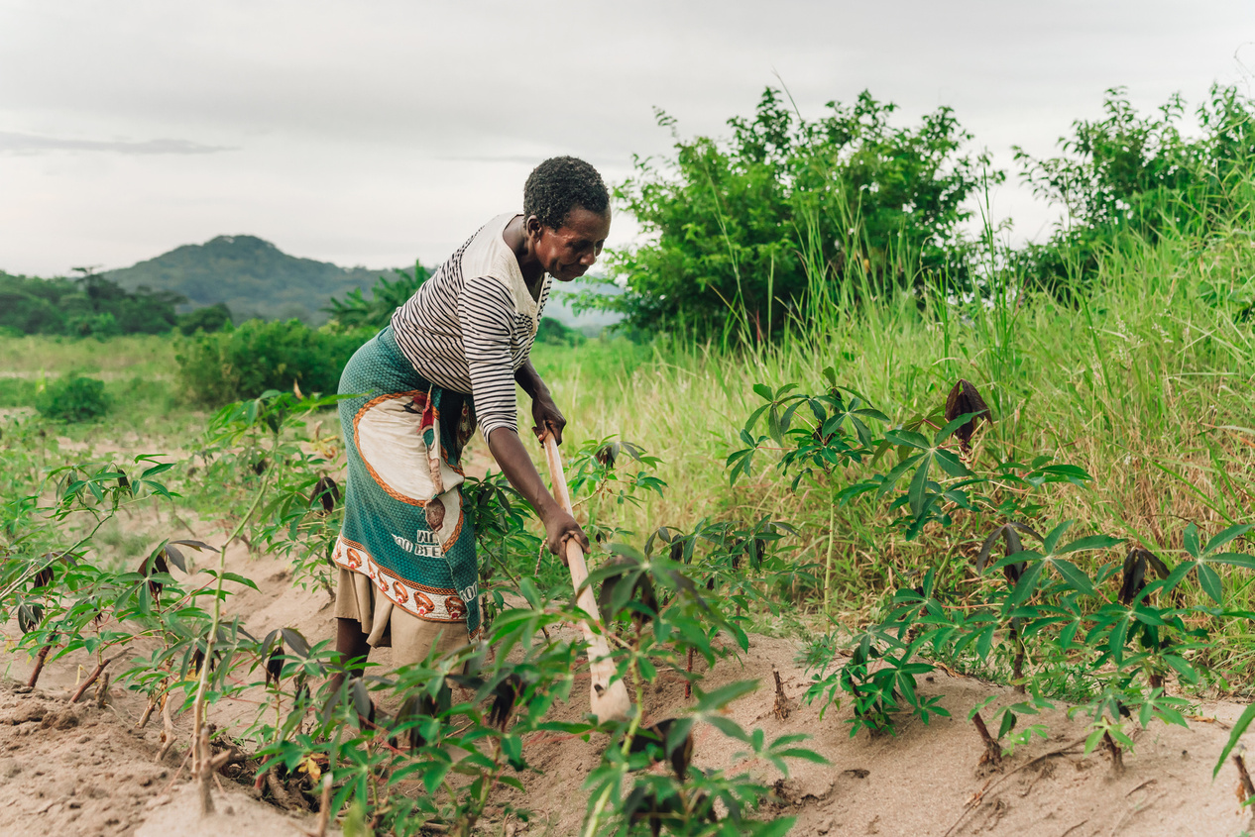
Impact assessment
VSAI will assess project impact against UN SDGs using measurable and forward
looking indicators that align with core value propos ition
Impact
KPI
Image of Farmers Harvesting
Build resilience among smallholder farmers and reduce their vulnerability to climate-related risks
Number of VSAI policies sold in areas prone to climate-related risks.
Reduce poverty among smallholder farmers by providing them with access to affordable insurance.
Number of smallholder farmers covered by VSAI.
Support the growth of the agricultural sector and provide more stable incomes for farmers.
Number of successful pay-outs made to farmers due to crop failure.
Provide insurance coverage to smallholder farmers who may otherwise be excluded from the formal financial sector.
Number of new VSLAs formed and the increase in income levels for participating farmers.

Slide 14
Team
Silver Tumwa
Lilian Kisebe
Nathan Emuron
He has 10 years experience in creating projects, guiding their implementation to completion. Facilitation skills for agribusiness marketing and development services in Uganda.
She has 3 year experience in
Food security project cycle management, practical skills in value chain development, participatory training methodologies in Uganda
Nathan Emuron has analytical skills and experience in business planning, budgeting and agribusiness linkages for over 5 years in Uganda.

Slide 15
Thank You

Slide 16
Consulted from;
Gulu University Faculty of Agriculture and Environment Department of rural development and Agribusiness. Dr Walter OdongO
Prof. Anthony Egeru and prof.Duncan Ongen Regional Universities Forum Uganda team (RUFORUM)
United Social Ventures Mr. Dan Waswa
Venture mentor Mobola Da silva
Venture attorney Katherine Orrick
Agrosure insurance company
References
Aragón, Fernando M., Francisco Oteiza, and Juan Pablo Rud. 2021. "Climate Change and Agriculture: Subsistence Farmers' Response to Extreme Heat." American Economic Journal: Economic Policy, 13 (1): 1-35.
Dewbre, C. J., Soglo, Production, F., Cervantes-Godoy, J., PIN, Amegnaglo, Y. Y., Akpa, A. F., Bickel, M., Sanyang, S., Ly, S., Kuiseu, J., Ama, S., Gautier, B. P., Officer, E. S., Officer, E. S., Eberlin, R., Officer, P., Branch, P. A., Oduro-ofori, E., … Swanson, B. E. (2014). The future of food and agriculture: trends and challenges. In The future of food and agriculture: trends and challenges (Vol. 4, Issue 4).
Global Commission on Adaptation. (2021). State and Trends in Adaptation. In State and Trends in Adaptation (Vol. 4).
World bank group. (2021). Climate Risk Country Profile: Uganda. In The World Bank Group (pp. 1–36). www.worldbank.org
World Bank. (2019). Agriculture Finance and Agriculture Insurance. In Financial Sector Brief (Issue August). http://www.worldbank.org/en/topic/financialsector/brief/agriculture-finance

Slide 17
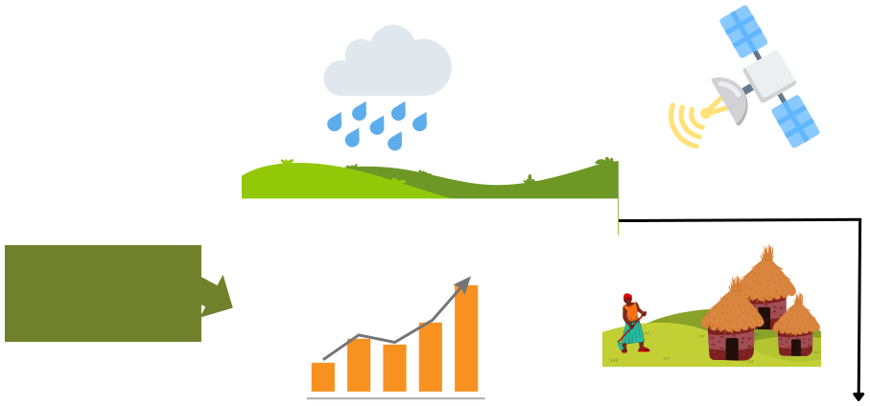
VSAI educates small holder farmers using index data
Weather event e.g. Rainfall
Vegetation levels
(a satellite-based index)
Index insurance is coverage based on an "index" correlate with farmer losses.
Index insurance.
Crop insurance
Average regional yield losses (an "area-based index)
Basis of Coverage
Based on index of loss
Based on actual loss
Agricultural Land
Premium Cost
Low
High
Farmers get paid only if this index falls above/below a pre- specified threshold.
Arcuately capture farmers reality on the ground
Premium Payment
In advance
Upon loss
Suitability
For smallholders
For large-scale farmers
Ensure farmer know they may not get a pay-out even when they suffer a loss
Risk sharing between policyholders
Risk Management
Risk transfer to insurer

Slide 18
Potential for Scale Up
VSLA Model has spread to 77 countries worldwide with more than 20 million people accessing safe savings, microcredit, and household welfare insurance from VSLA groups in SSA (Table 1)
VSLAs BY NUMBERS IN SELECTED COUNTRIES | VSLAs BY NUMBERS IN SELECTED COUNTRIES | VSLAs BY NUMBERS IN SELECTED COUNTRIES
Country | Uganda | Rwanda | Burundi | Ghana | Ethiopia
VSLA groups | 22,000 | 77,914 | 31,600 | 34,112 | 34,896
Membership | 600,000 | 2,025,152 | 774,237 | 852,800 | 691,397
Annual Savings | $2,900,000 | $34,022,554 | $14,865,350 | 15,000,000 | $7,476,088
% of Women | 75% | 72 | 71 | 68 | 71

Slide 19
VSAI: Financial Projections (10 Years)
Year | VSLAs | Small holder Farmers | No. of hectares per farmer | Number of Hectares | Premium Value | Total Premiums | Brokering commission revenue | Profesional Service fee revenue | Operating expenses | Total Revenue | Net profit | Cummalitive Net Profit
1 | 350 | 7,700 | 1.2 | 9,240 | 60 | 554,400 | 55,440 | 35,000 | 148,227 | 90,440 | -57,787 | -57,787
2 | 500 | 11,000 | 1.2 | 13,200 | 60 | 792,000 | 79,200 | 50,000 | 177,872 | 129,200 | -48,672 | -106,459
3 | 1000 | 22,000 | 1.2 | 26,400 | 60 | 1,584,000 | 158,400 | 100,000 | 213,447 | 258,400 | 44,953 | -61,506
4 | 1500 | 33,000 | 1.2 | 39,600 | 60 | 2,376,000 | 237,600 | 150,000 | 256,136 | 387,600 | 131,464 | 69,957
5 | 2000 | 44,000 | 1.2 | 52,800 | 60 | 3,168,000 | 316,800 | 200,000 | 268,943 | 516,800 | 247,857 | 317,814
6 | 2400 | 52,800 | 1.2 | 63,360 | 60 | 3,801,600 | 380,160 | 240,000 | 282,390 | 620,160 | 337,770 | 655,584
7 | 2880 | 63,360 | 1.2 | 76,032 | 60 | 4,561,920 | 456,192 | 288,000 | 296,510 | 744,192 | 447,682 | 1,103,266
8 | 3456 | 76,032 | 1.2 | 91,238 | 60 | 5,474,304 | 547,430 | 345,600 | 311,335 | 893,030 | 581,695 | 1,684,962
9 | 4147 | 91,238 | 1.2 | 109,486 | 60 | 6,569,165 | 656,916 | 414,720 | 326,902 | 1,071,636 | 744,734 | 2,429,696
10 | 4977 | 109,486 | 1.2 | 131,383 | 60 | 7,882,998 | 788,300 | 497,664 | 343,247 | 1,285,964 | 942,717 | 3,372,413

