Slide 1
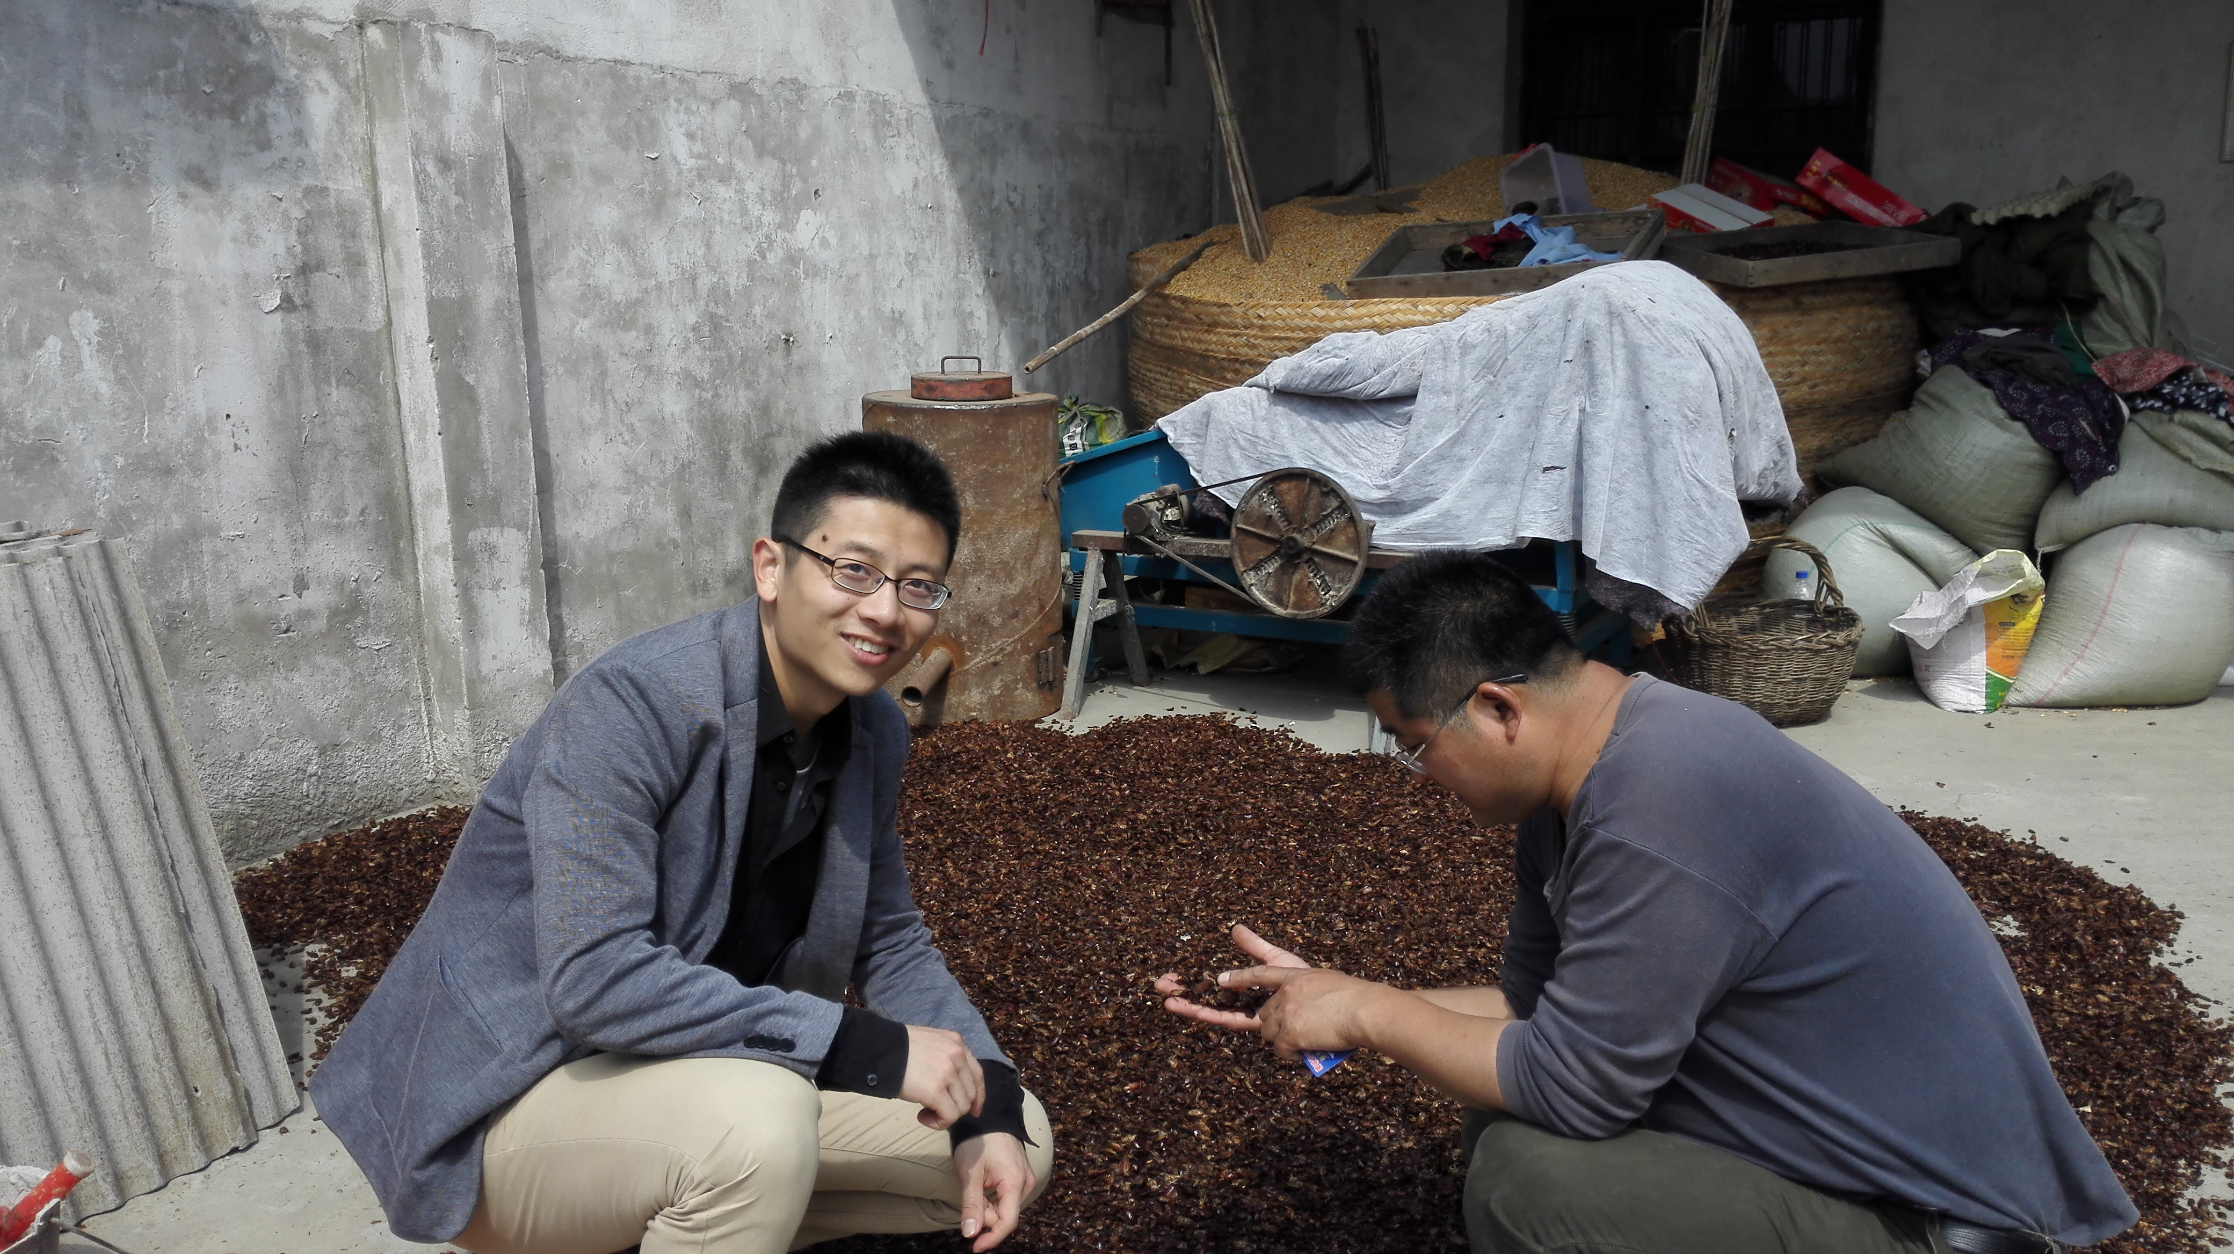
BIOGRICULTURE FUND
Creating sustainable income for resource-deprived villagers by investing in a proven productive insect farming business
15th April 2016

Slide 2

Executive Summary
BIOGRICULTURE
Business Model and Investment Thesis
Invest in existing insect farming companies to consolidate resources and provide support
Feasibility and Risk Mitigation
Target to meet market demand for animal feed and pharmaceutical materials
Challenges and Solution
Finance Overview and Exit Options
Identify insect farming as a solution to various social issues
Implementation Plan
Align economic interests of insect farmers and fund investors through profit sharing scheme
Gain first mover advantage in pilot province within 10 years and expand business across China
BIOGRICULTURE FUND aims to Invest in the channels and technologies essential to the insect farming sector in China, addressing the need for sustainable income and food productivity
Notes:
Enrique

Slide 3
Serious challenges are ahead of us …
Social
Resource
BIOGRICULTURE
Exponential growth in global population in emerging countries
Large population living under the poverty line
Extreme income disparities (Urban/Coastal vs. Rural/Inland)
99% poor live in rural areas
Many have no arable land
Lack of skills and technologies
  Population growth puts huge pressure on food supply
  Insufficient supply in the long run under current farming methods
  Ultimate constraints on arable land, fresh water and animal feed
  New source of nutrients needed
Notes:
Louis

Slide 4
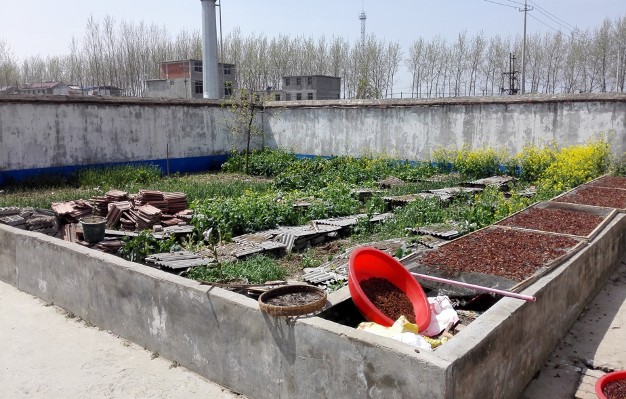
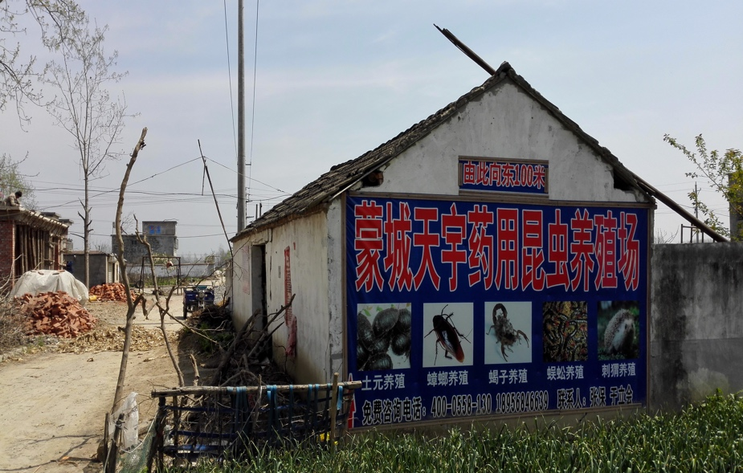
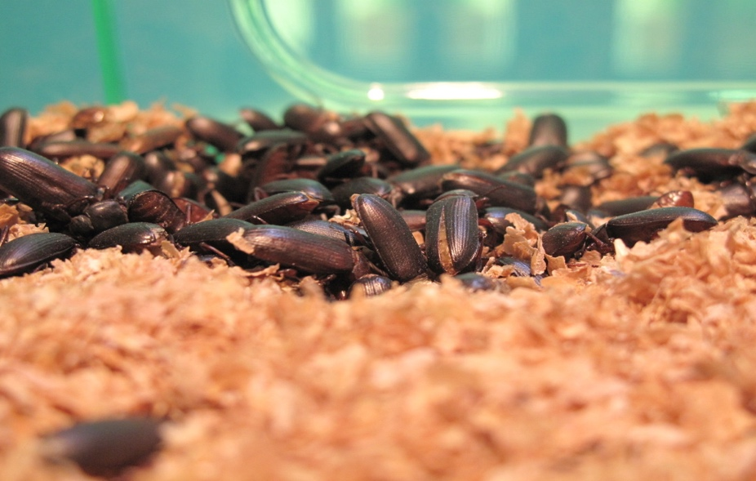
… but BIOGRICULTURE FUND has come up with SOLUTION!
BIOGRICULTURE
Invest in the channels and technologies essential to the insect farming sector in China, addressing the need for sustainable income and food productivity
Notes:
Louis

Slide 5
The THREEFOLD impact of insect farming are attractive …
BIOGRICULTURE
Improve employment rate in rural areas
Improve efficiency in land usage
Promote rural areas development
INSECT FARMING
Social
Economical
Environmental
Save natural resources for agriculture
Reduce greenhouse gas emission
Mitigate overfishing
Transform organic waste into useful biomass
Improve income level
Increase in protein and food productivity
Reduce the costs of farmed poultry and fish
Insect Farming is an ideal solution to address social, environmental and economical issues derived from traditional farming methods.
Source: Team Analysis
Notes:
Duncan

Slide 6




Innovative business model by us OPTIMIZES insect farming’s benefits
BIOGRICULTURE
Biogriculture Capital (GP)
Impact Investors (LP)
BIOGRICULTURE FUND
BIOGRICULTURE
Poultry & Fish Farms
Insect Feed Suppliers
Operating Companies
Pharmaceutical Factories
Insect Farms
Source: Team Analysis

Slide 7
BIOGRICULTURE FUND carries important missions
BIOGRICULTURE
RESOURCES INTEGRATION
Invest in existing insect farming companies to consolidate resources and provide technologies and support for insect farmers
SCALABILITY
Enable the business model to be replicated and scaled up across China to create higher social and economic values
INCOME LEVEL ENHANCEMENT
US$ 1.4-3.4K p.a. for insect farmers
potentially 120% above current annual income of Chinese farmers (US$ 1.5K)
Source: Team Analysis

Slide 8
Insect products as animal feed are indeed feasible because …
BIOGRICULTURE
MARKET DEMAND
Food production need to increase by 70% to feed the global population in 2050
COST ADVANTAGE
Insect products would be 15% cheaper than existing fishmeal (current market price US$1,550/ton)
PROTEIN PRODUCTION
Insect farm: average 150 tons per hectare vs. soybean farm: 0.9 ton per hectare per year
Half of global animal feed (~30million tons) imported by China every year
Estimated value of current total fish and poultry feed: US$ 24 billion
Notes:
Oliver

Slide 9
We noticed several potential risks but mitigation solutions are in place …
BIOGRICULTURE
REGULATION
PRODUCT QUALITY
SELLING PRICE OF INSECT PRODUCTS
MARKET RECOGNITION
Stringent regulation from European Parliament approves insect as animal feed
Technology driven rearing process
Regular on-site inspection by specialists
Long term forward contract with insect product buyer (e.g. poultry and fish farms)
Strategic partnership with local authorities or NGOs to promote insect products as animal feed
While using insect as animal feed or direct consumption inherit several risk factors, mitigation strategies are in place to minimize such risk factors
Source: Team Analysis
Notes:
Duncan

Slide 10
We intend to implement the master plan as follows …
BIOGRICULTURE
Task | Day 180 | Day 360 | Year 2 | Year 3 | Year 4-6 | Year 7-10
Short-term Enhance R&D team and acquire technical know-how and patents Consolidate regional insect farming resources Strengthen regional manufacturing and distribution network and achieve vertical integration
Long-term Expand businesses to neighbor provinces Extend product portfolio to other segment (e.g. pharmaceutical )
Source: Team Analysis
Notes:
Oliver

Slide 11
Our investment achievements will be reliable and fascinating
BIOGRICULTURE
Investment Highlights
Key Assumptions Summary
Investment Requirement:
US$ 20 million
Selected Pilot Areas of Investment: 4
Projected Exit Time:
In 10 years
IRR: around 15% for next 10 years
(Base Case)
Income of Farmers:
US$ 1.4-3.4K p.a.
(potentially 120% above China rural average 1.5K)
Selling Price of Insect Meal
Substantially below comparable products globally by 30%
Increasing at the pace of China’s inflation rate
Production Scale
Initially rapid growing at 20% for 2 years
Moderate growing at 10% for next 3 years
Sustainable growing at 5% or less afterwards
Number of Farmers Hired
200 farmers per area initially (i.e. 800 farmers in total)
Increase at the rate of China’s inflation
Exit (Terminal) Value Multiple
Comparable Multiple at 7x EV/EBITDA
Around 15% IRR over the 10-year investment horizon, and farmers’ individual income level will be way above rural residents’ average in Anhui, China
Source: Team Analysis
Notes:
Oliver + Duncan

Slide 12
Financial Forecast for Consolidated Operating Companies per Area (2017-2026)
BIOGRICULTURE
Steady increase in operating scale and profitability makes the operating companies attractive for other potential investors, which creates various exit options for Biogriculture Fund
Source: Team Analysis

Slide 13
A few exit options for our investment and we have a preference
BIOGRICULTURE
1
Trade Sale (*Preferred exit option)
Trade sale is likely to one of the larger listed agribusiness corporation COFCO Group (China’s largest food processing, manufacturer and trader) – likely to acquire Biogriculture business should the Group expect to expand feed source to insect farming Monsanto, ADM – likely to acquire Biogriculture business to realize China market entrance, the acquisition will be subjected to fewer restrictions than traditional agriculture sectors Domestic mid-scale competitors – likely to acquire Biogriculture business to achieve business line integration and expansion, increase market share and presence
Financial Sale
PE/VC funds always interested where there is value Since 1 January 2013, total Private Equity investment in global Agriculture / Fishery industry ~US$1,164 million, total Venture Capital investment ~US$264 million. Among total investment, China-targeted investments accounts for more than 65%.
Initial Public Offering
List in China / Hong Kong Profitability expected to be stabilized after 5-8 years of operation, it would be ready for public listing where the company has strong presence Success examples: SINOFERT (HK:00297), CHINA BLUECHEM (HK:03983) etc.
2
3
Source: Team Analysis

Slide 14
Executive Summary
BIOGRICULTURE
Business Model and Investment Thesis
Invest in existing insect farming companies to consolidate resources and provide support
Feasibility and Risk Mitigation
Target to meet market demand for animal feed and pharmaceutical materials
Challenges and Solution
Finance Overview and Exit Options
Identify insect farming as a solution to various social issues
Implementation Plan
Align economic interests of insect farmers and fund investors through profit sharing scheme
Gain first mover advantage in pilot province within 10 years and expand business across China
Biogriculture Fund aims to Invest in the channels and technologies essential to the insect farming sector in China, addressing the need for sustainable income and food productivity
Notes:
Enrique

Slide 15
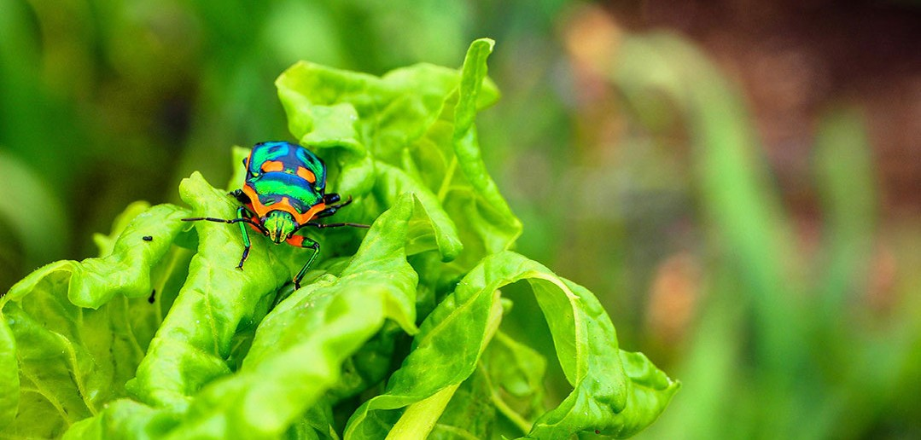
Thank you!
“If you care about the poorest, you care about agriculture.”
-- Bill Gates
Notes:
Oliver + Duncan

Slide 16
15th April 2016
Appendices

Slide 17
Content of Appendices
BIOGRICULTURE
Fund Profile
Process Cycle of Insect Farming as Animal Feed
Case Study by Our Team in Anhui Province
Scalability
Impact Analysis in Detail
Risk and Mitigation Analysis in Detail
Regulation Roadmap in EU (Using insect as food and feed) – A Reference
Financial Assumptions in Detail
Financial Forecast (2017-2026) – Spreadsheet Illustration
Fund Management Team Profile

Slide 18
1. Fund Profile
BIOGRICULTURE
BIOGRICULTURE FUND PROFILE
Total Fund Size | US$20 million
Minimum Investment | US$1 million
Target Beneficial Population | 800 insect farmers
Term of Investment | 10 years
Regional Focus | Rural areas in Anhui Province, People’s Republic of China
Target Investors | Impact investors looking for innovative and sustainable farming solutions in emerging markets
Target Gross Return | 15% IRR p.a. over 10-year investment horizon
Management Fees | 2% management fee on funds under management + 20% incentive fee
Potential Exit Strategy | Trade sale / Financial sale / IPO

Slide 19
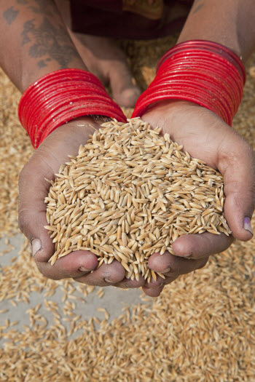
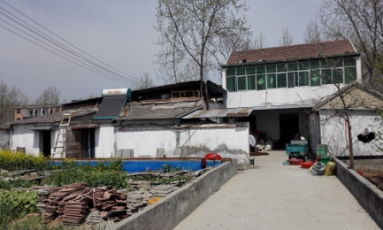
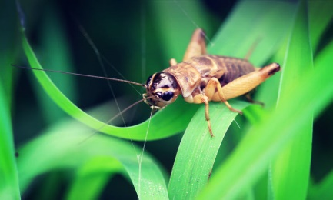
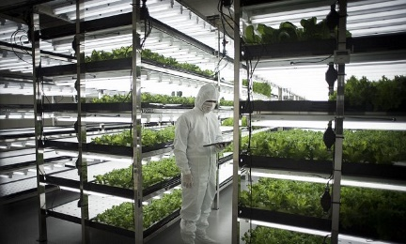
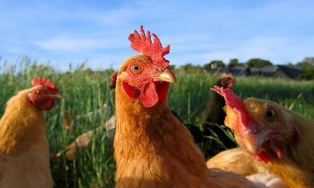
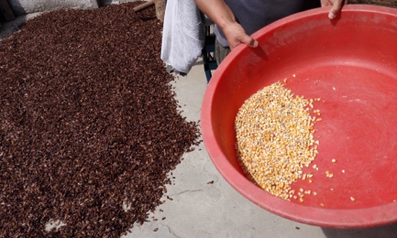
2. Process Cycle of Insect Farming as Animal Feed
BIOGRICULTURE
Collection of Organic Food Waste Or Biomass
Deliver To Farms For Processing
Insects Fed On Waste
Insect farming operations & management
Chicken (And Fish) Fed on Insect Products
Dried Insects Packed As Feed
Larval Growth From Recycled Nutrients
Source: Team Analysis

Slide 20
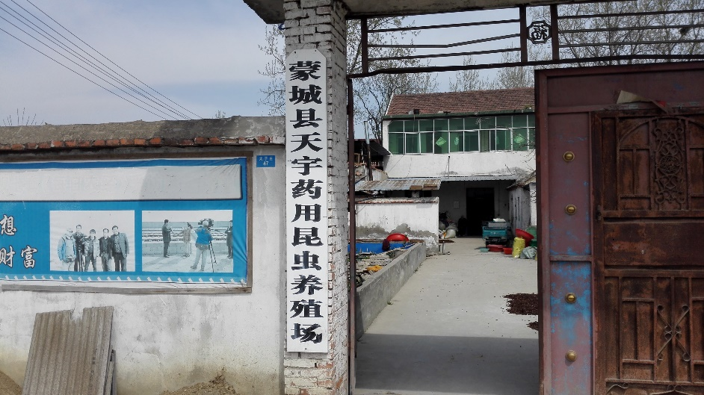
3. Case Study by Our Team in Anhui Province
BIOGRICULTURE
Tianyu Pharmaceutical Insect Farm
Location: Mengcheng, Bozhou City, Anhui Province, the PRC
Business:
  5 species of insect
  Partnership with 200 families in Bozhou, 1,000+ families across China
Cost structure:
  Capex: RMB160,000
  Equipment: 200~300 asbestos tiles = 500m²
  Labor: 3 workers
  Feed: RMB1 per kilogram
American cockroach annual production capacity:
  Live Insect: 12 tons
  Dried Insect Powder: 3 tons
  Total business dried insect: 20 tons
Annual profit as an operating company: RMB300,000

Slide 21
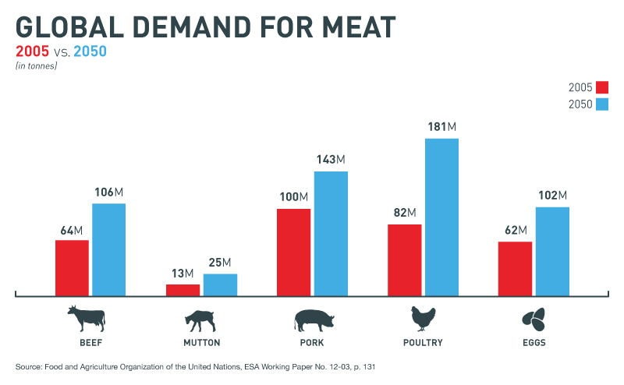
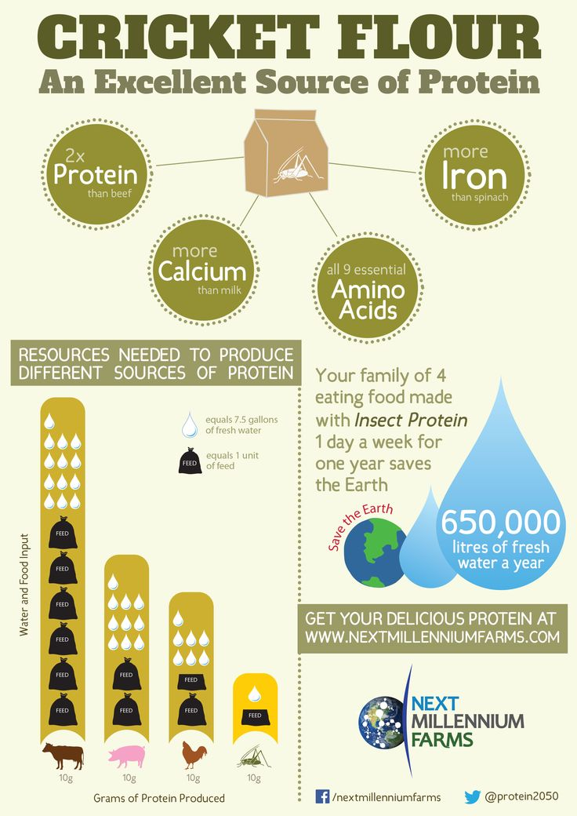
4. Scalability Analysis in Detail
BIOGRICULTURE
More batches per year to increase annual protein production
Expanded product usage (e.g. biogas or fertilizers) to increase demand
Higher feed demand to increase sales revenue
Higher protein market price to increase sales revenue
Cheaper insect feed to make insect products more profitable
Source: http://www.entomoanthro.org/blog
https://www.pinterest.com/bigcricketfarms/everything-crickets/

Slide 22
5. Impact Analysis in Detail
BIOGRICULTURE
Type of impact | Positive Impact | Direct Beneficiary | Measurement | Time Frame
SOCIAL | Increase in protein and food productivity | People who suffer from famine | Protein production yield (ton per hectare of land) | Mid-term
 | Improve efficiency in land usage | Villagers and rural area residents | Area of farmland saved, residential living space per capita | Long-term
 | Promote rural areas development; promote local community bonding | Villagers and rural area residents | Living standard benchmark; disease/death rate | Long-term
ENVIRONMENTAL | Reduce natural resources for agriculture; reduce greenhouse gas emission | People who suffer from climate change | CO2 emission/water usage per ton of protein produced | Long-term
 | Mitigate the overfishing problem | Endangered fish species | Population of endangered fish species | Long-term
 | Transform organic waste to useful biomass | Farmers | Percent of landfill used for organic waste | Long-term
ECONOMICAL | Improve income level | Insect farmers | Local GDP per capita | Short-term
 | Improve employment rate in rural areas | Insect farmers | Number of jobs created | Short-term
 | Reduce price of farmed fish/poultry | Consumers | Market price benchmark | Mid-term
Source: Team Analysis
Notes:
Duncan

Slide 23
6. Risk and Mitigation Analysis in Detail
BIOGRICULTURE
Risks | Mitigation Strategies
Insect used as feed for livestock might not be legalized in some countries | Regulatory bodies including European Food Safety Authority and European Commission has indicated that insect served as food and animal feed will be legalized soon
Stringent regional and local regulations on certain type of insect and insect flee | Implement technological solution to ensure rearing room is properly control
Insect farmer fail to meet production standard | Allocate more specialties to train insect farmers; Implement a quality control system
Insect made animal feed demand drop / fluctuation in insect feed price | Implement long-term fixed price contract with insect made animal feed buyers
People refuse to consume product that is fed by insect | Enhance marketing campaign; Form strategic partnership with authorities to clear people’s ethical concerns
Source: Team Analysis
Notes:
Duncan

Slide 24
7. Regulation Roadmap in EU (Using insect as food and feed) – A Reference
BIOGRICULTURE
Oct-2015
Nov-2015
Risk profile related to production and consumption of insects as food and feed published by EFSA (European Food Safety Authority):
When currently allowed feed materials are used as substrate to feed insects, the possible occurrence of microbiological hazards is expected to be comparable to their occurrence in other non-processed sources of protein of animal origin
The occurrence of prions – abnormal proteins that can cause diseases such as Bovine Spongiform Encephalopathy (BSE) in cattle and Creutzfeldt-Jakob Disease in humans – is expected to be equal or lower if the substrate does not include protein derived from humans (manure) or ruminants
Hazards related to the environment are expected to be comparable to other animal production systems
(Source: http://www.efsa.europa.eu/en/efsajournal/pub/4257)
The co-legislators the European Parliament and the Council have reached an agreement on the new Regulation (Regulation (EU) 2015/2283) regarding Novel Food which was adopted on 25 November 2015
The scope of this Regulation should, in principle, remain the same as the scope of Regulation (EC) No 258/97. However, on the basis of scientific and technological developments that have occurred since 1997, it is appropriate to review, clarify and update the categories of food which constitute novel foods. Those categories should cover whole insects and their parts
Novel Food is defined as food that has not been consumed to a significant degree by humans in the EU prior to 1997, when the first Regulation on novel food came into force. 'Novel Food' can be newly developed, innovative food or food produced using new technologies and production processes as well as food traditionally eaten outside of the EU
Examples of Novel Food: agriculture products from third countries (chia seeds) or extracts from existing food (rapeseed protein)
(Source: http://eur-lex.europa.eu/legal-content/EN/TXT/?qid=1449760581954&uri=OJ:JOL_2015_327_R_0001)
Jan-2016
Today
European Commission published a long waited article on Circular Economy Package
It stated that “use of former foodstuffs for animal feed” will no longer be considered as “waste”
(Source http://www.europarl.europa.eu/RegData/etudes/BRIE/2016/573899/EPRS_BRI(2016)573899_EN.PDF)
3 EU Member States – Belgium, France and the Netherlands – have performed risk assessments related to insects as food or feed
The European Commission is currently co-financing a research project to explore the feasibility of using insect protein for feed
The Commission is developing policy in the areas of novel foods and animal feed to reflect the potential use of insects as food and feed
(Source: http://www.efsa.europa.eu/en/press/news/151008a)

Slide 25
8. Financial Assumptions in Detail
BIOGRICULTURE
Financial forecast based on estimation of implementation of insect farming business model in FOUR (4) selected areas in Anhui Province, China.
Note: 1. Research Report “Insects A new sustainable protein source for feed and food Lars Lau Heckmann”; 2. NYU Research Estimation; 3 Team Analysis

Slide 26
9. Financial Forecast (2017-2026) – Spreadsheet Illustration
BIOGRICULTURE

Slide 27
10. Fund Management Team Profile
BIOGRICULTURE
Oliver BU
Louis CHAN
Enrique FANG
Duncan WONG
Former tax senior consultant and China business advisor at PricewaterhouseCoopers Hong Kong, specialized in group structuring and investment consulting
Private banker with over nine years of wealth management experiences. Key focus area includes asset allocation, portfolio construction and risk management
Former sustainable finance campaigner at Greenpeace East Asia focusing on energy and climate change with six year experience in prime brokerage, fixed income and investment advisory at Morgan Stanley China
Quantitative trader with over five years experience in high frequency algorithmic trading. Key focus areas include quantitative analysis and risk management

