Slide 1
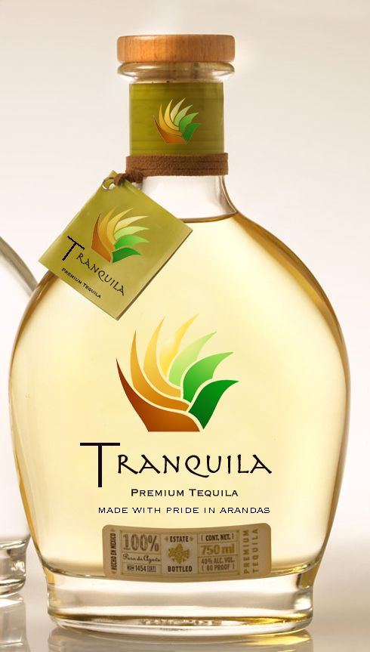
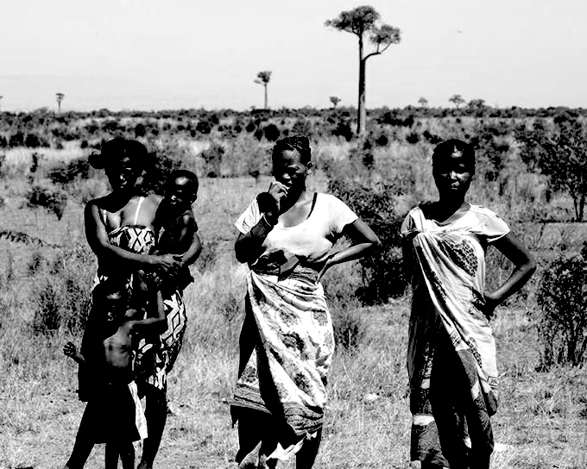
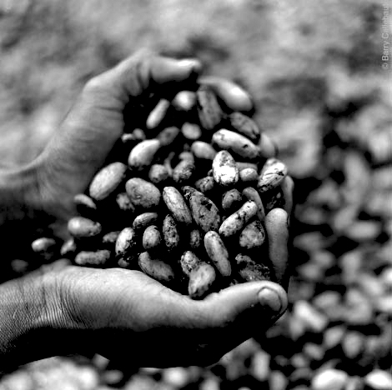
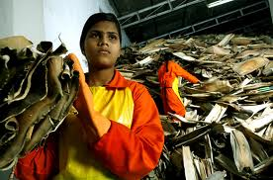
Nature for Growth
$25M fund
~10 deals
$20M upfront and $5M in reserves for carry-over investments
Strategy: Investing in existing companies in emerging markets focused on transforming natural resources into commercial products by keeping the value chain in the country
Exit: Recapitalizations, IPO, or selling to larger sponsors and/or strategic buyers
INVESTING WITH SOCIAL IMPACT

Slide 2
NFG will work with the invested companies to optimize operations and achieve financial and social returns
IIIC: Group A3
Work hand in hand with community
Provide capital and business skills/ knowledge to local communities
Achieve scale and scope
Build up a critical and scalable business knowledge level
Social, economic and environmental results
Economic and social infrastructures impact and create local spillover effects to other industries
Export final product to developed countries
Export locally manufactured high value products internationally
COMMUNITY DEVELOPMENT

Slide 3
NFG will use a six-step methodology to identify the best investment opportunities and provide support to companies in their growth
IIIC: Group A3
D
I
L
I
G
E
N
C
E
Select Country and Natural Resource
Select emerging market based on natural resources exports, local manufacturing opportunities, and regulatory requirements
Screen Companies
Create a list of companies currently manufacturing selected natural resource into end product in the market
Filter Companies
Test identified companies against social and financial criteria and identify high potential investments (FACES Grading System)
Select Company
Define financing and investment plan (e.g. stages, shares, additional terms and performance measures)
G
R
O
W
T
H
Strategy Development and Support
Develop operations and marketing strategy and key performance indicators for monitoring performance and social metrics
Implementation & Supervision
Identify and address gaps in actual and expected performance
INVESTMENT METHODOLOGY

Slide 4
As a part of the filter companies step, we have developed a grading scheme to evaluate the different investment opportunities
IIIC: Group A3
Impact Factor | Sample of questions to ask
Financial Return | What are the projections on the company financial statements? How can we capture the value in the company?
Accountability | What is the current governance structure in the company? What performance controls are present in the company?
Community Benefits | What employment benefits would our investment bring? What is the current remuneration level at the company?
Environment Impact | What are the environmental implications of our investment? What externalities are we creating?
Sustainability | How prepared is the management team? Will training be successful? Can this model be passed to locals in the mid term?
SOCIAL INVESTMENT GRADING

Slide 5
Example 2: Verterra™ is a proven and working example of the legitimacy of NFG’s investment strategy
IIIC: Group A3
F | 90% revenue and 202% gross margin increase in 2010 EBITDA and Net Income figures improving significantly in 2010
A | Founder/CEO is a Columbia Business School Graduate Awards: Natural Products Association (2x best new product of the year) Inducted into the Cooper Hewitt Design Museum for sustainable design
C | 200 employees supporting 600 families at Shimoga (40% unemployment) Wages50% above market,including health care, 75% women Production waste given to community, to sell as compost
E | Produced from fallen leaves using only steam heat an pressure Disposable, no chemical glues lacquers or bonding agents Packaging made of recycled materials
S | Retail 1000 stores, including Whole Foods National food service distribution through 5 distributors The community will set up a high grade natural fertilizer facility within two years
The size of the housewares market is the U.S. is ~$58 billion (retail) with steady growth of 2-3% per year
Casual tableware is the segment with the highest growth reflecting a general change in lifestyle
VERTERRA EXAMPLE
Notes: (1) Figures from the National Housewares Manufacturers Association

Slide 6
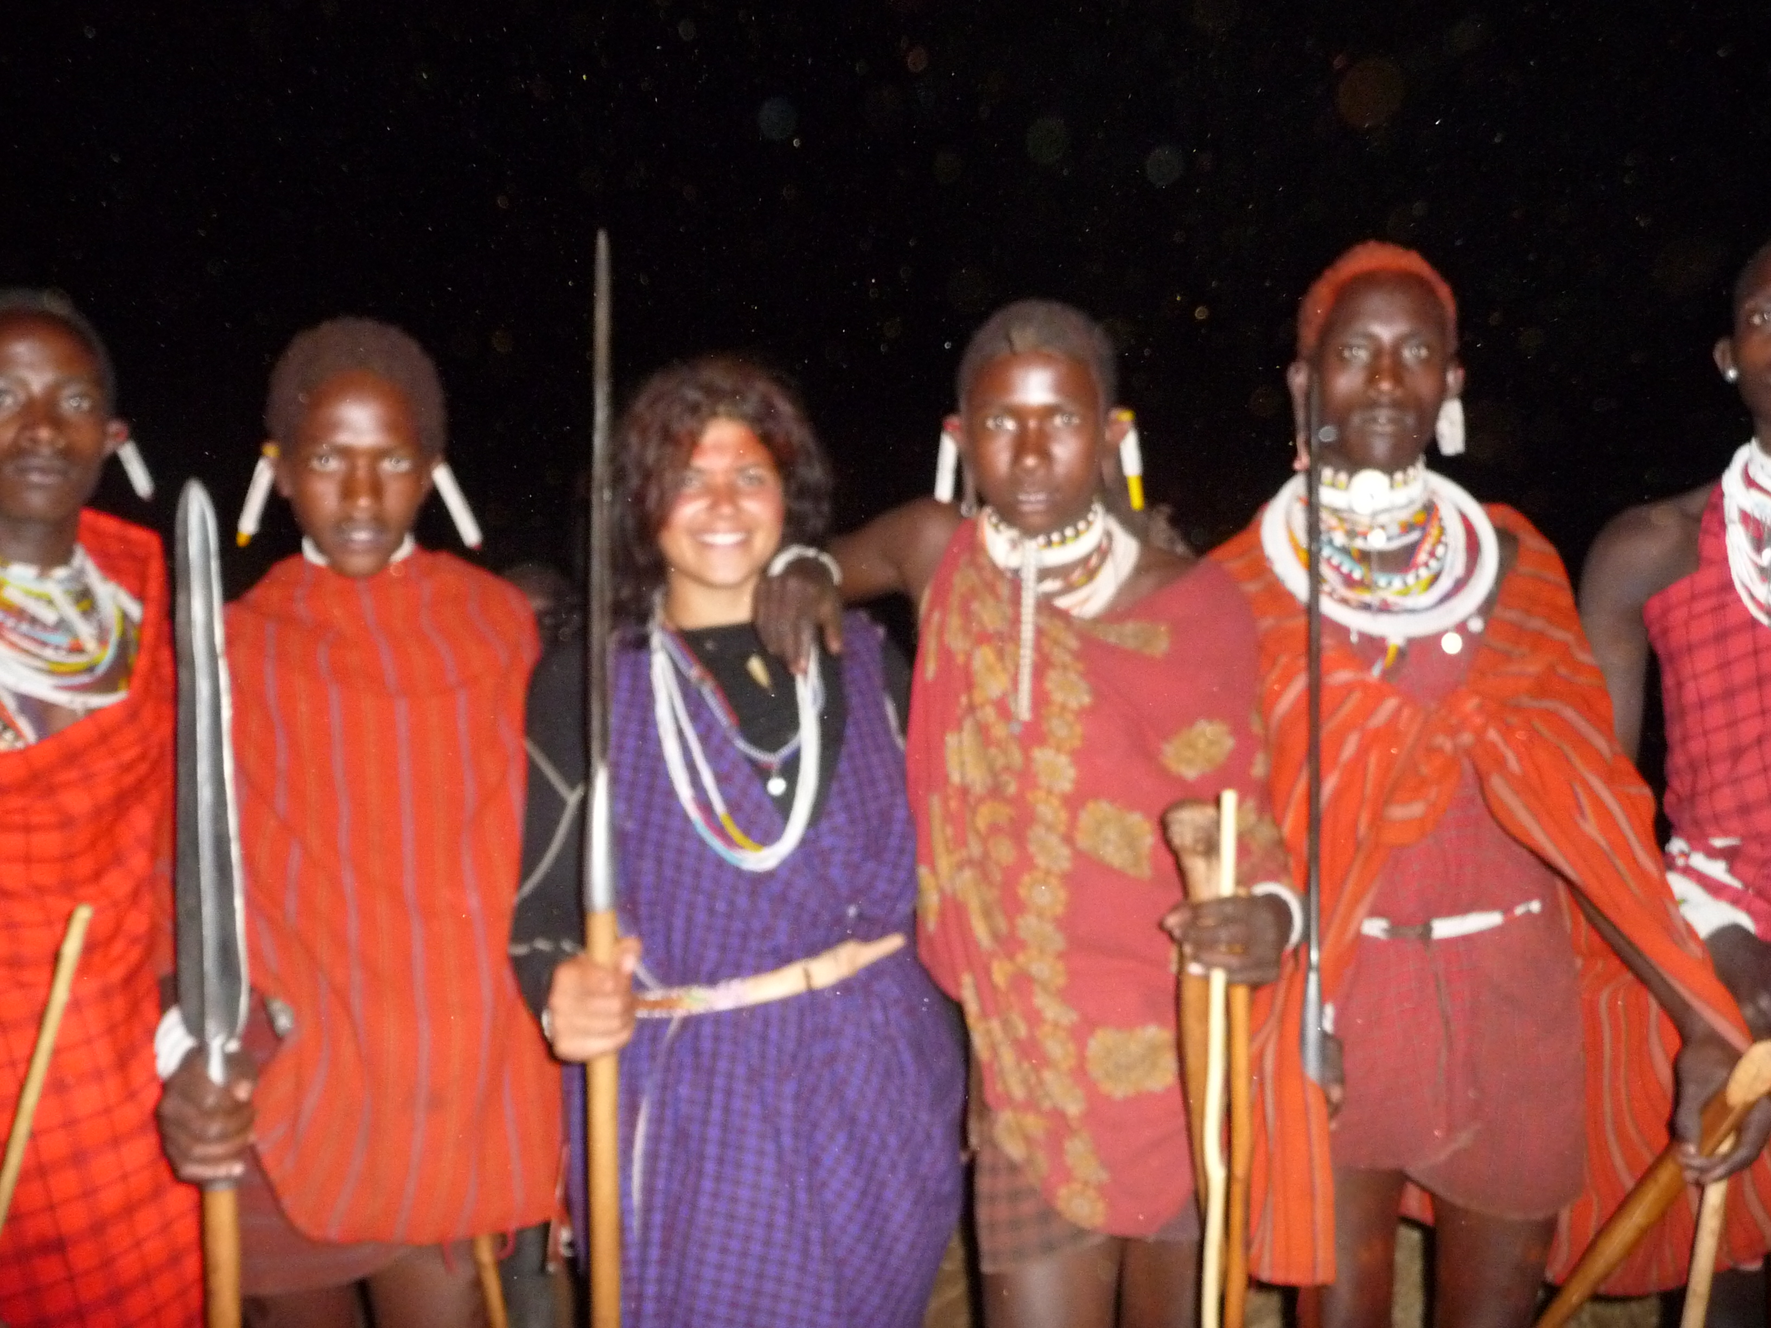
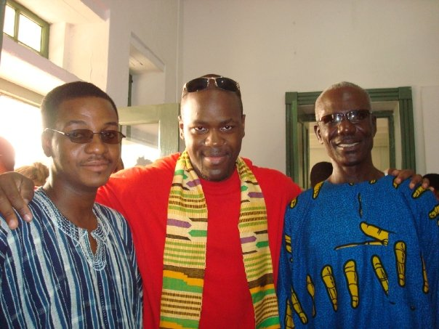
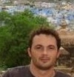
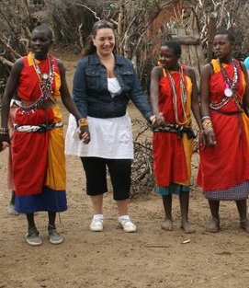
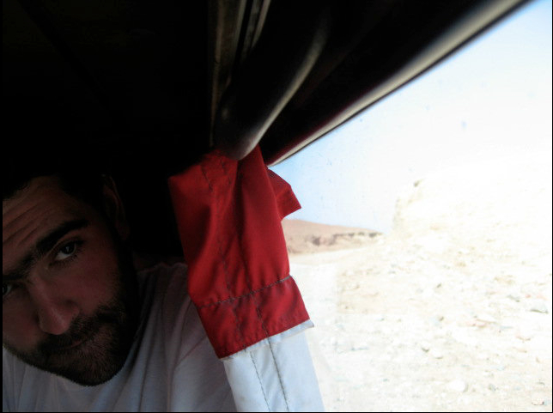
NFG has an international team with solid international business, finance, entrepreneurship, marketing and legal experience
IIIC: Group A3
Entrepreneurship,
Business Development
Business Development, Growth Strategy
Legal,
Finance
Growth Strategy,
Corporate Development
Brand
Management
Emerging Markets | X | X | X | X | X
Finance |  | X | X | X
Entrepreneurship |  | X | X
Marketing | X |  |  |  | X
Business Development | X |  | X
Operations |  | X |  | X
IT Strategy |  |  |  | X
Legal / Regulatory |  |  | X
MANAGEMENT TEAM

Slide 7
Tequila Deal: Tranquila, an exclusive tequila brand that will maximize financial and social return through laser-focus implementation
IIIC: Group A3
F | 23.7% Return over seven-year period, 3.0x Cash-on-Cash Return Available grants could create 29.7% Return, 3.7x Cash-on-Cash Return
A | Experienced management team with a nationally distributed wine brand Local monitoring
C | Leverage local expertise on agave production to increase connectedness to brand and quality of tequila Pay living wage plus benefits
E | Ensure continued growth and sustainability of agave plant Rebuild local tequila manufacturing Recycled packaging
S | Access to established distribution channels Develop local labor skills
70% of current premium tequila is bottled outside Mexico
Tequila is rapidly growing: 45% in the United States and 26% in Mexico in the past five years
Arandasregion is missing out from the premium Tequila high growth and profit margins (2x vs. lower end ones)
DUE DILIGENCE

Slide 8
Tequila Deal: Analysis of similar cost structures
IIIC: Group A3

Slide 9
Tequila Deal: Analysis depicting of the profit formula
IIIC: Group A3
7-year Revenue CAGR: 34,0% IRR: 23.7% Cash-on-Cash: 3.0x
Notes:
Return is function of: (1) Investment, (2)Revenue gains from marketing and established distribution channels, (3) COGS starts higher in 1st year dropping to 45% (still above average in industry and potential for lower number), (3)
Assuming 3500 cases sold in first year

Slide 10
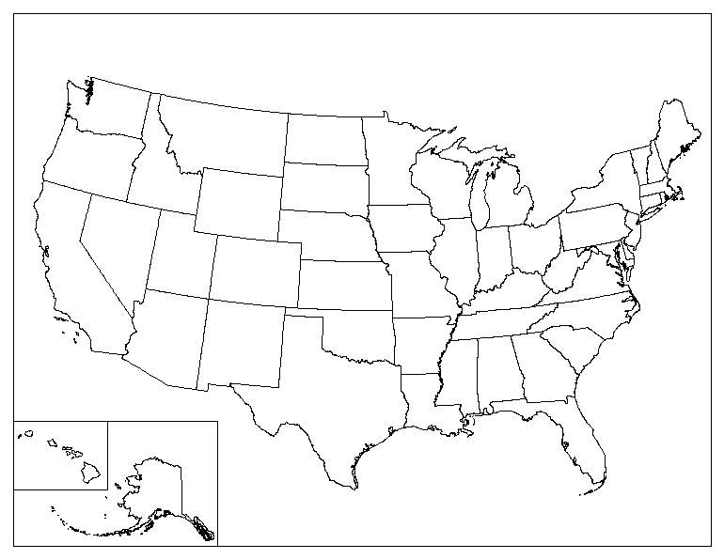
Roll Up
IIIC: Group A3
INTER AMERICAN FOUNDATION GRANTS
As low as $25k and high as $400k provided
Awarded around $16.84m dollars to 76 projects in 2010 (Avg. around $222K per projects
$250K grant creates 29.7% return, 3.7x cash-on-cash return
Phase 2: New York
Phase 1: Los Angeles
POTENTIAL PARTNERSHIPS & JOINT VENTURES
OPIC sponsored funds
Endeavor
Other local private equity funds and investors
Phase 3: Houston
10
10
10

Slide 11
Appendix: The Tequila example
IIIC: Group A3
 | General Principle | Tequila Deal
Brand Image | Leverage local sourcing and link to community as a competitive advantage for brand positioning | Create an aspirational, exclusive brand while down-to-earth and intrinsically powerful. Position as a unique blend between the perennial properties of the Agave, the heritage of the Earth and the tradition of the product manufactured from its original source in Mexico.
Competitive Position | Avoid direct competition with established multinationals. Select high potential niche and focus on a targeted point of difference to stimulate growth | Avoid initially competing with corporate giants (e.g. Don Julio and Herradura). Build distribution and maximize margins by establishing an exclusive, hard to access power brand.
Consumer Acquisition | Focus on high margin, high growth potential and established consumer segments | Laser focus on power groups and influencers interested in green, sustainability or economic development and attracted to originality and heritage (e.g. Antonio Banderas, Cameron Diaz)
Distribution Strategy | Phased distribution build-up, focusing on creating the necessity to stimulate retail demand in areas with high concentration of target customer. | Initial focus on off-trade commercialization. Create exclusivity agreements with key strategic partners for entering, launch on-trade once demand and scarcity perception has created a sense of necessity. Once demand is built, then mass distribute.
Product offering | Limited line up, consistent with sustainability and leveraging the key strengths of the resource and local manpower | Initial focus on exclusive brand with limited skus for off-trade commercialization. Follow a “hero” brand strategy and expand to flagship overtime.
Communication | Maximize effectiveness by focusing communication in single-minded message through selected targeted media | Focus on highly targeted communication. Advertise in recognized media, which has high reach among target (i.e. celebrity endorsement, yacht/surfing magazines, Robb Report). Leverage influencers for credibility.
PR/ Local Sponsorships | Link to the community in order to obtain support from key influencers. Leverage community benefits and advantage on local impact. | Leverage the competitive advantage of being a power brand created from the source of the tequila heritage. Link with authenticity, community involvement and intrinsic personal power with a celebrity endorsement (e.g. Banderas, Diaz). Identify key personalities and societies and sponsor events and appearances.
MARKETING AND GROWTH

Slide 12
Appendix: The Tequila advertising and marketing plan assumptions
IIIC: Group A3
MARKETING AND GROWTH

Slide 13
IIIC: Group A3
Appendix
Risk Type | Main Threats | Mitigating Strategy
Political/ Macroeconomic | Lack of stability in head of state, and in regional authorities Political unrest/ warfare Corruption | Skip certain countries if the scope of political risk is high Develop go/no go model
Investment | Unfavorable tax regimes Different accounting rules/ reporting requirements Currency volatility and inflation | Extensive financial due diligence Produce financial statements under GAAP and IFRS in both nominal and real terms Explore use of currency hedging instruments
HR/ Management | Insufficient corporate governance and management system Incomplete management team | Partner with investee company on development and implementation of corporate governance and management oversight plan Hire required functions under stringent selection process Consider developing possible training modules for employees
Legal | Unknown local regulatory environment Weak Judicial systems | Extensive regulatory and political due diligence Partner with local players to identify risks and possible solutions Conduct research on labor laws and investment protection mechanisms in place
Operational | Long time to growth plan implementation (e.g., scalability/roll out implementation) Organizational inefficiency | Constant monitoring and tracking system and quick responses to emerging operational concerns Design flowcharts to assign tasks and responsibilities to the different members of the organization
IT | Lack of IT capabilities Necessary IT platforms not in place | Create IT strategy as part of operational plan Partner with local players to ensure sufficient infrastructural capabilities
RISKS AND MITIGATING STRATEGIES

