Slide 1
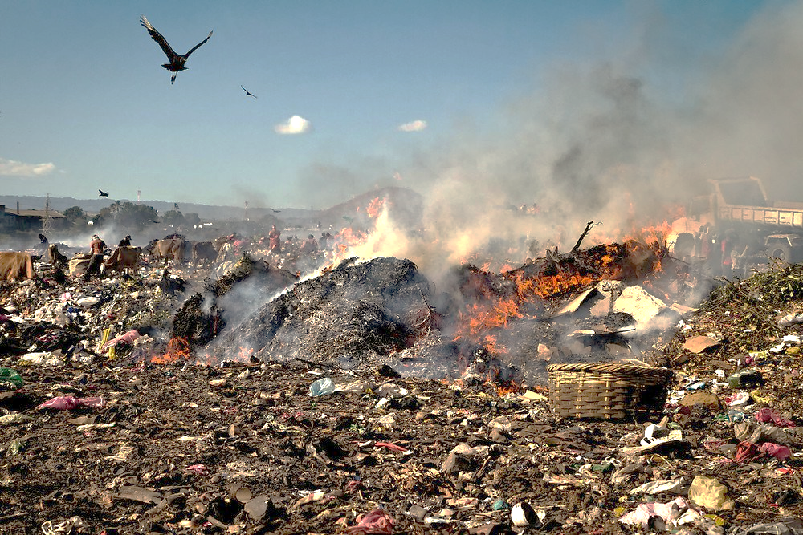
  CLEAN CAPITAL
  A FUND TO LEVERAGE WASTE TO POWER POSITIVE CHANGE

Slide 2
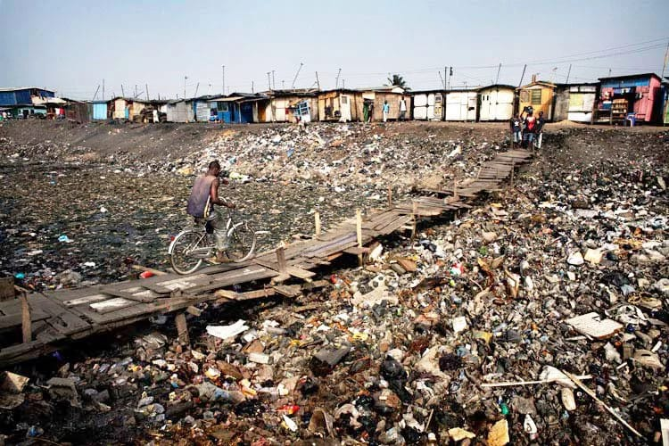
Challenge 1: Waste is building up in the slums of African megacities…
  Impact:
  Air pollution
  Groundwater pollution
  Land wastage
  Other hygiene impact
    Rodents
    Bad odors
Agbogbloshie, Ghana – 80,000 people live there
Notes:
Weight for weight, methane traps 21x more heat than CO2!

Slide 3
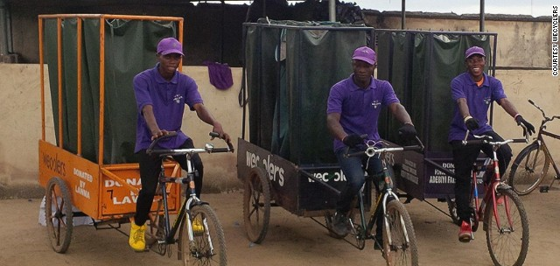
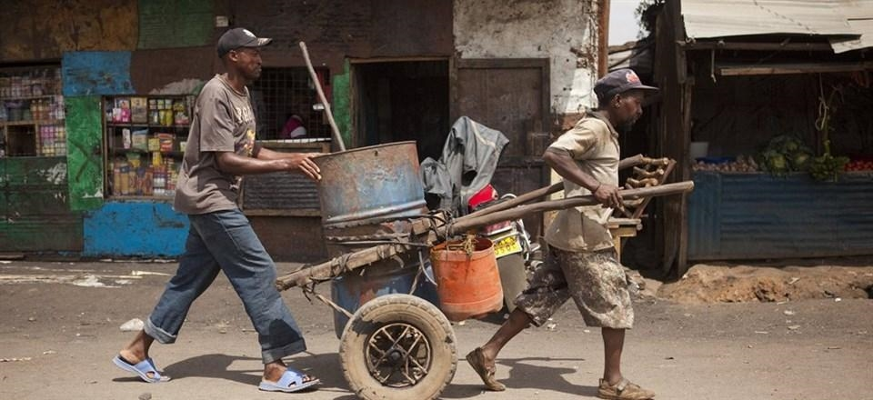
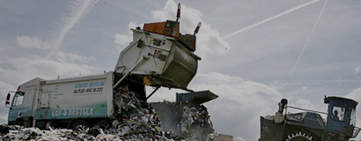
…As waste management is not keeping up with increasing urban population
Waste management services emerge across African megacities…
…Yet the population living in slums keeps increasing
Population living in urban slums
Proportion of total urban population
Urban waste collectors in Nigeria
200M
Fecal sludge collectors in South Africa
100M
Cape Town premieres citywide door to door collection service
Waste generation per capita | 0.5kg/day
Total waste generation in African slums | 100,000 tons/day

Slide 4
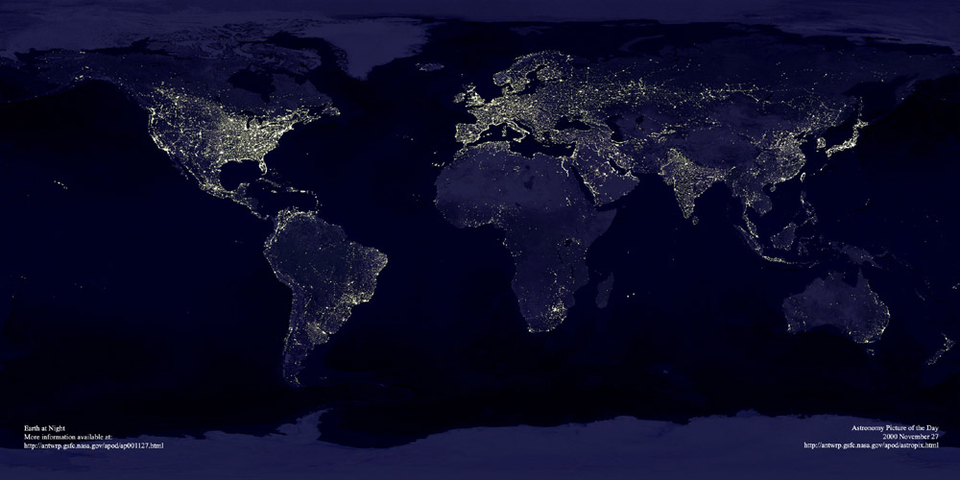
  Challenge 2: 68% of Sub Saharan Africa (SSA) still suffers from no access to electricity
634M people are still in the dark
Snapshot of the world at night, contrasts with the little access to electricity in Africa
2%
Annual GDP growth lost across Sub Saharan Africa due to power outages

Slide 5
  We care because of the implied negative effects of these challenges
Key impacts of inadequate waste management and low electrification include:
Sanitation
Waste
Power
115
400M
13Bn
Deaths/hour due to poor sanitation, hygiene and contamination
Tons of recyclable material that could be used for industries
US$ loss in manufacturing revenue due to power outages
6Bn
2X
11Bn
US$ in direct costs spent on disease outbreak like malaria
Growth in urban slum population by 2020, if no action is taken
US$ costs of new coal-fired power station in South Africa

Slide 6

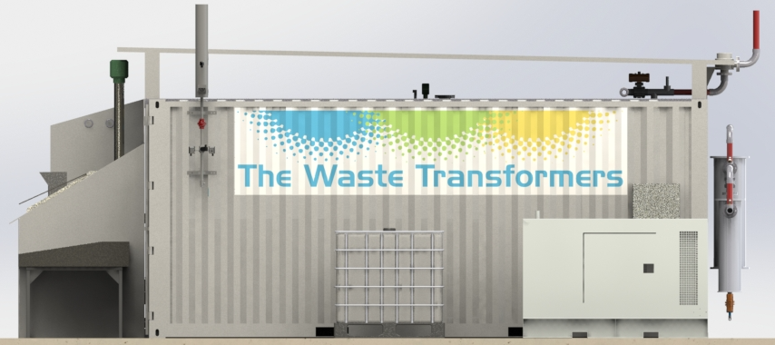


  Decentralized, on-site Waste to Energy (W2E) brings a positive solution for SSA...
Replace infrastructure-heavy model with small, on-site W2E
GAS
WASTE
ENERGY
ELECTRICITY
Suitable conditions for implementing decentralized W2E solutions | Conditions in SSA?
Large, rapidly growing urban areas
Electricity tariffs or high energy costs
Sufficient supply of waste over time
High level of organic content of waste
Inaction costs more than investments in proper waste management
✓
✓
✓
✓
✓

Slide 7
  …But there are hurdles towards implementing decentral W2E in SSA
Financing challenges
Operating challenges
Financial Support
Government support continues to go into burning coal
Unskilled labor
Abundant labor but difficulty in finding skilled workers
>5%
>50%
Proportion of GDP spent on fossil fuel subsidies
Unemployment between ages of 15 and 34
CAPEX-heavy
Difficulty to finance CAPEX required for energy projects
Reliable Partnerships
Difficulty to find reliable local partnerships with local expertise
US$
3M
Companies must ensure that they understand the local values, needs and behavior patterns of clients
Approx. CAPEX per MW
But: investments are in large scale coal

Slide 8
  Clean Capital aims to overcome these hurdles
Financing solutions
Operating solutions
Collateralized loans for decentral W2E
Provide senior loan underwritten by W2E equipment for max Debt/Equity ratio 70/30
Entrepreneurial incentive scheme
Entrepreneurs will hold equity in the machine and are incentivized to conduct maintenance
US$
175K
16%
Average size of loan for small-scale decentral W2E unit
Expected Project IRR for entrepreneur on starting a W2E ‘business in a box’
Impact investing fixed-income
Open utility-like income solution to institutional investors as impact investing
Reliable Partnerships
Our partner The Waste Transformers (TWT) has developed sustainable partnerships with key industry players in South Africa
US$
20M
The Fund will operate standard maintenance contracts with Bosch, a local company with thousands of employees
Size of Clean Capital’s Pilot Fund

Slide 9


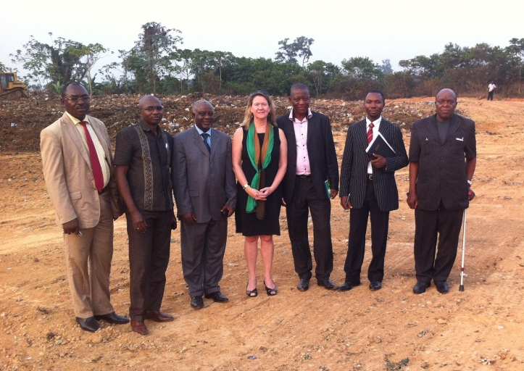
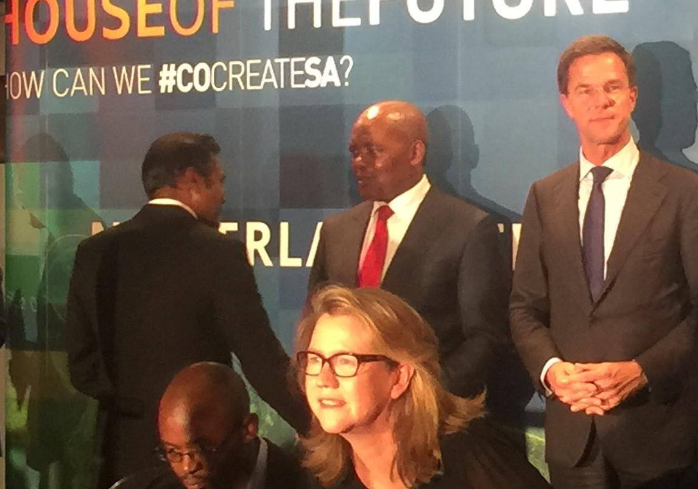


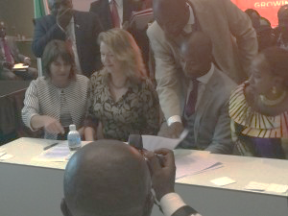

We found a strong exclusive partner: The Waste Transformers (TWT)
TWT create socially inclusive, sustainable economies around waste
Key TWT Partnerships:
IDF / p. equity
Governments
Lara van Druten, Founder
Municipalities
Cameroon
South Africa
Int’l OEM
Local O&M
Universities
Sierra Leone
Kenya
NGOs
The Waste Transformers:
Woman-led social venture
Role model in international entrepreneurship for the Dutch government
Niche player in small scale w2e transformations
Transformative solution provider for organic waste (OEM technology)
Manufacturing in The Netherlands and in South Africa
Key TWT project characteristics:
Able to efficiently convert low-value mixed waste streams into high-value energy
Small-scale, high-impact, on-site approach to energy production aimed at local consumption
Focus on building solutions for local entrepreneurs
Green, clean, ‘innovation lies in the business model not just the technology’

Slide 10
Clean Capital goals
  Clean Capital aims to…
  Bridge the financing gap by providing a fixed income solution
  Build and lead the decentralized W2E industry
  Deploy small-scale installations faster
  Help eliminate waste from slums
  Empower the people of Sub Sharan Africa

Slide 11



Clean Capital economics
Global
Cap. Mkt
Europe
SSA
Clean Capital
Financial Gatekeeper
Op Co.
W2E
Local community
Development
Bank
Pension funds
Family offices
Corporate foundations
Debt
Debt
Supplier of waste
4% for
9yr debt
8% for
9yr debt
  Free waste management
  Stable electricity:
  0.13US$/kWH
Buyer of electricity
PE, banks
Equity
Operational Gatekeeper
Equity
Local entrepreneur
10% Eq
EPC
US$50K
& IRR16%
Salary of
US$2K/yr
& IRR16%
US$140K
90% Eq
Local Companies
As LOCAL Operational Gatekeeper
EPC = Engineering, Procurement & Construction

Slide 12

Clean Capital can make a difference as a financier
Clean Capital aims to build and lead the decentralized, small-scale W2E-industry in the same way aviation expansion was lead by lease
Aircraft leasing industry
Clean Capital solution for decentralized W2E
4% CAGR over past 20 years
Industry supported the two strong OEMs create smaller airplanes
Leasing companies have lead industry expansion by acting as financial gatekeeper, as it:
  allowed low-cost carriers to start competing in a highly capital intensive industry, despite these challengers suffering from lower creditworthiness
  expanded the institutional investor base by attracting fixed-income
  helped build a secondary market based on asset value
Clean Capital
Financial Gatekeeper
Leverage
Operational Partner
Operating Gatekeeper
Appropriate
Risk & Profit
Share
Governance &
Financing
Education &
Maintenance
Strong local networks around ‘Business in a Box’
Ensure strong OEM-commitment
Standardize smaller scale W2E machines and contracts
Solution for new companies with no creditworthiness
Support expansion of investor basis
Machine is re-deployable

Slide 13
Clean Capital’s market solution for community-based ecosystem around W2E for ~10.000 people
2.5t / day
(high caloric)
660 kWh / day
2,500
Homes
0.13
US$/kWh
WASTE
ENERGY
*Levelized Cost
Community-based ecosystem
  Delivery fees to households:
  0.2 US$/kWh equivalent
  (after participation fees)
Entrepreneurs
Operate machine
Sample market solution to be tested in Pilot Fund
System benefits
Entrepreneur runs W2E like a business and is incentivized through equity stake to uphold maintenance
Organization of local waste management
Access to reliable electricity for participating community and local companies
Provide skilled and unskilled employment
Local work force
Operators &
Transporters
Local Industry
Electricity buyer
Increase quality of public health
Factory
Neighbor
Waste supplier
2.5K Homes
Buy electricity &
deliver waste
*Energy price forecasted at US$0.08 / kWh. Levelized costs (1.5x) include total cost of installing and operating a project expressed in dollars per kilowatt-hour of electricity generated by the system over its life

Slide 14

Clean Capital will start a W2E Pilot Fund for organic waste in South Africa
Why a pilot fund?
Five reasons next to the huge financial need in start-up phase
1
Monitor
remotely
2
Lack of
big player
3
No operational
track record
4
Build credibility in
local negotiations
5
Test business model
Why organic waste?
The technology is proven but not yet commercially or widely installed
Innovate
technology
Feasible
study
Proven
technology
Pilot
projects
Operational
reliability
Expansion
Why South Africa?
Established economy
Regulatory framework
Higher private sector participation
South Africa Entrepreneur Fund
Existing relationships with strong local partners
What is the scope of the Pilot Fund?
Total of 110 machines
100 machines with large farms and companies
10 machines with communities to develop and test market models for community deployment

Slide 15
Pilot fund overview
Fund Overview:
Fund Size | US$20M with first close of US$5M.
Fund Maturity | 10 years + potential 2 years for FX overrun payments
Asset Class | Fixed Income
Underlying Asset | Loans for Investing to W2E project in South Africa
Minimum ticket | US$ 500K before first close, thereafter US$1M
Target Investors | Institutions, Development Banks, Family Offices, Foundations
Coupon | 4%
Management Fees | No initial fee for investors; 0.5% of principal for secondary transactions; 2% fee over annual cash flows to the Fund
Underlying Loan Overview:
Lender | Clean Capital
Borrower | Local Entrepreneur (Op Co.)
Loan Size | US$175K (70% loan to value)
Loan Maturity | 9 years (with 3 year break clause)
Collateral | Machine avg. cost ~US$250K
Interest | 8%
Repayment Schedule | Principal repayment with weighted 25% over first 4 years, 75% over remaining 5 years
Conditions | Loan granted upon satisfying all the requirements of Clean Capital including completing the construction of the machine by the OEM

Slide 16
Clean Capital’s pilot fund’ cashflow during operation
Per machine in Pilot Fund (15 years)
US$ ‘000s
US$ M
IRR: 16%
Fund returns for the Pilot Fund (110 machines deployed by Y2)
US$ ‘000s
Impact Investing Fixed Income coupon: 4%
US$ M

Slide 17
Pilot fund risks & mitigations
Key Risk for Clean Capital
Mitigation
Remaining risks
Stable Dealflow
Shortage of dealflow
Low quality of deal
Sourcing from TWT
Clear criteria
TWT and local client ‘s risks (backed by machine value)
Revenue
No buyer for energy
Price decrease
Unit decrease
Buyer’s revenue > 2.5M/yr
15yr take-or-pay PPA
Re-location of machine
Mitigated country risks
Expense
Supply
No supplier
Price decrease
Unit increase
Buyer = Provider of waste
O&M
No operator
Operator’s capability
Improper maintenance
Training from TWT
Performance Guarantee from TWT
Capability of fund manager
Other
FX
Country risk
Revenue in EURO to offshore account

Slide 18
If 10% of SSA’s organic waste would be processed with digesters as in the Pilot Fund…
Category | Impact | Pilot fund | 10% of SSA’s organic waste*
Financial | Capital deployed | US$ 20M | US$ 2.5Bn
 | W2E units on the ground | 110 | 14,000
Socio-economic | Direct jobs | 330 | 42,000
 | Indirect jobs | 500 | 63,000
 | People with access to electricity | 300K (75K households) | 40M (10M households)
Sanitary | Waste eliminated from cities | 31K tons | 40M tons
Environmental | Greenhouse emissions reduced | Methane emissions reduction
 | Groundwater pollution reduced | Dependent on local groundwater availability
 | Less landfill required | Dependent on local situation
Financial
Health
Socio
Economic
Environmental
*Total SSA waste [620M tons] * 65% organic waste

Slide 19



Market Feedback and Clean Capital Advisor
Business, financial and academic advisors
MSSIC mentor
Potential client in Kenya
…and 4 institutional investors
Prof. Heinrich Liechtenstein
Prof. Alejandro Lago
Prof. Ricardo Barcelona

Slide 20
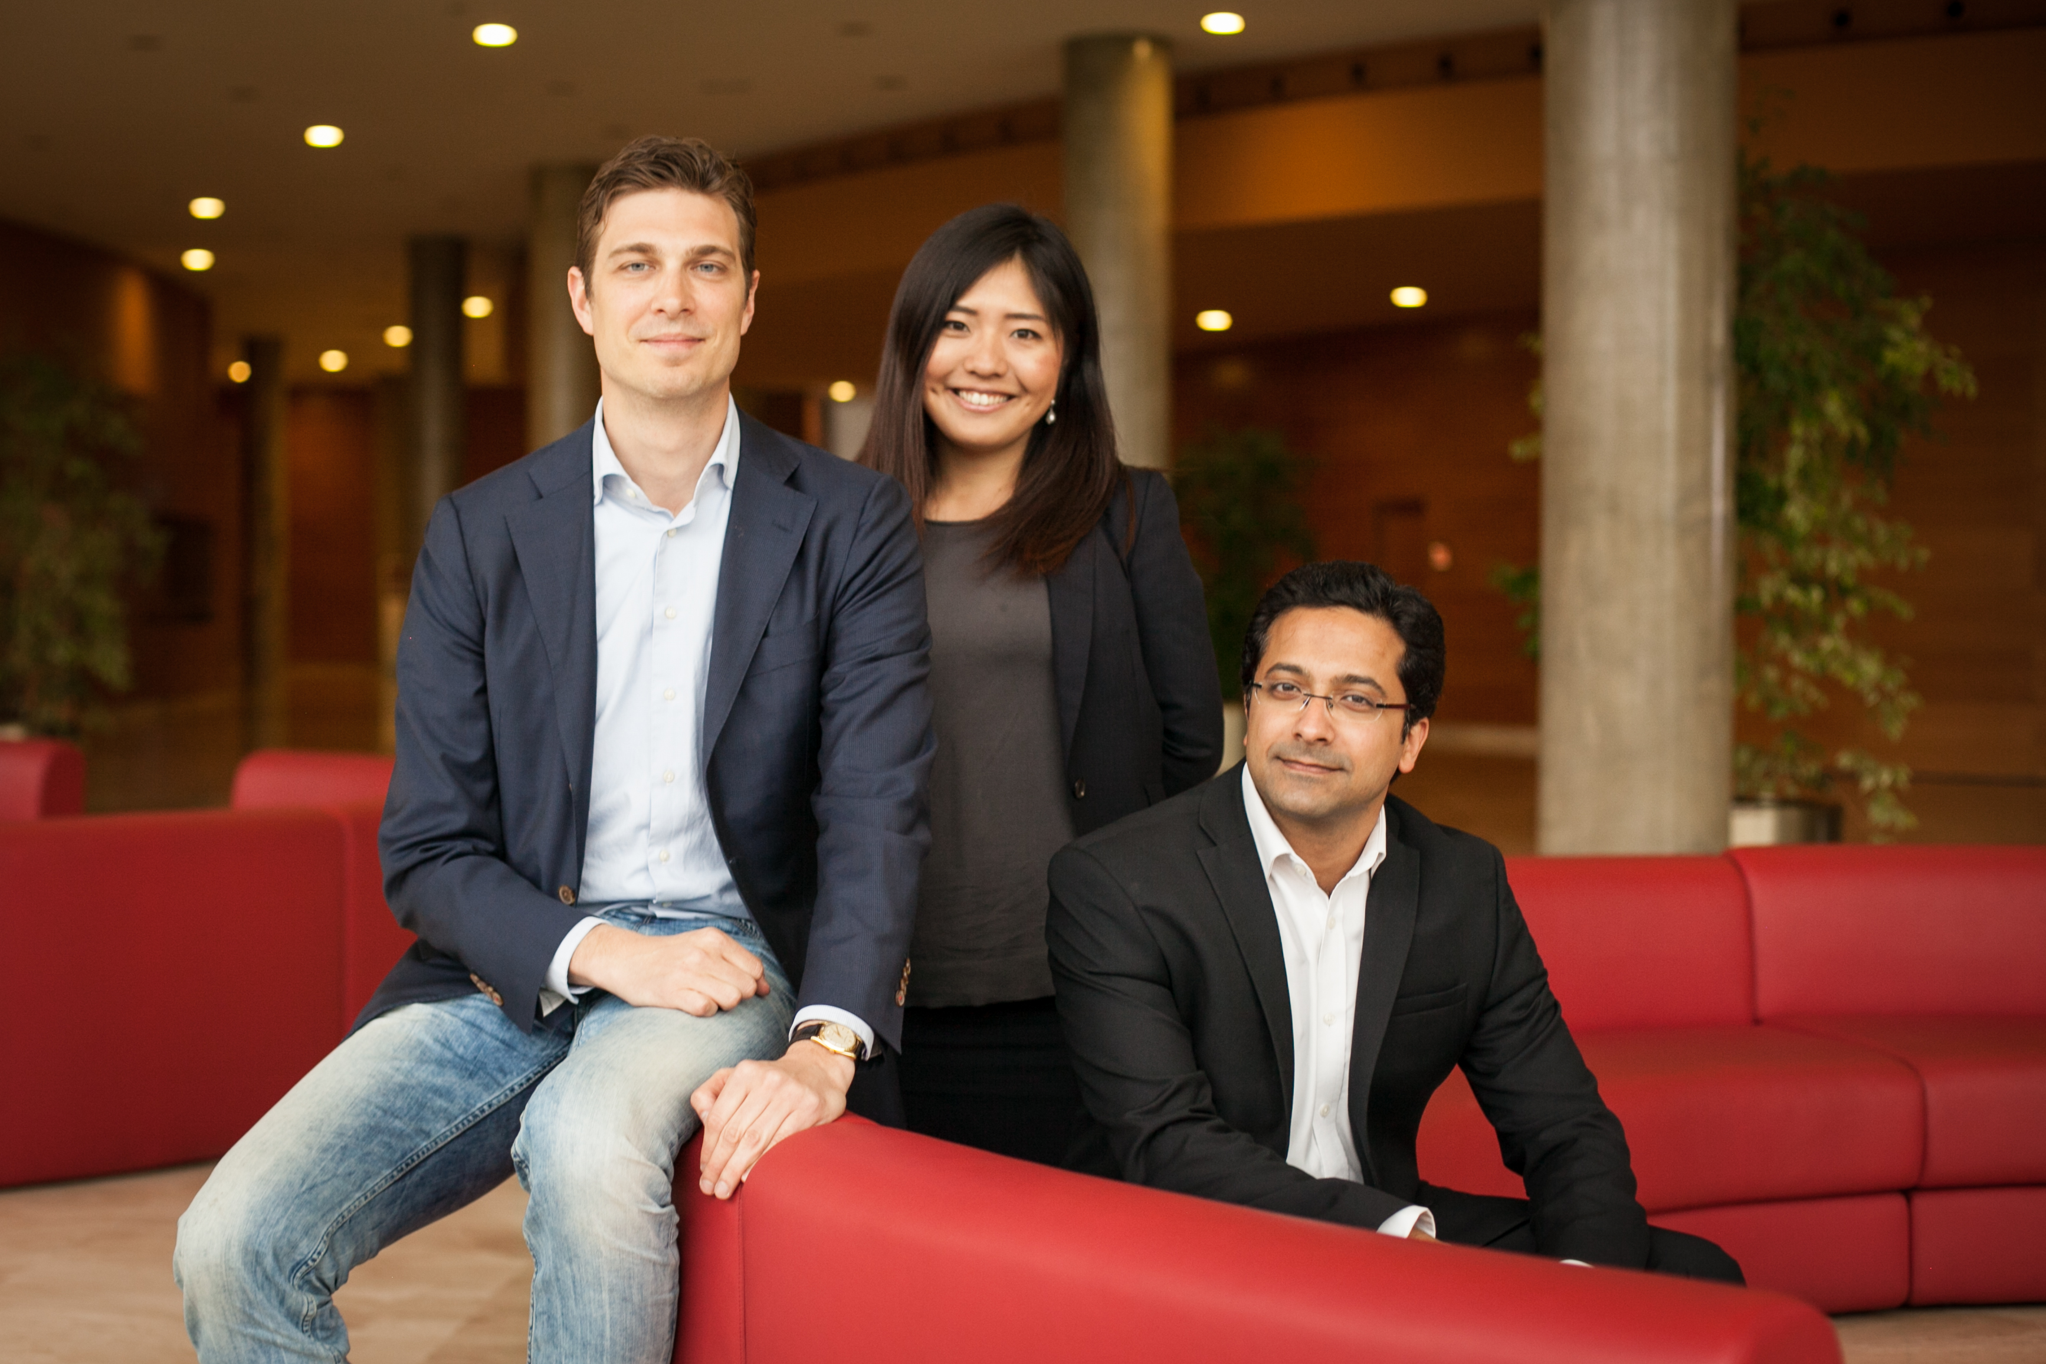
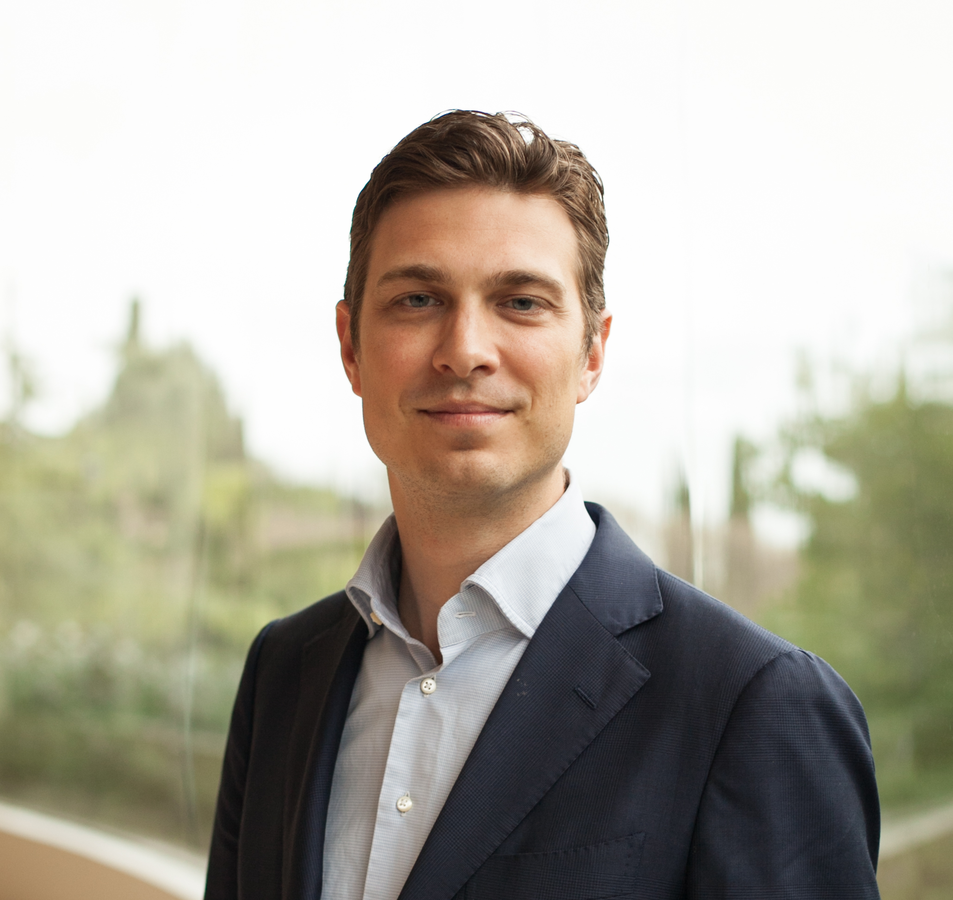

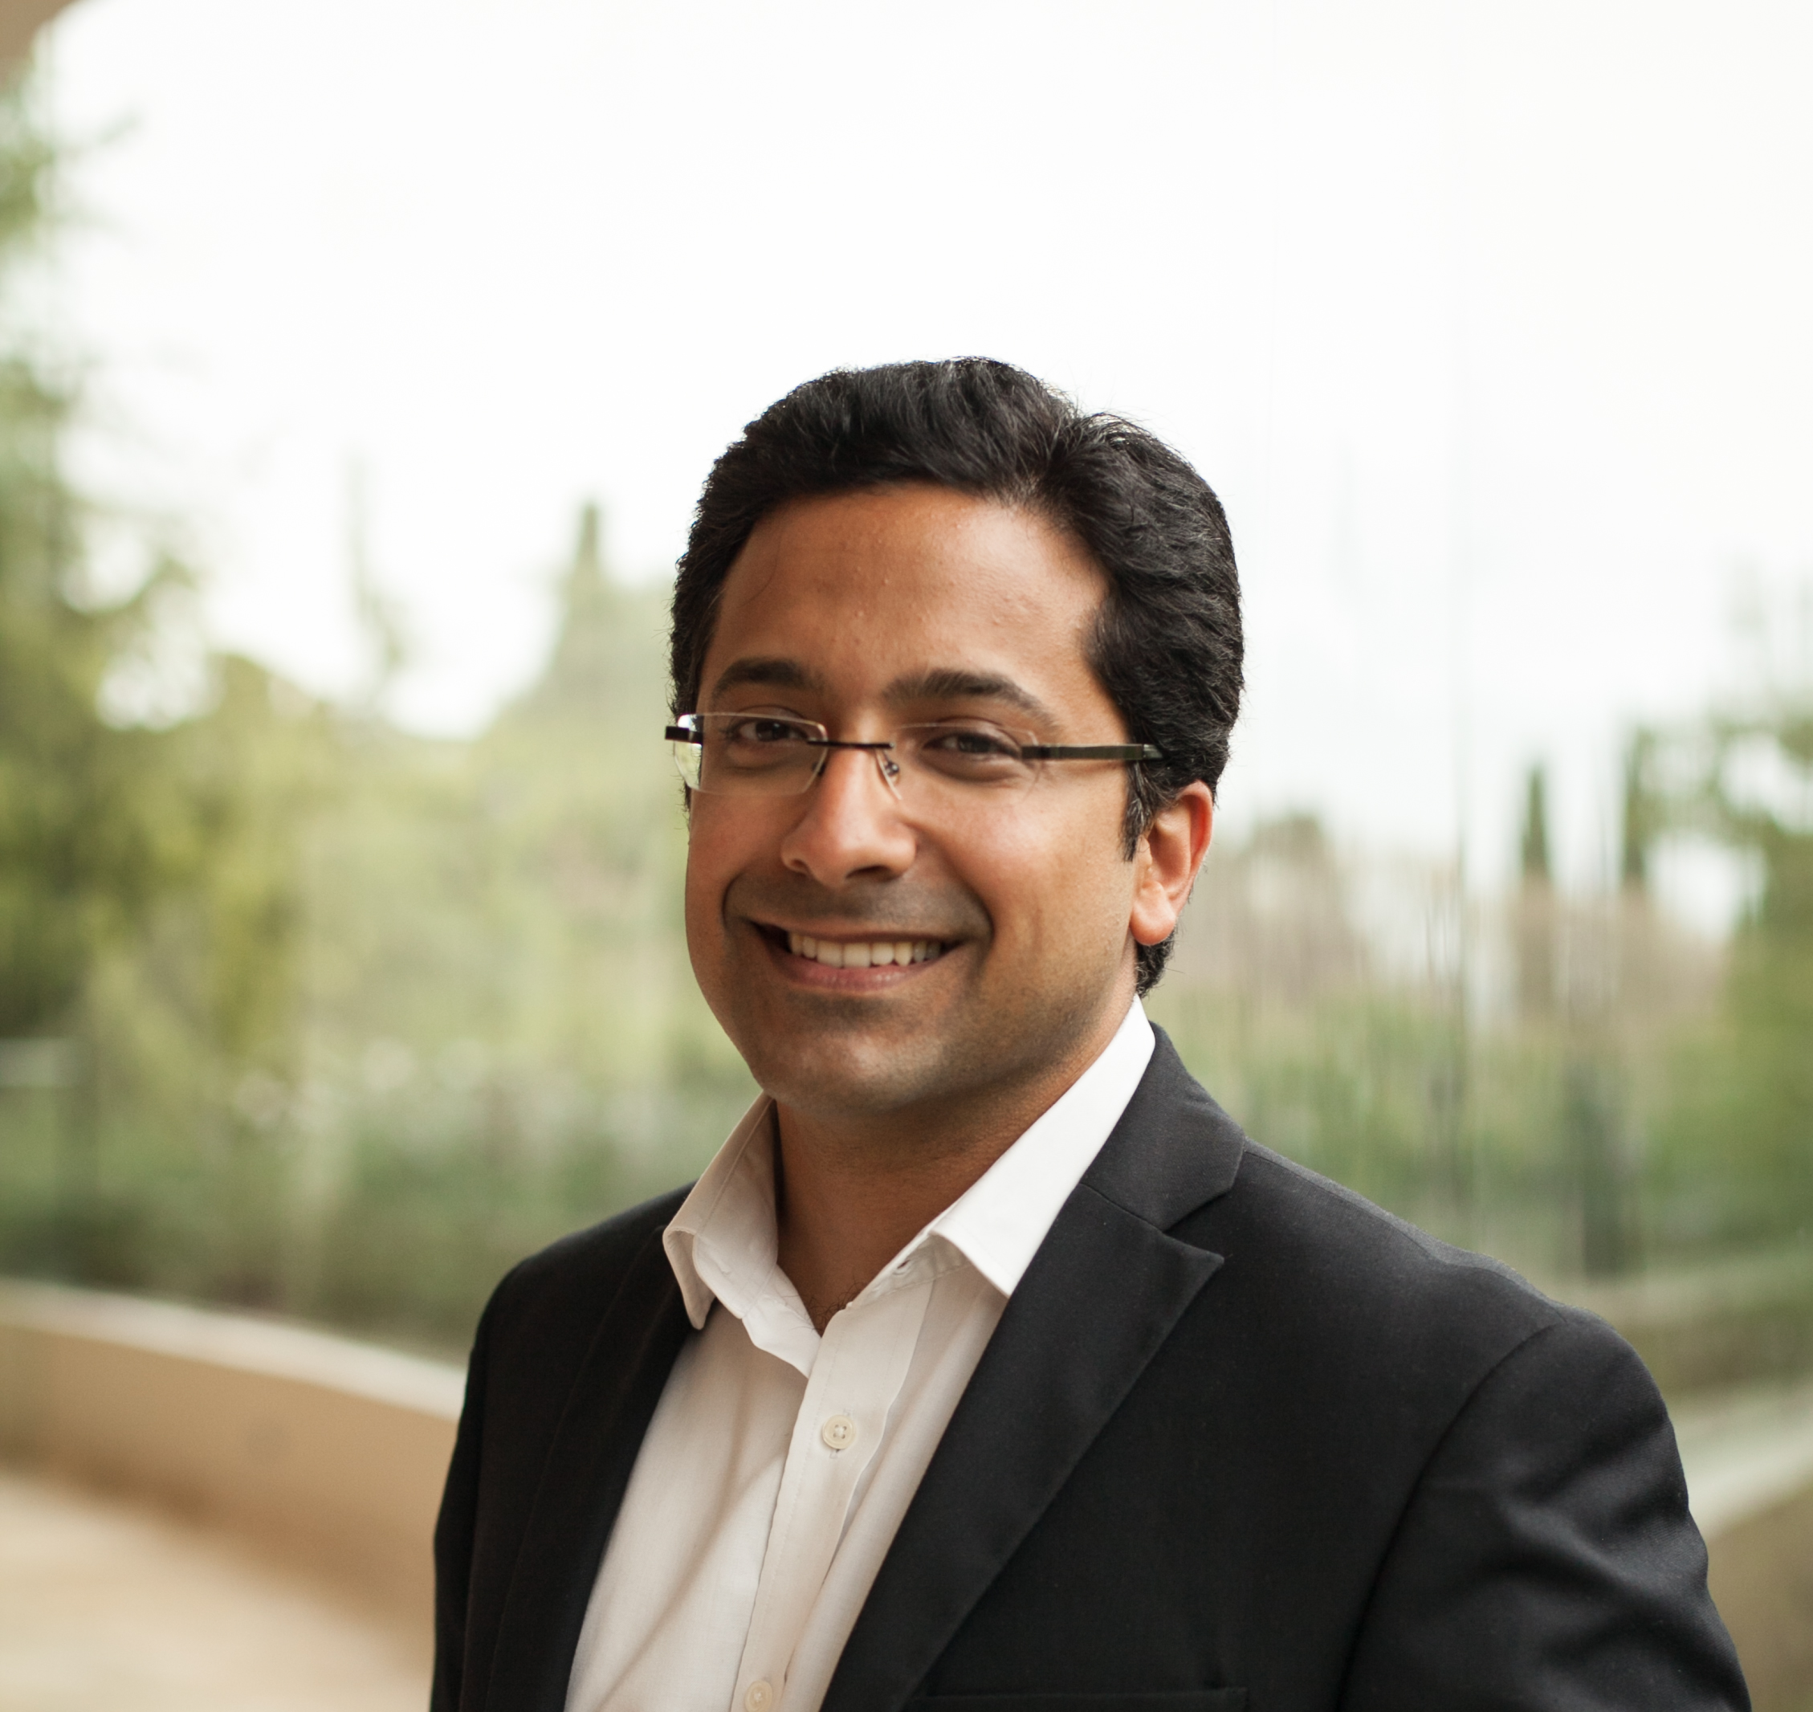






A passionate and professional team
Fabian Roobeek
Emerging Markets Deals Strategy
Urara Kamiya
Structured Finance
Porus Jungalwalla
Business Strategy
AGNI
(NGO in India)

Slide 21
APPENDIX | Project Structure

Slide 22
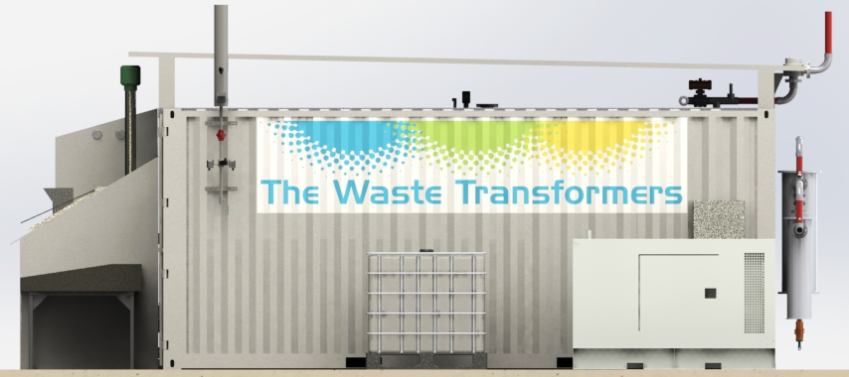
APPENDIX | The Technology: Containerized Waste to Energy
ELECTRICITY |  | unit
Electricity produced | 40 | kWh
Electricity produced | 262,800 | kWh/year
Operating hour | 6570 | hours/year
i.e. OEM assumption | 7600 | hours/year
Possible operating hour | 24 | Hours/day
% of uptime | 75% | % of time
Operating hour | 18 | Hours/day
# of days | 365 | Days/year
Economic Value to recover | 0.06 | US$/kWh
Levelized cost of energy | 0.10 | US$/kWh
Cubic meters of biogas per ton waste
  TWT’s organic waste digester
  Treatment of organic waste streams
  (fecal sludge, food waste, agricultural waste, grass)
  Mature digestion technology in sea-container sized installations for on-site transformation
  Requires loading only 1x per day for 24hr operations
  Capacity up to 40kW per hour
  Up to 2.5t of organic waste per day

Slide 23

APPENDIX | Feasibility study example – A farm in Nairobi
15,000
kWh
900
tons
25% - Farmers as fertilizer @ $15/ton
50% - Donated to charitable homes
25% - balance sent at no cost to Bio plant
ENERGY
WASTE
Per
month
Farm
Per
month
Benefits of using the TWT Machine
45%
Reduction in cost (Grid Electricity vs. machine depreciation and wages)
+2
days
Additional days of work gained per month by avoiding power outages.
+220 kwh
Additional electricity generated that can be sold / donated to neighbors
+2
jobs
Potential long term jobs created

Slide 24
APPENDIX | Future funds’ risks and mitigations
Key Risk for Clean Capital
Mitigation
The remaining risks
Stable Dealflow
Shortage of dealflow
Low quality of deal
Sourcing from TWT
Clear criteria
Sustainable system design with incentive
Revenue
No buyer
Price decrease
Unit decrease
Sufficient demand
Expected market price
Strong commitment from local community
Expense
Supply
No supplier
Price decrease
Unit increase
Sufficient supply backed by incentive
Country risks
O&M
No operator
Operator’s capability
Improper maintenance
Training from TWT
Performance guarantee from TWT
Capability of fund manager
Other
FX
Country risk
Derivatives, or local currency funding
Asset value of machine

