Slide 1

AlphaBrick Capital: Scaling Deconstruction
“AlphaBrick helps municipalities overcome blight and divert waste from landfills while providing investors with competitive return”
April 15, 2016

Slide 2
Agenda
1
Problem & Solution
2
AlphaBrick Capital proposal
3
Scaling opportunities & Risks
4
Appendix

Slide 3
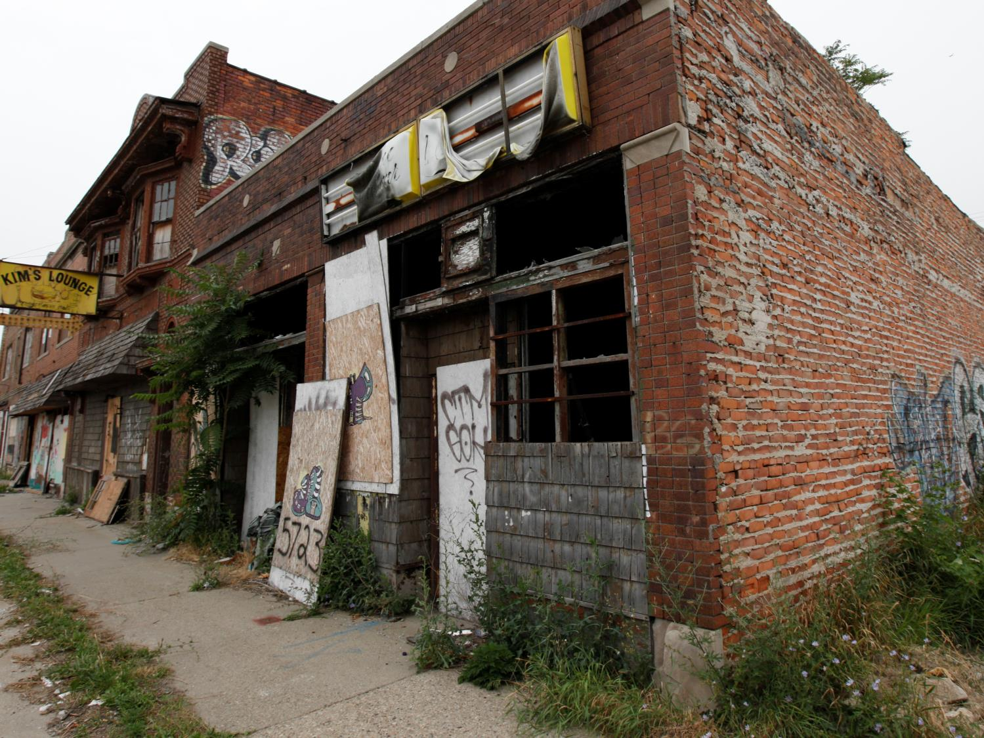
Urban blight is expensive for governments and society
1
Problem & Solution
  At least 550K blighted homes sit vacant in the US
Increased maintenance, law enforcement, and firefighting costs municipalities $1-2 billion a year
Reduced property values and foregone area investment cost another $17-19 billion a year
Notes:
The decay or deterioration of an urban area (building, lots, and houses) due to neglect or age

Slide 4
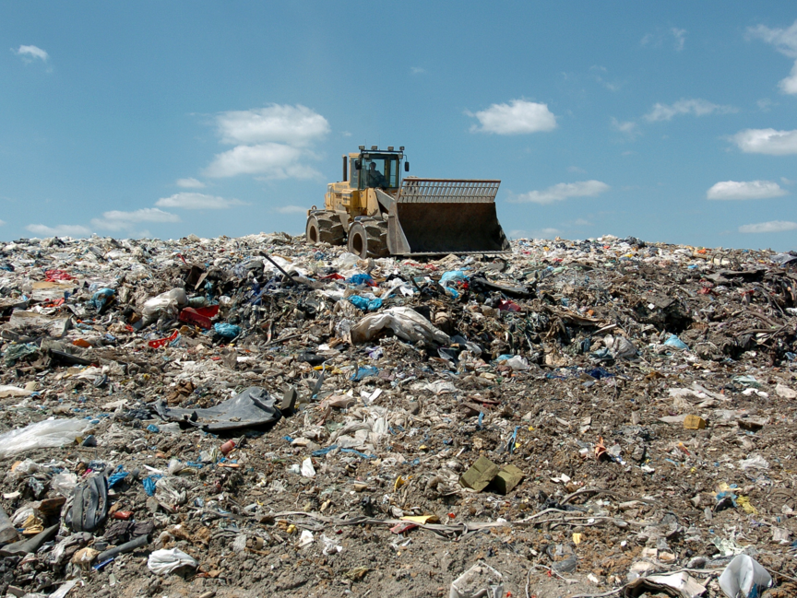
Demolition, the typical solution, has long term costs and pushes millions of tons of refuse into landfills
1
Problem & Solution
1 landfill
releases 3,000 tons of methane, a greenhouse gas 21 times more potent than carbon dioxide
It takes 500 years for 2.5 cm of topsoil to regenerate while US loses soil at a rate 17 times faster
45% of landfill waste is from construction and demolition
Notes:
Landfills are hazardous to human health and the environment due to toxins emitted into air and ground water

Slide 5
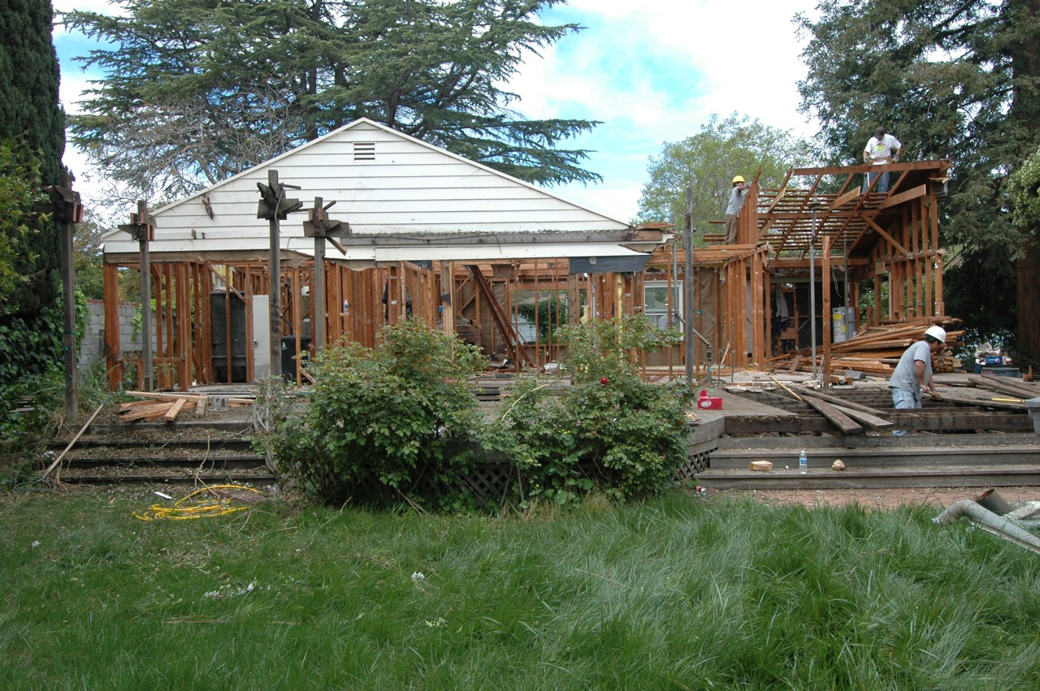
Deconstruction is the selective dismantling of buildings into materials that can be reused, recycled, and sold
1
Problem & Solution
Deconstruction safely removes blighted homes, cutting costs to municipalities…
…reduces waste by diverting 95% of materials from landfills…
…and is more cost-effective and sustainable than renewably harvested wood

Slide 6

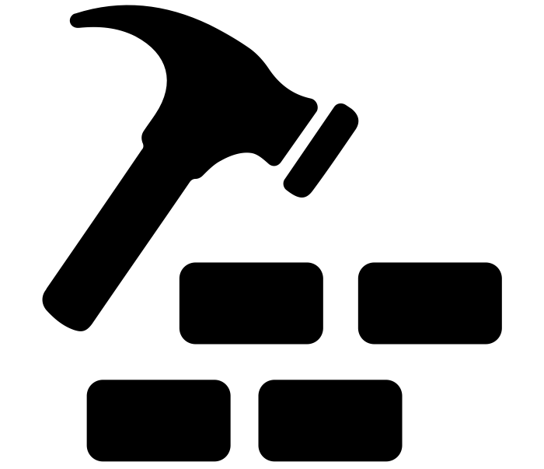



However, deconstruction today is not yet widely leveraged to solve urban blight
1
Problem & Solution
Current landscape & pain points
Pain points to scale
Cottage Industry
This practice & revenue stream are inapplicable for large scale abandoned urban buildings
Initiatives come from home owners
Revenues come in form of tax deductions
Depends on partnership with non-profits
Stiff competition from demolition
Demolition is the current go-to solution to fight urban blight
Cash-strapped municipalities prefer cheaper processes
Deconstruction costs 2x as much as demolition
Source: Stakeholder interviews.

Slide 7
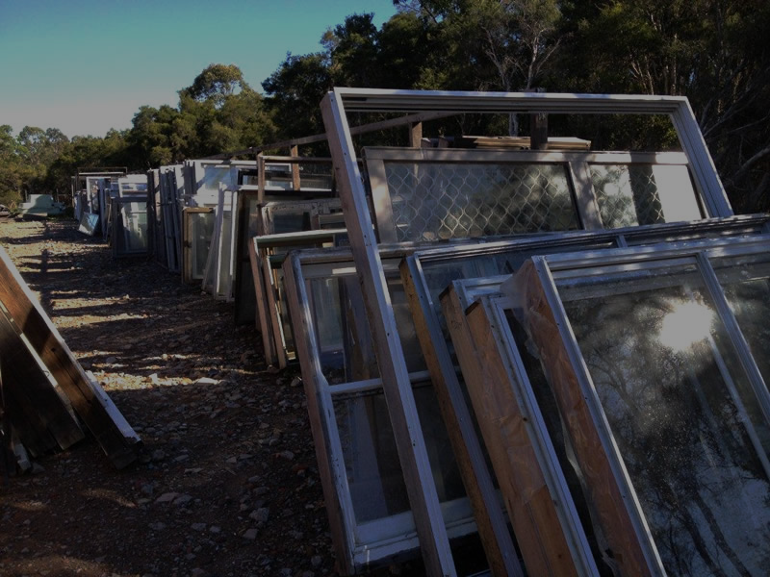
Where others see an eyesore, we see an opportunity
1
Problem & Solution
In a typical 2,000 sq ft house there are:
  When selling at scale, suppliers can charge 37% higher prices for large orders
  Costs of transportation are 30-80% lower for large volume shipments
  Old-growth lumber can command prices 4x those of contemporary equivalents
Others see abandoned homes
we see mispriced assets
13,837 board ft
of framing lumber
Confidential and Proprietary.
11,550 sq ft
of sheathing
3,011 sq ft
of exterior siding material
3,061 sq ft
of insulation
5,550 sq ft
of interior wall material
2,117 sq ft
of interior ceiling material
2,841 sq ft
of roof material
2,082 sq ft
of flooring material
226 linear ft
of ducting
18 windows
14 kitchen cabinets
12 interior doors
6 closet doors
3 bathroom sinks
3 exterior doors
1 patio door
2 garage doors
16.92 tons
of concrete
Notes:
In a typical 2,000 sq ft house there is:
13,837 board ft of framing lumber
11,550 sq ft of sheathing
3,011 sq ft of exterior siding material
3,061 sq ft of insulation
5,550 sq ft of interior wall material
2,117 sq ft of interior ceiling material
2,841 sq ft of roof material
2,082 sq ft of flooring material
226 linear ft of ducting
18 windows
14 kitchen cabinets
12 interior doors
6 closet doors
3 bathroom sinks
3 exterior doors
1 patio door
2 garage doors
16.92 tons of concrete

Slide 8





ABC partners with municipalities to issue taxable municipal revenue bonds that scale the reuse market
2
ABC Proposal
ABC Taxable Revenue DeconBond model
Reuse materials distributors
Take-or-pay contract
Materials
Pledged guarantee
Service fees
Govt. guarantor
Local Municipality
Materials
Deconstruction firms
Proceeds from bond
Coupon payment &
Principal return
Investors
Source: AlphaBrick Capital analysis.
Notes:
Professional buyers win bid to purchase call option or forward contract (depending on which is more attractive to them)
Federal government acts as bond insurer using grant money as collateral (what would have otherwise been paid out as HHF)
If the federal government won’t act as the bond insurer, philanthropic capital is used as collateral
If philanthropic capital can’t be found, then municipality uses funds from option payment to pay lump-sum insurance premium in return for credit enhancement
Municipality pays ABC underwriting spread in sale of bonds
ABC Sells bonds at par
Investors purchase bonds
Municipality uses funds to hire abatement, decon, and transportation crews
Municipality receives reused building materials
Municipality sells and delivers reused materials to professional lumber buyers at wholesale prices

Slide 9






We work with public and private partners in planning, origination, and implementation
2
ABC Proposal
Implementation plan with Dayton, OH
Pre-Project Initiation | Supply Prospecting | Buyer Contracting | Bond Issuance | Project Management
Build and own key relationships | Scout properties Activate partners | Negotiate terms | Underwrite bond Make market | Audit financial performance
 | Scope project |  | Create facility Issue bond | Run operations
 | Value properties | Negotiate terms Sign contracts |  | Buy and haul away salvage
 |  |  | Pledge grant funds as wrapper
 |  |  | Hire re-entry employees | Dismantle homes Collect materials
 |  |  | Provide training and consulting to contracted deconstruction firms
Local municipality
Materials Distributor
Government guarantor
Deconstruction Companies
Non-profit Association

Slide 10
Investors earn a market-rate return from an investment-grade bond…
2
ABC Proposal
AlphaBrick Capital expected cash flow
Original Principal
Coupon Payment
Principal Payment
$MM
Project IRR: 6-14%
Yield: 3.64% at par
20
73.5
15
10
5
2.7
2.7
2.7
2.7
2.7
2.7
2.7
2.7
2.7
0
2.7
-5
Payment will be made semi-annually
-10
-15
-73.5
Year
0
1
2
3
4
5
6
7
8
9
10
Source: AlphaBrick Capital analysis.

Slide 11
…while creating social impact and benefits for all involved stakeholders
2
ABC Proposal
Annual realized benefits
Municipalities
State and Federal Government
$10.6M
cost savings
area investment
$0
of grants spent
crime & recidivism
Local Community
Environment
960
new jobs
15%
property values
20M lb
waste diverted
52K tn
reduced GHG
Salvaged Material Distributors
Social Enterprises
31%
cost of goods sold
industry interest and activity
Source: Deconstruction Calculator, Department of Labor, Hazel Denhart “Deconstruction Disaster”, University of Sydney “Good Jobs and Recidivism”.
Notes:
17 dB less noise (the difference between a motorcycle and a blender)
5,000 lbs materials diverted from landfills (3 years of trash)
3,000 fewer kilowatt hours used (3 months of home electricity use)
13 metric tons fewer greenhouse gas emissions (140 gallons of gas)

Slide 12
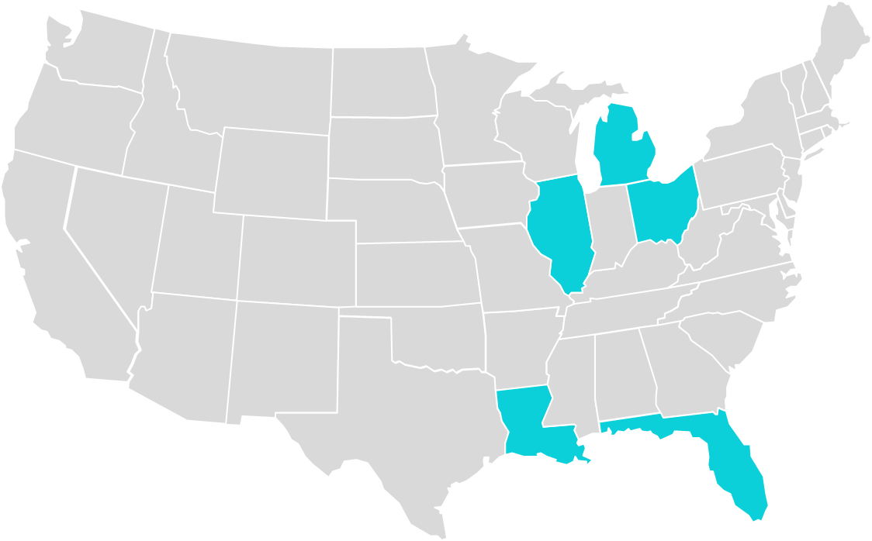
Target municipalities will meet five critical criteria
3
Scaling opp. & Risks
AlphaBrick Capital target states
Investment criteria
High number of blighted homes with expected valued materials
Municipalities actively seeking to eliminate blight using prior or existing funding
State or federal guarantor with adequate credit rating
Enough buyers within 600 mile radius able and willing to transport
Executed take-or-pay contracts at price and volume to ensure required returns
Michigan
83.7K
homes
Illinois
17.6K homes
Ohio
40.8K
homes
250K+ vacant foreclosures identified in US that can be tapped into
Louisiana
43.7K
homes
Florida
55.5K
homes
Source: RealtyTrac. HUD

Slide 13
We have established mitigation plans for the most significant financial risks…
3
Scaling opp. & Risks
Risks, sensitivity analysis, & mitigation
Sensitivity Analysis
Mitigation
$MM Change in project revenues
-10%
+10%
Market Value of Materials
(Salvage quality and
negotiated price)
Due diligence & analytics
Due diligence & analytics Partner with BMRA and TRP for quality assurance
Partner with TRP and BMRA for crew training Apply supplier power
Contract with distributors with pickups within 600 mi
Wrap bond with state credit Double-barrel bond with TIF
-64.5
+64.5
Salvage Rate
-50.6
+50.6
Cost per Job
-42.7
+42.7
Transportation Costs
(Price and Distance)
-13.9
+13.9
Interest Rate
-2.8
Source: AlphaBrick Capital analysis.

Slide 14



…and are building relationships to mitigate other more qualitative risks
3
Scaling opp. & Risks
Risks, sensitivity analysis, & mitigation
Risks
Partners
Mitigation
States and land banks resistant to place grant funds in reserve rather than spending it now |  | Communicate 10x return and natural fit for abatement and historical projects
Aaa and Aa rated state and city authorities hesitant to back bond with full faith and credit |  | Communicate investment, recidivism, & crime benefits Tweak ratios and operations
Municipal codes limit reuse material market potential |  | Advise clarifications to regulations that expand uses Seek global distributors
Immature industry processing capability limits potential scale |  | Coordinate contracts and transportation to partners’ centers via their logistics
Source: AlphaBrick Capital analysis.

Slide 15


















Acknowledgment & special thanks
Finance entities
Wendy Rowden
Deconstruction
David Chen
Steve Finley
David Stowell
Nicole Chavas
Mitchell Petersen
April Mendez
Alexandria White
Tiffany Smith
Ted Reiff
Greg Fodell
Tim Coffin
Recycler/ Distributor
Design
Kate Koval
Matt Edlen
Max Taubert
Tom Kelly
Lou Dickson
Peter Lobin
Hilary Gabel
Ken Ortiz
Government
Aaron Sorrell
NGOs
Heidi Phaneuf
Jon White
Brian Inderrieden
Ben Shorofsky
Tony Kroeger
Diane Shannon
Debbie Stone
Susan Vescovi
Anne Nicklin

Slide 16
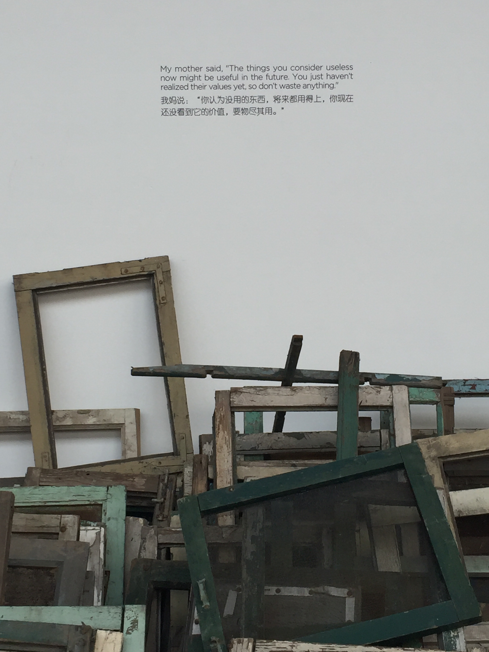
ALPHABRICK
CAPITAL
My mother said, “The things you consider useless now might be useful in the future. You just haven’t realized their values yet, so don’t waste anything.”
- Song Dong
我妈说： “你认为没用的东西，将来都用得上，你现在还没看到它的价值要物尽其用。”
- 宋冬

Slide 17
Appendix

Slide 18
However, deconstruction industry at the moment is largely a cottage industry
1
Problem & Solution
  Current business model depends on partnership of for-profit & non-profit entities
  Homeowner pays more upfront to deconstruction company than they would to a demolition company
  Materials are appraised by IRS-certified appraiser. Appraisals typically ~$80k for a 2500 sq ft house
  Homeowner donates deconstructed materials to non-profit resale company and receives tax deduction. May save $10,000 or more over demolition
  For-profit deconstruction is typically successful; non-profit resale does very well (typically divided into “boutique” resale of furnishing items and heavy materials)
Deconstruction already a very viable option for individual homeowners wishing to rebuild on their lots…
…but this solution inapplicable for abandoned urban buildings and no alternative, scalable business model is yet in place
Source: Stakeholder interviews, TheReusePeople, ReUseDepot.

Slide 19
Demolition is stiff competition for blighted homes from cash-constrained municipalities
1
Problem & Solution
Demolition
vs.
Deconstruction
Goals | Most expedient manner of removing building | Optimal reuse of component materials
Means | Highly skilled small teams (2-3 persons) use heavy machinery to destroy building | Lower skilled larger teams (5-6 persons) use handheld tools to take building apart piece-by-piece
Cost | $5000 for a 2k sq ft residence Overall, short-term cost effective | $10,000 for a 2k sq ft residence Overall, long-term cost effective
Time | 2-3 days | 2 weeks
Reuse | 0-20% of materials | 85%+ of materials
Results | Materials end up in landfills, noise pollution | Quieter, less environmental impact
Source: Deconstruction firms interviews, Delta Institute.

Slide 20
Landfill space has stagnated since 90s, however landfill tipping fees have continued to climb
1
Problem & Solution
Landfill tipping fees trends
CY 1985-2011, Total US Average
Number of Landfills
Average Tipping Fee per Ton
‘000
$/Ton
4.7% CAGR
1985
1986
1987
1988
1989
1990
1991
1992
1993
1994
1995
1996
1997
1998
1999
2000
2001
2002
2003
2004
2005
2006
2007
2008
2009
2010
2011
Tipping fees in Europe and Japan is over $150 per ton
Source: EPA, Property and Environment Research Center, EnvironmentalistEveryday.org

Slide 21
Where others see an eyesore, we see an opportunity
1
Problem & Solution
In a typical 2,000 sq ft house there is:
13,837 board ft of framing lumber
11,550 sq ft of sheathing
3,011 sq ft of exterior siding material
3,061 sq ft of insulation
5,550 sq ft of interior wall material
2,117 sq ft of interior ceiling material
2,841 sq ft of roof material
2,082 sq ft of flooring material
226 linear ft of ducting
18 windows
14 kitchen cabinets
12 interior doors
6 closet doors
3 bathroom sinks
3 exterior doors
1 patio door
2 garage doors
16.92 tons of concrete
Others see: abandoned houses
We see: mispriced assets
Old-growth lumber in Dayton trades at a discount to the same material in Portland and the cost to transport in small volumes is prohibitive
Prices can actually increase with volume because pro buyers like to buy in bulk
Source: Delta Institute, BMRA, City of Dayton, OH Dept Planning and Community Development,

Slide 22
Top end-customer markets for reused building material
2
ABC Proposal
Small
Usage / Market
Glass
Reuse
Fibreglass
Reflective Beads (Paint)
Amount recovered in a typical house
Old Growth Lumber
Furniture and Décor
Manufactured Wood Products
Designers and Architects
White Fixtures
Cost-sensitive Commercial (e.g., landlords) & Residential Real Estate (e.g., DIY-ers, contractors)
Wood Fixtures
Designers and Architects
Cost-sensitive Commercial (e.g., landlords) & Residential Real Estate (e.g., DIY-ers, contractors)
Metals
Reuse by Salvagers
Metal Feedstock
Scrap Dealers
Large
Bricks
Construction
International Construction
Common Wood
Non-Habitable Construction
International Construction
Manufactured Wood Products
Source: TheReusePeople, BMRA, The Delta Institute
Notes:
We’re calculating the addressable market for residential furniture alone is $76B
ADDITIONAL MARKETS
Common Wood: Fuel, Mulch, Composting, Alternative Wood Fibre-based Materials
Glass: Glasphalt, Inert Granular Additive
Paper And Cardboard: Paper Fibre Feedstock
Concrete: Road Base, Fill Material; Aggregate For New Ready-mix Concrete, Lime For Neutralizing Agent, Rip-rap/Embankments
Drywall: Soil Amendment, Cement Additive, New Drywall, Animal Bedding (Paper)
Asphalt Roofing: Asphalt Patch For Roads
Rubble: Road Base Or General Fill; Drainage Beds, Landfill Cover

Slide 23
We also expect low/middle customers, the largest segment, to grow due to US economy recovery…
2
ABC Proposal
Reclaimed materials customer composition
Low/middle customers are expected to increasingly spend more on housing & other big ticket items
High income customers
Customers who look mainly for antiques
15%
50%
Low to middle
income customers
35%
Contractors
Source: Stakeholder interviews.

Slide 24
…as evidenced by upward trajectory of construction and housing permit trends
2
ABC Proposal
Construction & housing permits trends
Monthly, CY 2000-2016, Total US
Residential construction
(inc. Improvements)
Total housing permits
$B
‘000
2000
2001
2002
2003
2004
2005
2006
2007
2008
2009
2010
2011
2012
2013
2014
2015
2016
Source: Census.

Slide 25



ABC partners with municipalities to issue taxable municipal revenue bonds that scale the reuse market
2
ABC Proposal
ABC Taxable Revenue DeconBond – Detailed Model
Tax Increment Financing
Reuse materials distributors
Scrappers
Retail Warehouses
Future tax revenues
Take-or-pay contract
Materials
Sales
Pledged guarantee
Service fees
Govt. guarantor
Local Municipality
Materials
Deconstruction firms
Proceeds from bond
Coupon payment &
Principal return
Investors
Source: AlphaBrick Capital analysis.
Notes:
Professional buyers win bid to purchase call option or forward contract (depending on which is more attractive to them)
Federal government acts as bond insurer using grant money as collateral (what would have otherwise been paid out as HHF)
If the federal government won’t act as the bond insurer, philanthropic capital is used as collateral
If philanthropic capital can’t be found, then municipality uses funds from option payment to pay lump-sum insurance premium in return for credit enhancement
Municipality pays ABC underwriting spread in sale of bonds
ABC Sells bonds at par
Investors purchase bonds
Municipality uses funds to hire abatement, decon, and transportation crews
Municipality receives reused building materials
Municipality sells and delivers reused materials to professional lumber buyers at wholesale prices

Slide 26
The AlphaBrick Capital DeconBond generates returns off assets harvested from the “industrial forest”
2
ABC Proposal
Bond profile
Type | Municipal Revenue Bond
Issuance | $73.5MM
Rating | AA (shadow: BBB)
Term | 10 Years
Size | 40,000 deconstructions
Investors | Institutional investors, municipalities, local retail investors
Yield | 2.20% (Market rate)
Payout | Semi-annual coupons
Underwriting Spread | 1%
Vertically Integrated Project Finance
Pure Project Finance
Real Asset Management
Commodities/Futures Hedge
Source: AlphaBrick Capital analysis.

Slide 27



Municipal bonds are the perfect way to scale this initiative…
2
ABC Proposal
What are municipal bonds?
Municipal bonds are debt obligations issued by states, cities, counties and other governmental entities
Primary purpose of the bond is to build infrastructure, housing and many other projects for the public good
Why municipal bonds?
Municipalities are the single biggest payor of the costs of urban blight, and these bonds provide cash-constrained municipalities cheap access to capital
Municipalities are familiar with managing urban renewal deconstruction
The required return and payout policy best fits the project return profile
In US, interest payments are exempt from federal taxes, perfect for investors in highest tax bracket
Most state credit ratings have improved over the last few years and generally 50-100 times less likely to default vs. corporate bond of comparable ratings
Source: Investor.gov

Slide 28
…and AlphaBrick Capital is well poised to leverage the vehicle effectively
2
ABC Proposal
AlphaBrick Capital financial instrument
AlphaBrick partners with municipalities to arrange, issue, and sell DeconBond municipal revenue bonds. These bonds are insured by the very grant money that would otherwise have been drained for the commission of demolitions
An illustrative portfolio of 40,000 homes (representative of a state like Ohio or Louisiana) over 10 years would seek $73.5 million. There are over $1 billion to be invested across the United States in DeconBonds. The Investment project is expected to run for 10 years for each bond and each bond has a 10-year term to maturity
The upfront capital will be deployed in the first year to contract the deconstruction, transportation, and sale of material of 4,000 properties. Follow on years will use cash flow from revenue to fund continued operations
In Dec 2015, congress passed a $2B federal fund to eliminate blight. We’ll work with the federal and state governments to hold on to this capital as bond insurance for our bonds. Municipalities will be able to deconstruct many times more houses by using grant money as wrapper rather than using the money directly
Source: Stakeholder interviews,

Slide 29



Assumptions used in our financial model
2
ABC Proposal
AlphaBrick Capital proforma assumptions
As comparison, city of Dayton, OH attempted to deconstruct 1,172 homes between 2009-2012
Projects
  $13,000 per deconstruction project
  4,000 deconstruction projects/year (~40 deconstruction firms)
  Average house size of 2,000 sq ft built in 1900-1959
Assets
  $120,000 appraised value of materials
  67% salvage rate
  Weighted-average market price of 38% of appraised value
Logistics
  Inventory transported for processing and distribution to warehouses in low-income Midwest at $5/sq ft
  7 part time warehouse employees all-in $18/hr
  All-in freight cost $1.82/mile
  All inventory turns every year
Source: TheReusePeople, HUD, BMRA, Dayton, OH City Commission, AlphaBrick Capital research & analysis.

Slide 30
Summarized Investor Returns (1/2)
2
ABC Proposal
AlphaBrick Capital ProForma – Bondholders
Time | Original Principal Bond Price | Coupon Payment c | Principal Payment FV | Free Cash Flow
Y0 | -$73,500,000 |  |  | -$73,500,000
Y1H1 |  | $1,338,576 | $0 | $1,338,576
Y1H2 |  | $1,338,576 | $0 | $1,338,576
Y2H1 |  | $1,338,576 | $0 | $1,338,576
Y2H2 |  | $1,338,576 | $0 | $1,338,576
Y3H1 |  | $1,338,576 | $0 | $1,338,576
Y3H2 |  | $1,338,576 | $0 | $1,338,576
Y4H1 |  | $1,338,576 | $0 | $1,338,576
Y4H2 |  | $1,338,576 | $0 | $1,338,576
Y5H1 |  | $1,338,576 | $0 | $1,338,576
Y5H2 |  | $1,338,576 | $0 | $1,338,576
Y6H1 |  | $1,338,576 | $0 | $1,338,576
Y6H2 |  | $1,338,576 | $0 | $1,338,576
Y7H1 |  | $1,338,576 | $0 | $1,338,576
Y7H2 |  | $1,338,576 | $0 | $1,338,576
Y8H1 |  | $1,338,576 | $0 | $1,338,576
Y8H2 |  | $1,338,576 | $0 | $1,338,576
Y9H1 |  | $1,338,576 | $0 | $1,338,576
Y9H2 |  | $1,338,576 | $0 | $1,338,576
Y10H1 |  | $1,338,576 | $0 | $1,338,576
Y10H2 |  | $1,338,576 | $73,500,000 | $74,838,576
Required Return | 3.64%
Price Paid (par) | $73,500,000.00
Source: AlphaBrick Capital analysis.

Slide 31
Summarized Investor Returns (2/2)
2
ABC Proposal
AlphaBrick Capital ProForma – Municipal Project
Project Gross NPV | $29,652,013
Project Gross IRR | 8.53%
Project Net IRR | 5.01%
Loan Life Coverage Ratio | 1.72
Source: AlphaBrick Capital analysis.

Slide 32



We expect to realize considerable positive social impacts
2
ABC Proposal
Expected social & environmental benefits per project
Economy
6 more people employed
$5,000 saved by municipalities and land banks
Social
2 more ex-offenders reentering the workforce
1.5% less recidivism per annually employed worker
0.8% less crime per annually employed worker
90% less air pollution
17 dB less noise
Environment
5,000 lbs materials diverted from landfills
3,000 fewer kilowatt hours used
13 metric tons fewer greenhouse gas emissions
Source: Deconstruction Calculator, Department of Labor, Hazel Denhart “Deconstruction Disaster”, University of Sydney “Good Jobs and Recidivism”.
Notes:
17 dB less noise (the difference between a motorcycle and a blender)
5,000 lbs materials diverted from landfills (3 years of trash)
3,000 fewer kilowatt hours used (3 months of home electricity use)
13 metric tons fewer greenhouse gas emissions (140 gallons of gas)

Slide 33


International markets present attractive expansion opportunities
3
Scaling opp. & Risks
Global market opportunities
Est. number of blighted homes
Total global market
(60MM+ homes)
Total US Market
(550K+ homes)
Europe: ~11MM homes
Identified pilots
(250K+ homes)
China: ~49MM homes
Source: US Census Bureau , The Guardian “Scandal of Europe’s 11M empty homes”, WSJ “More Than 1 in 5 Homes in Chinese Cities Are Empty, Survey Says”

Slide 34





Industry experts have shown optimism
3
Scaling opp. & Risks
Select quotes from stakeholders
NGOs
“The story of your community lives on beyond vacant lots and decrepit homes.”
“Already demo contractors do a form of deconstruction, they just don’t call it that.”
“There is an unmet retail potential for reclaimed materials reuse.”
“The waste market is huge – reclaimed steel is already hot.”
“We started selling second hand materials but couldn't keep up with the demand – so we created the deconstruction arm to help fill the store with more materials.”
“Commercial high-rises are a massive untapped opportunity.”
“A lot of the materials are better quality than what we see today “
“The big environmental damage is done during materials extraction--reuse reduces materials extraction.”
“We have tried deconstruction to fight urban blight and reduce recidivism. Money was our largest hurdle. As long as the risk and return are appropriate, we welcome the opportunity to collaborate”
Deconstruction & Warehouse
Govt.
Source: Stakeholder interviews.
Notes:
The building industry is severely siloed/specialized
For us, the more cooperation we do the better
Partner with the excavator or had some heavy equipment
We could move this faster
We'd deconstruct a house to a certain a point, then knock it into the backyard to be sorted while the rest of the work can continue
Pick it up and transfer to a processing facility
If we do the 80%, we can be much quicker and much cheaper
Keep waste out of landfill
Generally better
"Old growth" trees
Unique architectural salvage
Demands a premium, it's about getting that supply
Economic benefits to community are far greater
A few jobs for a few days
3-6 additional jobs
The material can be transferred on as a multiplier
Reclaimed furniture
Renew pride in your community
The story of your community lives on beyond vacant lots and decrepit houses
Already demo contractors do a form of deconstruction they just don't call it that
A "continuum" of building material reuse
You don't need to change all your processes
Unmet retail potential
Used furniture
Lumber
ESRE Business Analysts
"White Whale”
Using reclaimed materials
Reclaimed (newer than 1950)
What you'd get at Home Depot
Alternatives for reclaimed use
Regraded and reused, processing is tough!

Slide 35




AlphaBrick Capital Team Profile
$$α$$
Our team is composed of individuals with deep expertise in start-up, finance, strategy consulting,
non-profits sector, and public-private partnership
ALPHABRICK
CAPITAL
Brian Li
MBA Candidate ‘17
Chris Shaw
MBA Candidate ‘17
Tifanny Tjiptoning
MBA Candidate ‘17

