Slide 1



Kellogg-Morgan Stanley Sustainable Investing Challenge
Consolidate-And-Recycle Fund
C A R e
PINAKI SARKAR | NABANITA SENGUPTA | KRISHNA MYTHILI VUSULUMARTI
UNIVERSITY OF ROCHESTER, SIMON BUSNESS SCHOOL

Slide 2




Agenda
Fund Structure
Return Analysis
50:50 Debt Equity funded Investments
20% base case IRR, 2.1 million tons of CO2 reductions in 10 years
Solution
Risks & Mitigation
Fund to invest in the growth and expansion in the small companies
Economic, Social, operational and technology risk analysis and mitigation strategies
Challenge
Potential of Growth
C A R e
Great potential for scalability to states with strict recycling laws and other favorable factors for expansion
Need for a financial tool to challenge the status quo
2

Slide 3
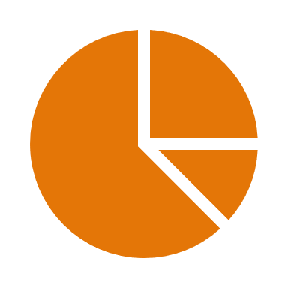






The Challenge
Steady increase in waste generation
China’s ban on importing waste
Monopolistic waste management industry
Soaring costs impact recycling volumes
Increased CO2 and Methane emissions
Countries used to ship about 7 million tons of plastic trash to China a year, where much of it was recycled into raw materials.
Then came the Chinese crackdown of 2018.- npr.org

Slide 4




The Solution
Grow and expand small companies
Creating a competitive market
Affordable recycling opportunities

Slide 5
Big 4: Too Big for Recycling!
Source: https://www.statista.com

Slide 6
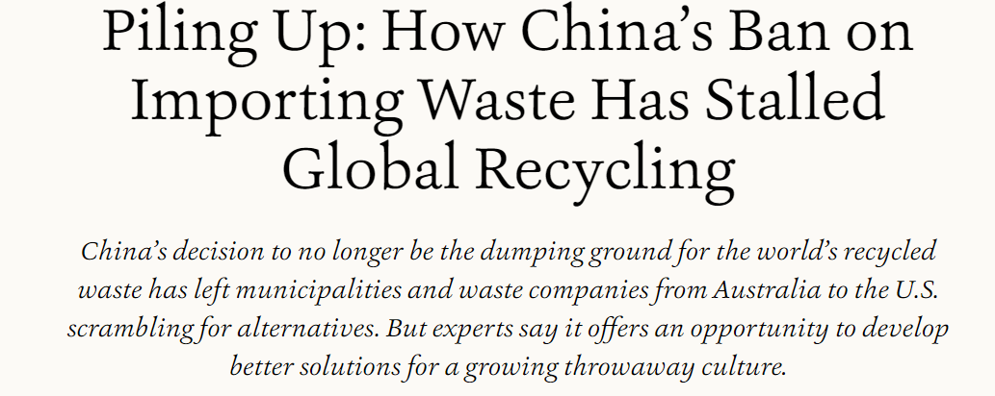
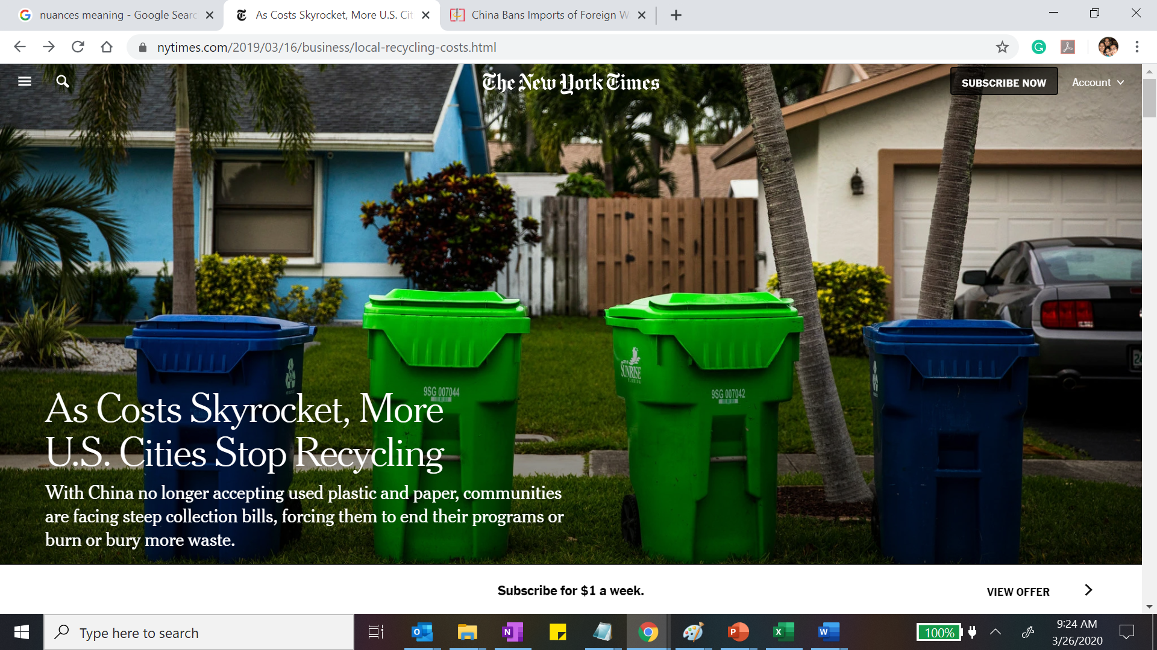
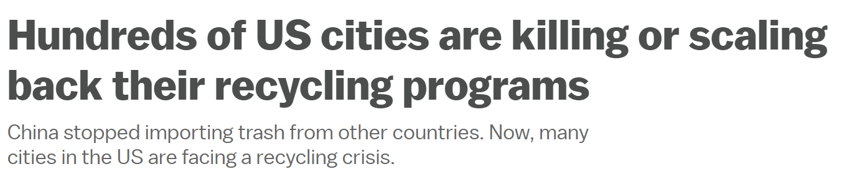
“No More Trash.”- China
Total plastic waste exported by United States to China in 2017: 557.88K metric tons*
China implemented National Sword Policy in 2018, strictly regulating imports of solid wastes as raw materials
Source: https://www.statista.com

Slide 7
Recycling Falls Off the Florida landscape…
We have a task force looking into options, but as of now, we are still suspended on the recycling. It just didn’t make sense for us to continue- Deltona Mayor Heidi Herzberg
Target
75%
Florida State’s Goal: Recycling 75 percent of trash by 2020
China quit buying recyclable material: American waste stream is too contaminated by non-recyclable materials
Expensive for local governments to recycle waste, compelling many of them to forgo recycling
The Broward County cities: Sunrise and Deerfield Beach opted not to renew contracts after Waste Management increased the pickup charge to $96/ton, from the previous $51.15/ton
49%
Source: https://www.floridaphoenix.com

Slide 8





‘Polluted’ State of Affairs
China Importing Trash
Waste Generated
Treatment
Communities
Waste Collectors
Waste Landfilled/Incinerated

Slide 9
Closing the Loop
Waste Generated
Waste Collection
CIRCULAR
RECYCLING
People
Treatment
75%
25%
Incineration/Landfill
Recyclers
Source: https://www.epa.gov

Slide 10










Consolidation: Better Together!
Waste Collectors
Stake = 51%
Debt
LT contract
Payments
Investment
Services
Corporates
Recycled
Products
Stake = 51%
Garbage Recyclers
Payments
Interest
Dividend
Dividend
services
Municipalities
Equity
LT contract Payments
Waste
Investment
Services
Stake = 51%
Scrap Disposals

Slide 11





Fund Profile
$30 million
Used partially in acquisition of majority stake in small companies and balance invested in their growth and expansion
Fund Size
2% of Fund Size + Deferred Incentives
Fixed mgmt. fees with deferred incentives aligned with growth in fund investments
Mgmt.
Fees
Florida (focus on Broward County)
And neighboring regions which have reduced recycling due to high costs, have a strong recycling culture and favorable regulations
Target
Geography
Equity and Bonds (50:50)
Target Impact-Oriented Investors, Institutional Investors, Family Offices and HNIs and with varying risk appetites
Asset Class
16-23% IRR over 10 years
Our 10-year IRR ranges between 16-23% (base case generating a 20% IRR) and target time horizon of 10-15 years
Returns & Time Horizon
11

Slide 12


Investment in Companies
Equity Stake
Buyout of existing shareholders
$12 million
Equity Returns
Base IRR: 20%
Initial Inv. $15 million
12% preferred Stock
$9 million
Capex
Bond Returns
Interest Rate: 7%
Initial Inv. $15 million
Admn. funds retained by CARe
$0.2 million
7% Bonds
$8.8 million
12

Slide 13



Investment Criteria: Targeting for Success
Quantitative Factors
Qualitative Factors
Annual Revenues
$2million-$15 million
Presence in Florida &
neighboring states
Strong Asset Base
Long track record of operations
Growing or Stable revenues
(at least before the 2018 ban)
Experienced management
profile
13

Slide 14



Conscious Capitalism: Value Driven Returns
Environmental Impact
0.23 – 0.55 million cubic yards of landfill space conserved
120K – 219K tons reduction in CO₂ emissions from landfills and incinerations
Social Impact
Direct and indirect job creation through improved recycling supply chain
Improved health outcomes and quality of living
Economic Impact
Investor access to a recession–proof high–margin industry
Increased balance of bargaining power between buyers and sellers
Organic and inorganic growth of small and reginal businesses
14

Slide 15
Due Diligence: Industry Attractiveness
Steady Revenues, Strong Investor Interest, Favorable Regulations
Operational
Financial
Regulatory
Ready markets with many Florida cities having suspended existing contracts
Small WM cos. dotted across Florida provide a large basket of targets
Municipal contracts range between 5-15 years providing steady revenue streams
China ban has fueled vertical integration with $8.1bn M&A deals in 2019 ($1.8bn in 2018)
History of profitable PE investments (Clairvest & County Waste, Ambienta & Envirogen)
Record high investments in sustainable funds of $21bn in 2019 (4x 2018)
Florida is struggling to meet its recycling goal of 75% by 2020
Florida has a stringent 80% GHG emission reduction target by 2050
Florida lawmakers focusing on climate change, e.g. creation of Climate Solutions Caucus in 2019

Slide 16
Due Diligence: Industry Outlook
Booming industry acquisitions driven by active PEs investments and aggressive consolidation by major players for regional market share
Clairvest and County Waste: A Success Story
In April 2013, PE firm, Clairvest acquired a 13% stake in County Waste LLC
They made a $13mm initial investment in the Virginia-based waste management company
Since 2013, County Waste completed over 60 follow-on acquisitions
County Waste grew its revenues by 400% in 7 years and expanded market share
In January 2020, Clairvest sold its stake to GFL Environmental Inc. at $46mm
The deal generated a 30% IRR and 3.6x Money-on-Money multiple for Clairvest
Source: CapitalIQ, Clairvest.com

Slide 17
Investment Return Analysis
Carbon Footprint reduction totaling 2,148K tons over 10 years
EBITDA margins improve from 15% in Year 1 to 20% in Year 10
Annual Expansion and Maintenance capex spends range between 8%-27% of revenue
Steady expansion keeps Unlevered FCF lower in initial years but displays continued YoY growth, hitting $14.4 Mil in Year 10

Slide 18


Assumptions
20%
Broward County Market Share
$50/ton
Waste Collection Rate charged
328k-718k tons
Annual Plant Input Capacity over 10 years
70%
Portion of collected waste recycled
$148/unit
Avg. SP of Recycled Products
Initial Market Share of 20% with a 2% annual increase
Long-term price charged to municipalities with annual 5% hike
Initially three 300 TPD recycling facilities; new addition every 2-3 years
70% salvageable waste with balance being disposed
Products incl. Plastic Pellets, Plastic & Paper Bales and Glass Cullet

Slide 19

Risks & Mitigation
Category | RISK DESCRIPTION | MITIGATION PLAN
Economic | Failure to acquire companies | Operational management control offered to existing promoters Way out for managements resisting buy-out from larger companies Capex fund infusion assurance without dilution of further promoter stake Hire external experts during negotiation process
 | Failure to secure contracts | Acquire companies with long track record of operations Offer rates lower than market rates to municipalities Target geographies which have cancelled/diluted contracts with industry giants Provide minimum recycling assurance
 | Aggressive competitor response | 5-15 year contracts with municipalities Protective provisions and heavy breach of contract penalties
Operational & Technology | Failure to run integrated operations | Mutually beneficial long-term contracts between the group companies High non-compliance penalties for breach of inter-company contract Management incentives linked to group performance Lock-in period for promoter shares complementary to our proposed time horizon
 | Poor recycling technology | Technical Due Diligence study of infrastructure before acquisition High expansion capex for recycling plants and vehicle fleet Regular maintenance and upgradation of machinery and vehicles
Socio-Political | Resistance to change | Target regions with high awareness towards recycling Partner with local organizations to promote CARe’s initiatives
 | Unfavorable regulatory changes | Highlight CARe’s benefits to local authorities and policy-makers Management teams maintain ongoing relations with authorities
High Risk
19

Slide 20





Potential for Growth
States | Cities | Opportunity
Alabama | Enterprise, Phenix, Opelika, Birmingham | Waste processing fees more than doubled Recycling facilities hours reduced Presence of suitable acquisition targets
California | San Diego, San Jose, Alameda, Bakersfield | Aggressive waste reduction targets Closure of recycling centers High awareness of recycling
Colorado | Boulder, Denver, Fort Collins | High stakeholder participation Increased dominance of Big4 companies Concerted waste diversion plans
Washington | Seattle, Spokane, Tacoma, Skagit | Efficient existing recycling programs Aggressive waste reduction targets Many recycling programs facing uncertainties
Connecticut | Stamford, New Canaan, Beacon Falls | Increasing awareness for waste recycling Development of recycling plans Increased dominance of Big4 companies

Slide 21
Summary
20% IRR
Provide a cost-effective and environmentally sustainable solution to communities
Create a dent in the near-monopoly status of current players at the regional level
Establish a competitive market for waste management businesses, inevitably moderating rates from their inflated level
Assure our portfolio companies of long-term contracts and continued operations, thus encouraging innovation and expansion
Reduce the high barriers to entry, promoting entry and competition from other small players in this high-margin industry
Develop recycling as an economically sustainable alternative to the traditional industry focus on landfills
Promote sustainable household waste disposal through shift from single stream disposal to multi-stream recycling
0.23 – 0.55 million cubic yards of landfill space saved
120K – 219K tons reduction in CO₂ emissions
21

Slide 22
Appendix

Slide 23
Entry and Exit Valuations
Particulars | $ Mil
Joint Revenue of 3 companies (Note 1) | 30
Overall EBITDA margin (Note 2) | 15%
EBITDA | 4.5
EV/EBITDA multiple (Note 3) | 10x
EV/Revenue multiple | 1.5x
Overall Debt ratio | 0.5
Enterprise Value | 45
Less: Debt | (22.5)
Add: Cash | 1
Equity Value | 23.5
Stake Acquired | 51%
Equity buy-out value | 12.0
Entry Year 0 | $ Mil
Equity stake acquired | 12.0
Further infusion:
- 7% Debentures | 9.0
- 12% Preferred Stock | 8.8
Admn. cash retained by CARe | 0.2
Total Funds utilized | 30.0
Exit Year 10 | $ Mil
Equity Value (Note 4) | 293.4
CARe's holding | 51%
Equity value returned to CARe | 149.7
Bullet repayment of bonds | 9.0
Pref Share redemption | 8.8
Bond interest for Year 10 | 0.6
Preference dividend for Year 10 | 1.1
Equity dividend for Year 10 | 1.5
Total earnings at exit (Year 10) | 170.7
Source:
The 40th largest US waste management company has $27 million (wastetodaymagazine.com)
Average EBITDA margin of Big 4 in 2018 stood at 29% (Form 10K)
Market leader Waste Management Inc. EV/EBITDA multiple: 11.08x, Republic Services: 10.97x (CapitalIQ)
Equity Value = 10x (Year 10 EBITDA) – Net Debt – Preference Shares

Slide 24
Investor Return Calculation
Base Case IRR: 20%
Particulars | Year 0 | Year 1 | Year 2 | Year 3 | Year 4 | Year 5 | Year 6 | Year 7 | Year 8 | Year 9 | Year 10 | IRR
Div from Subsidiary (Pref Div) | (8.8) | 1.1 | 1.1 | 1.1 | 1.1 | 1.1 | 1.1 | 1.1 | 1.1 | 1.1 | 9.9 | 12%
Div from Subsidiary (Equity Div) | (12.0) | 0.0 | 0.1 | 0.1 | 0.3 | 0.3 | 0.5 | 0.6 | 1.0 | 1.2 | 151.2 | 30%
Debenture Interest | (9.0) | 0.6 | 0.6 | 0.6 | 0.6 | 0.6 | 0.6 | 0.6 | 0.6 | 0.6 | 9.6 | 7%
Inflow | (29.8) | 1.7 | 1.7 | 1.8 | 2.0 | 2.0 | 2.1 | 2.3 | 2.7 | 2.9 | 170.7 | 22%
Management Fee @ 2% |  | (0.6) | (0.6) | (0.6) | (0.6) | (0.6) | (0.6) | (0.6) | (0.6) | (0.6) | (0.6)
Further incentives and admin costs retained |  | - | (0.1) | (0.1) | (0.2) | (0.2) | (0.2) | (0.2) | (0.3) | (0.3) | (13.7)
Payout to investors | (30) | 1.1 | 1.1 | 1.1 | 1.2 | 1.2 | 1.3 | 1.5 | 1.8 | 2.0 | 156.4 | 20%
All amounts in $ millions

Slide 25
Recycling and CO2 emission calculations
Particulars | Year 1 | Year 2 | Year 3 | Year 4 | Year 5 | Year 6 | Year 7 | Year 8 | Year 9 | Year 10
Recycling facilities (#) | 3 | 3 | 4 | 4 | 5 | 5 | 5 | 6 | 6 | 6
Capacity (tons/day) | 300 | 303 | 306 | 309 | 312 | 315 | 318 | 322 | 325 | 328
Annual Capacity (TPA) | 328,500 | 331,785 | 446,804 | 451,272 | 569,731 | 575,428 | 581,182 | 704,393 | 711,437 | 718,551
Recyclable waste % | 65% | 65% | 65% | 65% | 65% | 65% | 65% | 65% | 65% | 65%
Recyclable waste volume (TPA) | 556,014 | 623,848 | 694,173 | 767,061 | 842,587 | 920,827 | 1,001,860 | 1,085,766 | 1,172,627 | 1,262,529
Utilization % | 90% | 92% | 94% | 96% | 98% | 100% | 100% | 100% | 100% | 100%
Plant Capacity (TPA) | 295,650 | 305,242 | 419,996 | 433,221 | 558,336 | 575,428 | 581,182 | 704,393 | 711,437 | 718,551
Waste Recycled (TPA) | 295,650 | 305,242 | 419,996 | 433,221 | 558,336 | 575,428 | 581,182 | 704,393 | 711,437 | 718,551
Co2 per ton of waste | 40.5% | 40.5% | 40.5% | 40.5% | 40.5% | 40.5% | 40.5% | 40.5% | 40.5% | 40.5%
Reduced Carbon Footprint ('000 TPA) | 120 | 124 | 170 | 175 | 226 | 233 | 235 | 285 | 288 | 291
Landfill Volume (cubic yards) | 227,423 | 234,802 | 323,074 | 333,247 | 429,489 | 442,637 | 447,063 | 541,841 | 547,259 | 552,732
All amounts in $ millions

Slide 26
Revenue Calculation
In $ Mil | Year 1 | Year 2 | Year 3 | Year 4 | Year 5 | Year 6 | Year 7 | Year 8 | Year 9 | Year 10
Waste Collection (Exhibit 1) | 42.8 | 48.0 | 53.5 | 59.2 | 65.1 | 71.2 | 77.5 | 84.1 | 90.9 | 98.0
Recycled Plastic Sale (Exhibit 2) | 17.8 | 18.3 | 25.2 | 26.0 | 33.6 | 34.6 | 34.9 | 42.3 | 42.8 | 43.2
Total Revenue | 60.5 | 66.4 | 78.8 | 85.2 | 98.6 | 105.8 | 112.5 | 126.4 | 133.7 | 141.2
Exhibit 1
Waste Generated (TPA) | 4,502,141 | 4,592,184 | 4,684,028 | 4,777,708 | 4,873,263 | 4,970,728 | 5,070,142 | 5,171,545 | 5,274,976 | 5,380,476
Waste collected % | 95% | 95% | 95% | 95% | 95% | 95% | 95% | 95% | 95% | 95%
Total Waste Collected (TPA) | 4,277,034 | 4,362,575 | 4,449,826 | 4,538,823 | 4,629,599 | 4,722,191 | 4,816,635 | 4,912,968 | 5,011,227 | 5,111,452
Market Share | 20% | 22% | 24% | 26% | 28% | 30% | 32% | 34% | 36% | 38%
Volume Collected by CARe group (TPA) | 855,407 | 959,766 | 1,067,958 | 1,180,094 | 1,296,288 | 1,416,657 | 1,541,323 | 1,670,409 | 1,804,042 | 1,942,352
Collection Rate/ton | 50.0 | 50.1 | 50.1 | 50.2 | 50.2 | 50.3 | 50.3 | 50.4 | 50.4 | 50.5
Collection income ($ Mil) | 42.8 | 48.0 | 53.5 | 59.2 | 65.1 | 71.2 | 77.5 | 84.1 | 90.9 | 98.0
Exhibit 2
Volume of plastic recycled (TPA) | 295,650 | 305,242 | 419,996 | 433,221 | 558,336 | 575,428 | 581,182 | 704,393 | 711,437 | 718,551
Recycled Plastic Sale ($ Mil) | 17.8 | 18.3 | 25.2 | 26.0 | 33.6 | 34.6 | 34.9 | 42.3 | 42.8 | 43.2
All amounts in $ millions

Slide 27
Cashflow Breakdown
Particulars | Year 1 | Year 2 | Year 3 | Year 4 | Year 5 | Year 6 | Year 7 | Year 8 | Year 9 | Year 10
EBITDA | 10.1 | 10.9 | 12.8 | 14.9 | 16.0 | 17.8 | 19.3 | 23.1 | 25.4 | 27.8
EBIT | 2.9 | 3.0 | 3.4 | 4.6 | 4.1 | 5.1 | 5.8 | 8.0 | 9.3 | 10.9
Tax rate | 21% | 21% | 21% | 21% | 21% | 21% | 21% | 21% | 21% | 21%
EBIAT (NOPAT) | 2.3 | 2.3 | 2.7 | 3.7 | 3.3 | 4.0 | 4.6 | 6.3 | 7.4 | 8.6
Depreciation and amortization | 7.3 | 8.0 | 9.5 | 10.2 | 11.8 | 12.7 | 13.5 | 15.2 | 16.0 | 16.9
Changes in net working capital | (0.6) | (0.2) | (0.2) | (0.2) | (0.2) | (0.2) | (0.2) | (0.3) | (0.2) | (0.2)
Other assets & liabilities | 4.0 | 0.3 | 0.3 | 0.3 | 0.3 | 0.3 | 0.3 | 0.3 | 0.4 | 0.4
Unlevered CFO | 13.0 | 10.4 | 12.1 | 14.0 | 15.2 | 16.8 | 18.2 | 21.5 | 23.5 | 25.7
Less: Capital expenditures | (16.2) | (6.3) | (7.9) | (8.5) | (9.9) | (10.6) | (10.1) | (11.4) | (10.7) | (11.3)
Unlevered FCF | (3.2) | 4.1 | 4.3 | 5.5 | 5.3 | 6.2 | 8.1 | 10.1 | 12.8 | 14.4

Slide 28
Base, Stressed and Best Cashflow Scenarios
Particulars | Year 1 | Year 2 | Year 3 | Year 4 | Year 5 | Year 6 | Year 7 | Year 8 | Year 9 | Year 10
Base Case:
EBITDA | 10.1 | 10.9 | 12.8 | 14.9 | 16.0 | 17.8 | 19.3 | 23.1 | 25.4 | 27.8
Cashflow from Operations | 11.8 | 9.4 | 11.2 | 13.1 | 14.3 | 16.1 | 17.6 | 21.0 | 23.3 | 25.6
Unlevered Free Cashflows | (3.2) | 3.8 | 3.5 | 4.6 | 5.3 | 6.2 | 8.1 | 10.1 | 12.8 | 14.4
Stressed Case:
EBITDA | 3.4 | 3.8 | 4.8 | 5.9 | 6.6 | 7.8 | 8.6 | 10.8 | 12.0 | 13.3
Cashflow from Operations | 6.3 | 2.9 | 3.9 | 5.0 | 5.7 | 6.8 | 7.6 | 9.7 | 11.0 | 12.2
Unlevered Free Cashflows | (8.7) | 0.6 | 0.2 | 0.8 | 1.0 | 1.6 | 2.7 | 3.6 | 5.2 | 6.0
Best Case:
EBITDA | 20.6 | 21.9 | 24.9 | 28.2 | 29.7 | 32.2 | 34.5 | 40.5 | 43.9 | 47.7
Cashflow from Operations | 20.3 | 19.3 | 22.1 | 25.2 | 26.9 | 29.4 | 31.6 | 36.9 | 40.3 | 43.9
Unlevered Free Cashflows | 5.2 | 8.6 | 8.5 | 10.3 | 11.7 | 13.0 | 15.8 | 19.3 | 23.5 | 25.9
All amounts in $ millions
Base Case: $50/ton waste collection rate; 20% initial Broward County market share
Stressed Case: $30/ton waste collection rate; 10% initial Broward County market share
Best Case: $70/ton waste collection rate; 30% initial Broward County market share

Slide 29
10-year IRR Sensitivity
 |  | Collection Rate per ton
 |  | 10 | 20 | 30 | 40 | 50 | 60 | 70 | 80
Market Share in Broward County | 5% | 4% | 7% | 10% | 12% | 14% | 16% | 17% | 19%
 | 10% | 5% | 8% | 12% | 14% | 16% | 18% | 20% | 21%
 | 15% | 6% | 10% | 13% | 16% | 18% | 20% | 22% | 23%
 | 20% | 6% | 11% | 14% | 18% | 20% | 22% | 23% | 25%
 | 25% | 7% | 12% | 16% | 19% | 21% | 23% | 25% | 26%
 | 30% | 8% | 13% | 18% | 20% | 22% | 24% | 26% | 27%
 | 35% | 8% | 14% | 19% | 21% | 23% | 25% | 27% | 28%
 | 40% | 9% | 15% | 19% | 22% | 24% | 26% | 28% | 29%
 | 45% | 10% | 16% | 20% | 23% | 25% | 27% | 29% | 30%
 | 50% | 10% | 17% | 21% | 24% | 26% | 28% | 30% | 31%
Base Case IRR: 20%
Range of IRR quoted: 16-%23%

Slide 30
Per unit Rate Assumptions
Waste Collection Rate 2019 (Broward County)
Recycled Plastic Selling Price
Company | Location | Disposal Rate/ton
Waste Connections | Pembroke Park | 75
Waste Management | Davle | 97
Republic Services | Fort Lauderdale | 120
Waste Management | Pompano Beach | 69
Waste Management | Monarch Hill | 74
Waste Connections | Deerfield Beach | 60
All County Waste | Deerfield Beach | 67
Miami-Dade County | Various | 63
Miami-Dade County | Various | 92
Palm Beach County | Various | 136
Average |  | 85
Base Case Initial Rate of CARe |  | 50
% saving per ton by Municipalities |  | 41%
Recycled Products | Output% | MT | Price/ton | Year 1 Revenue ($ Mil)
Plastic Pellets | 0.3 | 35,921 | 400.0 | 14.37
Industrial plastic bales | 0.25 | 29,935 | 100.0 | 2.99
Industrial paper bales | 0.2 | 23,948 | 6.9 | 0.16
Glass cullet | 0.2 | 23,948 | 10.0 | 0.24
Others | 0.05 | 5,987 | 1.0 | 0.01
Total waste recycled |  | 119,738 | 148.4 | 17.77
Source: Broward County Budget, August 27, 2019; Resource-recycling.com, nepis.epa.gov

Slide 31
CARe –vs.- Private Equities
Particulars | PE | CARe
Acquisition method | Usually LBOs | Equity infusion
Investment horizon | 3-7 years | 5-15 years
Objective | Taking advantage of existing high rates | Moderating rates through competitive bidding
Scope | Relatively larger, partially/fully integrated companies | Small companies
Investors | Small pool of accredited investors | Institutional Investors, Family Offices, Impact-Oriented Investors
Revenue | At or above market rates | Lower than market rates
Cost | Stringent cost cutting | Further fund infusion for expansion

